Slide 1
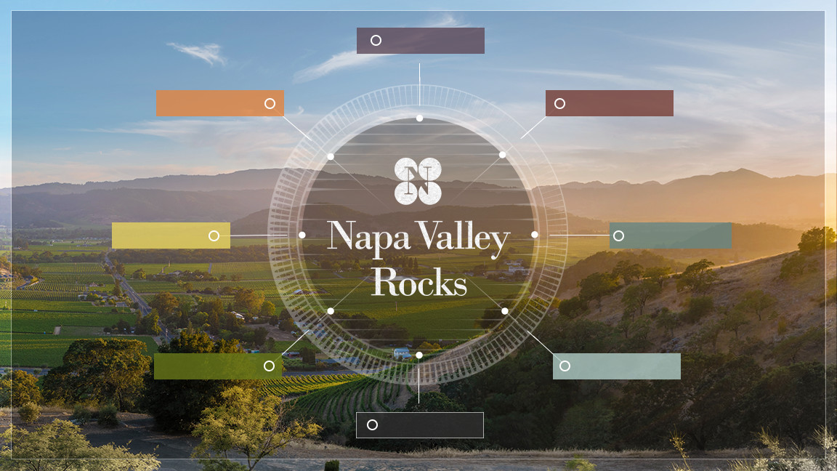
INTRODUCTION
NAPA VALLEY
SOILS
CLIMATE
VITICULTURE
WINEMAKING
HISTORY
NAPA VINTNERS

Slide 2
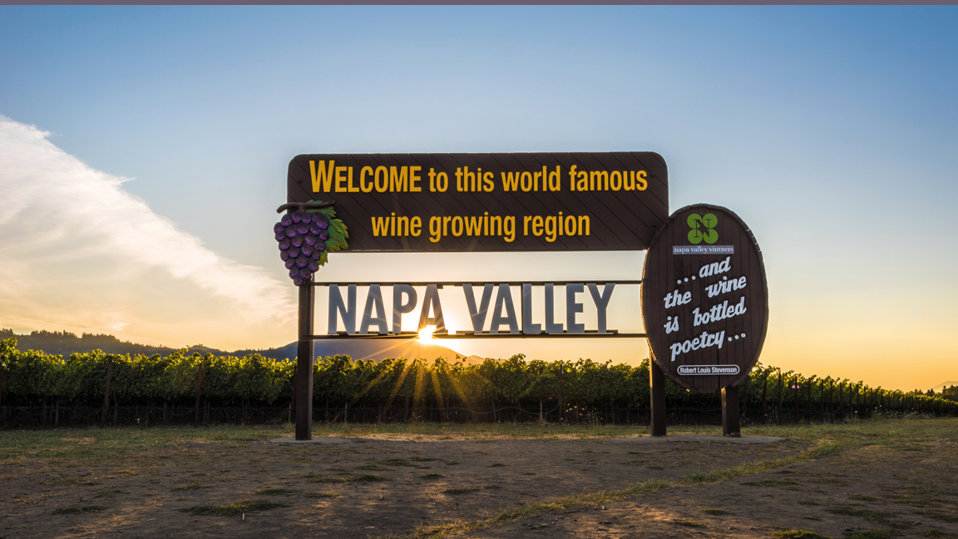
Wines of the highest quality, cultivated with excellence in one of the world’s most extraordinary places

Slide 3
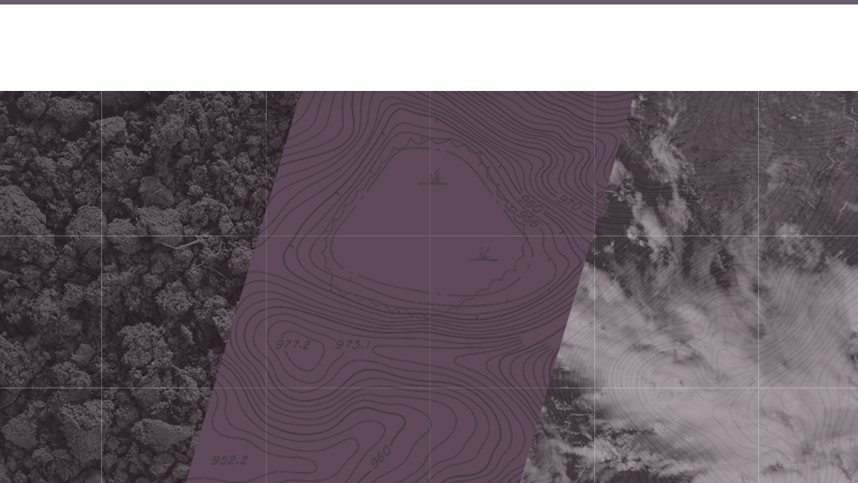
Terroir (terˈwär)
Noun: the complete natural environment in which a particular wine is produced, including factors such as the soil, topography, and climate
Soil + Topography + Climate

Slide 4
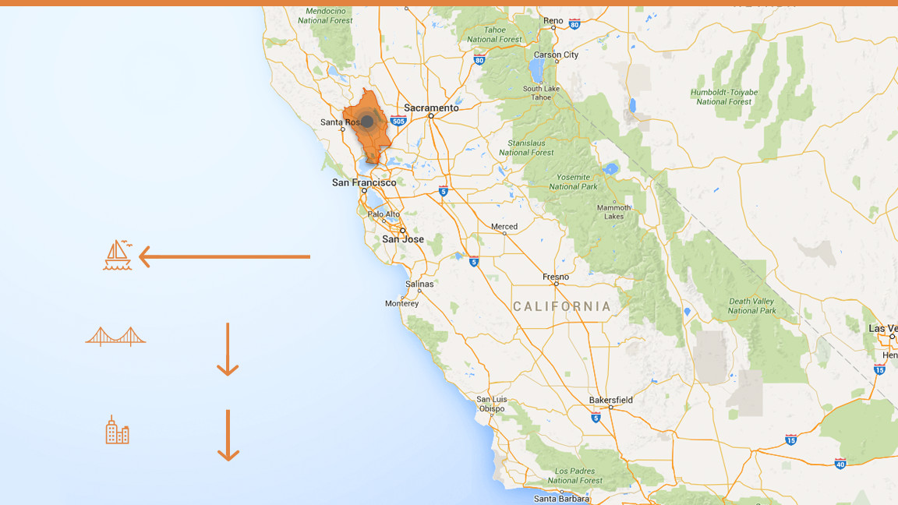
Napa Valley
became the first American Viticultural Area (AVA) to be recognized in California,
in 1981
Distance to Pacific Ocean
36 mi / 58km
Distance to San Francisco
48mi 77km
Distance to Los Angeles
360mi 579km

Slide 5
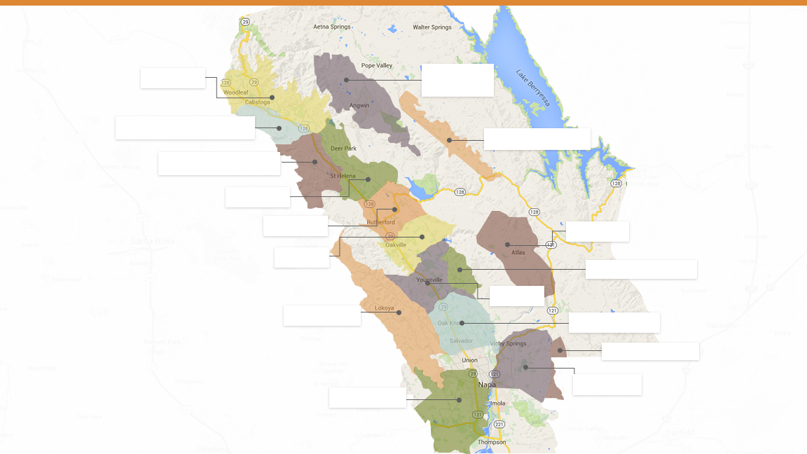
Calistoga
Howell Mountain
Diamond Mountain District
Chiles Valley
Spring Mountain District
St. Helena
Rutherford
Atlas Peak
Oakville
Stags Leap District
Yountville
The Napa Valley AVA and its nested AVAs
Mount Veeder
Oak Knoll District
Wild Horse Valley
Coombsville
Los Carneros

Slide 6
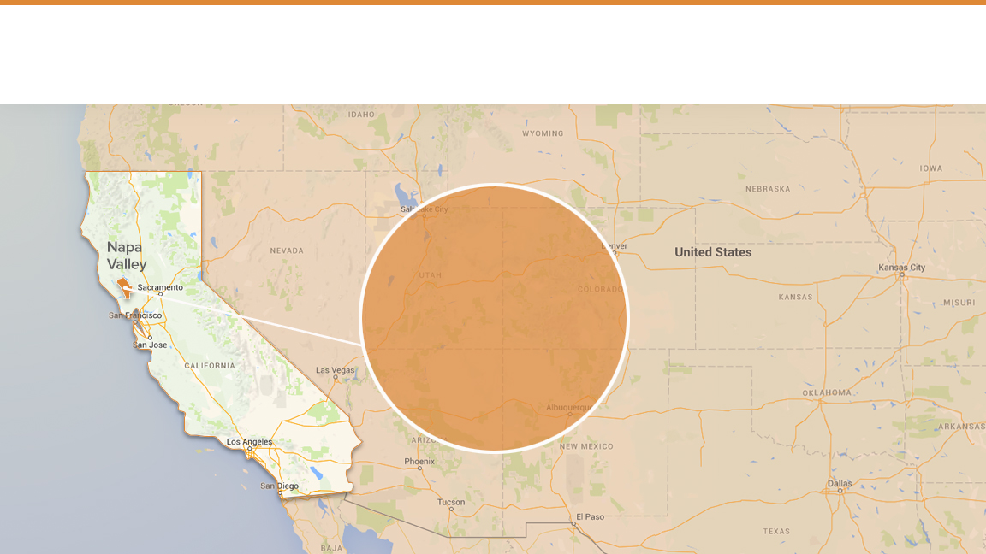
Small Region, Small Producers
4%
of California’s wine

Slide 7
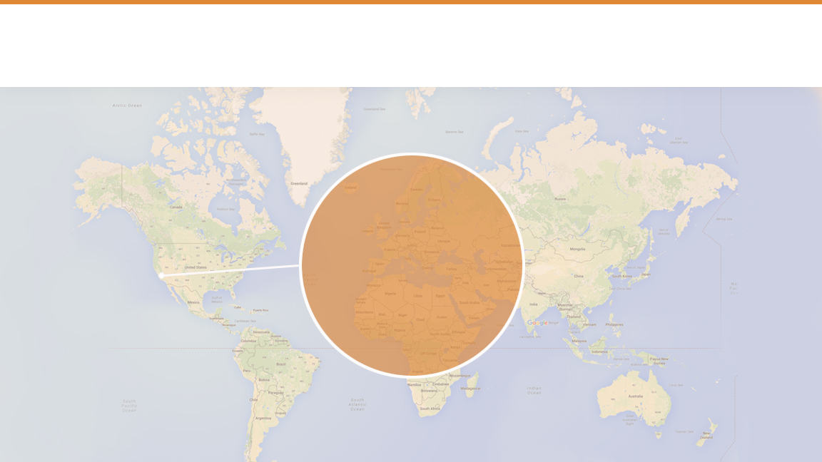
Small Region, Small Producers
.4%
of the world’s wine

Slide 8
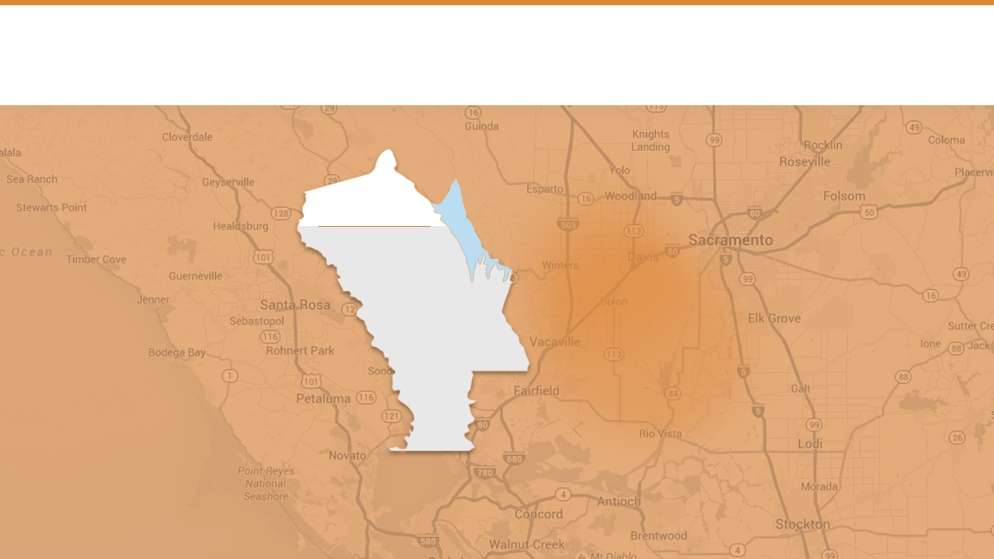
Small Region, Small Producers
78%
Napa
Valley
of NVV members
produce less than
10,000
cases of wine a year

Slide 9
95%
of all Napa Valley wineries are family owned or operated

Slide 10
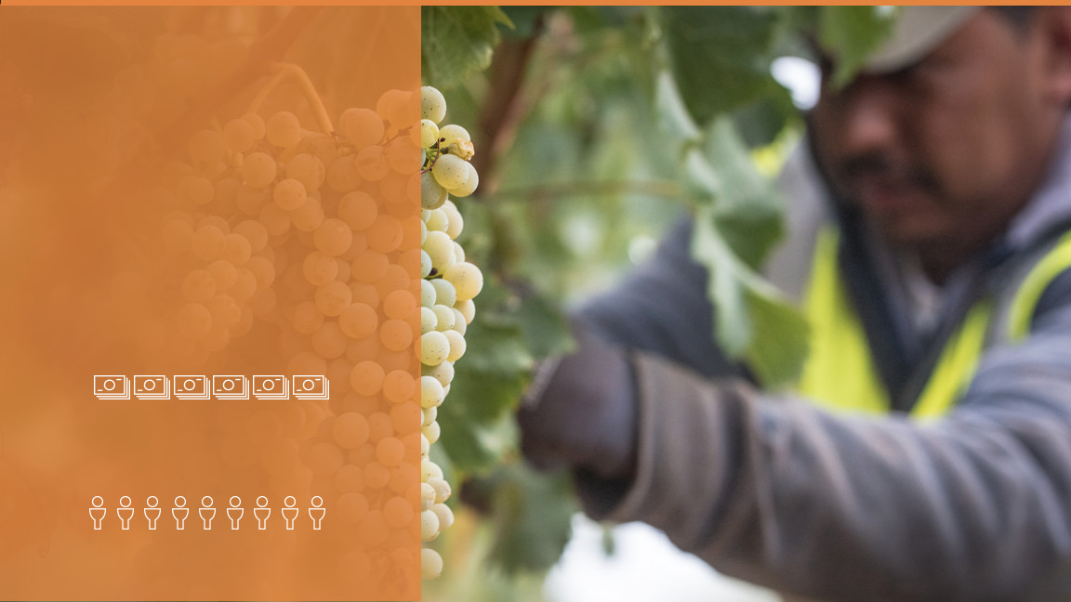
Big Local Impact
$9 billion
annual economic impact
44,000 jobs

Slide 11
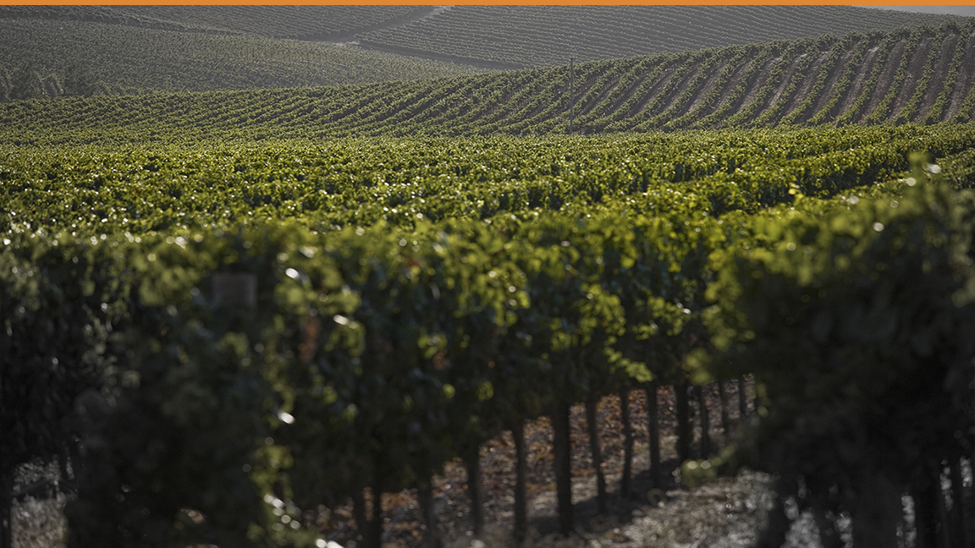
Top Varieties
Cabernet Sauvignon
Chardonnay
Merlot
Sauvignon Blanc
Pinot Noir
Zinfandel
Cabernet Franc
Petite Sirah
Syrah

Slide 12
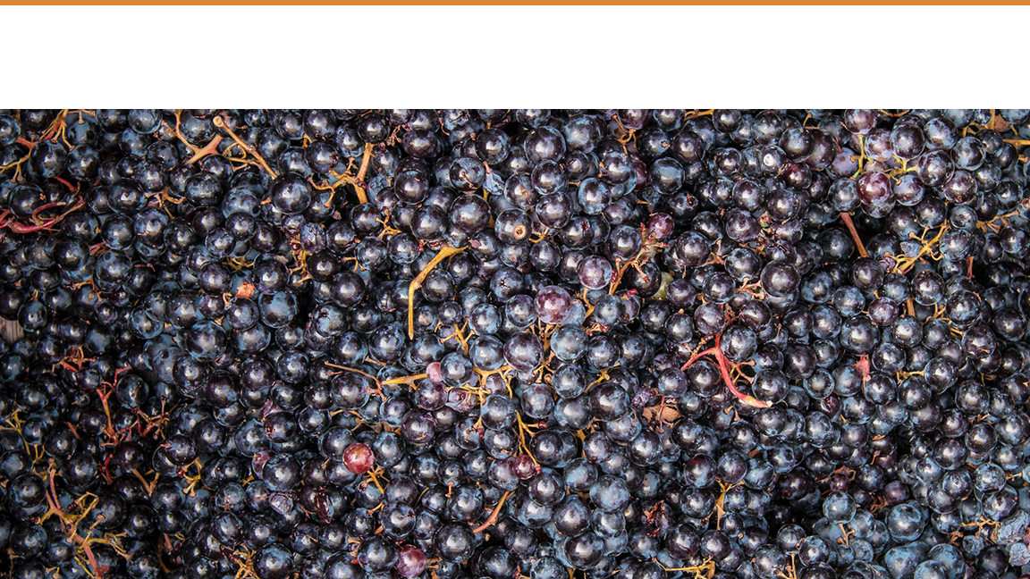
Cabernet Sauvignon
15%
47%
67%
of the total California wine grape harvest
of the total Napa Valley wine grape harvest
of the value of the Napa Valley wine grape harvest

Slide 13
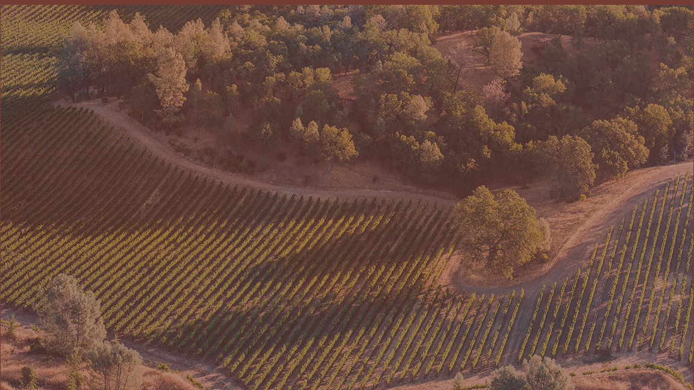
SOILS

Slide 14
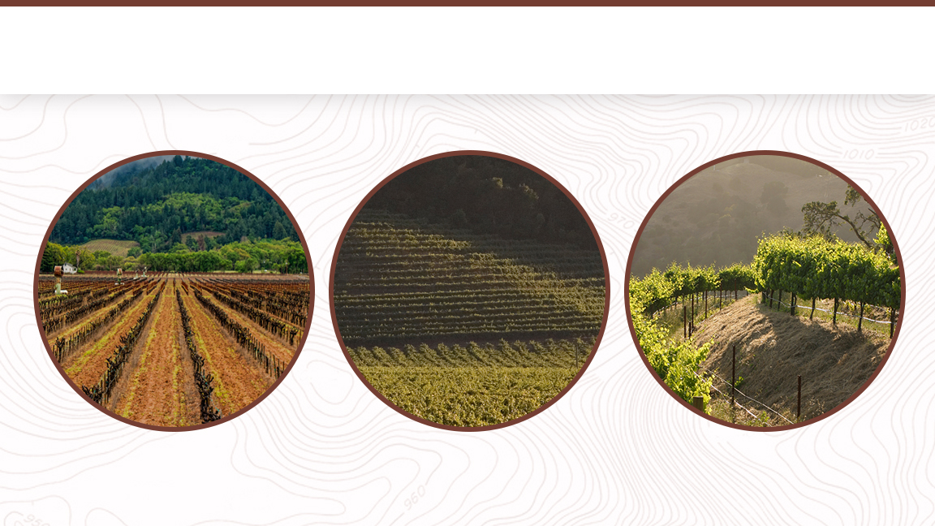
Soils of the Napa Valley
Fluvial
Alluvial
Mountain

Slide 15
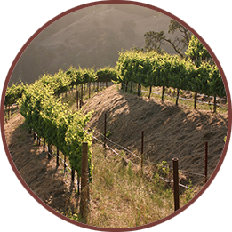
Mountain Soil
Thin, rocky soils that cling to hillsides as vines struggle to survive
SOIL-FORMING PROCESS
Created in place
WINE STYLE
Small, intensely flavored wines with structured tannins and complex aromatics
PROVENANCE
The primary breakdown of underlying bedrock

Slide 16
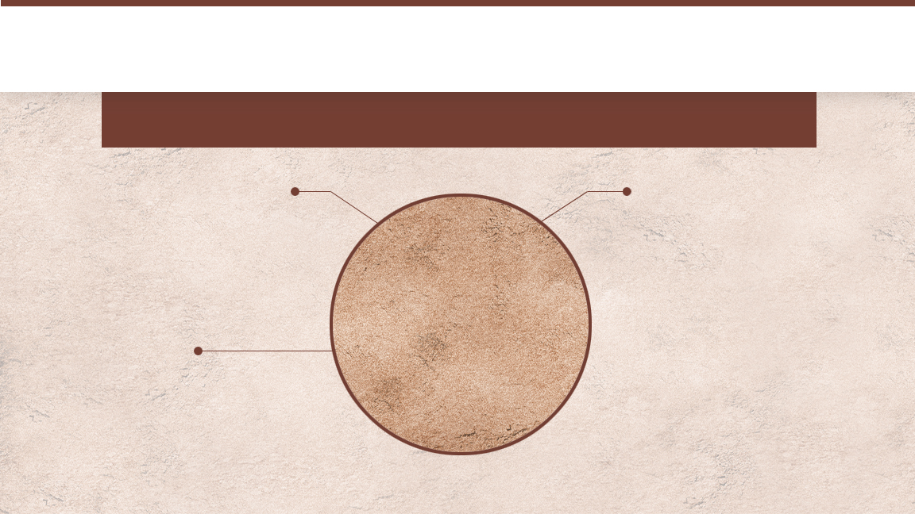
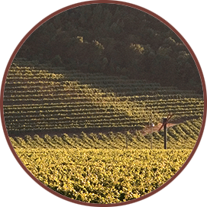
Alluvial Fans
Deep, rocky and well-drained soils with moderate fertility
SOIL-FORMING PROCESS
Settles at the base of a mountain after being washed downhill along a stream
WINE STYLE
More fruit forward with less aggressive tannin structure than wines grown on mountain soils, although more so than with wines from Fluvial soils
PROVENANCE
The product of bedrock material found on the hillside above

Slide 17
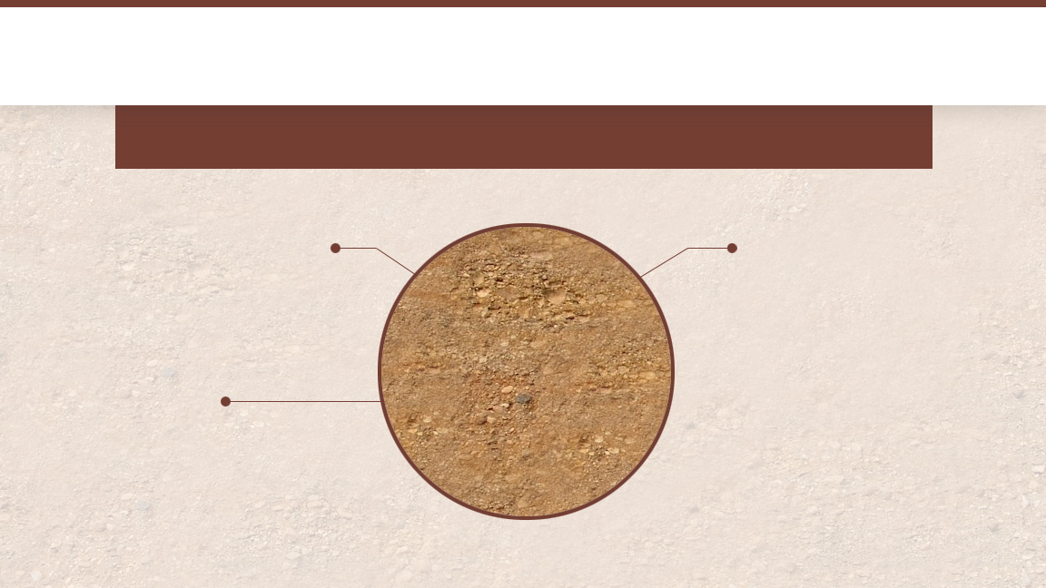
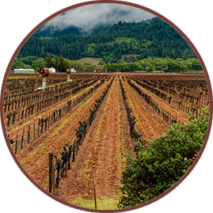
Fluvial Soil
Silts and clays deposited along banks of the Napa River
SOIL-FORMING PROCESS
Silts and clays deposited along riverbank as floodwaters rise and recede over the years
WINE STYLE
Lush and generous fruit-forward wines
PROVENANCE
All bedrock material along the hillsides upriver

Slide 18
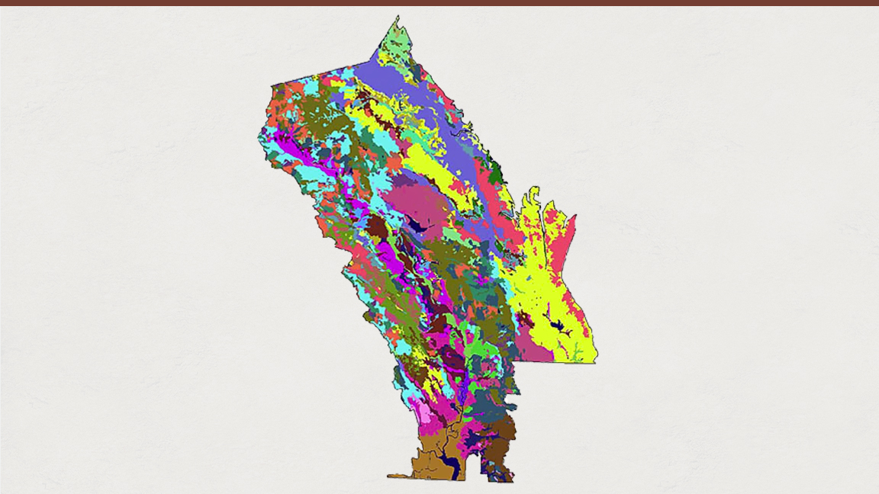
50% of the world’s soil orders
33 soil series
Incredible Soil Diversity
© Terra Space Inc. 2003

Slide 19
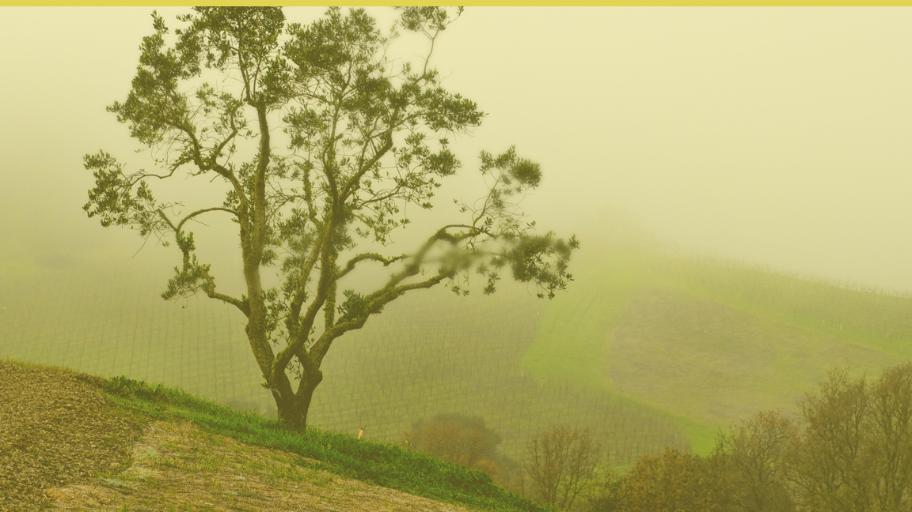
CLIMATE

Slide 20
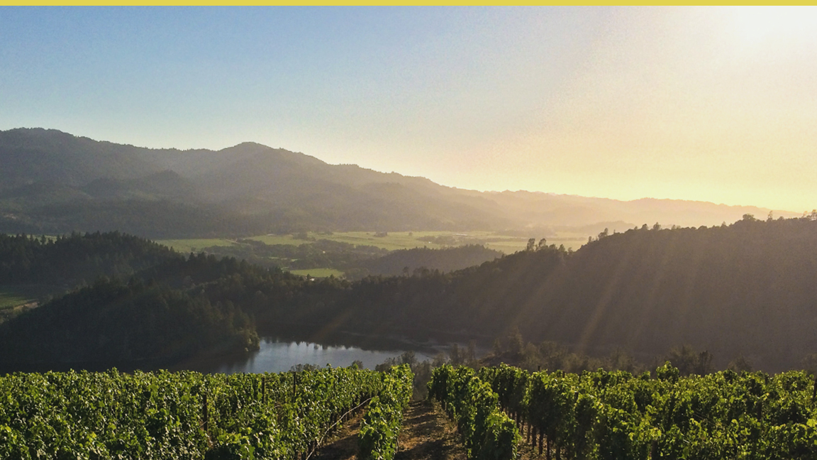
Mediterranean
Climate
2% of Earth's surface

Slide 21
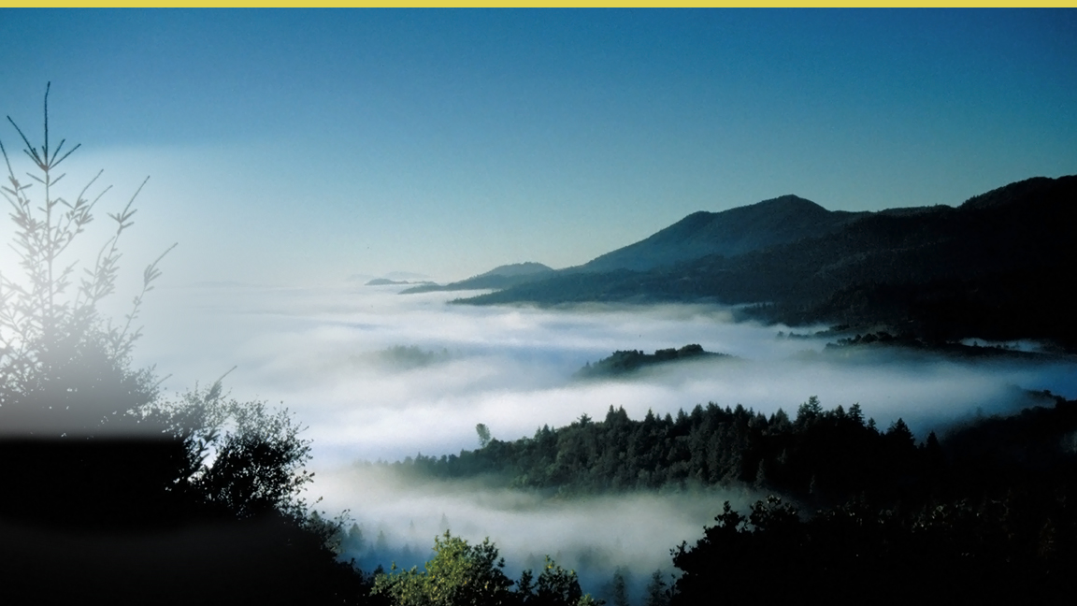
Fog in Napa Valley
Hot air rises, drawing in moist, cool air from the Pacific Ocean, forming fog

Slide 22
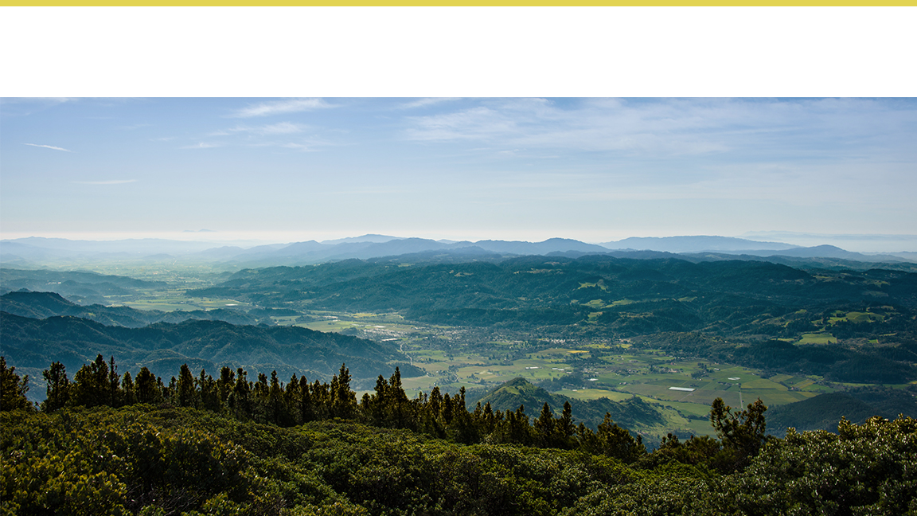
Incredible Diversity of Terroir
RAINFALL
TOPOGRAPHY
ELEVATION
TEMPERATURE

Slide 23
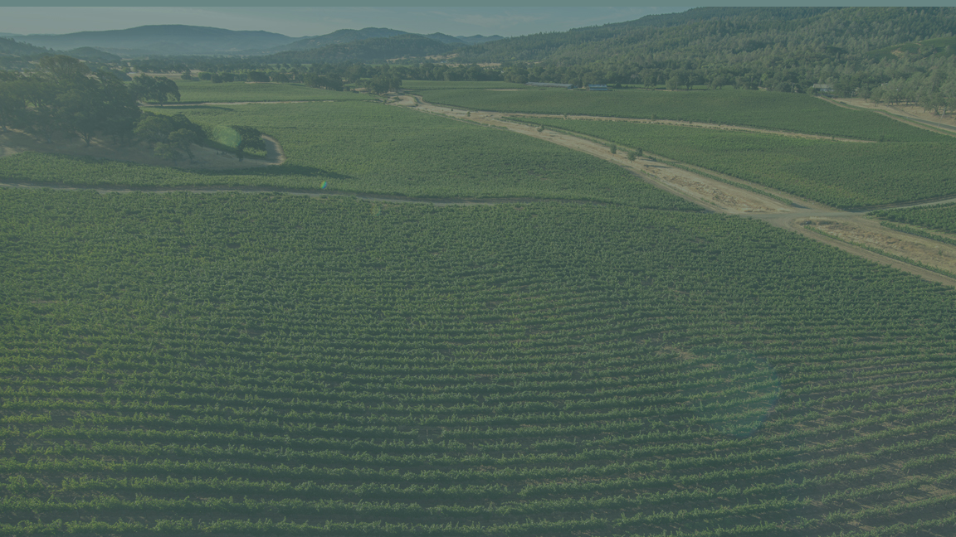
VITICULTURE

Slide 24
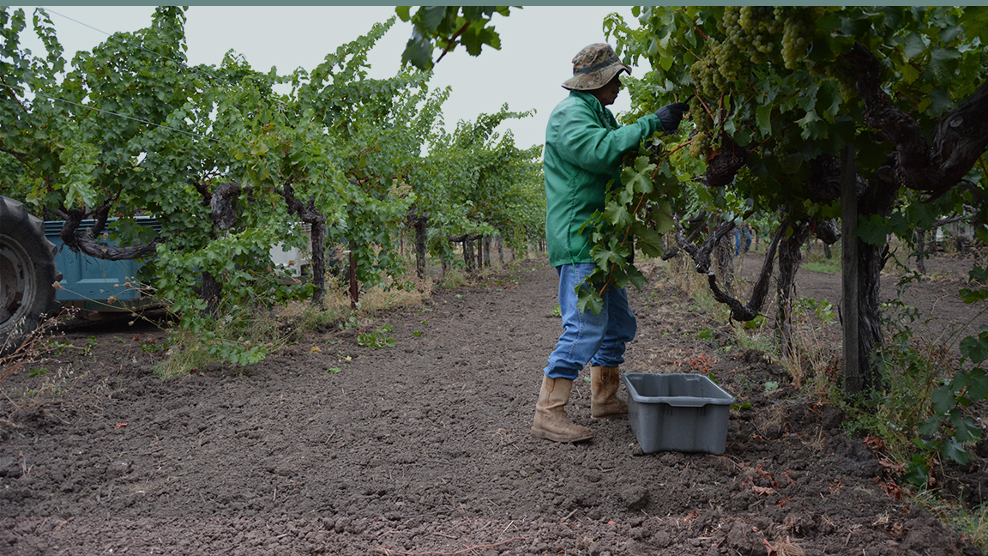
Both time-tested farming methods and the latest technology
The right varieties in the right places.

Slide 25
Terroir and Viticulture
SITE SELECTION
Soil Composition
Topography
Microclimate Conditions
Sun Exposure
Drainage
VITICULTURAL PRACTICES
Vine Material Selection
Soil Management
Irrigation Techniques
Trellising and Canopy Management

Slide 26
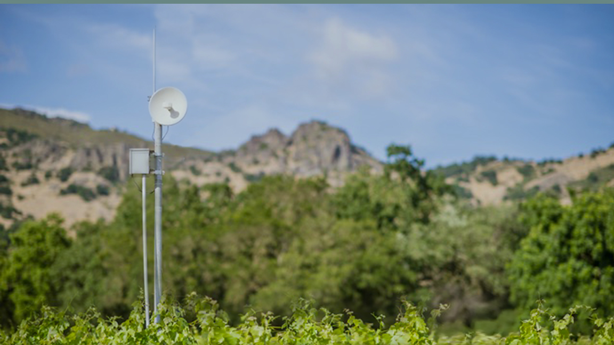
Napa Valley growers harness the latest technology in the vineyard

Slide 27
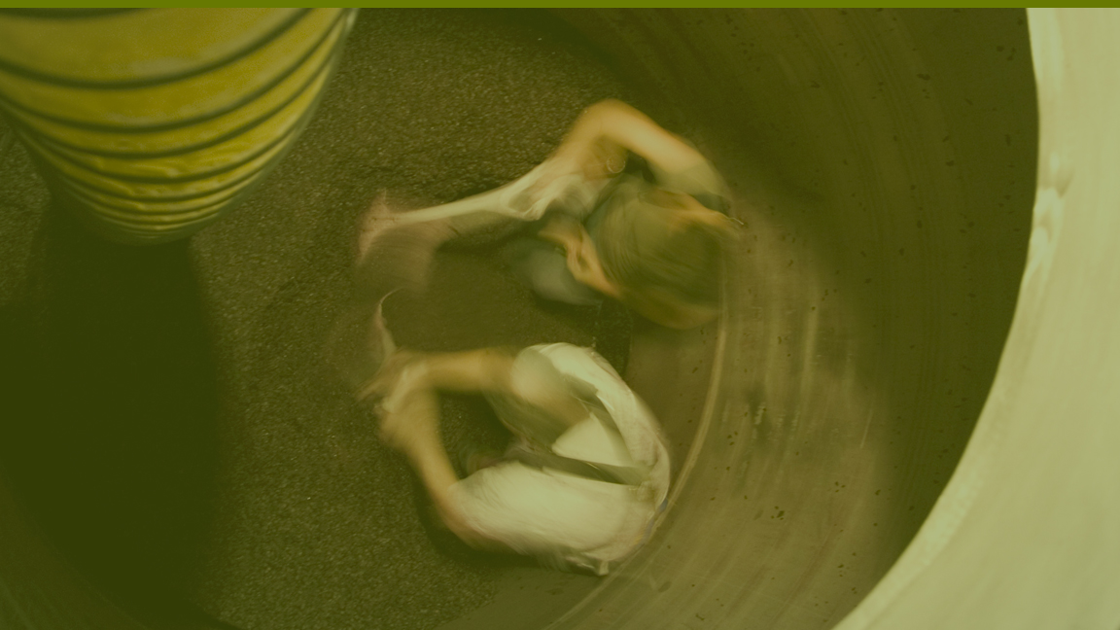
WINEMAKING

Slide 28
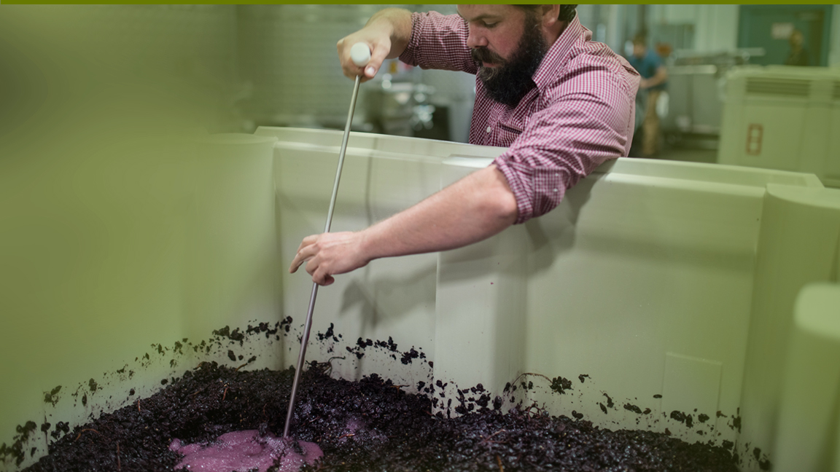
Attention to detail
Latest technology
Constant evaluation
Experimentation
Collaboration

Slide 29
History
1879—1900
1933
1976
2000s
Late 1980s–Early 1990s
1848—1855
1890s
1933–1960s
1838–1839
1889
1944
1981
Today
1860s–1870s
1906–1933
1968
1997

Slide 30
1838–39
WINEMAKING IN THE NAPA VALLEY BEGINS
George Calvert Yount, founder of the town of Yountville, plants the first vineyards
1830
1860
1900
1940
1980
1990
Present

Slide 31
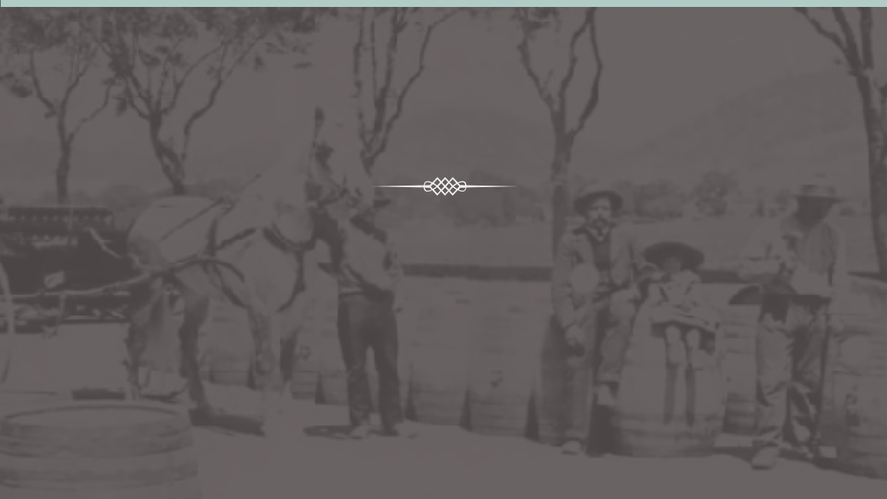
1860s-1880s
FIRST GOLDEN AGE FOR NAPA VALLEY
First commercial winery founded in 1861
Region is recognized for quality wines
140 wineries by 1889
1830
1860
1900
1940
1980
1990
Present

Slide 32
1890-1933
WEATHERING STORMS
1890s
Phylloxera destroys 14,000 acres of grapevines
1917
The United States enters World War I
1920-1933
The enactment of Prohibition lasts 13 years
1906
The San Francisco Earthquake destroys 30 million gallons of California wine
1929
The Great Depression hits
1830
1860
1900
1940
1980
1990
Present

Slide 33
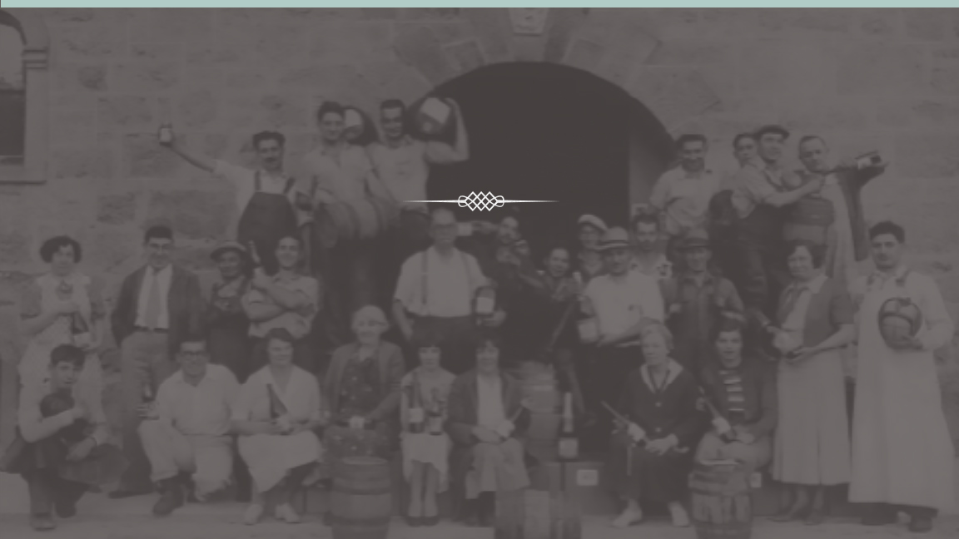
1933
RECOVERY
After Prohibition is repealed, Napa Valley begins the slow road to recovery
1830
1860
1900
1940
1980
1990
Present

Slide 34
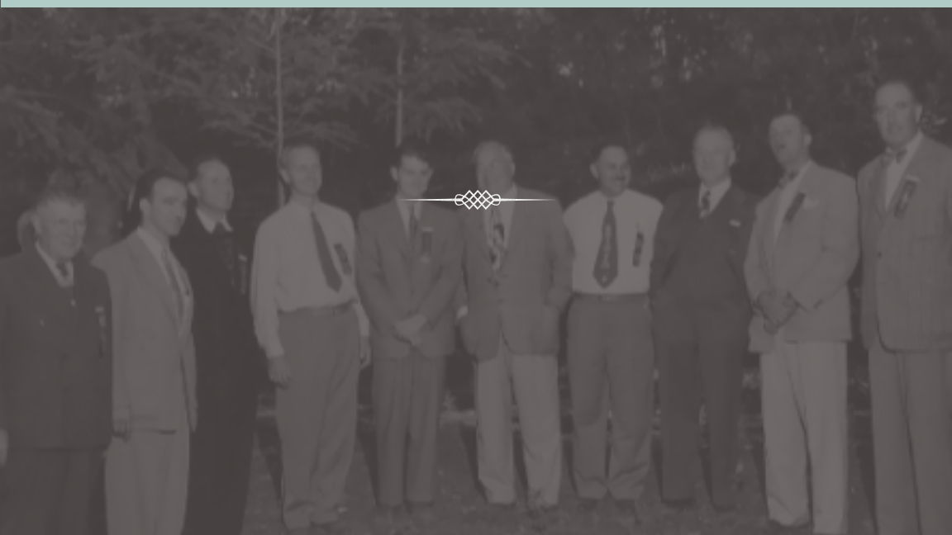
1944
NAPA VALLEY VINTNERS IS BORN
“We are stronger together than individually”
1830
1860
1900
1940
1980
1990
Present

Slide 35
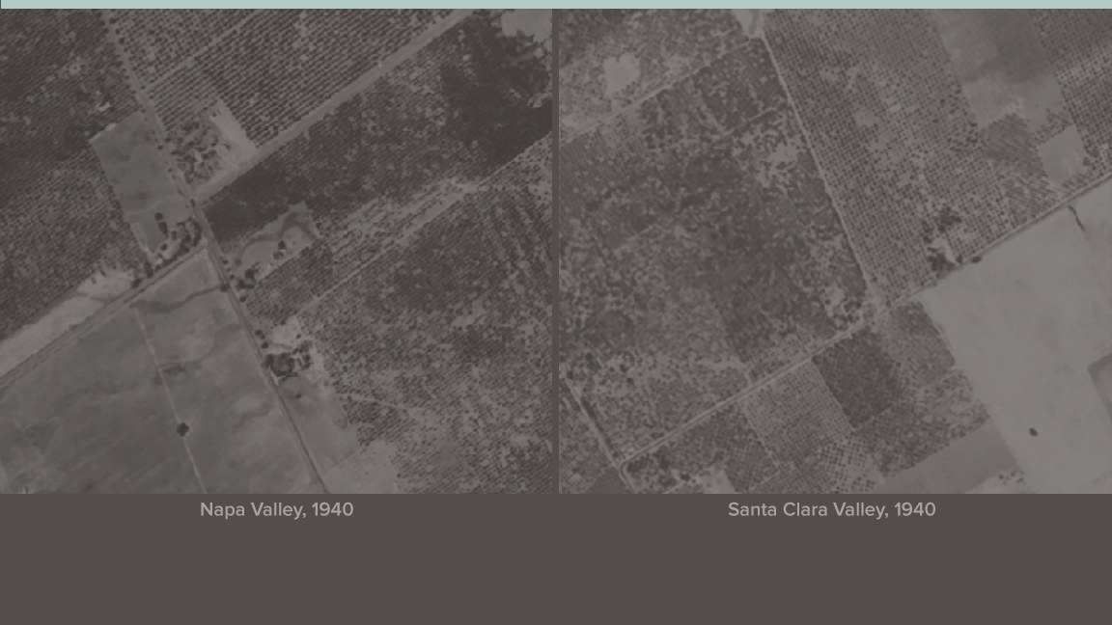
1968
NAPA VALLEY AGRICULTURAL PRESERVE FOUNDED
It is the first agricultural preserve in the United States
1830
1860
1900
1940
1980
1990
Present

Slide 36
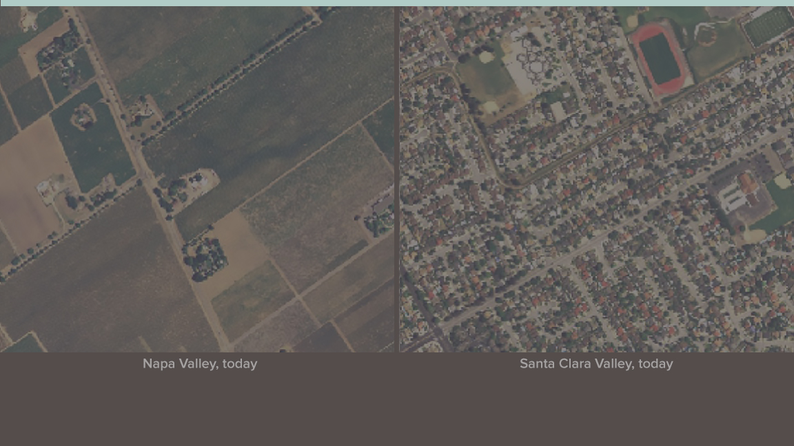
1968
NAPA VALLEY AGRICULTURAL PRESERVE TODAY
1830
1860
1900
1940
1980
1990
Present

Slide 37
1981
NAPA VALLEY RECOGNIZED AS AMERICAN VITICULTURAL AREA
California's first AVA
1830
1860
1900
1940
1980
1990
Present

Slide 38
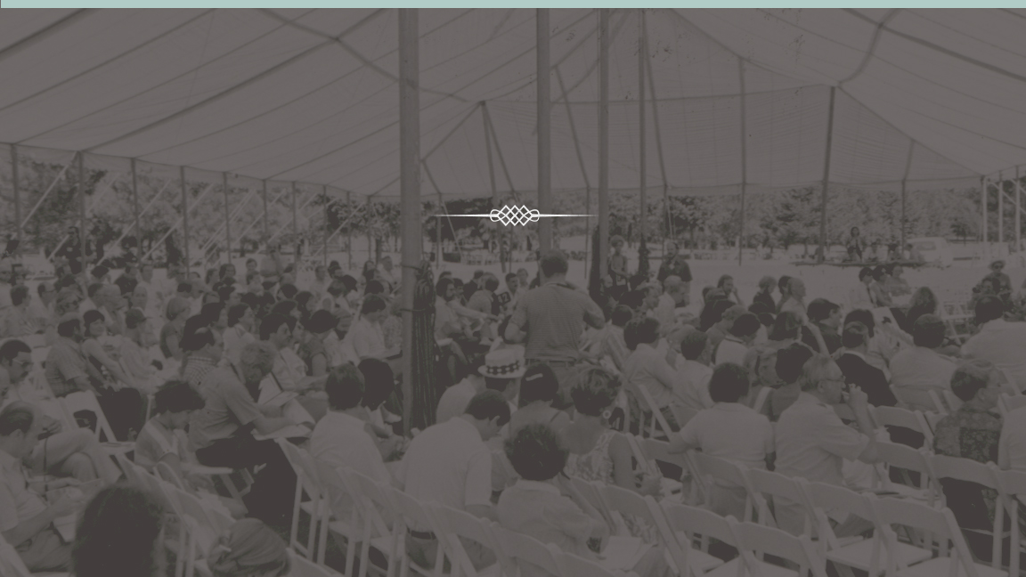
1981
CARING FOR THE COMMUNITY
Inaugural Auction Napa Valley
1830
1860
1900
1940
1980
1990
Present

Slide 39
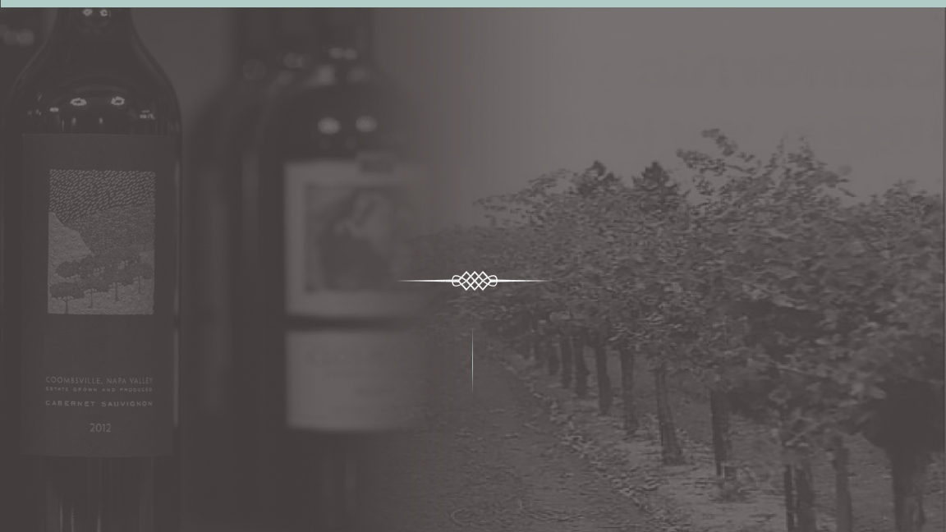
Late 1980s
and Early 1990s
CONJUNCTIVE LABELING
PHYLLOXERA RETURNS
1830
1860
1900
1940
1980
1990
Present

Slide 40
2000s
NAPA GREEN
Wine industry’s most rigorous programs further protect the environment
1830
1860
1900
1940
1980
1990
Present

Slide 41
2000s
NAME PROTECTION
Through a variety of efforts and initiatives, NVV works to protect the Napa Valley name
1830
1860
1900
1940
1980
1990
Present

Slide 42
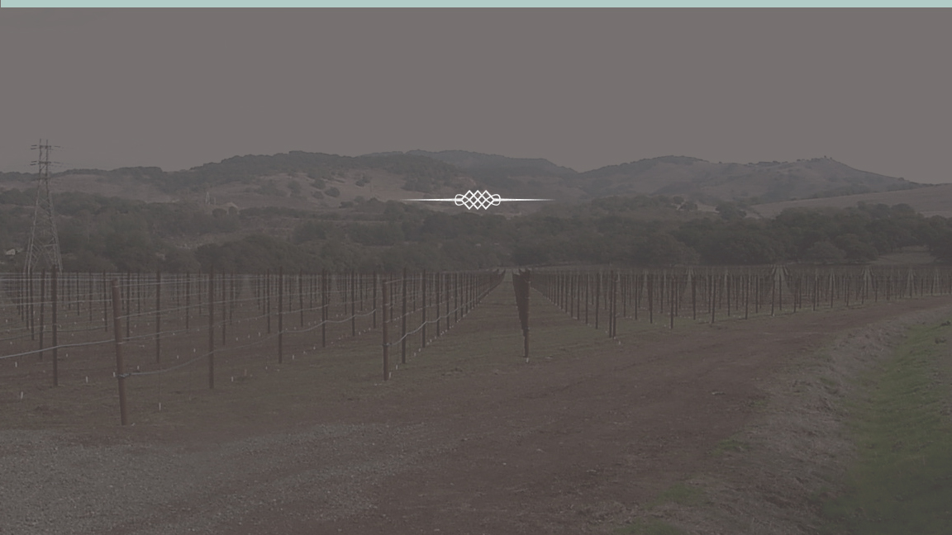
Today
NAPA VALLEY WINE INDUSTRY THRIVING
Vintners continue to strive for even higher quality wines
1830
1860
1900
1940
1980
1990
Present

Slide 43
Today
NAPA VALLEY WINE INDUSTRY STRIVING
NVV's 2020 Goal:
All eligible wineries certified Napa Green
1830
1860
1900
1940
1980
1990
Present

Slide 44
Today
CARING FOR THE COMMUNITY
Auction Napa Valley has given more than $185 million since 1981
1830
1860
1900
1940
1980
1990
Present

Slide 45
Today
SOCIAL SUSTAINABILITY
Adopt-a-School
Napa Neighbor Program
Morning in Winery
Afternoon in Vineyards
Vine Trail
1830
1860
1900
1940
1980
1990
Present

Slide 46
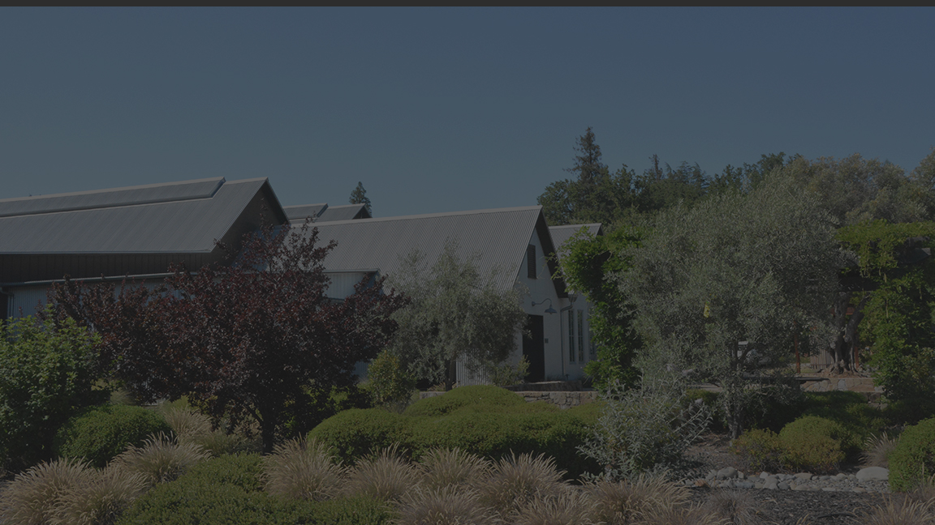
NAPA VALLEY VINTNERS
NAPA VALLEY VINTNERS

Slide 47
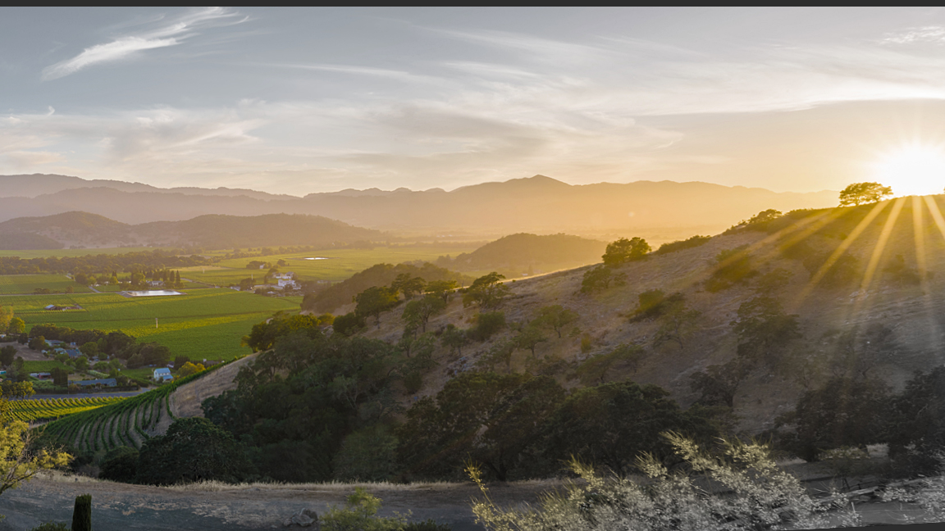
Our mission
To promote, protect and enhance the Napa Valley

Slide 48
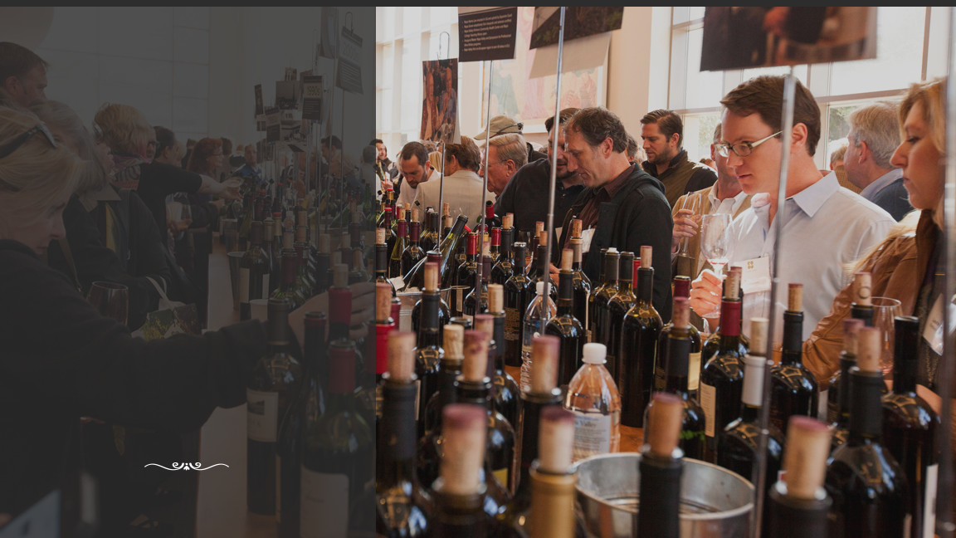
Promoting the Valley
Protecting the Valley
Fostering Collaboration within Industry

Slide 49
Top 5 Takeaways
1
Extraordinary Place
Quality Wines
Culture of Collaboration
Thriving Industry
Long History of Cultivating Excellence
2
3
4
5

Slide 50
Learn More
NapaVintners.com
napavintners
/NapaVintners
@NapaVintners

