Slide 1
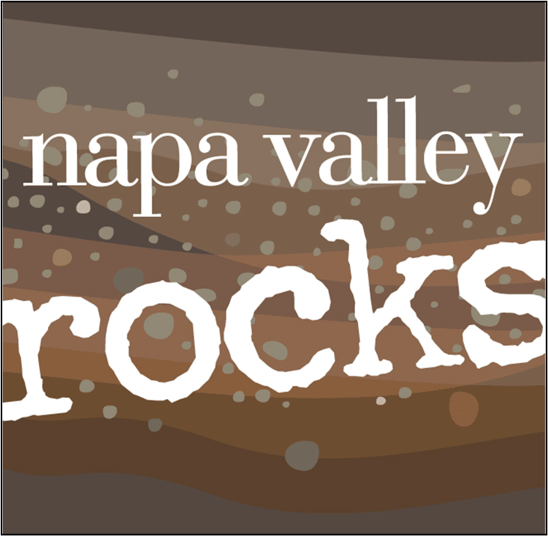
Notes:
Thank you for being here and welcome to “Napa Valley Rocks”
(INTRODUCE YOURSELF, INCLUDING YOUR TITLE AND YOUR WINERY NAME)
We’re proud members of the Napa Valley Vintners or N-V-V, the non-profit trade organization dedicated to the promotion, protection, and enhancement of the Napa Valley.
During this presentation, I’ll share with you scientific data, fun facts, history, and examples of specific attributes which make the Napa Valley unique in the world of wine.
We’ll also talk about the leadership of vintners past and present and how the combination of diverse geology, ideal climate, and dedicated people make the Napa Valley what it is today.

Slide 2
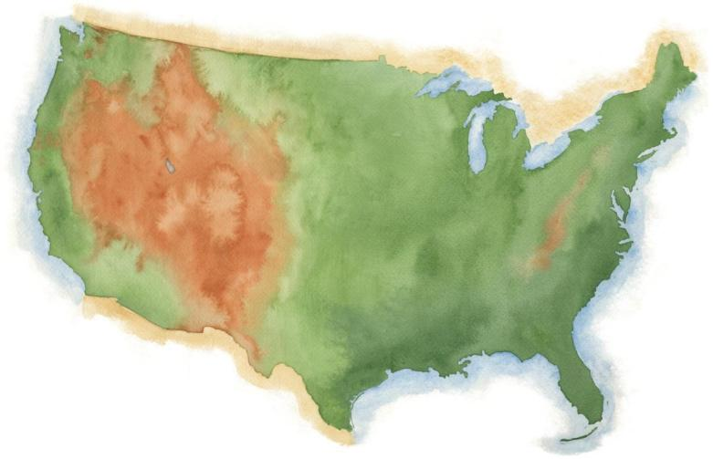
NAPA VALLEY
Notes:
Napa Valley is located in Northern California, very close to San Francisco and the Pacific Ocean, and several hundred miles from Los Angeles.

Slide 3
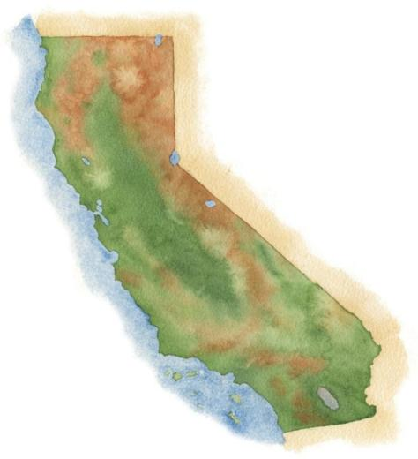
NAPA VALLEY
San Francisco
Los Angeles
Notes:
3
It’s a fairly young, “new world” wine region where wine has been made for only about 170 years.

Slide 4
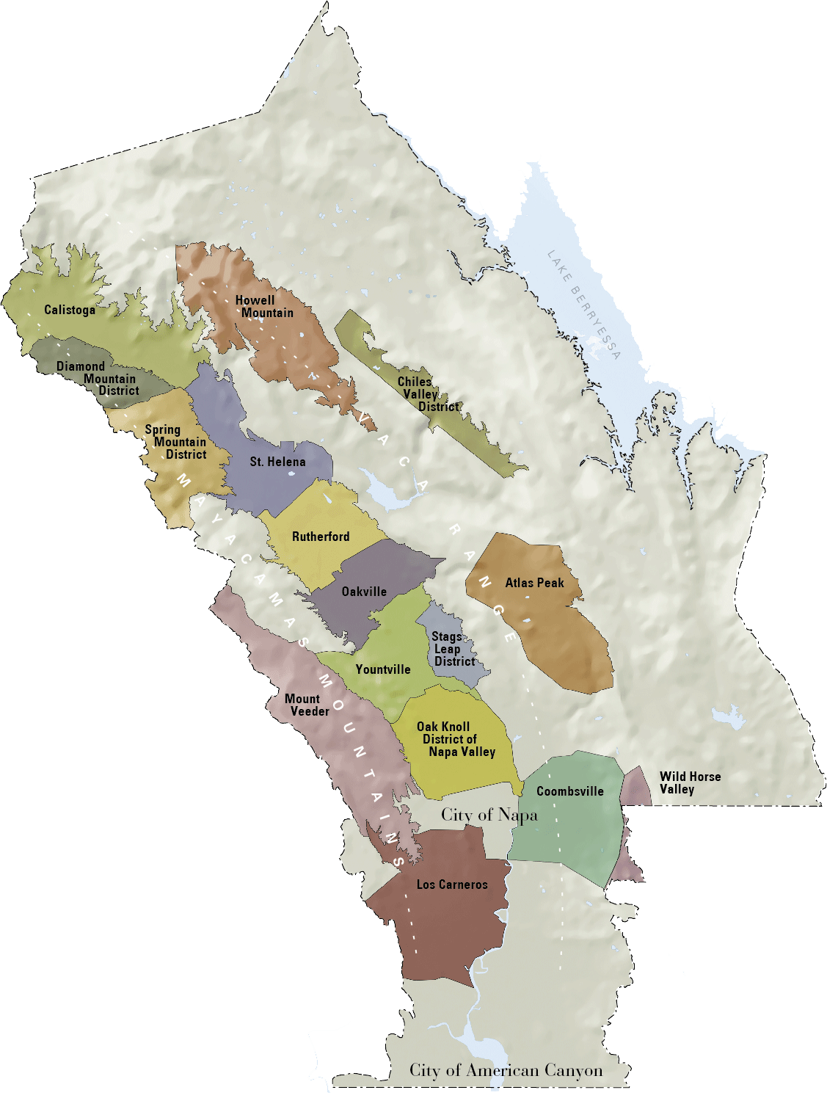

NAPA VALLEY
Distancia al Océano Pacífico
36mi / 58km
Distancia a San Francisco
48mi / 77km
Distancia a Los Angeles
360mi / 579km
Notes:
4
Napa Valley is small: the valley floor, located between the Mayacamas Mountains and Vaca Range, is just about 5 miles (about 8 kms) across at its widest point and 30 miles (about 48 kms) at its longest.
There are even smaller places within it: the Napa Valley itself is an AVA or American Viticultural Area, the first to be recognized in California in 1981
Within the Napa Valley AVA there are 16 recognized sub- or “nested” AVAs

Slide 5


Region pequeña
NAPA VALLEY AVA
área pequeña.
gran calidad y diversidad
responsable por el 4% del vino californiano
responsable por .04% del vino total del mundo
Napa Valley AVA
Notes:
5
If there’s one message we could leave you with today, it’s that the Napa Valley may be one of the most renowned wine growing regions in the world, but it is also one of the smallest.
Napa Valley produces just 4% of California’s wine and a mere four-tenths of one percent of the world’s wine.

Slide 6
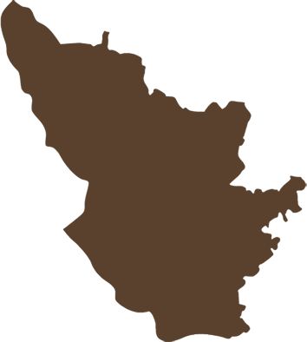
Region pequeña
NAPA VALLEY AVA
45,000 acres (18,250 ha)
de viñas
Bordeaux AC
290,000 acres (117,500 ha)
de viñas
NAPA VALLEY es 1/6
el tamaño de Burdeos
Napa Valley AVA
Bordeaux AC
(Burdeos AC)
Notes:
6
There are approximately 45,000 acres (about 18,000 ha) under vine in the Napa Valley AVA, about 9% of all of Napa County.
And has about one-sixth the planted area of Bordeaux.

Slide 7
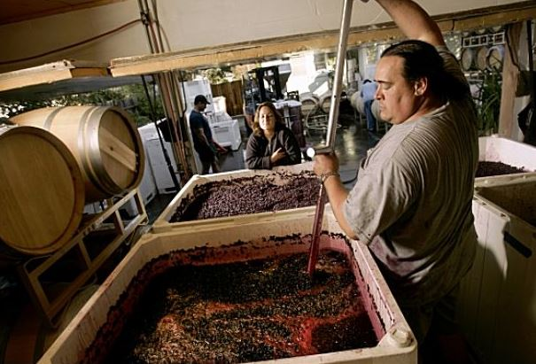
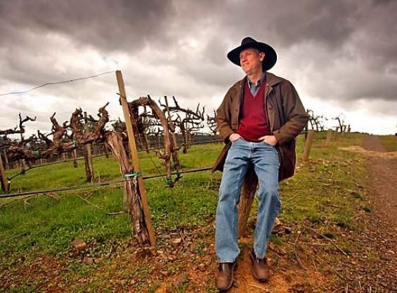
Productores
Pequeños
el 78% de los miembros de NVV hacen menos de 10,000 cajas de vino al año
el 67% producen menos de 5,000 cajas
el 95% son propiedad de familia
Notes:
7
The majority of Napa Valley’s producers are also small:
Nearly 80% of the NVV’s nearly 500 member wineries make less than 10,000 cases of a wine a year.
Nearly 70% produce fewer than 5,000 cases annually.
95% of all Napa Valley wineries are family owned.

Slide 8
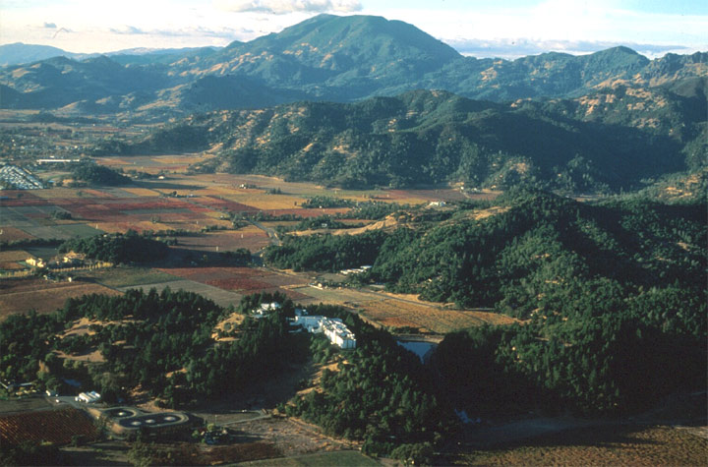
Napa Valley es una de las regiones vinícolas más diversas del mundo
Notes:
The French term terroir refers to how the physical environment of a winegrowing region gives unique character to the wines made there.
Although the place and the industry are relatively small, Napa Valley is one of the most diverse wine growing regions in the world.
Because Napa Valley has an amazing assortment of soils, diverse topography and almost countless microclimates, a wide array of grape varieties grow extraordinarily well here.

Slide 9
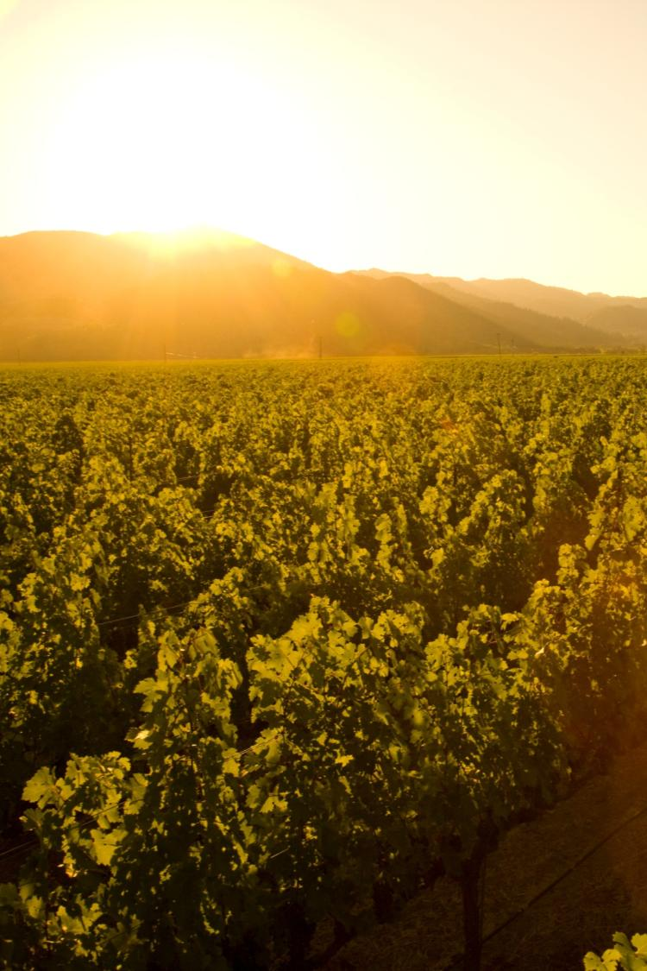
Clima Mediterráneo
Larga temporada de crecimiento
Carencia de precipitación de verano
Consistencia de cosecha a cosecha
Reducción del riesgo para la enfermedad de viñedo
Notes:
9
9
Napa Valley is located within the rare Mediterranean climate zone, which encompasses just 2% of the earth’s surface.
The long growing season is marked by warm summer days and cool evenings – ideal for wine grapes to ripen slowly and evenly, with great balance between sugar and acid development.
Lack of summer rainfall helps to
contribute to consistency of vintages and
reduces the risk of vineyard diseases
Most areas of the appellation can dry farm or tightly manage their irrigation practices.
Compared to most growing regions in the world, Napa Valley is unique in this regard.

Slide 10
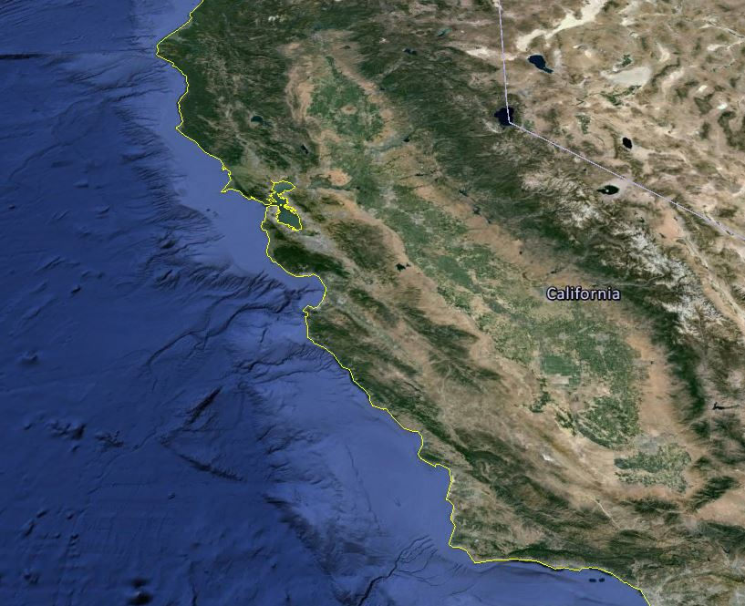


Las condiciones climáticas de Napa Valley son únicas y crean un patrón recurrente de la niebla marina en las sierras costeras
H
C
Pacific Ocean
Notes:
10
10
During the summer growing season, conditions exist for creating a recurring pattern of marine fog from the Pacific Ocean.
As hot air in California’s interior valley rises, it creates a vacuum effect which draws in moist, cool air from the Pacific Ocean, forming fog.
This pattern repeats most days during the warmer months of the year.

Slide 11


NAPA VALLEY AVA
Gran variación de temperatura en el verano de:
sur a norte
día a noche
y del fondo del valle a las laderas
40-50ºf / 4.5-10ºc
85ºf / 29ºc
40-50ºf / 4.5-10ºc
95ºf / 35ºc
50ºf / 10ºc
77ºf / 25ºc
Notes:
11
11
Daytime temperatures can also vary dramatically throughout the AVA during the growing season.
The southern part of the valley, particularly Los Carneros AVA, is closer to San Pablo Bay and is cooled by marine breezes.
In summer, there can be as much as an 10-15° difference during the day between Carneros and St. Helena, to the north.
On many days, due to the cooling effect of the fog, there is a large diurnal (day to night) temperature swing throughout the valley.

Slide 12
NAPA VALLEY AVA
La elevación y topografía desempeñan un papel crucial en la creación de diversos microclimas
Mount St. Helena
(montaña Santa Helena)
4000 ft / 1,219 m
Spring Mountain
2200 ft / 671 m
La ladera
El aspecto
La exposición
Atlas Peak
2600 ft / 793 m
Mount Veeder
2100 ft / 650 m
fondo del valle
0– 750 ft / 0 – 214 m
Notes:
12
12
Adding to the diversity of Napa Valley is its topography.
It changes with its length, from the flat estuaries in the south near San Pablo Bay to the rolling hills just before 4,000-foot (1219m) Mount St. Helena in the north.
And don’t forget the Mayacamas and Vacas to the west and east – each range reaches approximately 2,500 feet (760 meters) above the valley floor.
There is a strong correlation between topography and climate: slope, aspect, and elevation all influence the many mesoclimates found throughout the Napa Valley.

Slide 13
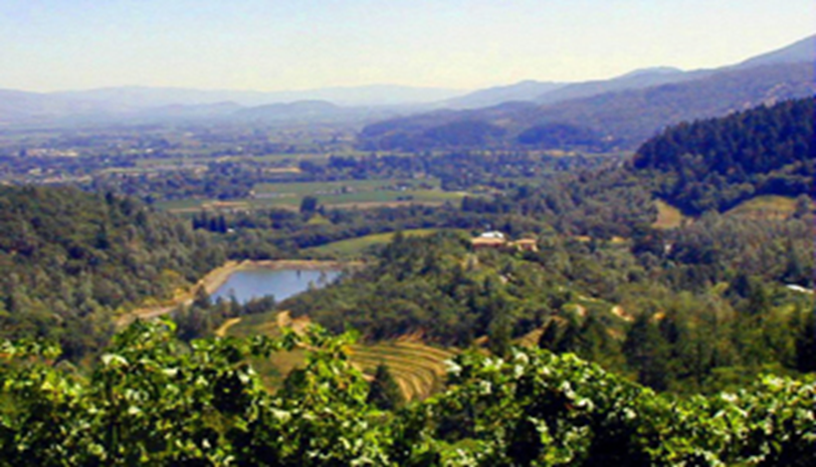
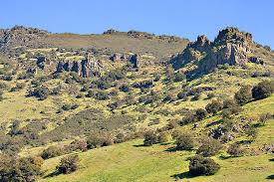
Las montañas Mayacamas
mirando hacia el oeste a Yountville
DIVERSO
La geología diversa, las exposiciones y el clima crean ...
La Cordillera Vaca
mirando hacia el este, Distrito Stags Leap
Notes:
13
Millions of years of geology have also influenced the Napa Valley, creating an incredible diversity of soil.
As you can see in these photos, the two sides of the Napa Valley, less than 5 miles (8 kms) apart, look completely different due to the variation in geology and climate.\
Diverse geology, exposures and climate create…

Slide 14
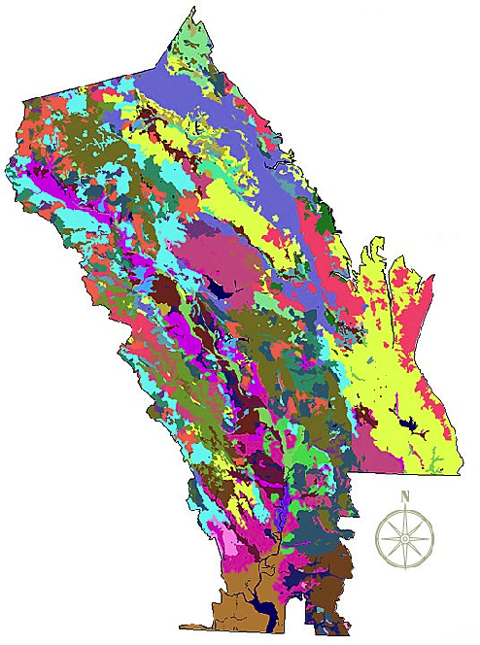
Napa Valley
AVA tipos de suelos
más de 100 variaciones de suelos
33 tipos de suelos
Napa Valley cuenta con la mitad de los suelos para el mundo
Copyright Terra Spase, Inc. 2003
Notes:
14
Napa Valley contains more than 100 soil variations, 33 soil series, and half the soil orders found in the world.
This picture shows how, literally, you can have different kinds of soil in the same vineyard in Napa Valley.
This diversity allows vintners to grow and produce – and to produce well – a great number of different wine varieties in the Napa Valley.
One of the secrets of great winegrowing is in the soil and Napa Valley has some of the greatest soil diversity found in winegrowing regions around the world.
(Note difference between a soil order, series and variation: soil orders are based largely on soil forming processes. Soil series is of a similar evolution or formation, chemistry, and physical property. Soil variations take into account vegetative material, climate, and topography differences and/or make-up).

Slide 15
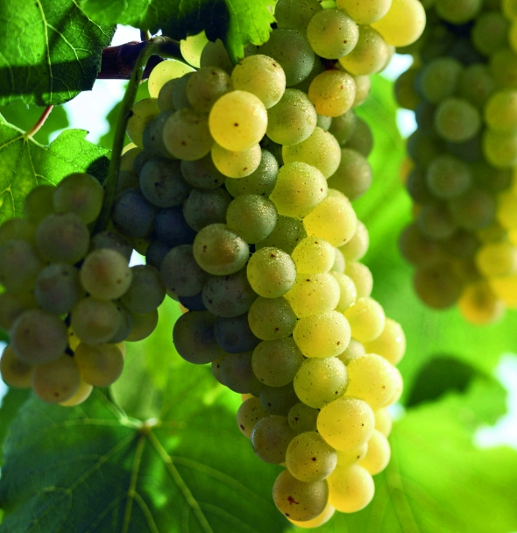
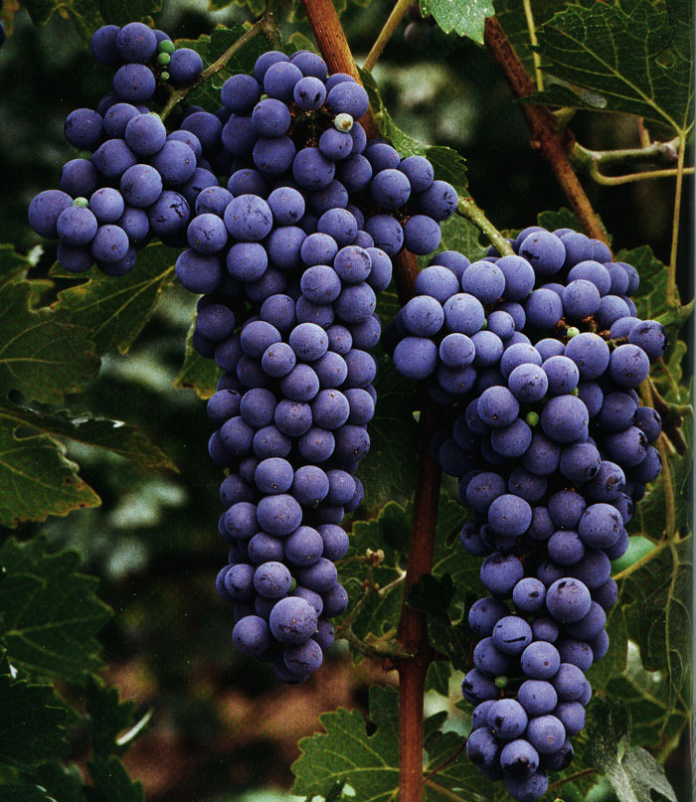
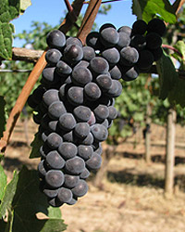
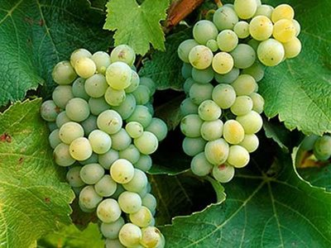
Las mejores variedades del Valle de Napa en orden descendente
Cabernet Sauvignon
Chardonnay
Merlot
Pinot Noir
Sauvignon Blanc
Zinfandel
Cabernet Franc
Petite Sirah
Syrah
Notes:
15
15
Napa Valley has become synonymous with Cabernet Sauvignon.
The majority of Napa Valley winemakers produce it.
But, thanks to the many diverse growing conditions we’ve talked about, all kinds of varieties flourish here.
Conditions are well-suited for growing both Burgundian (Chardonnay and Pinot Noir) and Bordeaux-style varieties (Cabernet, Merlot, Cabernet Franc, and Sauvignon Blanc).

Slide 16
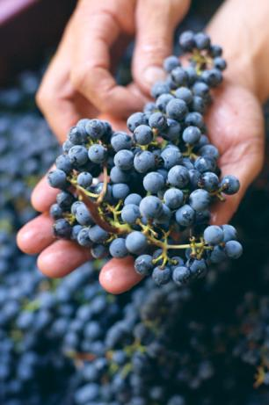
12%
El 12% de la cosecha total de uvas de vinificación en California es Cabernet Sauvignon
40%
Cabernet Sauvignon constituye el 40% de la cosecha total de uvas de vino del Valle de Napa
55%
Pero tiene un valor del 55% de la cosecha de la uva de vino del Valle de Napa
Notes:
16
16
Cabernet Sauvignon accounts for 12% of California’s wine grape harvest.
It makes up approximately 40% of Napa Valley’s overall wine grape harvest, yet had a value of 55% of the harvest, according to the most recent crush report.
In 2011, the value of a ton of Napa Valley Cabernet Sauvignon grapes was four times the statewide average price for a ton (1,000 kgs) of Cabernet Sauvignon grapes.
Napa’s quality is reflected in its grape prices.

Slide 17
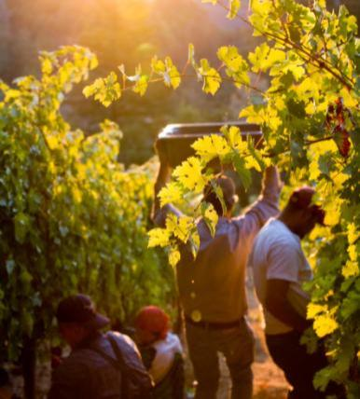
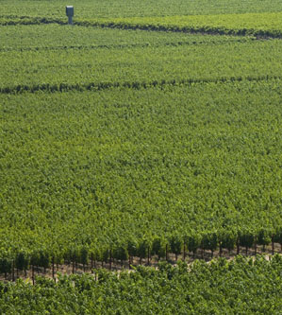
Prácticas del viñedo: Las raíces de calidad son intencionalmente cultivados de tal forma para cosechar menos toneladas pero con alta calidad
La cultivación se da a medida de la variedad de uva y su terreno
Notes:
17
17
Vineyard Practices: The roots of quality
Most winemakers will tell you that quality starts in the vineyard.
Napa Valley vineyards are intentionally farmed to produce low yields to allow only the healthiest of grape clusters to mature.
Throughout the growing season, the canopy is managed with leaf pruning, shoot pulling, and fruit thinning – all of which is done by hand – resulting in a perfect sunlight to shade ratio and optimal fruit development.
Viticultural practices are tailored to the grape variety and the site
This attention to detail in the vineyard is designed to produce wine grapes of the highest quality.

Slide 18
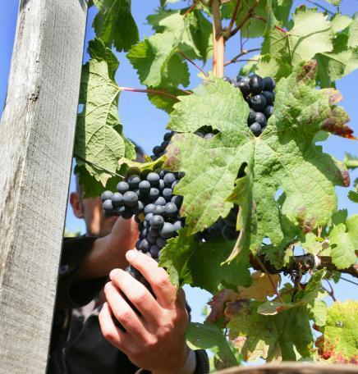
Prácticas de vinificación: una cultura de calidad
el manejo suave de la uva es la norma
centrarse en la innovación y la calidad
la colaboración es común
continuar la educación para una mejoría continua
Notes:
18
18
Winemaking practices: A culture of quality
Napa Valley vintners are always trying to improve quality - there is a culture of “we can do better.”
Gentle handiling is the norm: Inside the winery, most Napa Valley winemakers agree that “less is more” and their best approach is gentle and “hands off” allowing the grapes to express themselves.
Innovative viticulture practices sometimes give a nod to the past, like use of concrete fermenters, gravity flow facilities, or wild yeasts, and also have a vision for the future, like new technology, which can provide an automated godsend to small producers with limited manpower.
Napa vintners regularly collaborate and participate in local wine technical group meetings and discussions, including the NVV’s winemaker discussion group.
They also regularly attend knowledge-building programs at local education institutions, like UC Davis, Sonoma State University, or even the local community college, which has an extensive enology program.

Slide 19
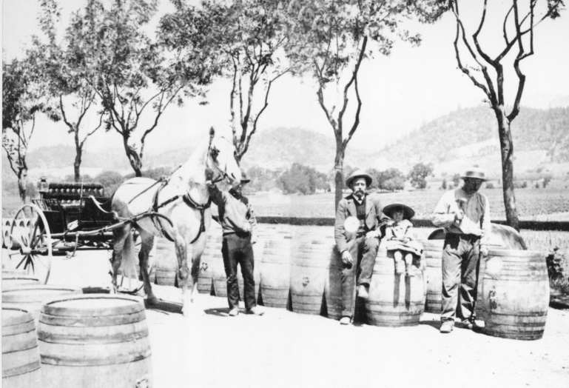
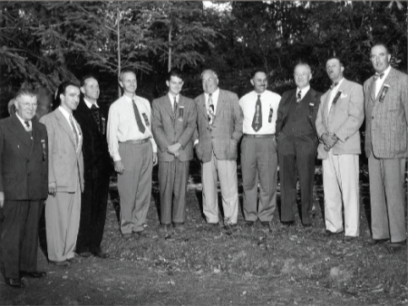
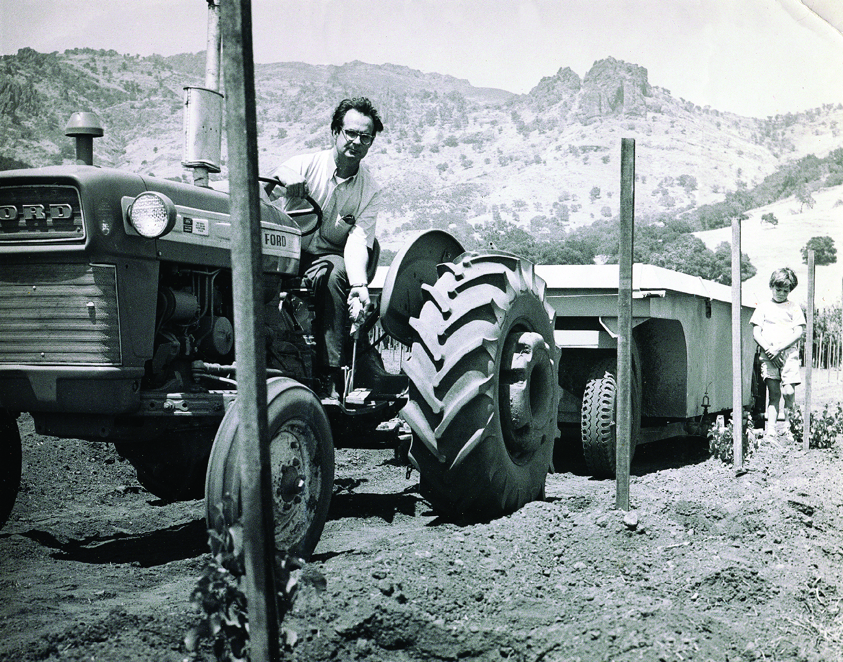
Cronología de Napa Valley
Napa Valley Timeline
1838
George Yount planta la primera viña
1849
California Gold Rush
1889
Napa Valley es hogar de 140 bodegas
1900
La filoxera destruye a los viñedos de Napa
1919
Comienza la Ley Seca. Napa Valley es hogar de 12 bodegas
1944
La Asociación de Vinateros del Valle de Napa es formado
1968
La Preservación Agrícola de Napa Valley es fundada
1976
La degustación en el Juicio de Paris
2003
Se instituye Napa Green Certified Land
2008
Se instituye Napa Green Certified Winery
Notes:
19
19
It has taken more than 150 years and a long line of great leaders to make the Napa Valley what it is today
1838- George Calvert Yount, founder of the town of Yountville, plants the first commercial vineyards in the valley
1849- California’s Gold Rush brings thousands to northern California- pioneers, prospectors and entrepreneurs take up residence in Napa Valley
1889- NV experiences a huge boom, by 1889, Napa had more than 140 wineries, including Schramsberg, Beringer, and Inglenook
1900- Phylloxera- Acreage in Napa Valley declined from 15,807 in 1888 to just 2,000 acres by 1900
1919- By the time Prohibition begins, NV is home to 12 wineries
1944- The Napa Valley Vintners Association is formed
1968- the nation’s forst Ag Preserve is formed
2003- Napa Green Certified Land program is launched
2008- Napa Green Certified Winery program is launched

Slide 20
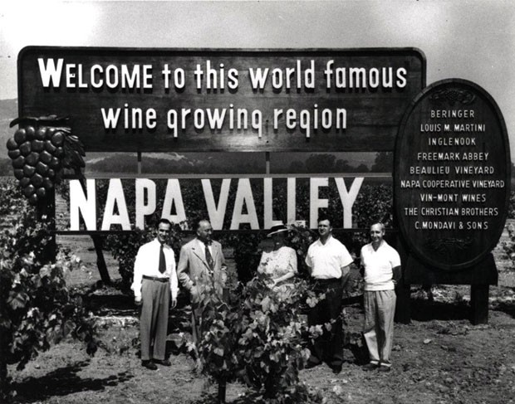
El objetivo de Napa Valley Vintners promover, proteger y mejorar la denominación Napa Valley, nuestros vinos, viticultores y comunidad
Notes:
20
20
Formed in 1944, the Napa Valley Vintners today has nearly 500 member wineries who work to promote, protect and enhance the Napa Valley appellation, our wines, vintners and community.
Napa Valley is the home to America’s first Agricultural Preserve and is a region of incomparable natural beauty.
Though accounting for a fraction of California’s harvest, Napa Valley is the industry’s undisputed leader in land and community stewardship and is renowned the world over for its extraordinary wines.

Slide 21



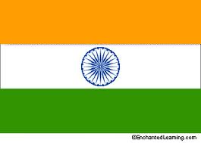
Protegiendo a Napa Valley
Legislación en el nombre Napa
Primera región vinícola para obtener la Indicación Geográfica (IG) en China
Primera región vinícola no europea en obtener el estatus de indicación geográfica en la Unión Europea
Indicación geográfica obtenida en Brasil, Canadá, India y Tailandia
Marca comercial en curso
Seguimiento
Notes:
Napa Valley Vintners also believe that for a wine to have “Napa Valley” on the label, including in the brand name, it should have Napa Valley wine in the bottle.
In other words, consumers should know where the wine they’re drinking really comes from.
The Napa Valley Vintners work to ensure that truth in wine labeling laws are adhered to around the globe – and have taken the fight all the way to the US Supreme Court, China, the European Union, and other major countries.
NV was the first wine region to receive Geographic Indication status in the European Union and China
And GI status has been attained around the world
We also continuously monitor trademark applications around the globe to ensure these principles are adhered to.

Slide 22
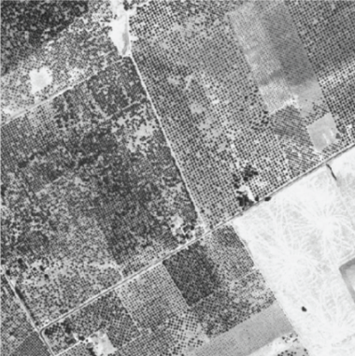
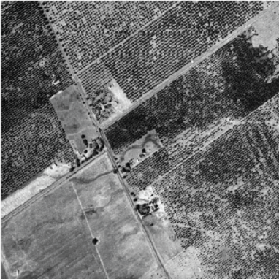
La Preservación Agrícola de Napa Valley el mejor y mayor uso de la tierra
Napa Valley, 1940
Santa Clara Valley, 1940
Napa Valley, 1940
Santa Clara Valley, 1940
Notes:
22
22
The Napa Valley Ag Preserve was the first in the U.S. to set aside land specifically for agriculture as the highest and best use of the land
This slide and the next show the impact of the Ag Preserve on our county…and our way of life.
Here’s an aerial photo of Napa Valley and the Santa Clara Valley taken around 1940 – both of these communities are about an hour from San Francisco…

Slide 23
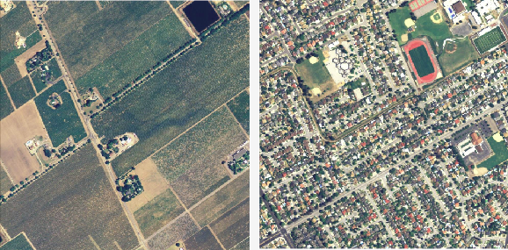
La Preservación Agrícola de Napa Valley
Protege aproximadamente 38,000 acres de tierras de cultivo
Napa Valley, 2005
Santa Clara Valley, 2005
Notes:
23
23
A photo was taken again of the same two places in 2005 – a couple of pictures here are worth more than 1,000 words!
Founded in 1968, the Ag Preserve has been going strong more than 40 years without compromise, and now protects 38,000 acres (15,000 ha) of valley floor farmland.
Another 53,000 acres (21, 000 ha) of Napa Valley land have been placed into permanent conservation easements by the local Land Trust.

Slide 24
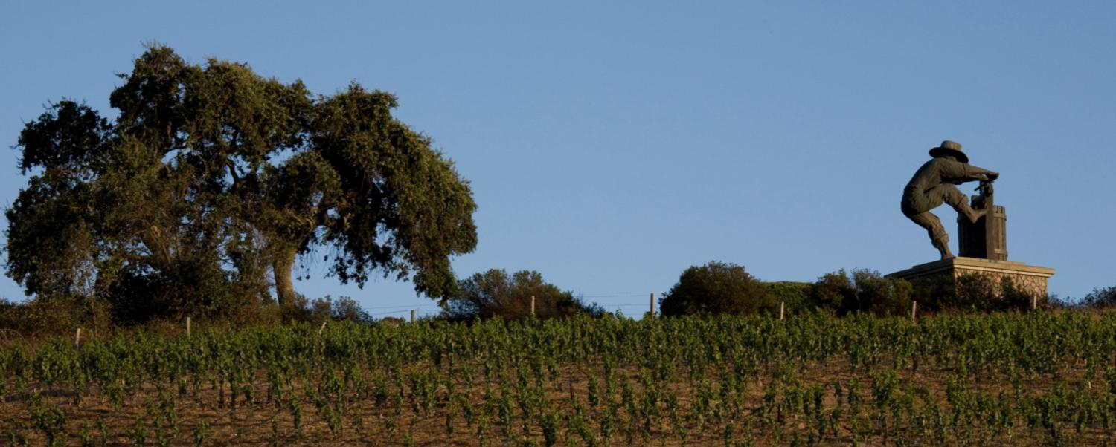



Napa Valley: vinos americanos legendarios
aprende más: NapaVintners.com
Facebook.com/NapaVintners
Twitter: @NapaVintners
NapaVintners.com/blog
Notes:
24
24
Millions of years of science…150 years of grape growing…70 years of cooperation and camaraderie.
Today, Napa Valley is the most recognized appellation in America, its wines are considered some of the finest and most age-worthy in the world.
No other winegrowing region offers more diversity or a greater tradition of leadership.
Thank you for listening to our story.

