Slide 1
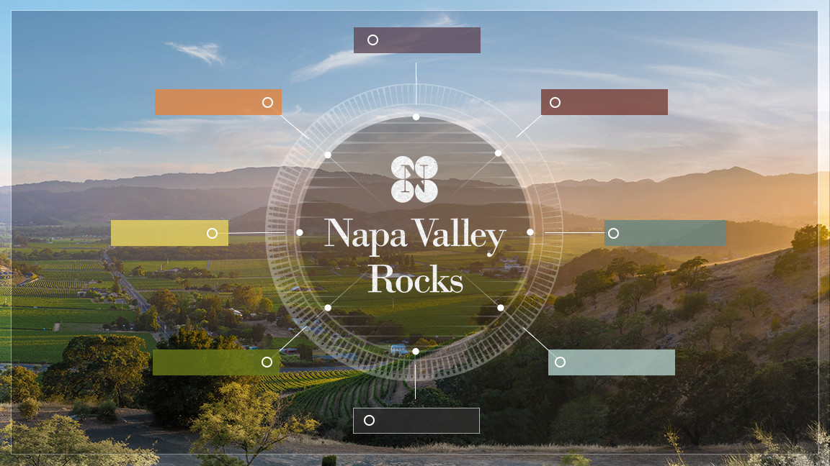
INTRODUCTION
NAPA VALLEY
SOILS
CLIMATE
VITICULTURE
WINEMAKING
HISTORY
NAPA VINTNERS

Slide 2
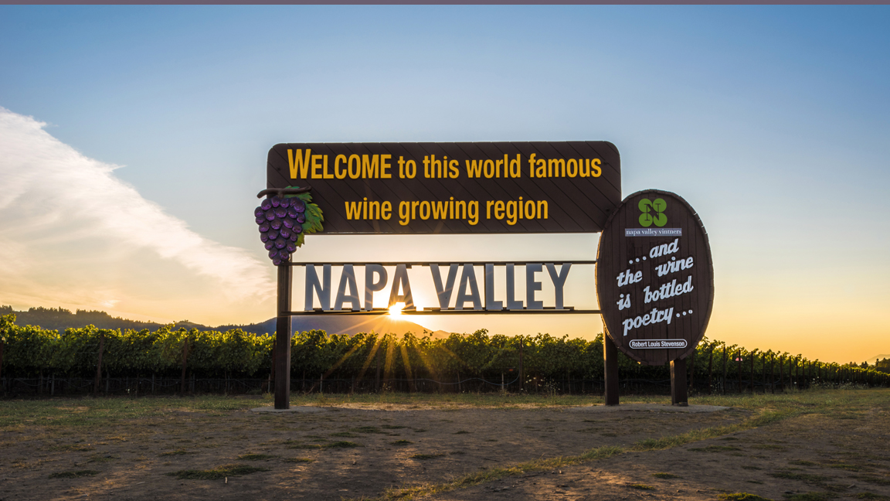
Wines of the highest quality, cultivated with excellence
in one of the world’s most extraordinary places

Slide 3
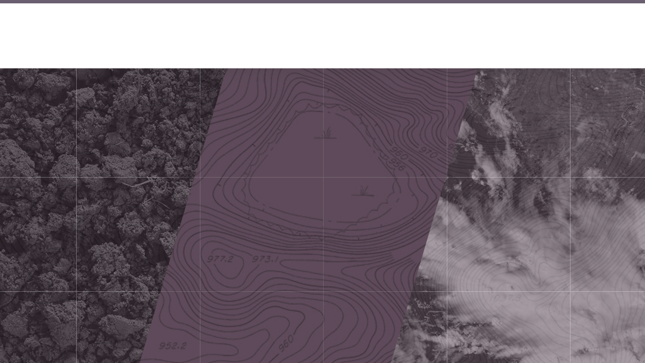
Terroir (terˈwär)
Noun: the complete natural environment in which a particular wine is produced,
including factors such as the soil, topography, and climate
Soil + Topography + Climate

Slide 4
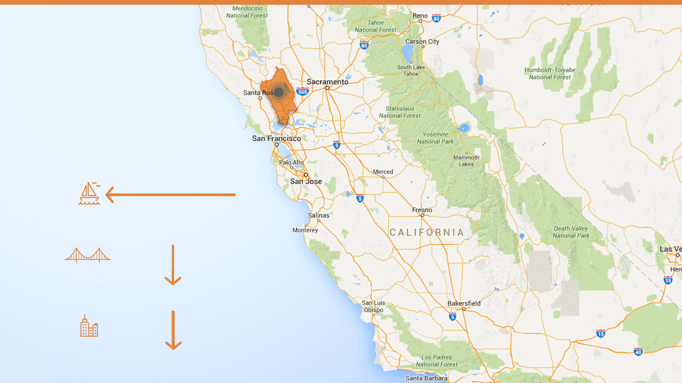
Napa Valley
became the first American Viticultural Area (AVA) to be recognized in California
in 1981
Distance to Pacific Ocean
36 mi / 58km
Distance to San Francisco
48mi 77km
Distance to Los Angeles
360mi 579km

Slide 5
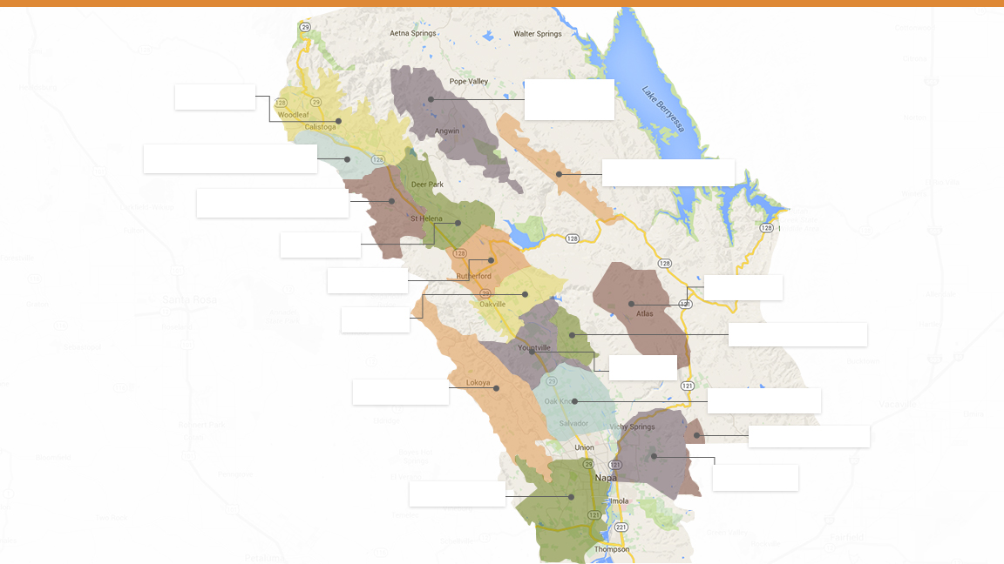
Calistoga
Howell Mountain
Diamond Mountain District
Chiles Valley
Spring Mountain District
St. Helena
Rutherford
Atlas Peak
Oakville
Stags Leap District
Yountville
The Napa Valley AVA and its
nested AVAs
Mount Veeder
Oak Knoll District
Wild Horse Valley
Coombsville
Los Carneros

Slide 6
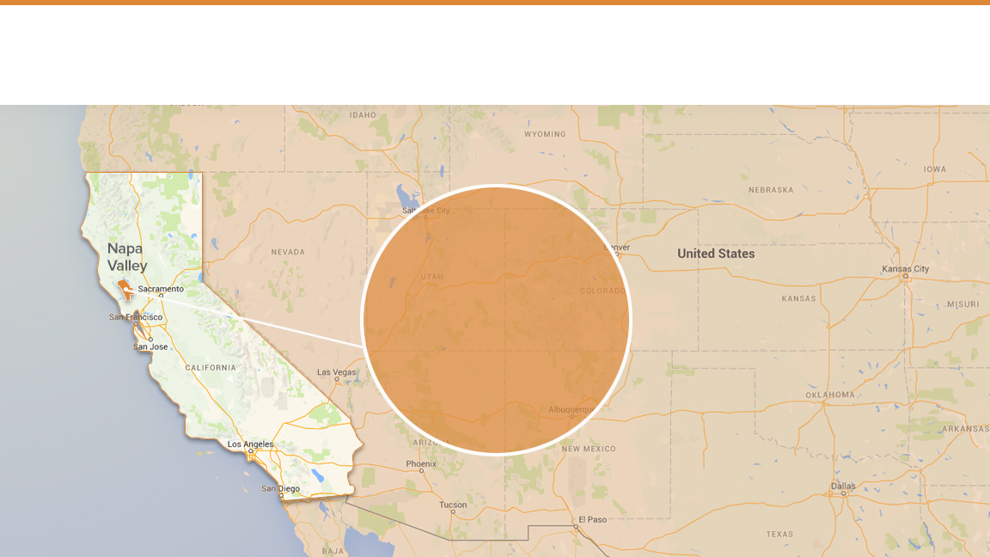
Small Region, Small Producers
4%
of California’s wine

Slide 7
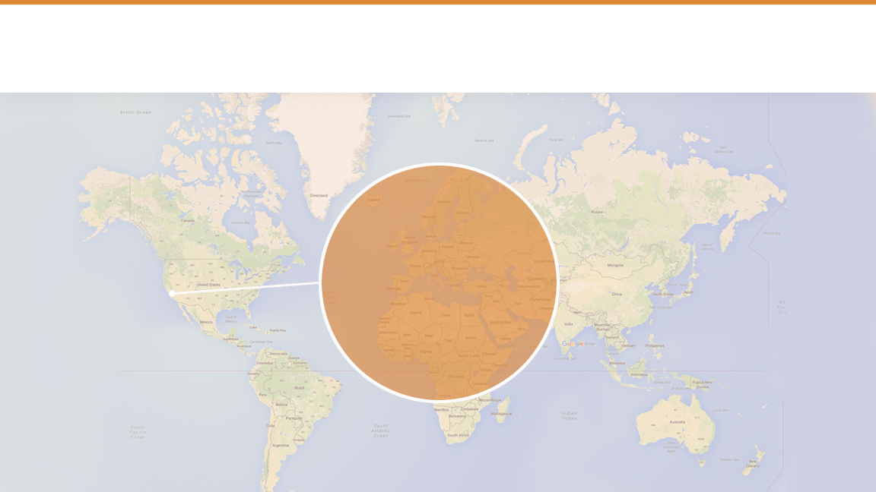
Small Region, Small Producers
.4%
of the world’s wine

Slide 8
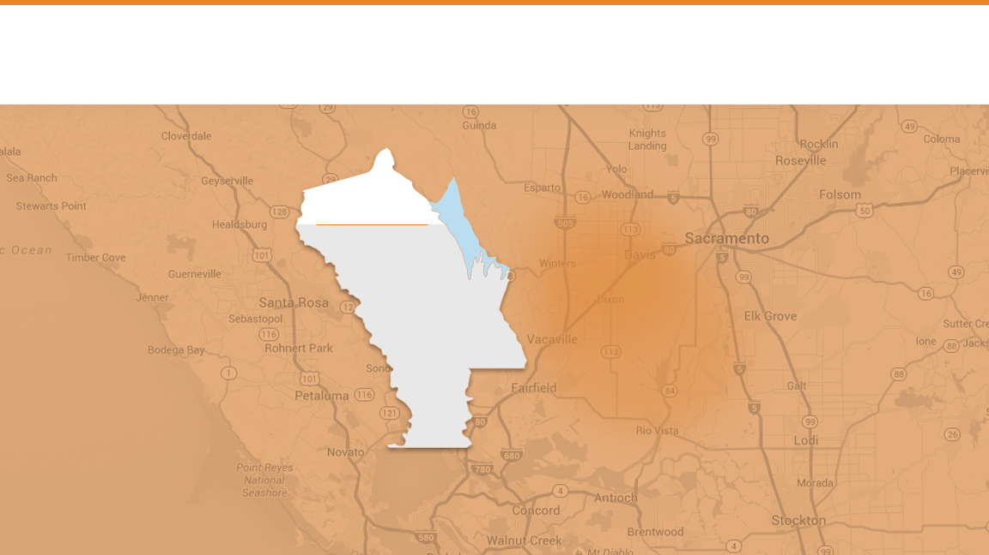
Small Region, Small Producers
78%
Napa
Valley
of NVV members
produce less than
10,000
cases of wine a year

Slide 9
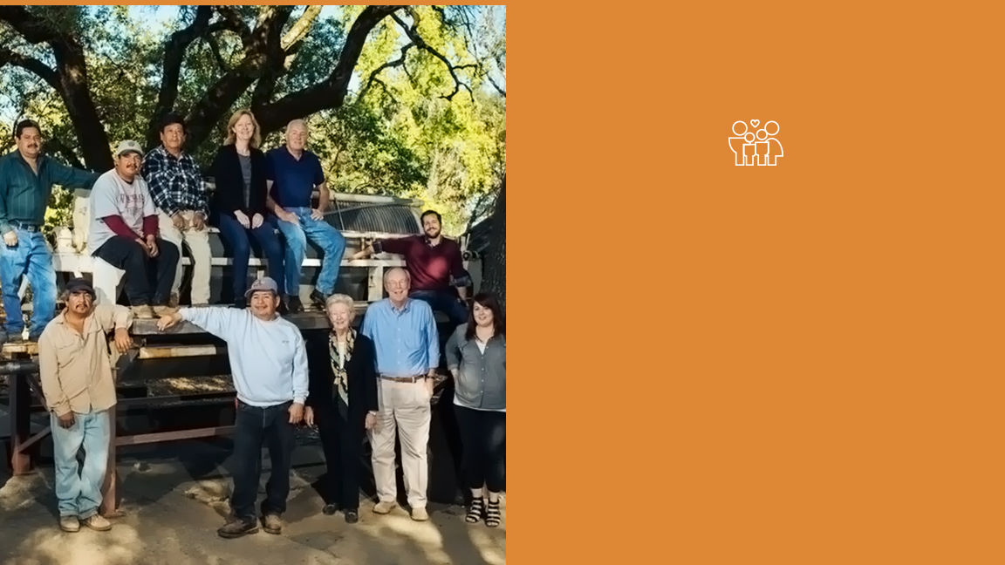
95%
of all Napa Valley wineries are
family owned or operated

Slide 10
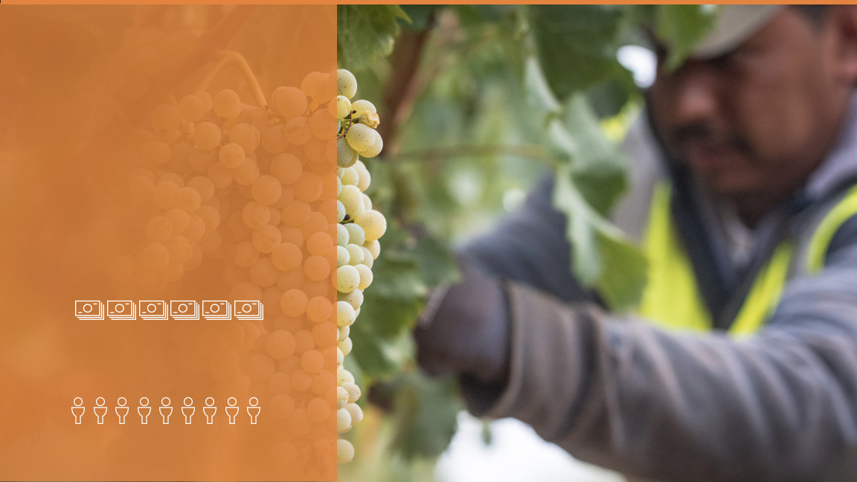
Big Local Impact
$9 billion
annual economic impact
44,000 jobs

Slide 11
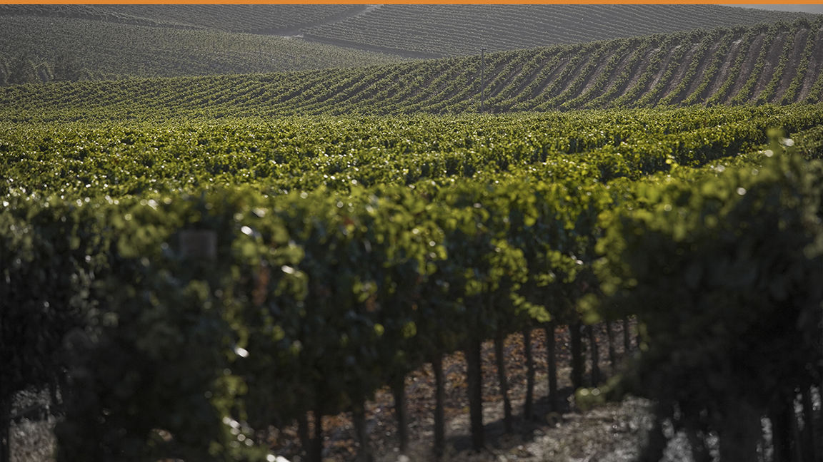
Top Varieties
Cabernet Sauvignon
Chardonnay
Merlot
Sauvignon Blanc
Pinot Noir
Zinfandel
Cabernet Franc
Petite Sirah
Syrah

Slide 12
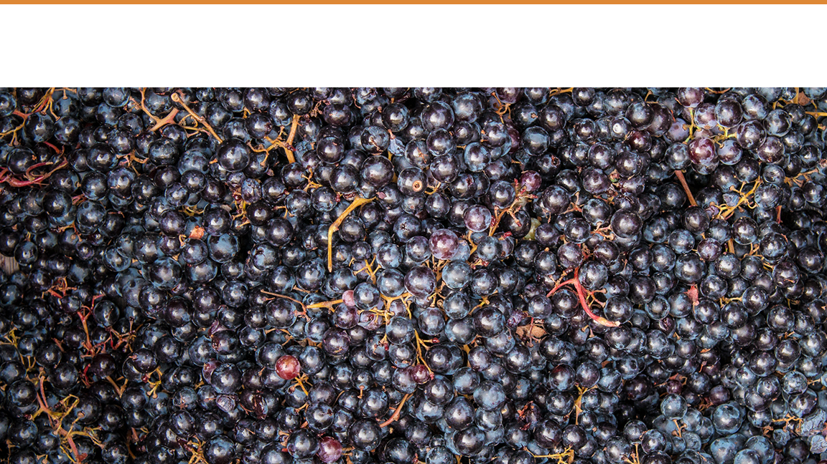
Cabernet Sauvignon
15%
47%
67%
of the total California
wine grape harvest
of the total Napa Valley wine grape harvest
of the value of the
Napa Valley wine
grape harvest

Slide 13
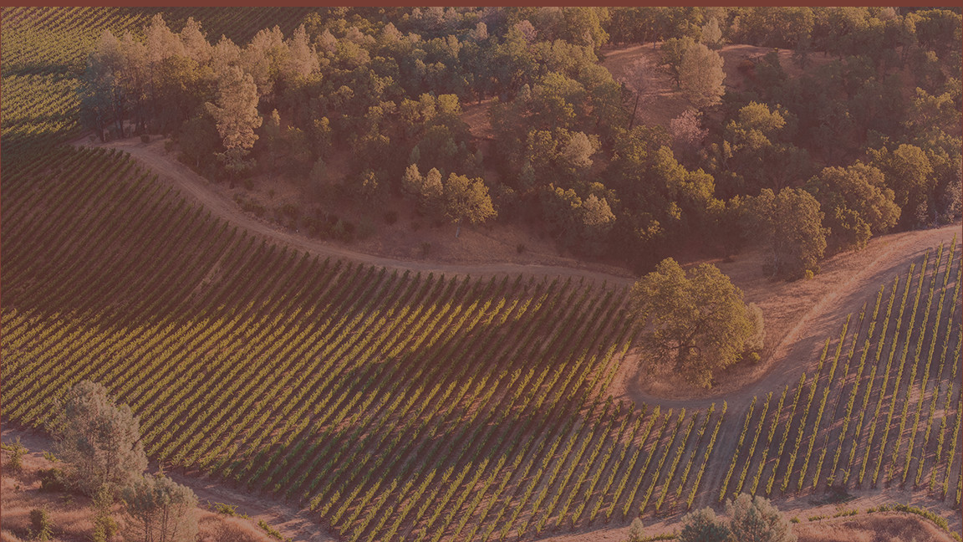
SOILS

Slide 14
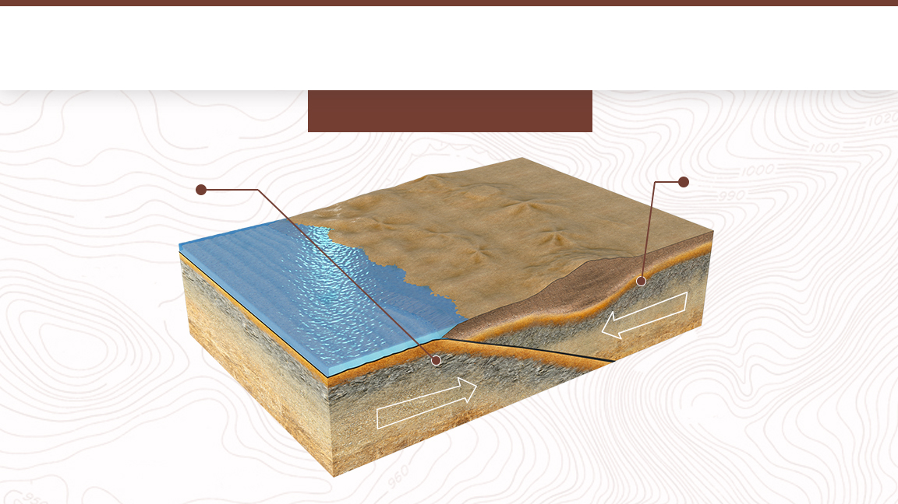
Plates Colliding
150-25 million years ago
Descending
Farallon Plate
North American Plate

Slide 15
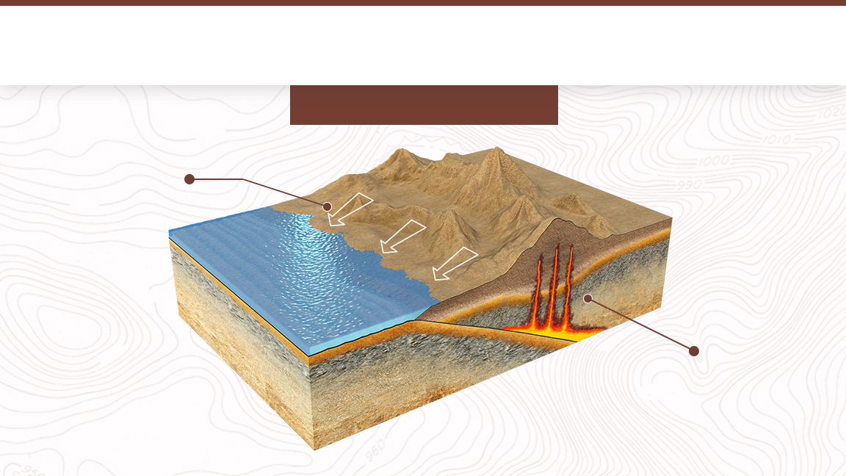
Sierra Nevada / Great Valley Sequence
150-25 million years ago
Mountains
erode, creating sedimentary rock
Magma rises, forming a string of volcanoes along the coast

Slide 16
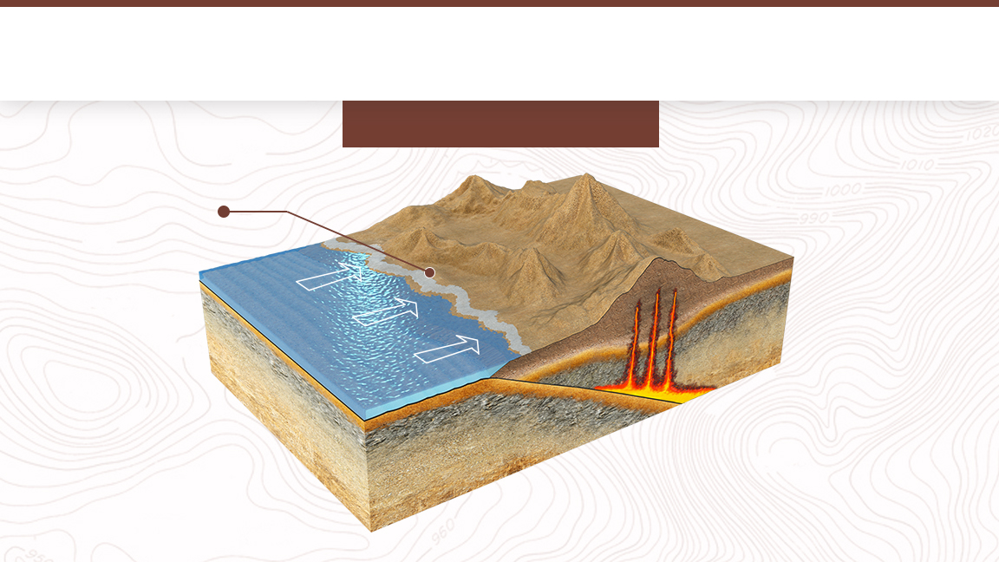
Franciscan Formation
150-25 million years ago
Bits of ocean floor deposited on top of the continent

Slide 17
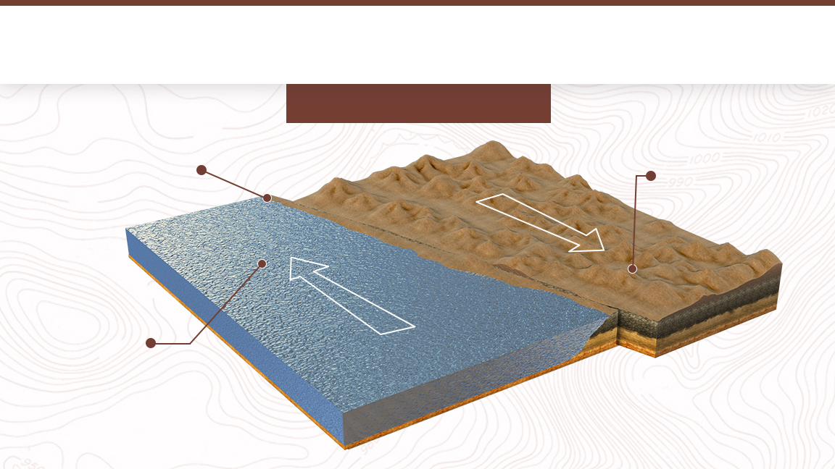
San Andreas Fault
25 million years ago
San Andreas
Fault
Continent moving southward
along fault
Ocean floor moving northward

Slide 18
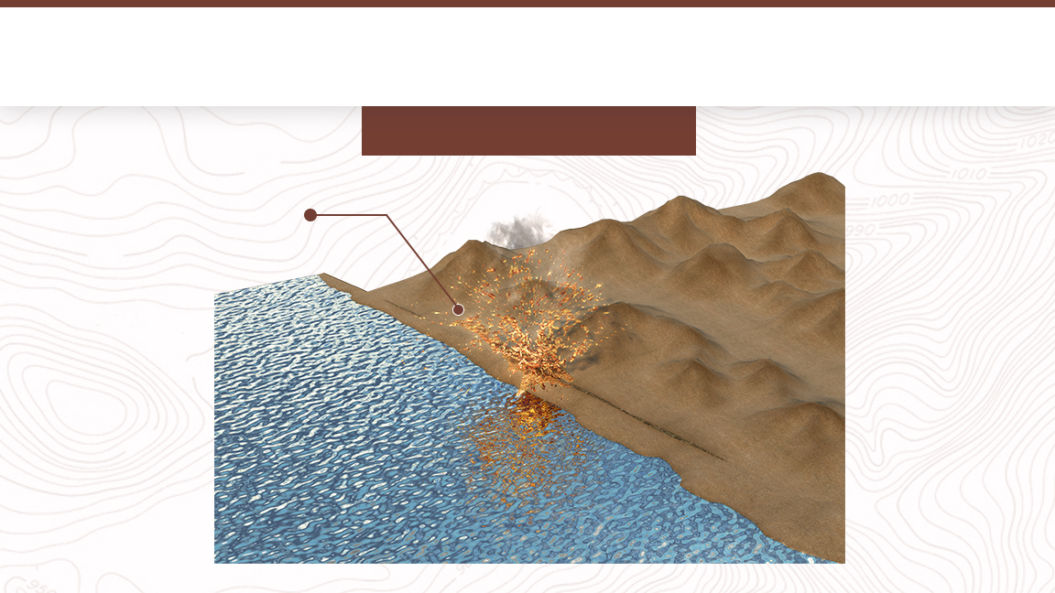
Napa Volcanics
5 million years ago
Lava deposits on top of Franciscan Formation and Great Valley Sequence

Slide 19

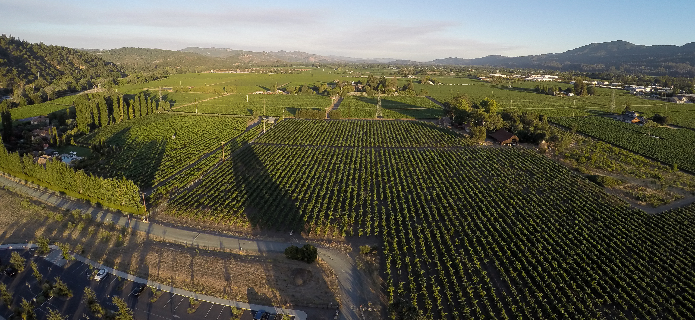
Coast Range Formation
The Vaca and Mayacamas ranges are lifted, creating a valley in between

Slide 20
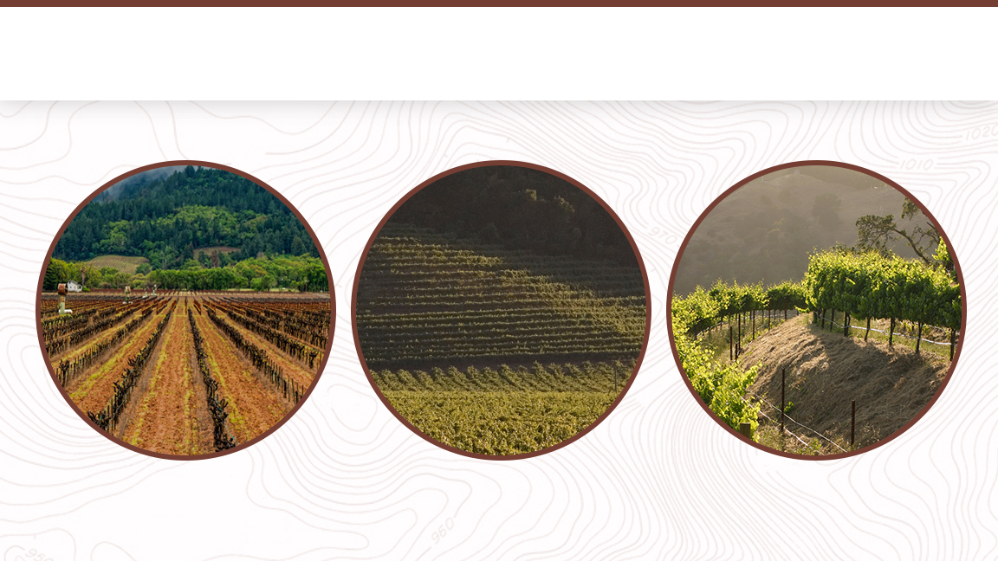
Soils of the Napa Valley
Fluvial
Alluvial
Mountain

Slide 21
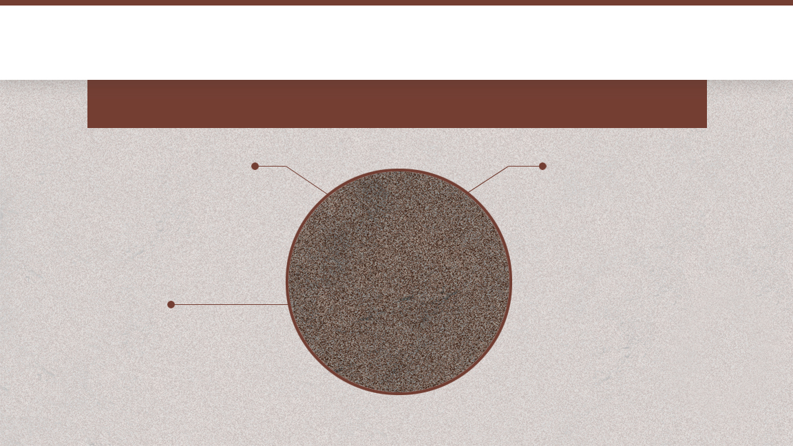
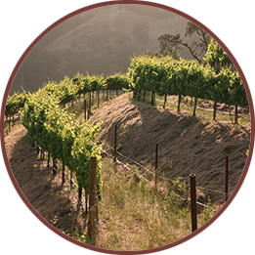
Mountain Soil
Thin, rocky soils that cling to hillsides as vines struggle to survive
SOIL-FORMING PROCESS
Created in place
WINE STYLE
Small, intensely flavored wines with structured tannins and complex aromatics
PROVENANCE
The primary breakdown of underlying bedrock

Slide 22
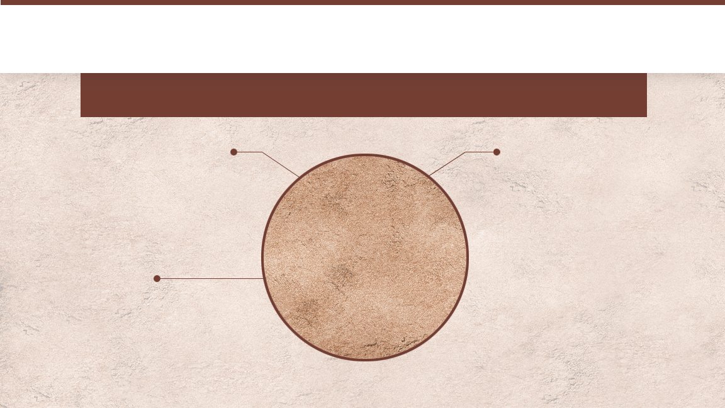
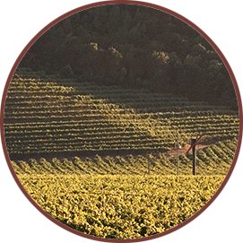
Alluvial Fans
Deep, rocky and well-drained soils with moderate fertility
SOIL-FORMING PROCESS
Settles at the base of a mountain after being washed downhill along a stream
WINE STYLE
More fruit forward with less aggressive tannin structure than wines grown on mountain soils, although more so than with wines from Fluvial soils
PROVENANCE
The product of bedrock material found on the hillside above

Slide 23
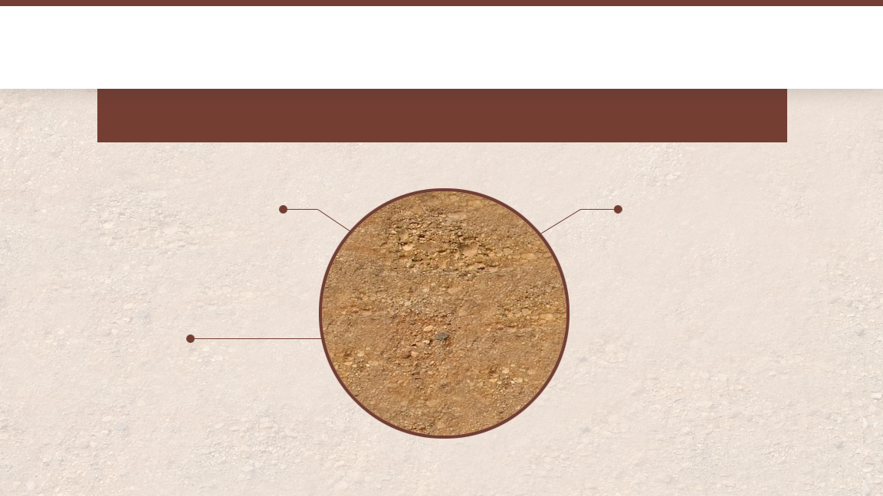
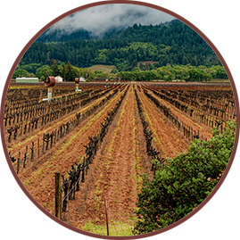
Fluvial Soil
Silts and clays deposited along banks of the Napa River
SOIL-FORMING PROCESS
Silts and clays deposited along riverbank as floodwaters rise and recede over the years
WINE STYLE
Lush and generous fruit-forward wines
PROVENANCE
All bedrock material
along the hillsides upriver

Slide 24
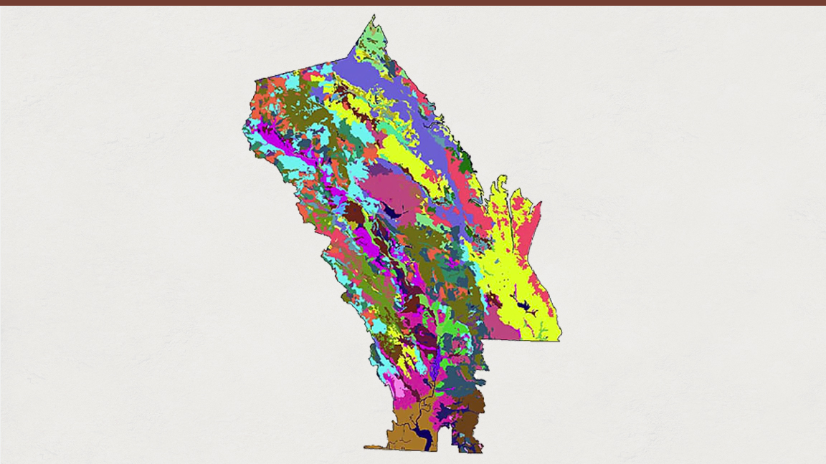
50% of the world’s soil orders
33 soil series
Incredible Soil Diversity
© Terra Space Inc. 2003

Slide 25
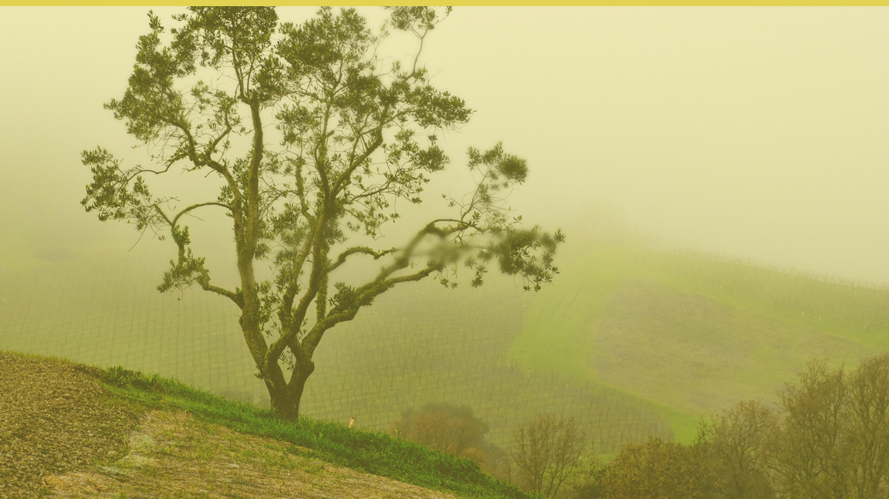
CLIMATE

Slide 26
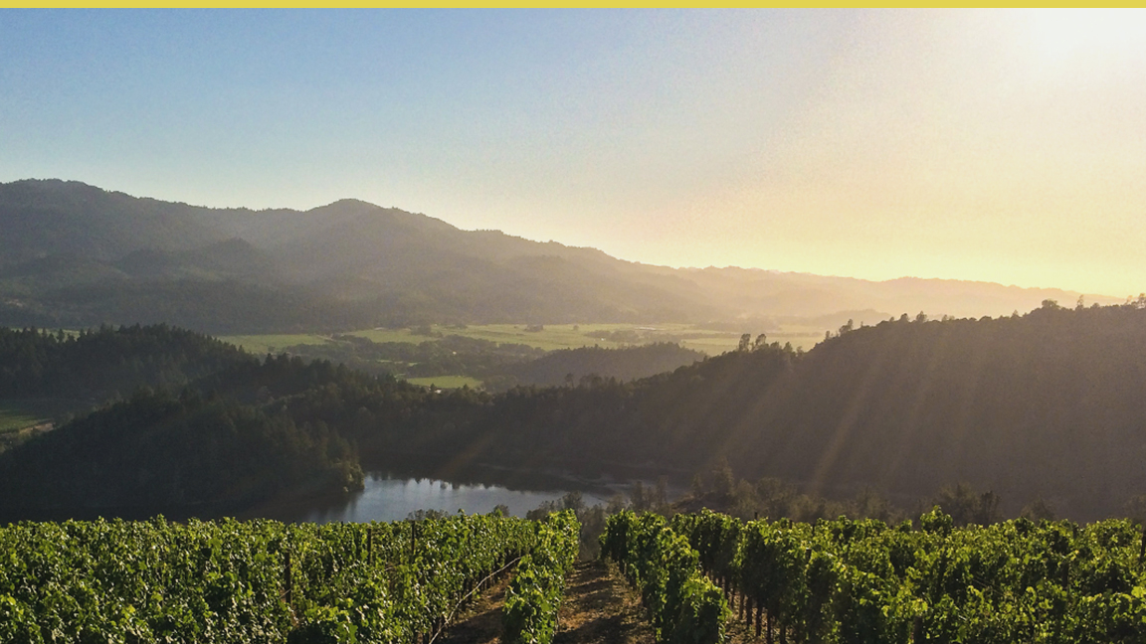
Mediterranean
Climate
2% of Earth's surface

Slide 27
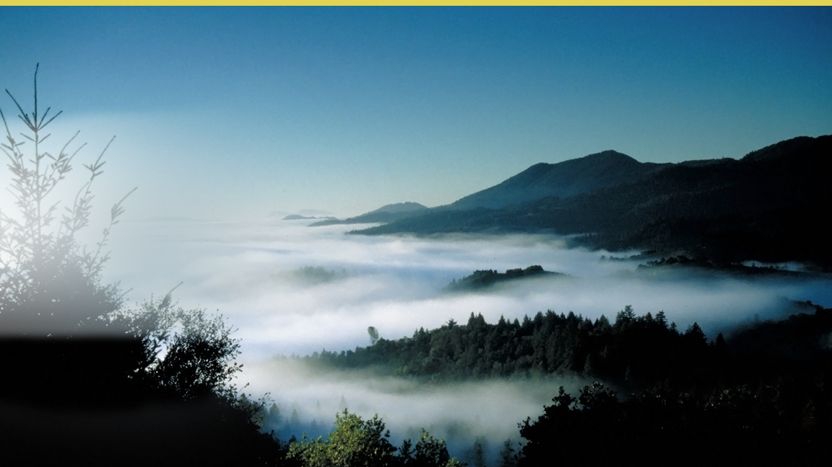
Fog in Napa Valley
Hot air rises, drawing in moist, cool air
from the Pacific Ocean, forming fog

Slide 28
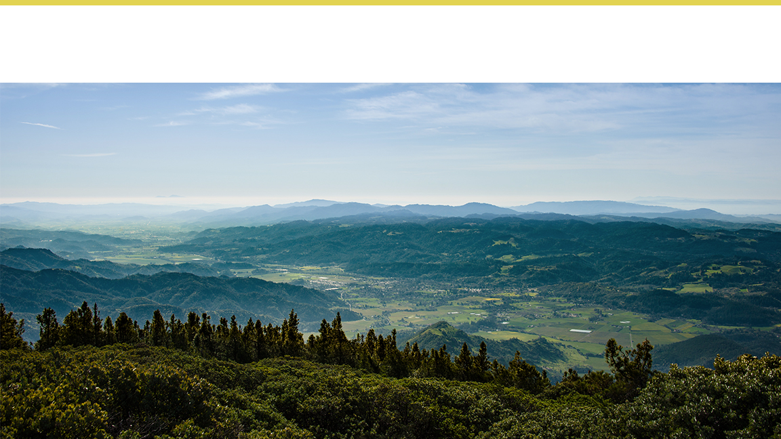
Average Annual Rainfall
SOUTH VALLEY FLOOR
18 in / 46 cm
MOUNTAINS
> 40 in / 102 cm
NORTH VALLEY FLOOR
35 in / 89 cm

Slide 29
Elevation and Topography
MOUNTAIN RANGES
2,000+ feet
SOUTH VALLEY FLOOR
Sea level in the south
NORTH VALLEY FLOOR
350 feet in the north

Slide 30
Temperature
Typical Summer Highs/Lows
SOUTH VALLEY FLOOR
Low 60°F/High 80°F
MOUNTAINS
Warmer lows/Cooler Highs
NORTH VALLEY FLOOR
Low 50°F/High 90°F

Slide 31
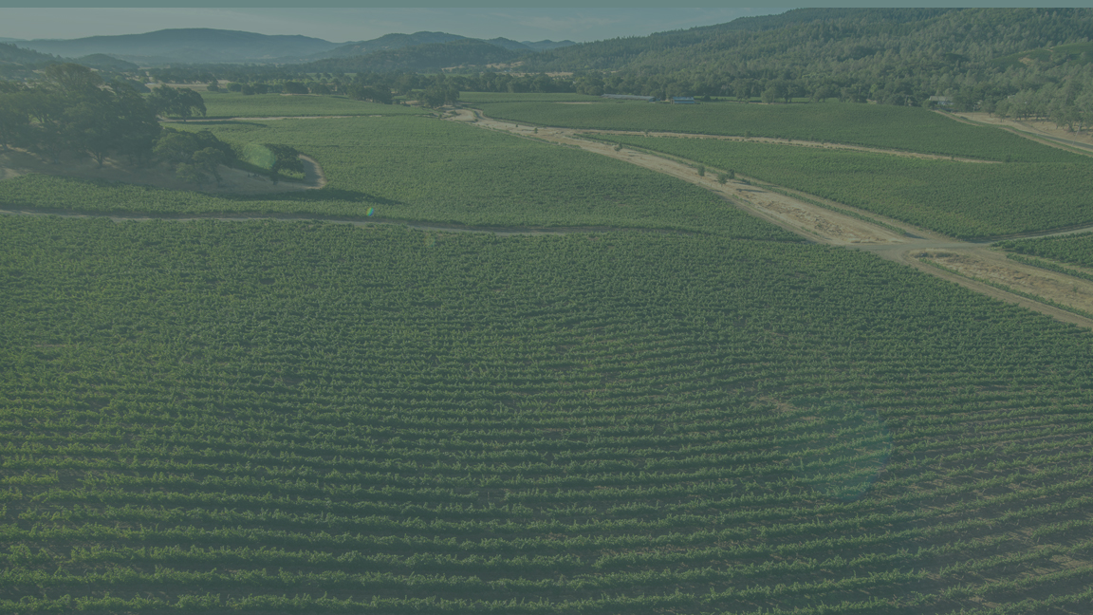
VITICULTURE

Slide 32
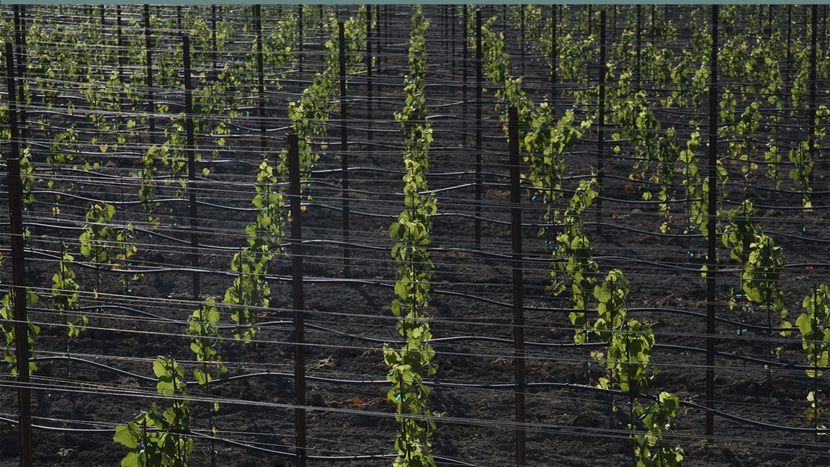
The diversity of soil types and climates allows vintners to select
the right varieties for the right places

Slide 33
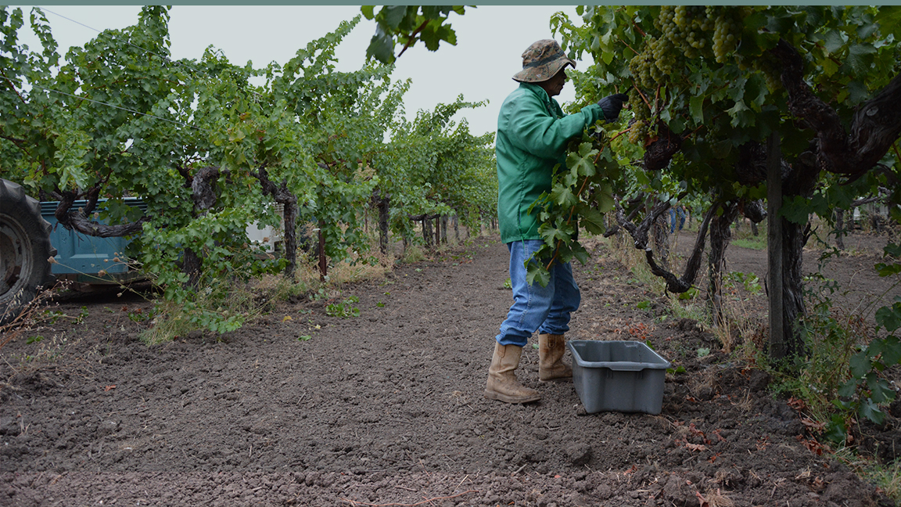
When farming a vineyard, a grower is able to use both time-tested
farming methods and the latest technology

Slide 34

Terroir and Viticulture
SITE SELECTION
Soil Composition
Topography
Microclimate Conditions
Sun Exposure
Drainage
VITICULTURAL PRACTICES
Vine Material Selection
Soil Management
Irrigation Techniques
Trellising and Canopy Management

Slide 35
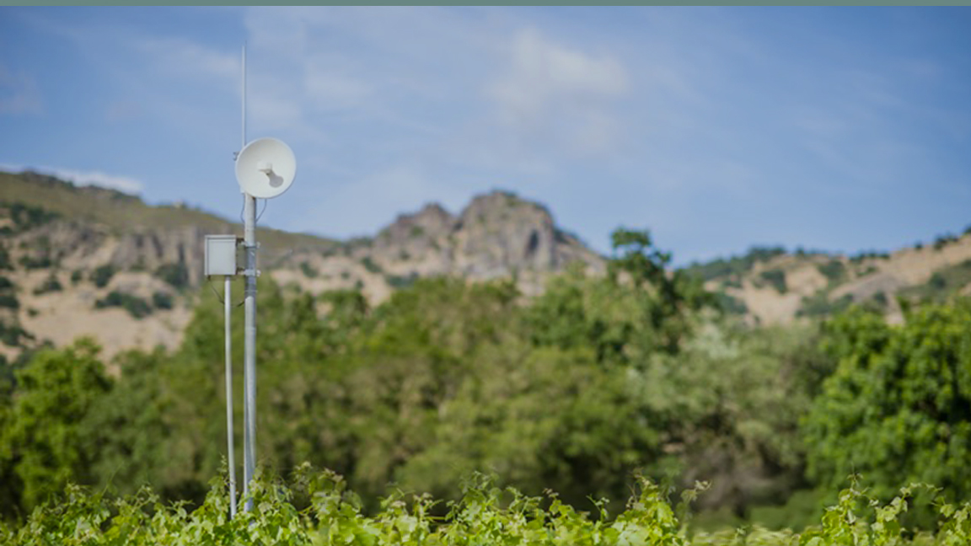
Napa Valley growers harness the latest technology in the vineyard

Slide 36
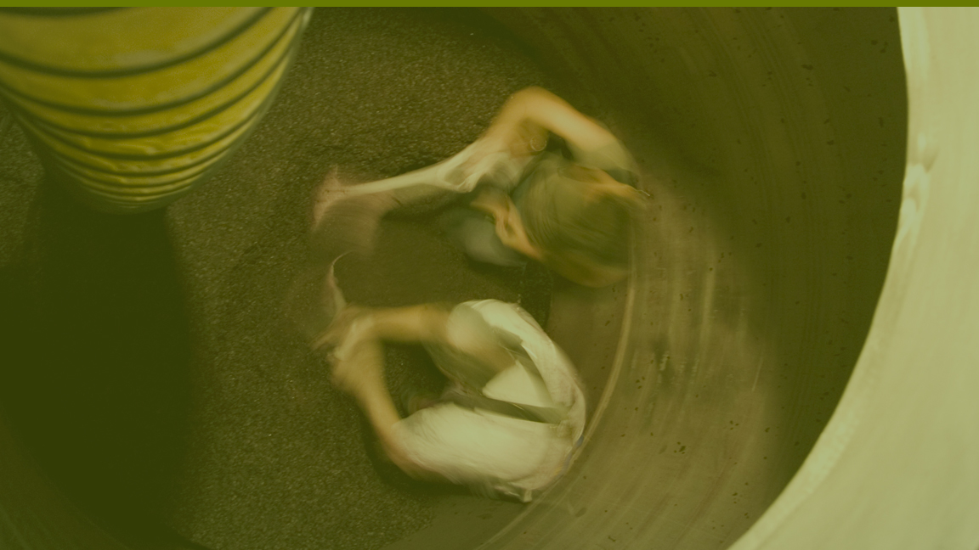
WINEMAKING

Slide 37
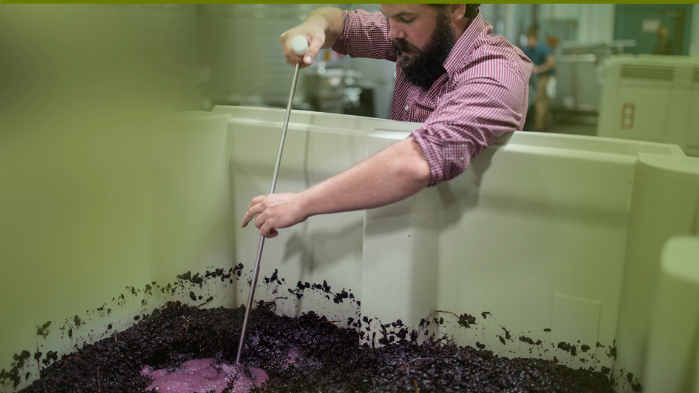
Winemakers
ferment grapes with the same attention to detail that began in
the vineyard

Slide 38
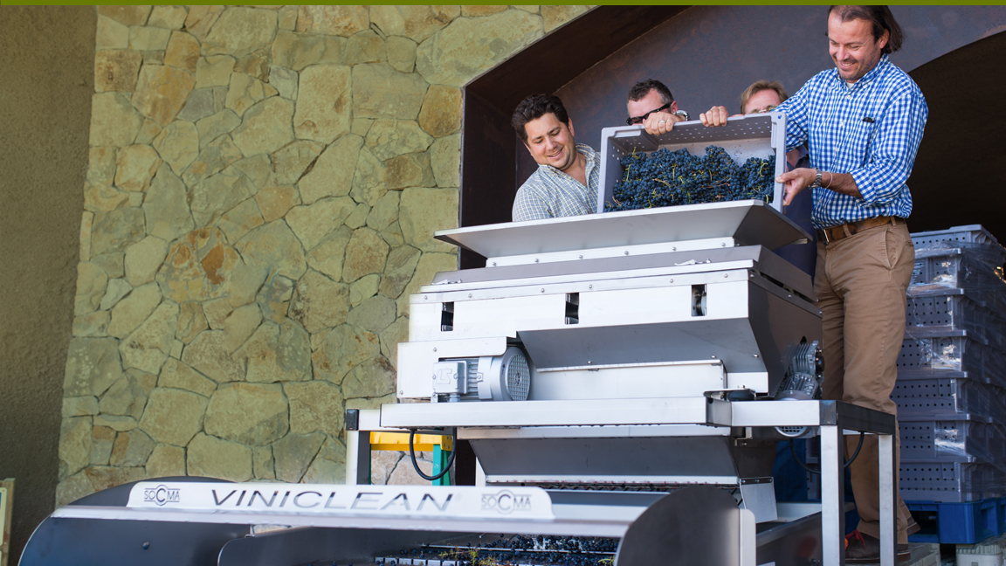
Winemakers use the best equipment and technology
to ensure gentle handling of the fruit and wine in the winery

Slide 39
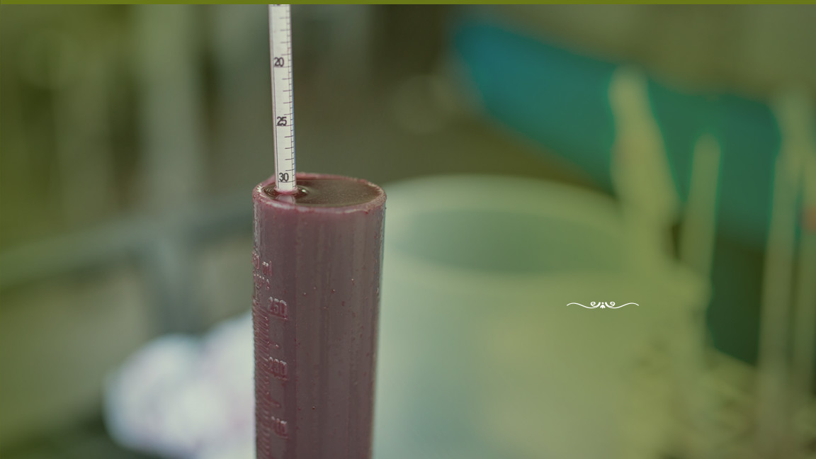
Winemakers in the Napa Valley
continuously evaluate
their wines to ensure quality

Slide 40
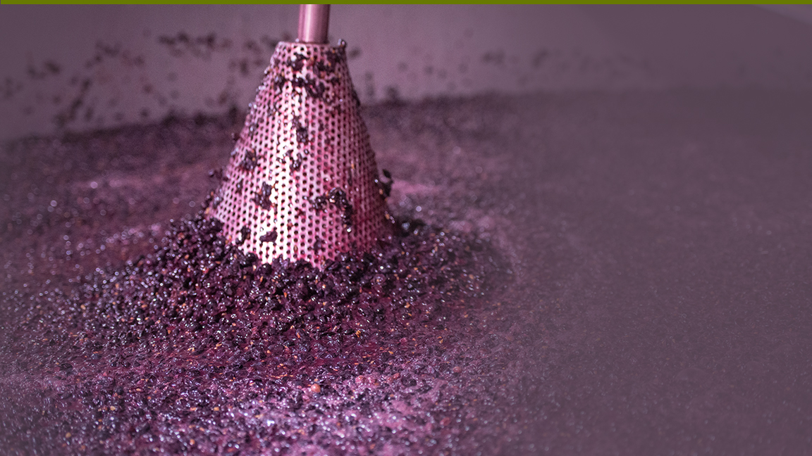
Experimentation
Winemakers routinely try new technology to push the quality envelope forward.

Slide 41
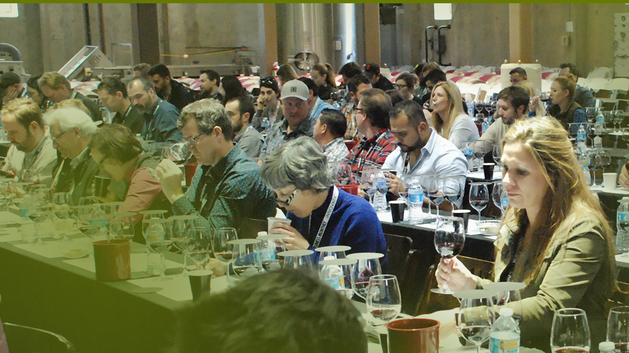
There is a culture of
collaboration
and education
within Napa Valley’s winemaking community

Slide 42
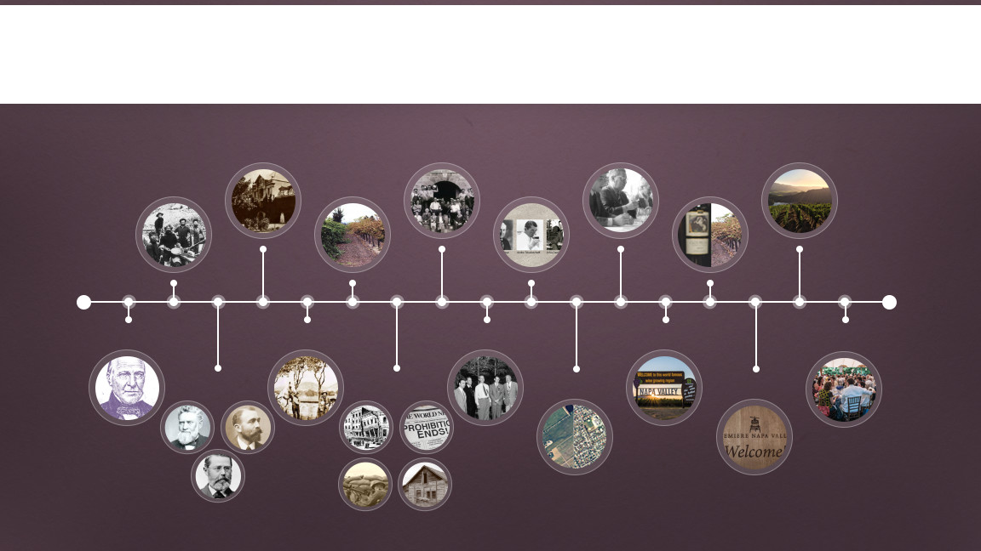
History
1879—1900
1933
1976
2000s
Late 1980s–Early 1990s
1848—1855
1890s
1933–1960s
1838–1839
1889
1944
1981
Today
1860s–1870s
1906–1933
1968
1997

Slide 43

1838–39
WINEMAKING IN THE NAPA VALLEY BEGINS
George Calvert Yount, founder of the town of Yountville, plants the first vineyards
1830
1860
1900
1940
1980
1990
Present

Slide 44
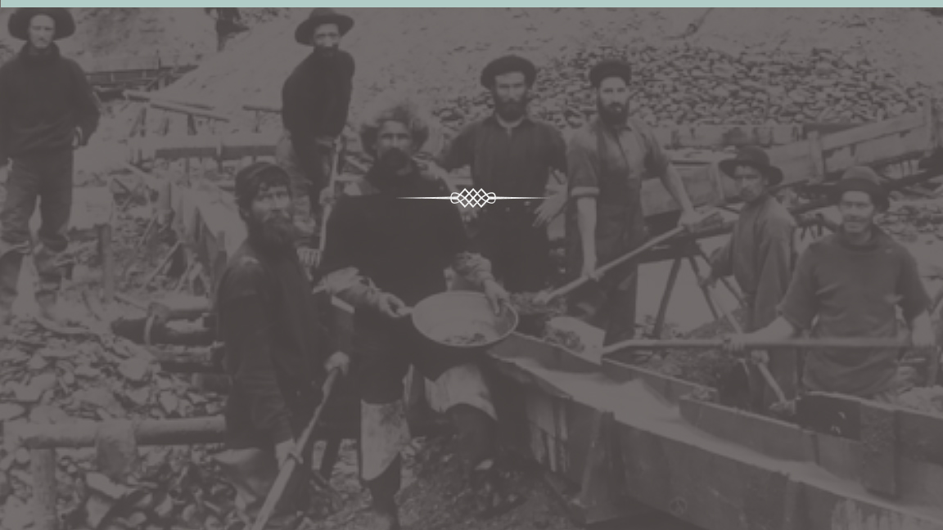
1848–1855
THE GOLD RUSH AND THE FIRST WAVE
San Francisco grows from a settlement of 200 in 1846 to a city of 36,000 by 1852
1830
1860
1900
1940
1980
1990
Present

Slide 45
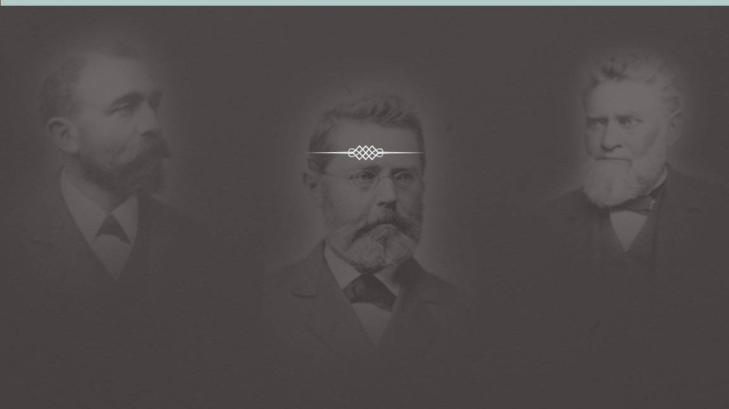
1860s–1870s
THE BIRTH OF AN INDUSTRY
Europeans including Jacob Schram, Charles Krug,
and Jacob Beringer, try their hands at making
wine to rival the wines from their homelands
1830
1860
1900
1940
1980
1990
Present

Slide 46
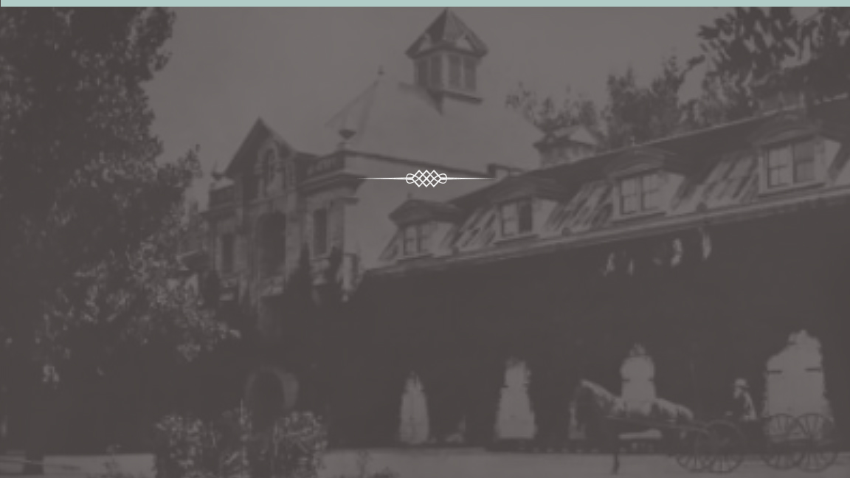
1879–1900
THE QUALITY REVOLUTION
Gustave Niebaum, a Finnish fur trader, establishes
Inglenook and H.W. Crabb establishes To Kalon and
grows more than 400 grape varieties
1830
1860
1900
1940
1980
1990
Present

Slide 47
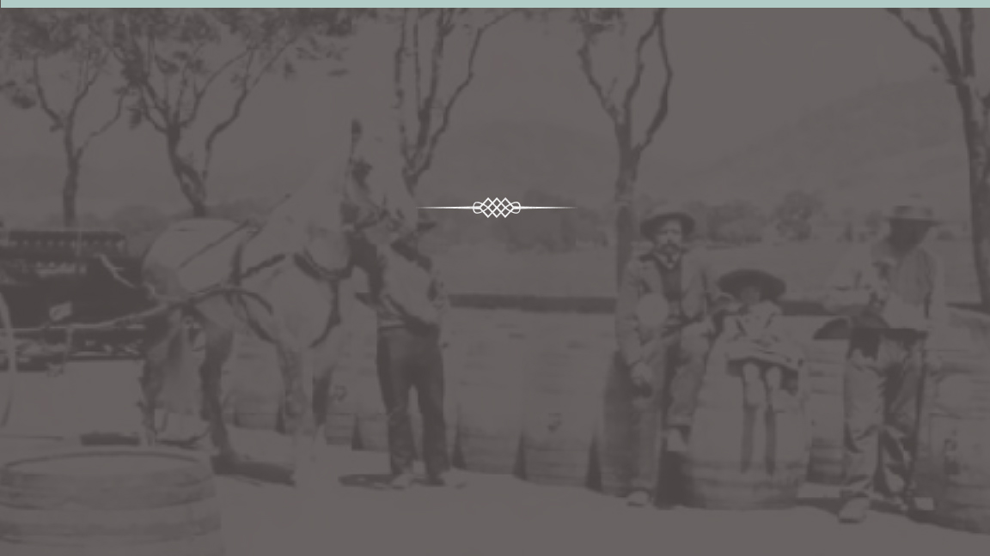
1889
THE FIRST BOOM
Napa Valley has more than 140 wineries
1830
1860
1900
1940
1980
1990
Present

Slide 48
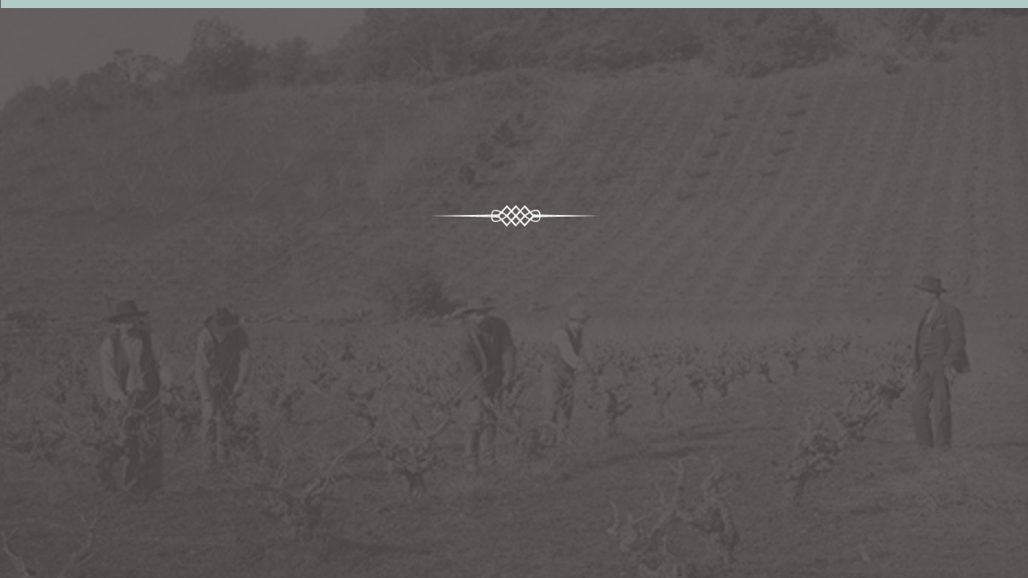
1890s
WEATHERING STORMS: PHYLLOXERA
Grapevine acreage decreases from
15,807 to 2,000 in just 12 years.
1830
1860
1900
1940
1980
1990
Present

Slide 49

1906–1933
WEATHERING STORMS
1906
The San Francisco Earthquake destroys 30 million gallons of California wine
1920-1933
The enactment of Prohibition lasts 13 years
1917
The United States enters World War I
1929
The Great Depression hits
1830
1860
1900
1940
1980
1990
Present

Slide 50
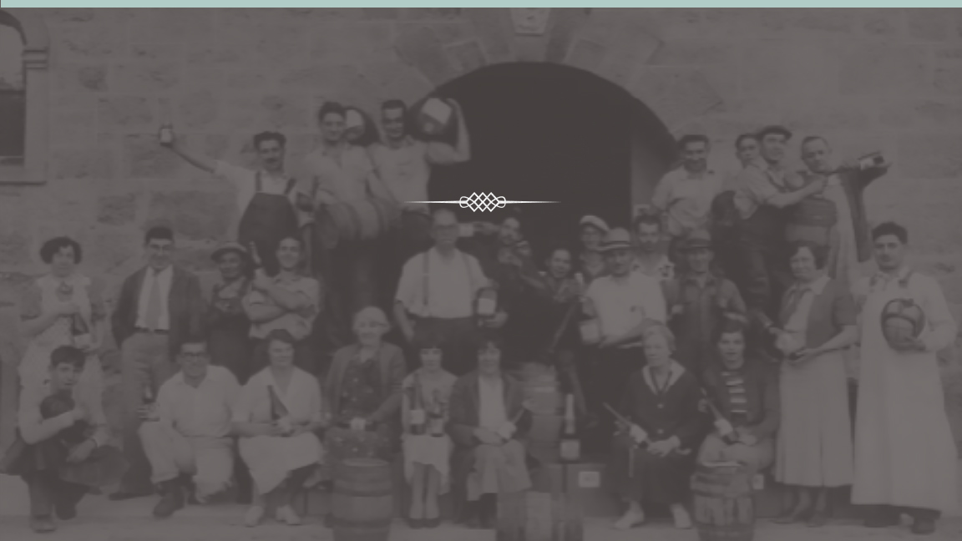
1933
RECOVERY
After Prohibition is repealed, Napa Valley begins the slow road to recovery
1830
1860
1900
1940
1980
1990
Present

Slide 51

1933—1960s
REBIRTH
Napa Valley experiences a renaissance
led by bold and visionary vintners like
Georges de Latour, Andre Tschelischeff,
John Daniel Jr. and the Mondavi family
1830
1860
1900
1940
1980
1990
Present

Slide 52
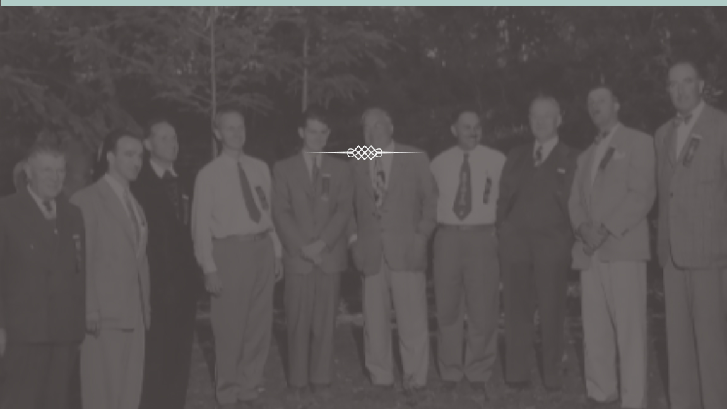
1944
NAPA VALLEY VINTNERS IS BORN
“We are stronger together than individually”
1830
1860
1900
1940
1980
1990
Present

Slide 53
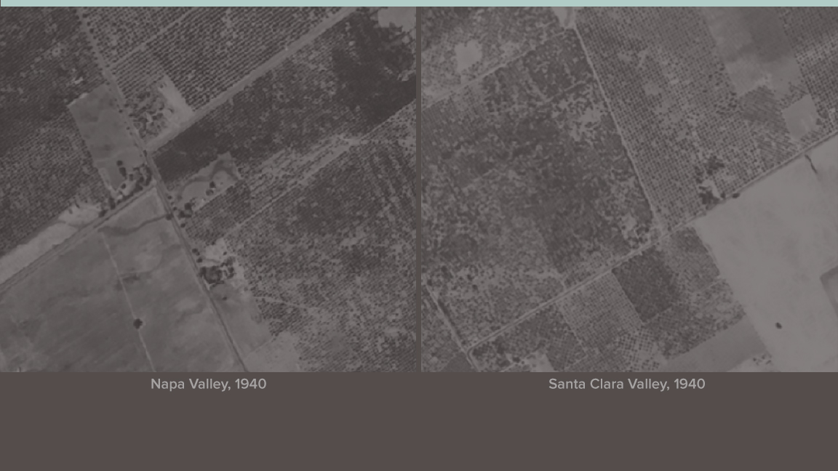
1968
NAPA VALLEY AGRICULTURAL PRESERVE FOUNDED
It is the first agricultural preserve in the United States
1830
1860
1900
1940
1980
1990
Present

Slide 54

1968
NAPA VALLEY AGRICULTURAL PRESERVE TODAY
1830
1860
1900
1940
1980
1990
Present

Slide 55

1976
THE PARIS TASTING
Known as “the vinous shot heard ‘round the world,’ this event puts Napa Valley on the wine map
1830
1860
1900
1940
1980
1990
Present

Slide 56

1981
NAPA VALLEY RECOGNIZED AS AMERICAN VITICULTURAL AREA
California's first AVA
1830
1860
1900
1940
1980
1990
Present

Slide 57

1981
CARING FOR THE COMMUNITY
Inaugural Auction Napa Valley
1830
1860
1900
1940
1980
1990
Present

Slide 58

Late 1980s
and Early 1990s
CONJUNCTIVE LABELING
QUALITY REVOLUTION
1830
1860
1900
1940
1980
1990
Present

Slide 59

1997
INAUGURAL PREMIERE NAPA VALLEY
Napa Valley Vintners creates Premiere Napa Valley,
an auction of one-of-a-kind wines for the wine trade
1830
1860
1900
1940
1980
1990
Present

Slide 60

2000s
NAPA GREEN
Wine industry’s most rigorous programs
further protect the environment
1830
1860
1900
1940
1980
1990
Present

Slide 61

2000s
GLOBAL NAME PROTECTION
Through a variety of efforts and initiatives, NVV works to protect the Napa Valley name
1830
1860
1900
1940
1980
1990
Present

Slide 62

Today
NAPA VALLEY WINE INDUSTRY THRIVING
Vintners continue to strive for even higher quality wines
1830
1860
1900
1940
1980
1990
Present

Slide 63

Today
NAPA VALLEY WINE INDUSTRY STRIVING
NVV's 2020 Goal:
All eligible wineries certified Napa Green
1830
1860
1900
1940
1980
1990
Present

Slide 64

Today
CARING FOR THE COMMUNITY
Auction Napa Valley has given more
than $180 million since 1981
1830
1860
1900
1940
1980
1990
Present

Slide 65

Today
SOCIAL SUSTAINABILITY
Adopt-a-School
Napa Neighbor Program
Morning in Winery
Afternoon in Vineyards
Vine Trail
1830
1860
1900
1940
1980
1990
Present

Slide 66

NAPA VALLEY VINTNERS

Slide 67

Our mission
To promote, protect and enhance the Napa Valley

Slide 68

Promoting
the Valley
Auction Napa Valley
Premiere Napa Valley
Trade Education Programs
Taste Napa Valley
Media Relations

Slide 69

Protecting
the Valley
Community Investment
Name Protection
Advocacy
Sustainability

Slide 70

Fostering
Collaboration
Within the
Industry
As Robert Mondavi was often quoted, "In Napa Valley,
a rising tide lifts all boats."

Slide 71

Top 5 Takeaways
1
Extraordinary Place
Quality Wines
Culture of Collaboration
Thriving Industry
Long History of Cultivating Excellence
2
3
4
5

Slide 72

Learn More
NapaVintners.com
@napavintners
/NapaVintners
@NapaVintners

