Slide 1
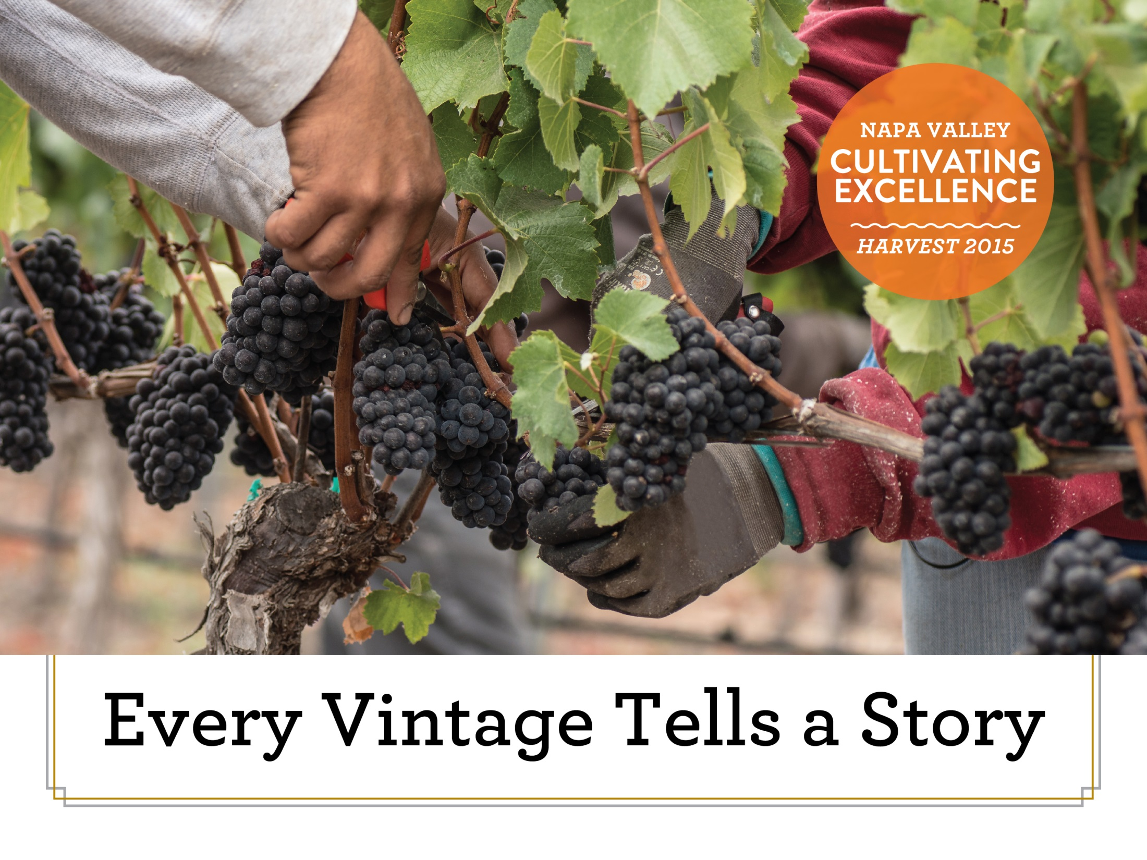
HARVEST NAPA VALLEY 2014
- CULTIVATING EXCELLENCE -
Notes:
Overview
There are many great wine regions and Napa Valley is one of them. Napa Valley is the home to world class wines and is a region of incomparable natural beauty. Though accounting for just 4% of California’s harvest and .04% of the world’s total wine production, Napa Valley is the industry’s undisputed leader in land and community stewardship and is renowned the world over for its extraordinary wines.
The following slides will demonstrate the diversity of Napa Valley and the many steps that Napa Valley growers and winemakers take throughout the year to craft the world-class wines that consumers have come to expect.

Slide 2
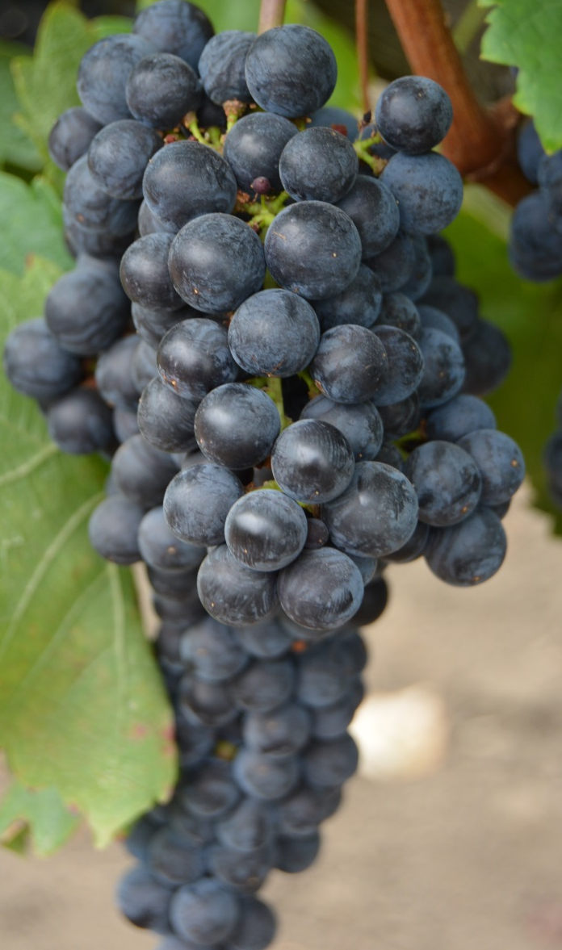
The Diversity of Napa Valley
Top Red Varieties
Cabernet Sauvignon
Merlot
Pinot Noir
Zinfandel
Cabernet Franc
Top White Varieties
Chardonnay
Sauvignon Blanc
Notes:
Diversity of the Napa Valley In addition to being one of the world’s premiere wine regions, Napa Valley is one of the most diverse with vineyards stretching from cool San Pablo Bay in the south to warmer areas like Calistoga in the north. The Napa Valley AVA includes vineyards near sea level on the valley floor all the way to a couple thousand feet in mountain AVAs like Howell Mountain, Mount Veeder, Spring Mountain, Diamond Mountain and Atlas Peak. And, because of the area’s complex geologic history, the Napa Valley AVA includes half of the world’s soil orders.
Because of Napa Valley's diverse soils, topography and climate, vintners are able to produce a wide array of varieties ranging from Albarino to Zinfandel. There are more than 35 different varieties planted in the Napa Valley.
While Napa Valley is most know for Cabernet Sauvignon, it produces a variety of red wines that you typically wouldn’t see grown within a single region. Carneros, with it’s cool bay influence, is ideal for cool weather varieties like Pinot Noir. On warm summer days, the high temperatures in Carneros are often more than 10 degrees cooler than in places further north where you are more likely to find Cabernet Sauvignon.
In addition to red grapes, the Napa Valley also produces an array of white grape varieties. Carneros is also home to world class Chardonnay, another cool weather variety. Sauvignon Blanc, the second most widely planted white grape, grows throughout the valley. Other white varieties such as Pinot Gris, Semillon and Viognier are planted throughout the valley.

Slide 3
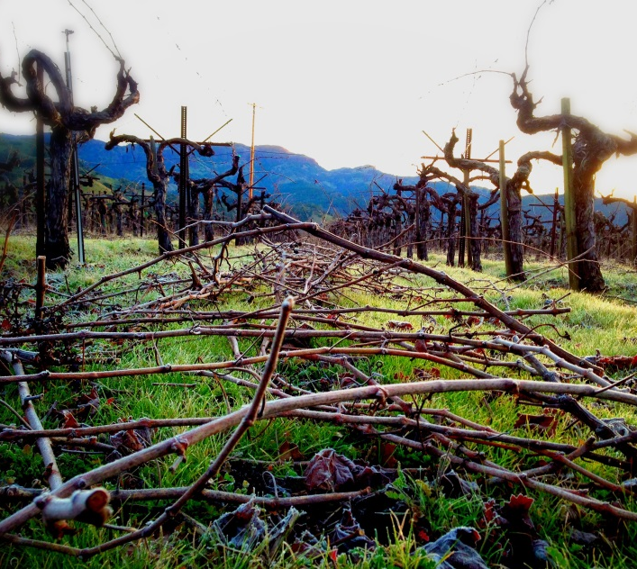
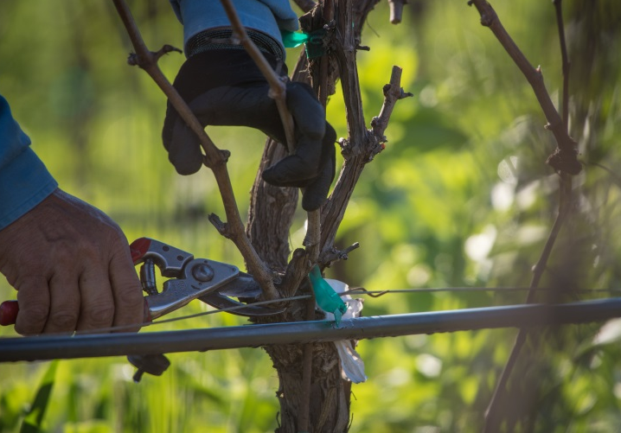
Winter Pruning
Winter pruning , which removes the vast majority of last-year’s growth, sets the stage for the upcoming year by ensuring that the vine is a manageable size.
As a result, our winter pruning practices are thoughtfully tailored to grape variety and climate.
The purpose is to set the pattern of growth for the coming growing season.
Notes:
Winter Pruning
Every growing season begins in the winter with the pruning of the grape vines. Pruning is a highly skilled vineyard practice that takes place when the vines are dormant. In Napa Valley, much of this work is done by vineyard workers who are year-round employees.
Pruning, which removes the vast majority of last-year’s growth, set’s the stage for the upcoming year by ensuring that the vine is a manageable size and determining the next year’s yield.
Pruning guides the vine’s growth to ensure optimal development.

Slide 4
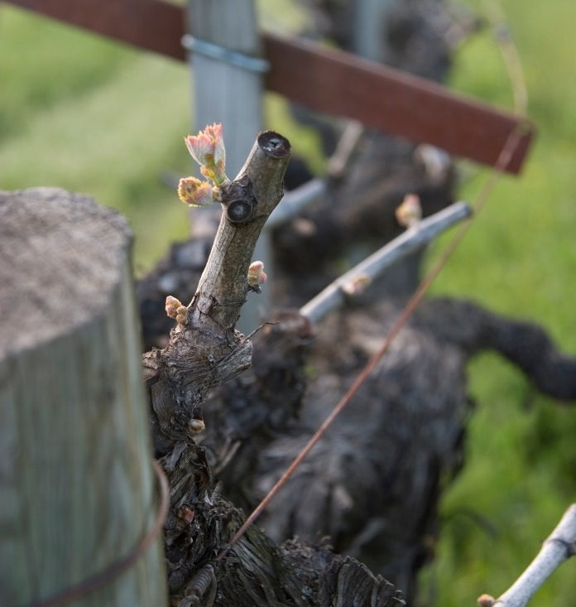
Bud Break
The first tender buds of the growing season emerge from the dormant vine.
The threat of frost is highest at this time, especially on the valley floor.
Depending on vine variety and vineyard location, bud break can take place over a two month period throughout Napa Valley.
Notes:
Bud Break
The first tender buds of the growing season emerge from the dormant vine in early spring. Depending on vine variety and vineyard location, bud break can take place over a two month period. With such great viticultural diversity, one might think that Napa Valley is quite large. However, our little region is only 30 miles long by five miles wide at its widest point. The region has just one-sixth of the vineyard acreage of Bordeaux.
Frost is a major concern at this stage of development. When there is danger of frost, vintners and growers take steps to protect the tender young shoots, including the use of large fans to circulate the cold air; sprinkling the vines with water to coat them in a blanket of protective ice; and use of heaters to warm the air temperature in the vineyard.

Slide 5
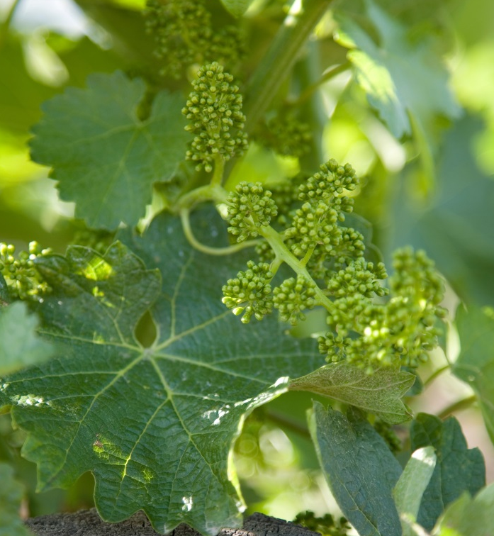
Flowering
In a short time, the vines will develop tight bunches of tiny flowers.
Each flower has the potential to form a single grape berry.
Grapevines are self pollinating, and cold, rainy weather at this time can interfere with this process.
Notes:
Flowering
After a month or so of vegetative growth, a vine will develop tight bunches of tiny flowers. Grape flowers are self pollinating, meaning that they do not require bees or other insects to fertilize them. Each flower has the potential to form a single grape berry. Wind and rain can be a major issues at this stage in the game causing flowers to not get fertilized.
In the Napa Valley, grapes grow in a wide variety of meso-climates and at different elevations, all determining how long it takes a vine to mature from bud break to flowering. Elevations range from sea level to 2,600 feet. The variance in temperature from the cooler, southern Carneros region, with its San Pablo Bay influence, to the northern Calistoga sub appellation, can be ten degrees Fahrenheit or more. As a result, the period of flowering can stretch over two-months, depending upon the particular vineyard location.

Slide 6
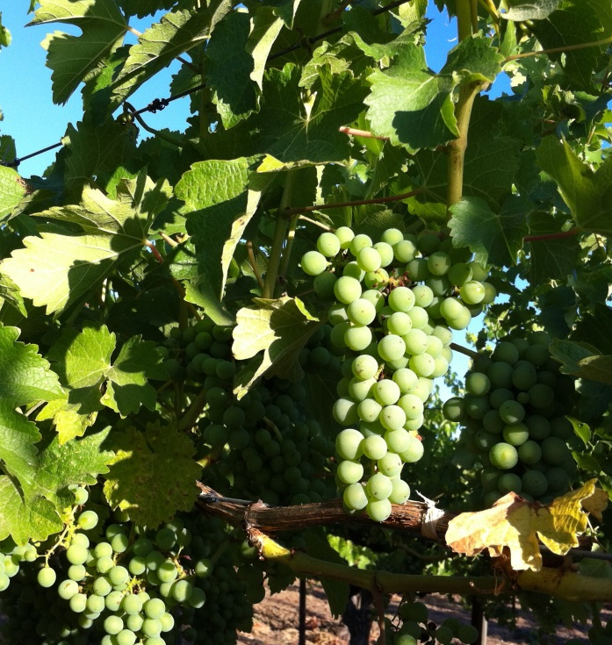
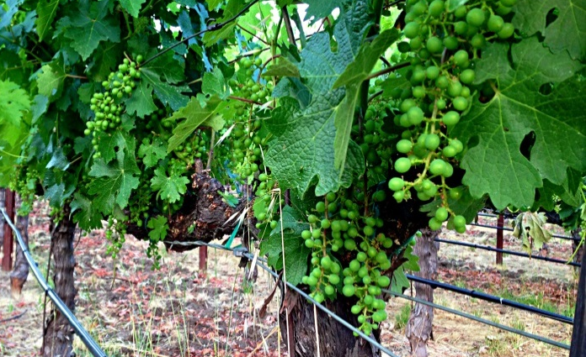
Fruit Set
As the flowers drop, a tiny, green sphere begins to emerge.
Once set, the fruit will begin to ripen under the influence of Napa Valley’s warm, dry Mediterranean climate.
Notes:
Fruit Set
As the now-pollinated flowers drop their petite petals, a tiny, green sphere begins to emerge at the end of the stem. As these little grapes grow, bunches begin to take their familiar shape. In this stage, grapes undergo physical development forming their seeds and growing larger in size without really increasing in sweetness.
Frost is still a concern, with vintners keeping an eye on the weather on an almost moment by moment basis. Once set, the fruit will begin to ripen under the influence of Napa Valley’s warm, dry Mediterranean climate. This unique climate is found on only 2% of the earth’s surface and contributes to the consistent quality found in Napa Valley’s wines.

Slide 7
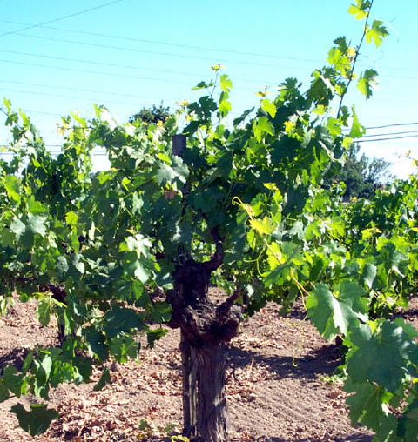
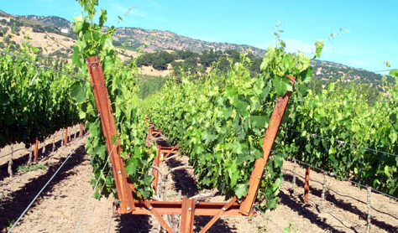
Canopy Management
The vigorous shoot growth of the spring must be managed to ensure optimal grape production and ripening.
A variety of decisions, such as leaf removal and shoot thinning, must be made at different times.
The goal is to achieve the perfect balance of shade, sunlight and air circulation around each grape bunch.
Notes:
Canopy Management
At a certain point, the vigorous shoot growth that has occurred during the spring must be managed to ensure optimal grape production and ripening.
A complex process, canopy management refers to a variety of decisions and actions related to leaf removal, vigor management, shoot thinning and shoot positioning. The goal is to achieve the perfect balance between shoot growth and the fruit and also ensure the proper amount of shade, sunlight and air circulation around each grape bunch to promote optimal ripening. In Napa Valley vineyard workers often make more than 20 passes through a single row of vines each year, part of our artisan approach to agriculture.

Slide 8
Veraison
All grape varieties begin their yearly journey green in color – it is not until mid-summer that grape pigmentation develops.
Veraison marks the shift between berry growth and berry ripening.
The wide diurnal range in Napa Valley is one of the many reasons why it is such an ideal place to grow fine wine grapes.
Notes:
Veraison
All grape varieties begin their yearly journey green in color. It’s not until mid-summer that red or white grapes reveal their identity to the untrained eye. This period of grape pigment development is called veraison and, just like bud break, occurs over a long period of time, depending on the grape variety and the meso-environment of a particular vineyard site.
Napa Valley experiences wide diurnal temperature swings – the variation between daytime and nighttime temperatures – sometimes as much as 30-40 degrees Fahrenheit. It’s one of the many reasons why Napa Valley is such an ideal place to grow fine wine grapes. The heat of day promotes ripeness and sugar development in the grapes. The cooler, often fog-infused nights help the grapes to retain acidity and freshness, resulting in beautifully balanced flavors. After veraison, grapes become increasingly sweet as they ripen.

Slide 9
Crop Thinning
To ensure the highest quality grapes, Napa Valley growers will purposefully thin the crop.
Also know as dropping fruit or green harvesting, this practice ensures those bunches left on the vine achieve optimum ripeness.
As a result, our vineyards typically yield only half the yield of most other growing regions in California.
Notes:
Crop Thinning
Often called “green harvesting,” crop thinning refers to the dropping of unripe grape bunches that are not perfect and which may not be developing in an even pattern. By doing this, growers increase concentration of flavors in the grapes and ensure that the grapes reach optimal maturity.
This is one of the many ways that grapes in Napa Valley are purposely tended to yield only half the amount of grapes per acre compared to any other wine region in California. And, it’s one of the reasons that Napa Valley’s average price per ton of grapes is approximately five times more than the average California price per ton.

Slide 10
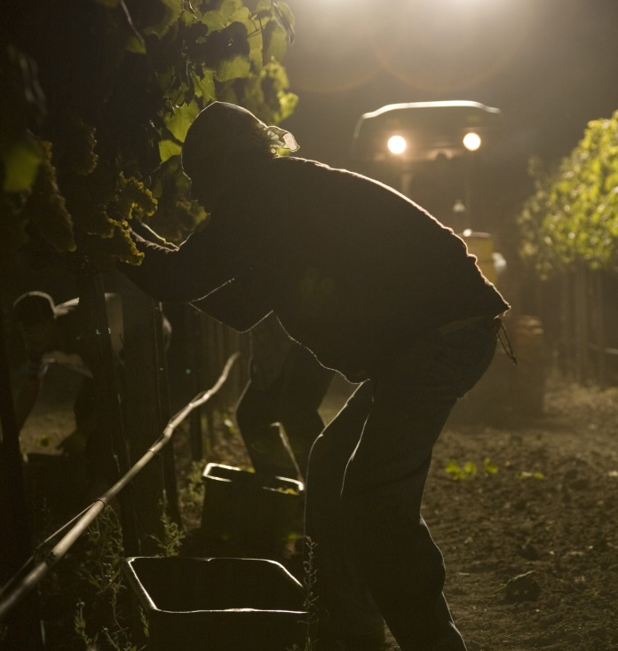
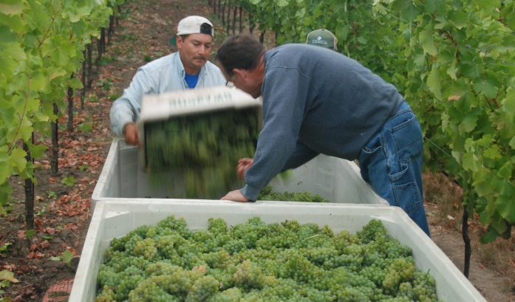
Harvest
The Napa Valley harvest is performed almost entirely by hand and at night and accounts for only 4% of the total California wine grape harvest.
Harvest can begin in late July for sparkling wines and continue through October for Cabernet Sauvignon.
Notes:
Harvest
This is it. Half a year of getting to know each and every vine culminates in a magical moment when we pick our grapes, mostly by hand and often at night. Leading up to harvest, winemakers walk the vine rows almost daily eating a lot of grapes. When the grapes reach optimal flavor development and tannin maturity, they start to pick. Of course, in addition to their taste buds, they also rely on modern lab tests to monitor the basic chemistry of the grapes to back up their taste buds. When to pick is one of the most important decisions winemakers make because it directly impacts the finished wine. Picking at optimal ripeness takes practice.
Since we make all styles of wine in Napa Valley, our harvest usually begins in late July or early August for the grapes that become sparkling wines. Grapes for still white wines are picked next. Harvest continues through late October – sometimes early November - for red varieties. It can last until December for late-harvest dessert wines. Although world-renowned, Napa Valley’s wine grape harvest is quite small – just 4% of California’s total annual harvest. However, wine produced in Napa Valley accounts for 50% of the retail value of all California wine sold.

Slide 11
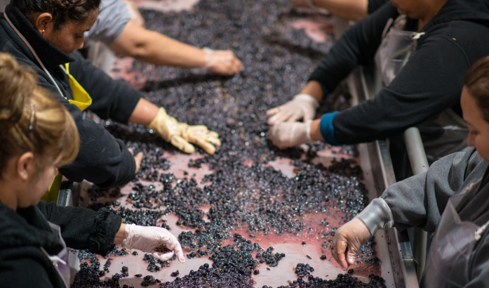
Crush
An artisan approach is employed during crush, tailoring technique to stylistic goals.
Grapes are gently “crushed” and sent to the appropriate vessel to ferment.
Napa Valley winemakers employ some of the latest technology in the pursuit of making the finest possible wine.
Notes:
Crush
After harvest, Mother Nature’s job is over and it’s the winemakers job to turn the fruit into wine.
Once the grapes are harvested, usually at night, they are brought to the winery where white grapes are usually pressed off their skins and seeds. The juice is then transferred to a tank or barrel for fermentation. Red grapes are generally destemmed, crushed and then pumped into the tank to ferment with their skins and seeds, giving the wines a rich color and tannin structure.
Napa Valley winemakers use some of the latest technology in their pursuit of making the finest wine in the world. Some wineries employ the use of an optical sorter at this point. This new technology sets tight specifications into a computer-controlled monitor to only allow fruit with particular qualities to make it through.

Slide 12
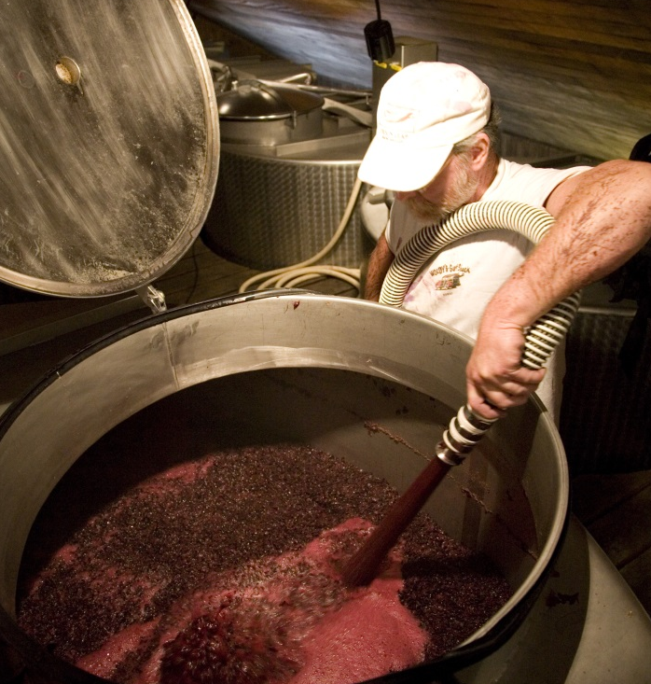
Fermentation
Grapes are the only fruit on earth with enough sugar to make a sound wine on their own.
The approaches to fermentation in Napa Valley are as numerous as the number of grape varieties that thrive here.
Winemakers take the time to truly understand the fruit and how to coax out the desired flavors and texture.
Notes:
Fermentation
Fermentation is the age-old process of yeast converting sugar-laden grape juice into wine. Because of the myriad grape varieties that are grown in Napa Valley, and the drive by winemakers to craft the finest wines in the world, there are hundreds of different fermentation methods.
Sauvignon Blanc and other light white varieties are fermented at cool temperatures in stainless steel to preserve primary fruit aromas and crisp acidity. Chardonnay is often barrel fermented and goes through malolactic fermentation to create complex, creamy notes. Pinot Noir will typically sit on its skins for a few days before fermentation in a “cold soak” to extract more color from this thin-skinned, red variety. Cabernet Sauvignon and other high tannin red grape varieties, like Syrah and Petite Verdot, often spend time on their skins after fermentation to soften the tannins and create deeper color and a denser mouth feel in the resulting wine.
Once fermentation is done, the yearly cycle is nearly complete. The new wine is then either readied for bottling in the case of lighter white such as Sauvignon Blanc, or barrel down for aging in the case of most reds and some Chardonnays.

Slide 13
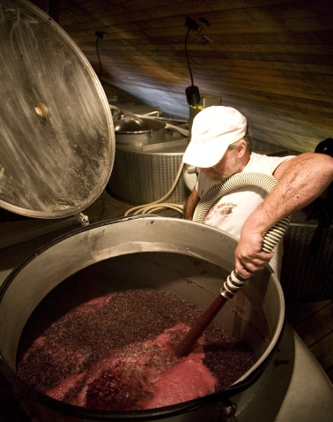
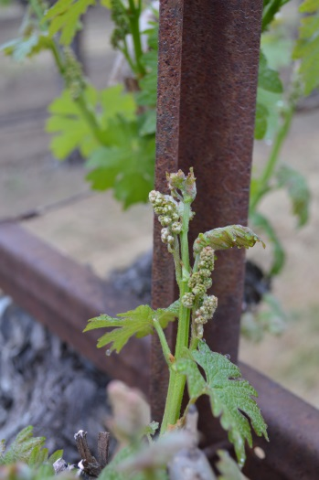
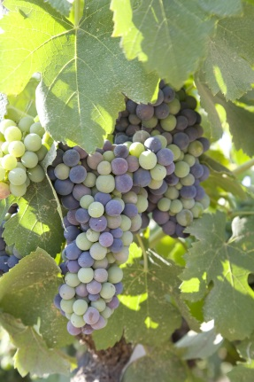
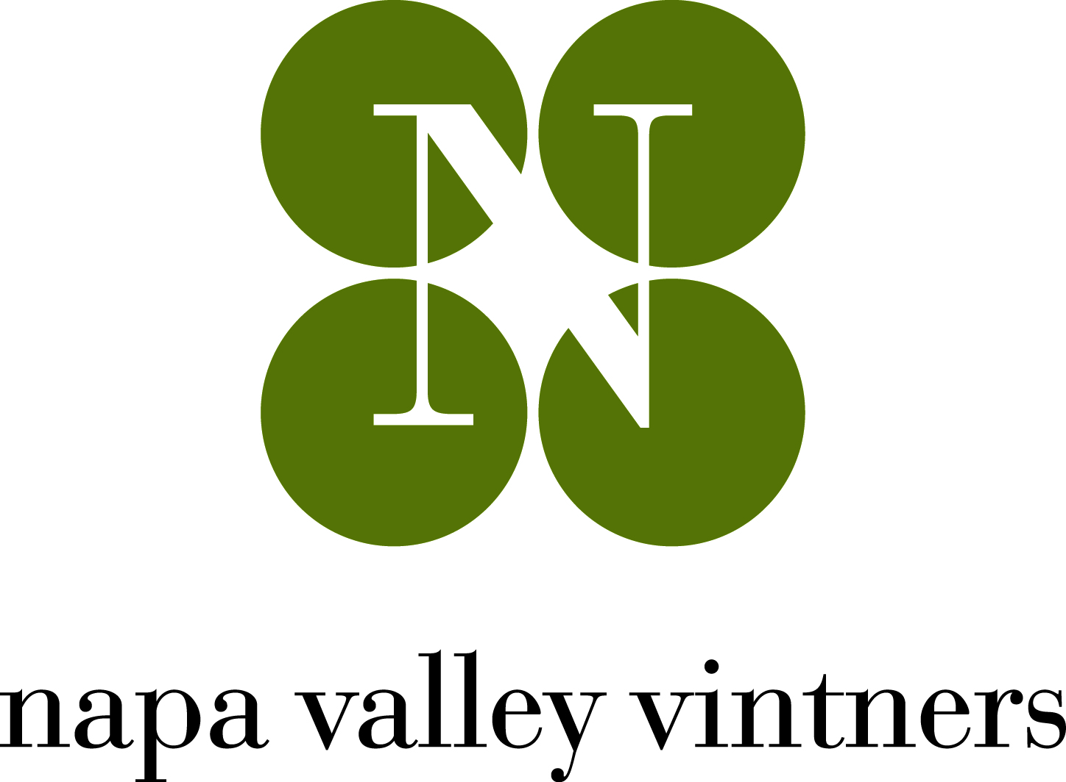
The end…and the new beginning
After the Harvest season, the valley takes a short rest before starting the yearly cycle again in the dead of winter…cultivating the next vintage of Napa Valley wine.
Visit napavintners.com
Notes:
The End and the Beginning
At this point, growers and winemakers then settle into a short period of rest before starting the yearly cycle all over, striving to create world class wines vintage after vintage.
As these slides demonstrate, Napa Valley stands for wines of the highest quality, cultivated with excellence in one of the world’s most extraordinary places.

