Slide 1
Notes:
Thank you for being here and welcome to “Napa Valley Rocks”
(INTRODUCE YOURSELF, INCLUDING YOUR TITLE AND YOUR WINERY NAME)
We’re proud members of the Napa Valley Vintners or N-V-V, the non-profit trade organization dedicated to the promotion, protection, and enhancement of the Napa Valley.
During this presentation, I’ll share with you scientific data, fun facts, history, and examples of specific attributes which make the Napa Valley unique in the world of wine.
We’ll also talk about the leadership of vintners past and present and how the combination of diverse geology, ideal climate, and dedicated people make the Napa Valley what it is today.

Slide 2
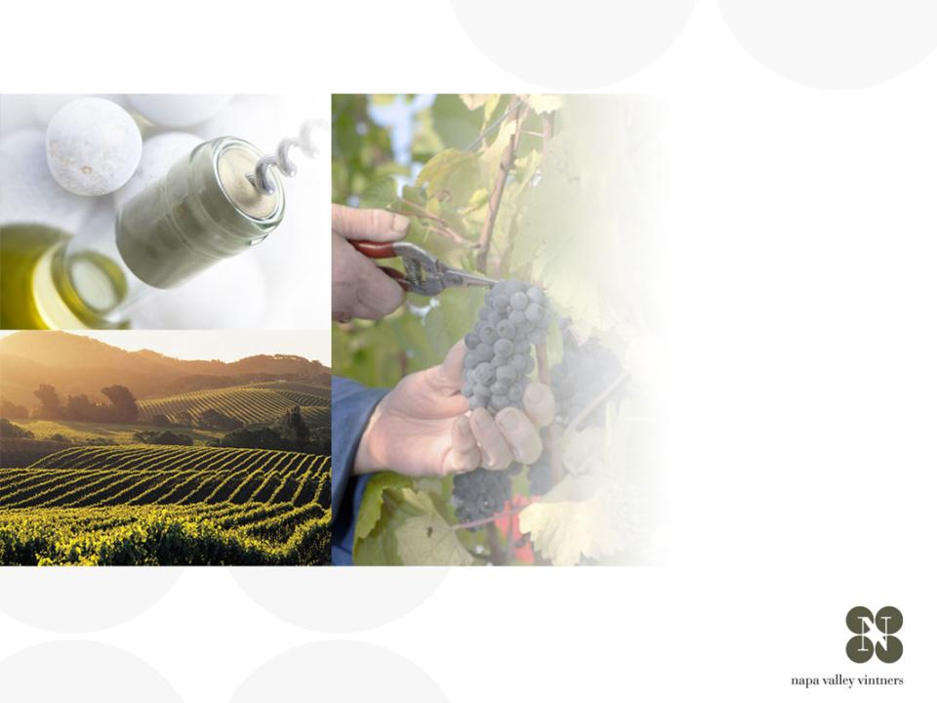
overview of
NAPA VALLEY
纳帕谷概述
Notes:
There are many great wine regions and Napa Valley is one of them.
Napa Valley is the home to America’s first Agricultural Preserve and is a region of incomparable natural beauty.
Though accounting for just 4% of California’s harvest, Napa Valley is the industry’s undisputed leader in land and community stewardship and is renowned the world over for its extraordinary wines.

Slide 3
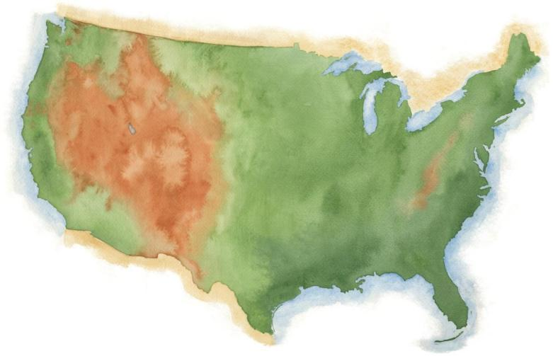
NAPA VALLEY
纳帕谷
Notes:
Napa Valley is located in Northern California, very close to San Francisco and the Pacific Ocean, and several hundred miles from Los Angeles.

Slide 4
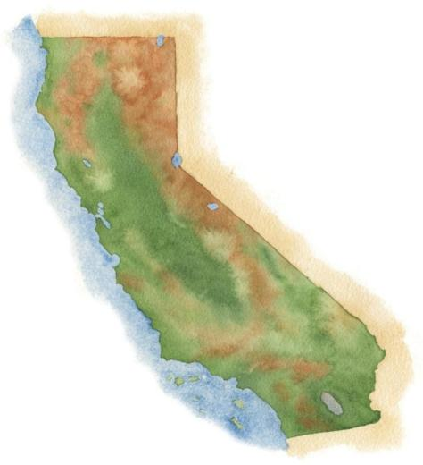
NAPA VALLEY
纳帕谷
San Francisco
旧金山
Los Angeles
洛杉矶
Notes:
4
It’s a fairly young, “new world” wine region where wine has been made for only about 150 years.

Slide 5
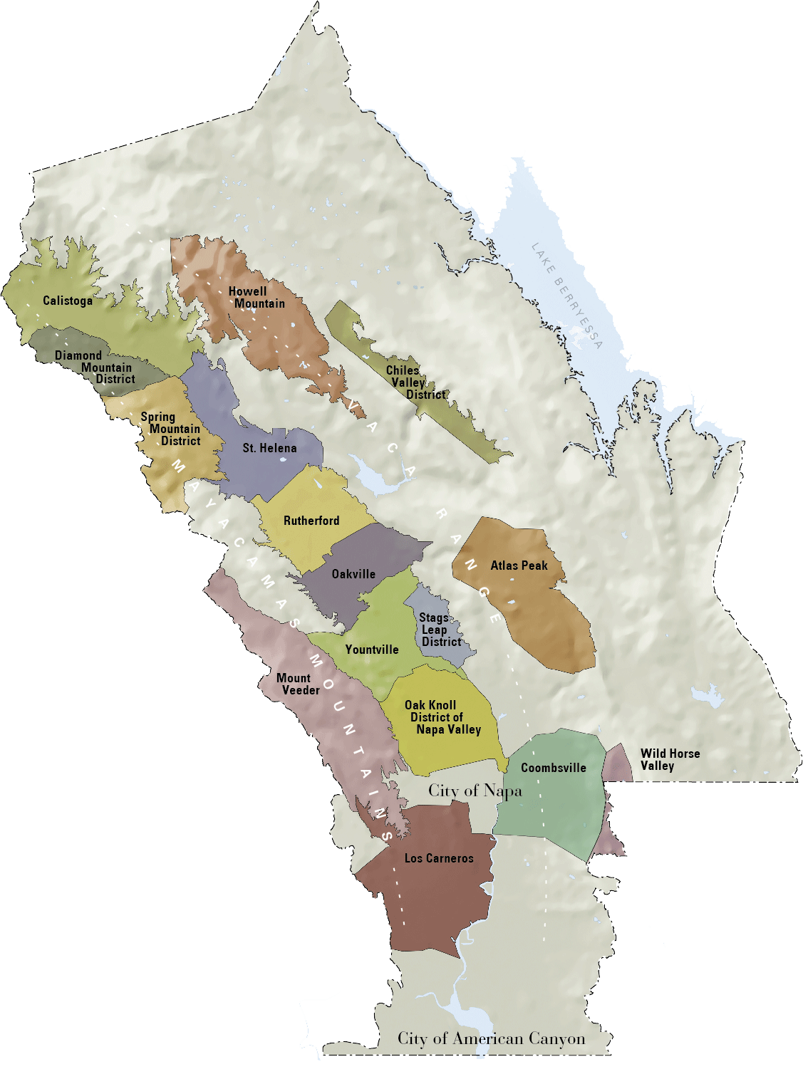

NAPA VALLEY
纳帕谷
Distance to Pacific Ocean
到太平洋的距离
36mi / 58km
36英里/58公里
Distance to San Francisco
到旧金山的距离
48mi / 77km
48英里/77公里
Distance to Los Angeles
到洛杉矶的距离
360mi / 579km
360英里/579公里
Notes:
5
Napa Valley is small: the valley floor, located between the Mayacamas Mountains and Vaca Range, is just about 5 miles across at its widest point and 30 miles at its longest.
The Napa Valley became California’s first recognized AVA or American Viticultural Area in 1981.
Within the Napa Valley AVA there are currently 16 recognized sub- or “nested” AVAs.

Slide 6
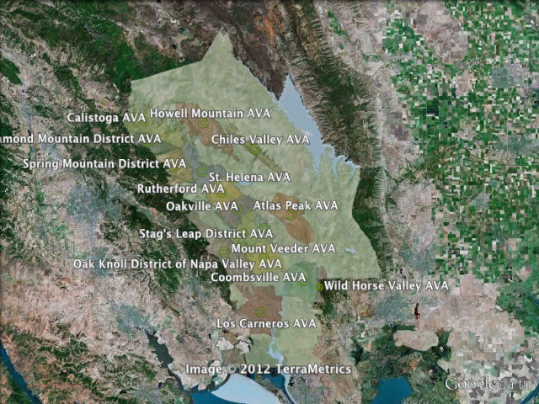
Notes:
An AVA is a geographic grape growing area that possesses distinguishable characteristics, including microclimate and terrain, and cultural and historic distinction.
Vintners and growers within these regions determine the boundaries of the growing area and give it a name that reflects the regional designation.
This data is then submitted to the U.S. government, which decides whether the proposed appellation designation will be granted.
Unlike Europe, these designations do not limit the type of grapes grown, the method of vinification, or the crop yield.
An AVA specifies only a geographical location from which at least 85% of the grapes used to make a wine must have been grown.

Slide 7
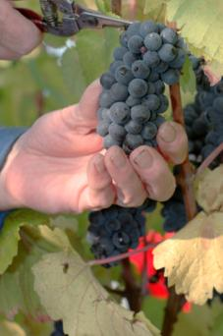


Napa Valley AVA
纳帕谷葡萄栽培区
NAPA VALLEY
纳帕谷
Small in size.
Big in quality and diversity
面积虽小，质量和多样性方面大
4% of California wine
占加州葡萄酒4%的产量
4/10ths of 1% of the
world’s wine
占全球葡萄酒产量1%之中的十分之四
Notes:
7
If there’s one message we could leave you with today, it’s that the Napa Valley may be one of the most renowned wine growing regions in the world, but it is also one of the smallest.
Napa Valley produces just 4% of California’s wine and a mere four-tenths of one percent of the world’s wine.

Slide 8
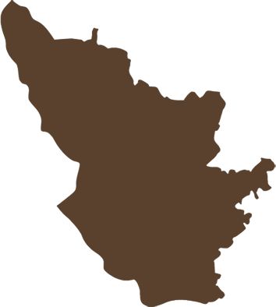
Napa Valley AVA
纳帕谷葡萄栽培区
NAPA VALLEY AVA
纳帕谷葡萄栽培区
45,000 acres
(18, 250 ha) under vine
45,000英亩(18,250英亩)产量
Bordeaux AC
波尔多法定产区
290,000 acres
(117,500 ha) under vine.
290,000英亩(117,500英亩)产量
NAPA VALLEY is 1/8
the size of Bordeaux
纳帕谷是波尔多面积的八分之一
Bordeaux AC
波尔多法定产区
Notes:
8
It is roughly the same size of the Medoc in Bordeaux and Burgundy’s Côte d’Or, and has about one-eighth the planted acreage of the entire Bordeaux AOP.
There are approximately 45,000 acres under vine, about 9% of all of Napa County.

Slide 9
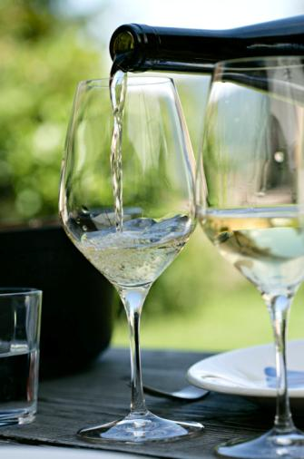

77%
Small producers
小型酒庄/生产者
77% of NVV members make less than 10,000 cases of a wine a year 77%的纳帕谷酿酒商协会成员每年产量少于10,000桶
63% produce less than 5,000 cases
63%的年产量少于5,000桶
Notes:
9
The majority of Napa Valley’s producers are also small:
Nearly 80% of the NVV’s 450 member wineries make less than 10,000 cases of a wine a year.
More than 60% produce fewer than 5,000 cases annually.

Slide 10
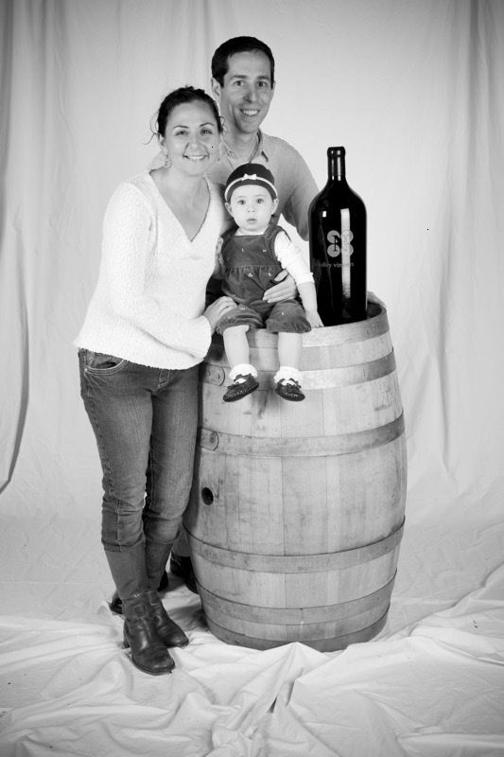

95%
Small producers
小型酒庄/生产者
95% of Napa Valley wineries are family owned or operated
95%的酒庄是家族酒庄
Notes:
10
10
95% of Napa Valley wineries are family owned or operated.

Slide 11
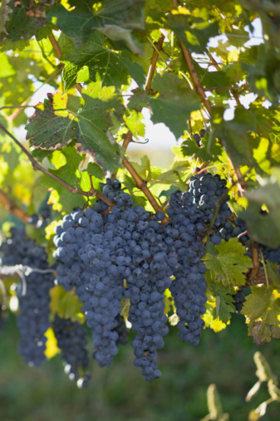
$13B
130亿美元
Big impact in Napa County 在纳帕郡有很大影响
46,000 jobs
46,000份工作机会
$13 billion annual economic impact 每年带来130亿美元的经济影响
Notes:
11
In spite of its small size, the Napa Valley wine industry has a big impact.
It results in 46,000 jobs in Napa County and an annual local economic impact of more than $13 billion.

Slide 12
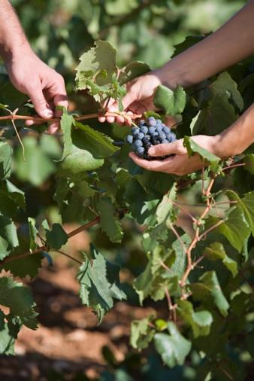
$50B
500亿美元
Big impact beyond Napa County 在纳帕郡之外的巨大影响力
$50 billion annual impact on the US economy 每年对整个美国经济产生500亿美元的影响
Notes:
12
The Napa Valley wine industry has a $50 billion annual impact on the US economy
This accounts for 27% of the California wine industry’s total impact on the US

Slide 13
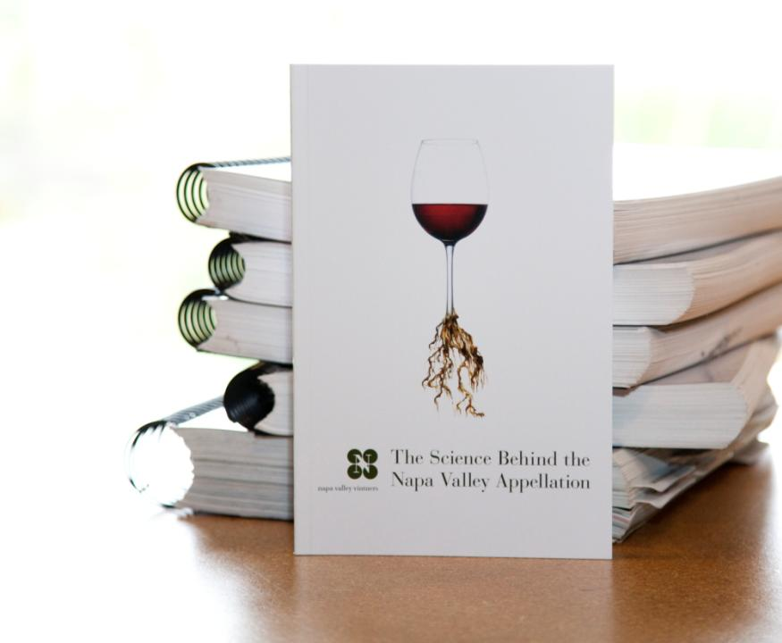
We have
the research
behind it
我们有科研的支持
Notes:
13
13
Although the place and the industry are relatively small, Napa Valley is one of the most diverse wine growing regions in the world.
It’s one thing to say a place is special, but it’s another to prove it.
Between 2001 and 2003, the Napa Valley Vintners trade organization commissioned three major studies to verify how our unique geology, soils, climate, weather and topography all work together to nurture the winegrapes.
The next part of this presentation will explain more.
(The scientists who conducted the studies were Jonathan Swinchatt of EarthVision and Paul W. Skinner, PhD. Of Terra Spase.)

Slide 14
a great place for wine:
一个葡萄酒的伟大产区：
SOIL
土地
Notes:
We’ll start from the ground up - with soil.

Slide 15
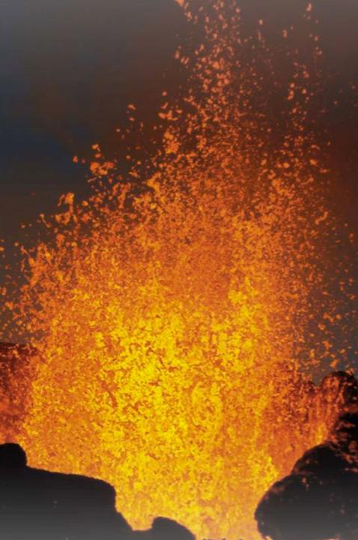
About 150 million years ago a domino-like chain
of events began.
约在1亿5千万年前，
一连串多米诺骨牌式的连锁地质反应开始了。
Notes:
15
About 150 million years ago, a series of geologic events caused the shifting, sliding, and lifting of land masses in the area that we know of today as California.
That plastered material onto the edge of North America and formed it into its present, yet ever-changing configuration.
This is the process that created the Napa Valley.

Slide 16

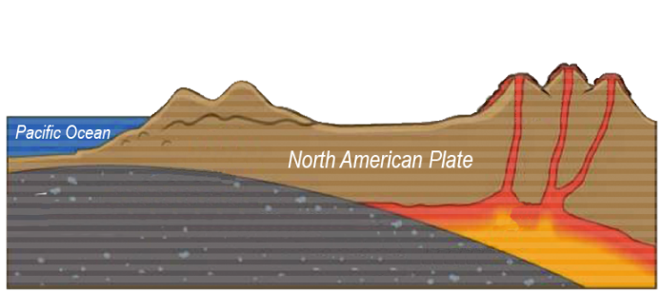
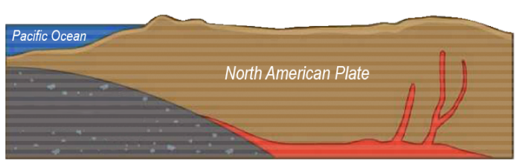



The Great Valley Sequence and The Franciscan Formation
大峡谷的连续反应以及弗朗西斯层的形成
Franciscan Formation 弗朗西斯层
(ocean floor)(产生于洋底)
Pacific Plate 大西洋板块 Subduction 消亡带
Great valley
sequence
大峡谷的连续反应
Magma rises to
form volcanoes
and mountains
岩浆冒出形成
火山与山脉
Notes:
16
Over time the mountains eroded and reformed, helping to create California.
Geologists call this the Great Valley Sequence, the remains of which are generally found on the east side of the Napa Valley.
As volcanoes were forming inland, the surface of the ocean floor was being sheared off as it met the coastline, literally plastering all sorts of marine sediment on top of the newly forming landmass, extending California westward.
Geologists call this the Franciscan Formation, the remains of which are generally found on the west side of present day Napa Valley.

Slide 17
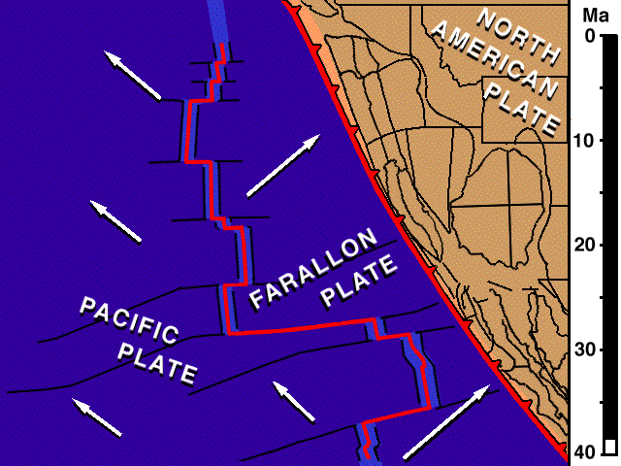
The San Andreas Fault System
圣安德烈亚斯断层系统
Farallon Plate, Pacific Plate, North American Plate meet at a “Triple Junction.” 费瑞龙板块，太平洋板块，北美版块在一个三联点互相作用
Plates change to lateral northern direction creating San Andreas Fault 板块因而平级向北移动从而形成了圣安德烈亚斯断层
Notes:
17
About 24 million years ago the San Andreas Fault system took shape with the joining of three tectonic plates – the Farallon, the Pacific, and the North American.
These plates started to move laterally south to north, moving this volcanic and sedimentary bedrock in all directions.
As this “triple junction” slowly moved north, dragging the San Andreas fault along, tremendous compression forces pushed up wrinkles in the earth’s crust that eventually became the Coast Range and the Mayacamas Mountains.

Slide 18
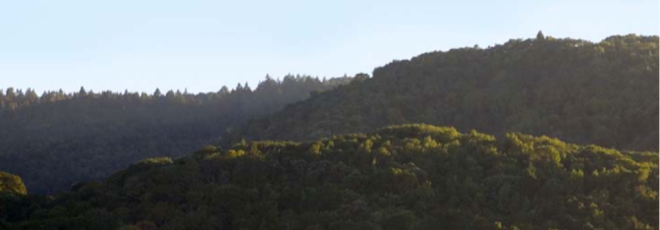
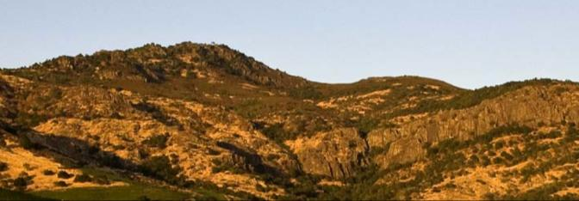
Mayacamas Mountains 梅亚卡玛斯山脉
Looking west, Yountville 从 Yountville 向西看
Vaca Range 瓦卡山脉
Looking east, Stags Leap District 从 Stags Leap District 往东看
Notes:
18
Around 3 million years ago plate motion shifted direction again, this time folding the land over on top of itself, creating the Mayacamas Mountains, the Vaca Range, and Napa Valley in-between.
The multiple bedrock sources that would make up Napa Valley’s distinct soils were now in place.

Slide 19
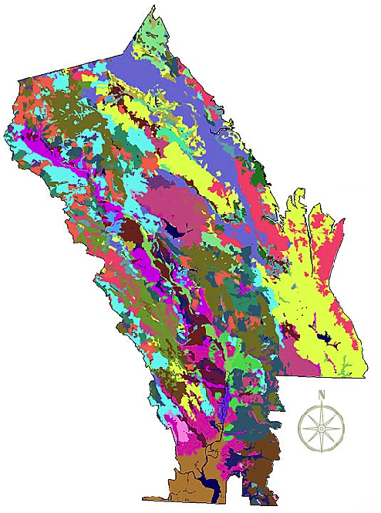
Napa Valley
AVA Soil Series 纳帕谷法定产区的土壤类型
Over 100 Soil variations
超过100种土壤品种
33 soil series
33种土系
Half the world’s
soil orders
拥有全球土纲的一半
Notes:
19
Napa Valley contains more than 100 soil variations, 33 soil series, and half the soil orders found in the world.
This picture shows, quite literally, how you can have different soil types within the same vineyard in Napa Valley.
This diversity allows vintners to grow and produce – and to produce well – a great number of different grape varieties in the Napa Valley.
One of the secrets of great winegrowing is in the soil, and Napa Valley has perhaps the greatest soil diversity found in any winegrowing regions in the world.
(Note difference between a soil order, series and variation:
Soil orders are based largely on soil forming processes.
Soil series are of a similar evolution or formation, chemistry, and physical property.
Soil variations take into account vegetative material, climate, and topography differences and/or make-up).

Slide 20
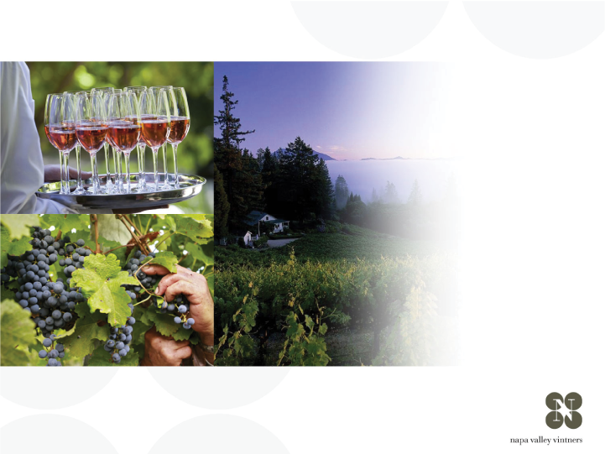
a great place for wine:
一个葡萄酒的伟大产区：
CLIMATE
气候
Notes:
20
Climate also has a significant impact on the flavor of the grapes.

Slide 21
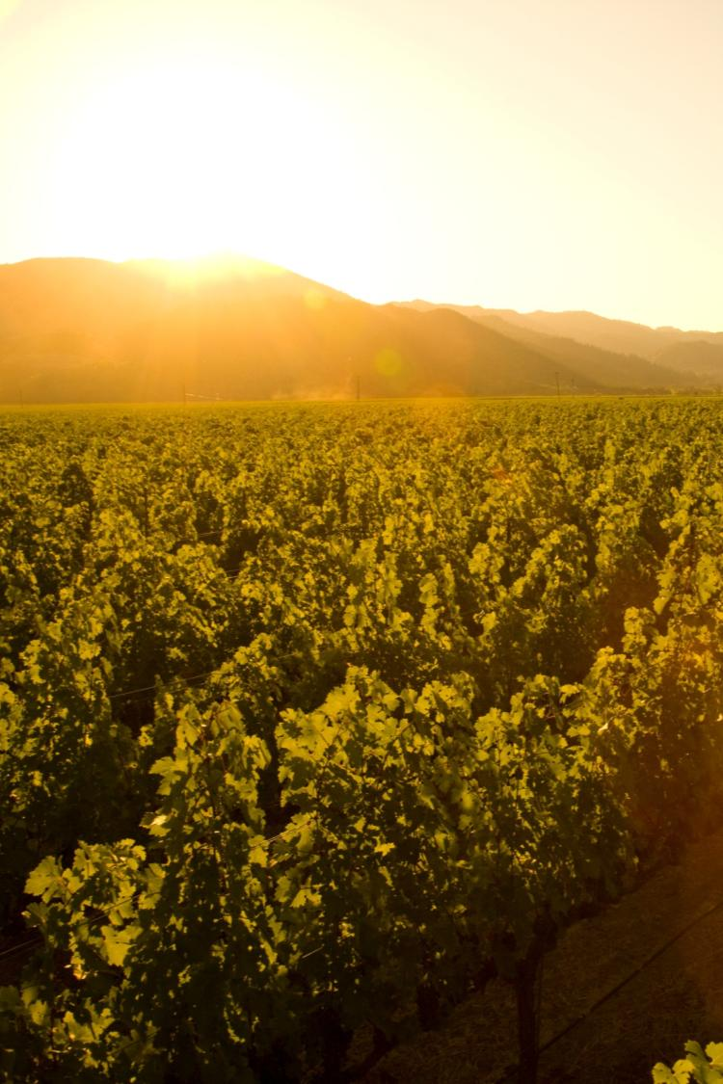
Mediterranean climate zone
地中海气候区
Long growing season
漫长的生长季
Lack of summer rainfall
夏天雨水缺乏
Vintage to vintage consistency and reduced risk for vineyard disease
年份之间的稳定性
降低了葡萄园染病的风险
Notes:
21
21
Napa Valley is located within the rare Mediterranean climate zone, which encompasses just 2% of the earth’s surface.
The long growing season is marked by warm summer days and cool evenings – ideal for wine grapes to ripen slowly and evenly, with great balance between sugar and acid development.
Lack of summer rainfall helps to contribute to consistency of vintages and reduces the risk of vineyard diseases.
Most areas of the appellation can dry farm or tightly manage their irrigation practices.
Compared to most growing regions in the world, Napa Valley is unique in this regard.

Slide 22

NAPA VALLEY AVA
纳帕谷葡萄栽培区
Average rainfall
平均降雨量
40-55 in 英寸/102-140 cm 厘米
18-24 in 英寸/46-61 cm 厘米
Notes:
22
22
When it does rain in the winter, the southern reaches of Napa Valley AVA receive just 18 inches of rain each year.
The mountains at the northern end can record nearly 60 inches.

Slide 23


Conditions exist for creating a recurring pattern of marine fog
适合海洋雾循环模式形成的现存条件
C
H
Pacific Ocean
太平洋冷空气
Notes:
23
23
During the summer growing season, conditions exist for creating a recurring pattern of marine fog from the Pacific Ocean.
As hot air in California’s interior valley rises, it creates a vacuum effect which draws in moist, cool air from the Pacific Ocean, forming fog.
This pattern repeats most days during the warmer months of the year.

Slide 24

Notes:
This video shows how the fog advances and retreats in the Napa Valley from early until late morning.
Typically, the fog has a greater impact on the valley floor – often the hillsides, like the one where this video was filmed, are not reached by the fog.

Slide 25

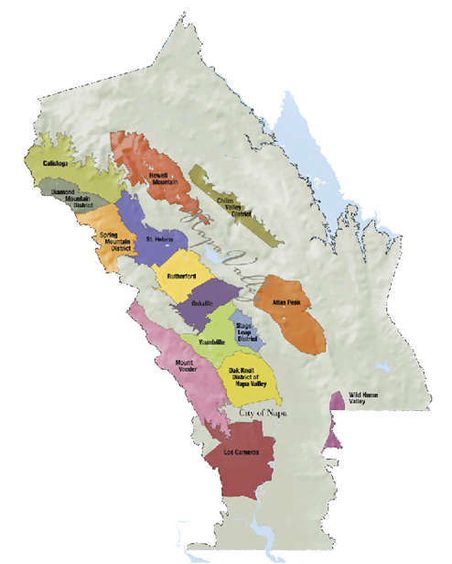
NAPA VALLEY AVA
Temperature variation – summer
纳帕谷葡萄栽培区
温度的变化——夏天
40-50ºf / 4.5-10ºc
85ºf / 29ºc
40-50ºf / 4.5-10ºc
95ºf / 35ºc
ºf-华氏度
ºc-摄氏度
50ºf / 10ºc
77ºf / 25ºc
Notes:
25
25
Daytime temperatures can also vary dramatically throughout the AVA during the growing season.
The southern part of the valley, particularly Los Carneros AVA, is closer to San Pablo Bay and is cooled by marine breezes.
In summer, there can be as much as an 10-15°F difference between Carneros and St. Helena, to the north.
On many days, due to the cooling effect of the fog, there is a large diurnal (day to night) temperature swing throughout the valley.

Slide 26
Mount St. Helena
圣海伦娜山
4000 ft / 1,219 m
NAPA VALLEY AVA
Elevation
纳帕谷葡萄栽培区
海拔
Spring Mountain
斯普林山
2200 ft / 671 m
Atlas Peak
阿特拉斯峰
2600 ft / 793 m
Mount Veeder
维德山
2100 ft / 650 m
ft-英尺
m-米
Valley Floor 谷底
0– 750 ft / 0 – 214 m
Notes:
26
26
Adding to the diversity of Napa Valley is its topography.
It changes with its length, from the flat estuaries in the south near San Pablo Bay to the rolling hills just before 4,000-foot Mount St. Helena in the north.
And don’t forget the Mayacamas and Vacas to the west and east – each range reaches approximately 2,500 feet above the valley floor.
There is a strong correlation between topography and climate: slope, aspect, and elevation all influence the many mesoclimates found throughout the Napa Valley.

Slide 27

Napa Valley 纳帕谷
VITICULTURE
葡萄栽培
Notes:
27
Terroir also includes people – the people who make the decisions about how the grapes will be grown.

Slide 28
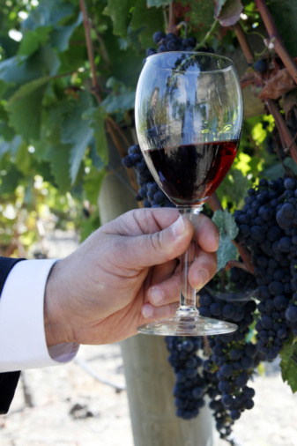
Napa Valley’s top varieties in descending order 纳帕谷主要葡萄品种（降序排列如下）:
Cabernet Sauvignon 赤霞珠
Chardonnay 霞多丽
Merlot 美乐
Sauvignon Blanc 长相思
Pinot Noir 黑比诺
Zinfandel 增芳德
Syrah 西拉
(& several others 以及其他品种)
Notes:
28
28
Napa Valley has become synonymous with Cabernet Sauvignon.
The majority of Napa Valley winemakers produce it.
But, thanks to the many diverse growing conditions we’ve talked about, all kinds of varieties flourish.
Conditions are well-suited for growing both Burgundian (Chardonnay and Pinot Noir) and Bordeaux-style varieties (Cabernet, Merlot, Cabernet Franc, and Sauvignon Blanc).

Slide 29
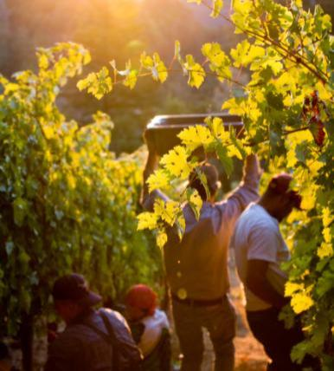
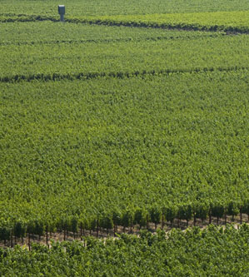
Napa Vineyards 纳帕葡萄园
Intentionally farmed to produce low yields
有目的的耕种方法以获得低产量
Notes:
29
29
Most winemakers will tell you that quality starts in the vineyard.
Napa Valley vineyards are intentionally farmed to produce low yields to allow only the healthiest of grape clusters to mature.
Throughout the growing season, the canopy is managed with leaf pruning, shoot pulling, and fruit thinning – all of which is done by hand – resulting in a perfect sunlight to shade ratio and optimal fruit development.
During the year, vineyard workers will tend to each individual vine at least 20 times.
This attention to detail in the vineyard is designed to produce wine grapes of the highest quality.

Slide 30
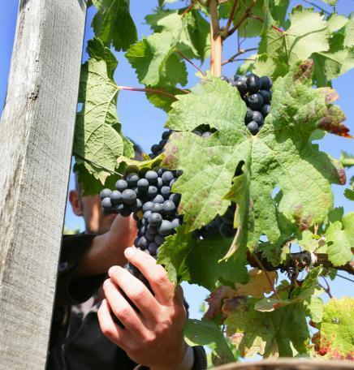
Winemaking Practices 酿酒实践中
Gentle handling is the norm 以温和手法作为规范
Focus on innovation
and quality
专注于创新和品质
Collaboration is common
协作也很常见
Continuing education for
ongoing improvement
为不断改进而进行继续教育
Notes:
30
30
Inside the winery, most Napa Valley winemakers agree that “less is more” and their best approach is gentle and “hands off” allowing the grapes to express themselves.
Napa Valley vintners are always trying to improve quality - there is a culture of “we can do better.”
Innovative viticulture practices sometimes give a nod to the past, like use of concrete fermenters, gravity flow facilities, or wild yeasts, and also have a vision for the future, like new technology, which can provide an automated godsend to small producers with limited manpower.
Napa vintners regularly collaborate and participate in local wine technical group meetings and discussions, including the NVV’s winemaker discussion group.
They also regularly attend knowledge-building programs at local education institutions, like UC Davis, Sonoma State University, or even the local community college, which has an extensive enology program.

Slide 31
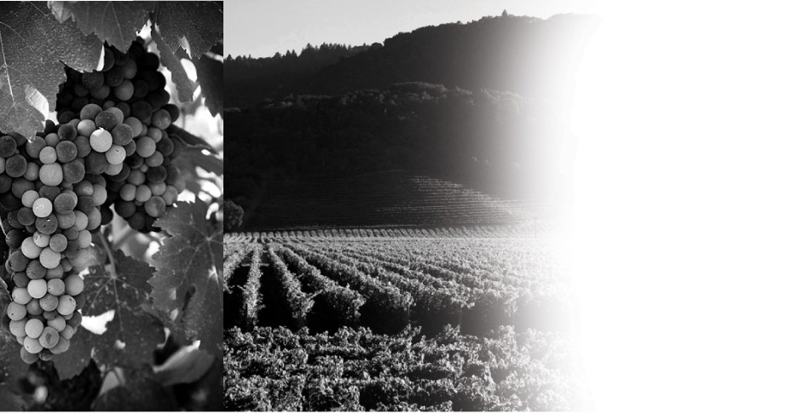
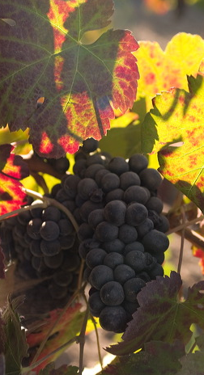
Napa Valley 纳帕谷
HISTORY
历史
Notes:
31
It has taken more than 150 years and a long line of great leaders to make the Napa Valley what it is today.
Let’s take a look back at the history of this special place.

Slide 32
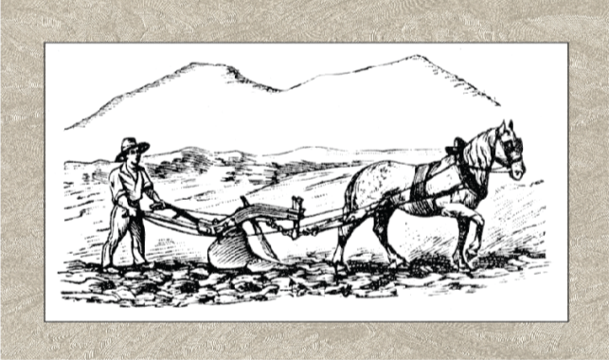
NAPA VALLEY 纳帕谷
Experimenters, innovators, leaders
实验者，创新者，领导者
George Yount plants first vineyards in 1838-39
乔治 杨特在1838-1839年种下了第一个葡萄园
1830
1840
1850
1860
1870
1880
1890
1900
Notes:
32
32
The Napa Valley of the Wappo Indians was home to spawning salmon, wildcats, elk, black bear, grizzlies… and wild grapes.
The name “Napa” is believed to mean “abundance” in the Wappo language.
Early settlers like George Calvert Yount were the first to recognize the valley's potential for cultivating wine grapes.
In 1838-1839, Yountville was established, and Yount was the first to plant vineyards in the valley.

Slide 33

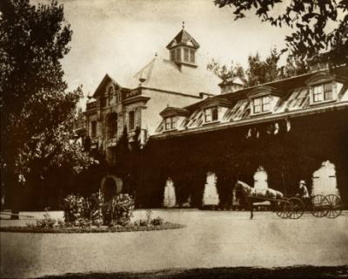
1861-1880
First wineries established 第一个酒庄的成立
Charles Krug, first commercial winery, 1861
查尔斯 库克，第一个商业化酒庄，1861年
Inglenook, first chateau-style winery, 1879
Inglenook，第一个城堡风格的酒庄，1879年
1830
1840
1850
1860
1870
1880
1890
1900
Notes:
33
33
Following California’s Gold Rush, in the 1860s and ‘70s, Europeans arrived in Napa, eager to try their hand at making wine to rival the wines from their homeland.
Most of the wine at that time was shipped in bulk to San Francisco for sales and distribution.
Charles Krug is credited with establishing Napa Valley's first commercial winery in 1861.
In 1879, Gustav Niebaum established Inglenook, the first chateau-style winery in the US and he was also the first to sell wine in bottles.
By 1889, Napa Valley had 140 wineries.

Slide 34
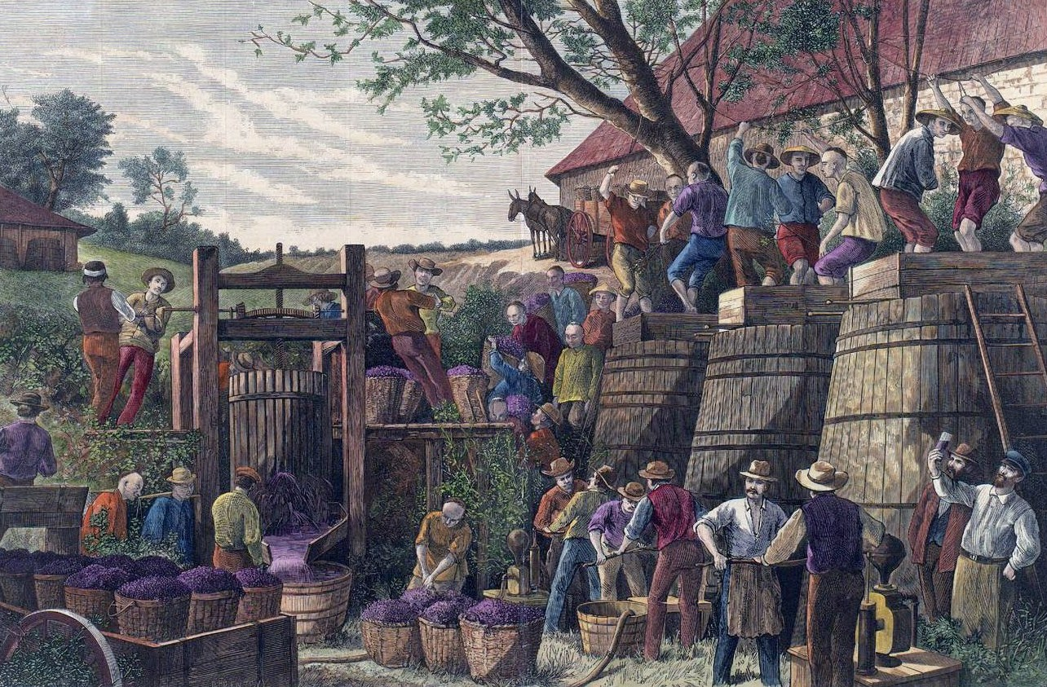
Late 1800’s 19世纪晚期
Chinese contract labor 中国契约劳工
First immigrant labor force for grape harvest, 1870’s 19世纪70年代第一批移民劳工参与葡萄采收
Experience in building railroad translates to underground wine cave construction
从修建铁路转移到修筑地下酒窖
1830
1840
1850
1860
1870
1880
1890
1900
Notes:
34
34
Another significant group of immigrants to make their way to Napa Valley were Chinese laborers
By some accounts, field laborers of the 1870’s and 1880’s were primarily Chinese
Later, following the completion of the transcontinental railroad, many Chinese made there way to the Bay Area and continued their hard labor on projects like building underground wine caves in the Napa Valley

Slide 35
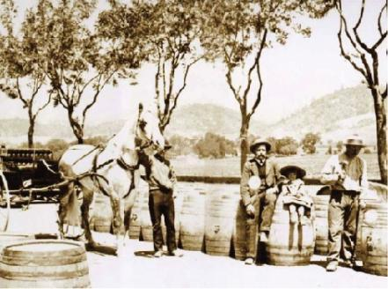
Late 1800’s 19世纪晚期
Napa Valley’s first boom 纳帕谷首次繁荣发展
By 1889, Napa had more than 140 wineries
截止1889年，纳帕谷已有140多家酒庄
1830
1840
1850
1860
1870
1880
1890
1900
Notes:
35
35
By 1889, Napa had more than 140 wineries, including Schramsberg, Beringer, and Inglenook.
Though never a large producer – that description was more apt for other agricultural areas of California, like Los Angeles, Sonoma, and Livermore – Napa was booming.
PHOTO: Avenue of Elms, St. Helena, about c. 1900. Frederick Beringer (sitting on his barrel), next to his daughter

Slide 36
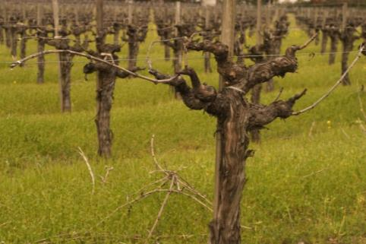
Weathering Storms 行业的暴风雪
Phylloxera 根瘤蚜虫
Grapevine acreage decreases from 15,807 to 2,000 in just 12 years 葡萄树的种植面积仅在12年内从15,807英亩骤减到了2,000英亩
1830
1840
1850
1860
1870
1880
1890
1900
Notes:
36
36
But, what’s a success story without a stunning setback or two?
In the late 1890s phylloxera, tiny sap-sucking insects which feed on the roots of grapevines and kill them, hit and nearly decimated Napa’s vineyards.
Acreage in Napa Valley declined from 15,807 in 1888 to just 2,000 acres by 1900.

Slide 37
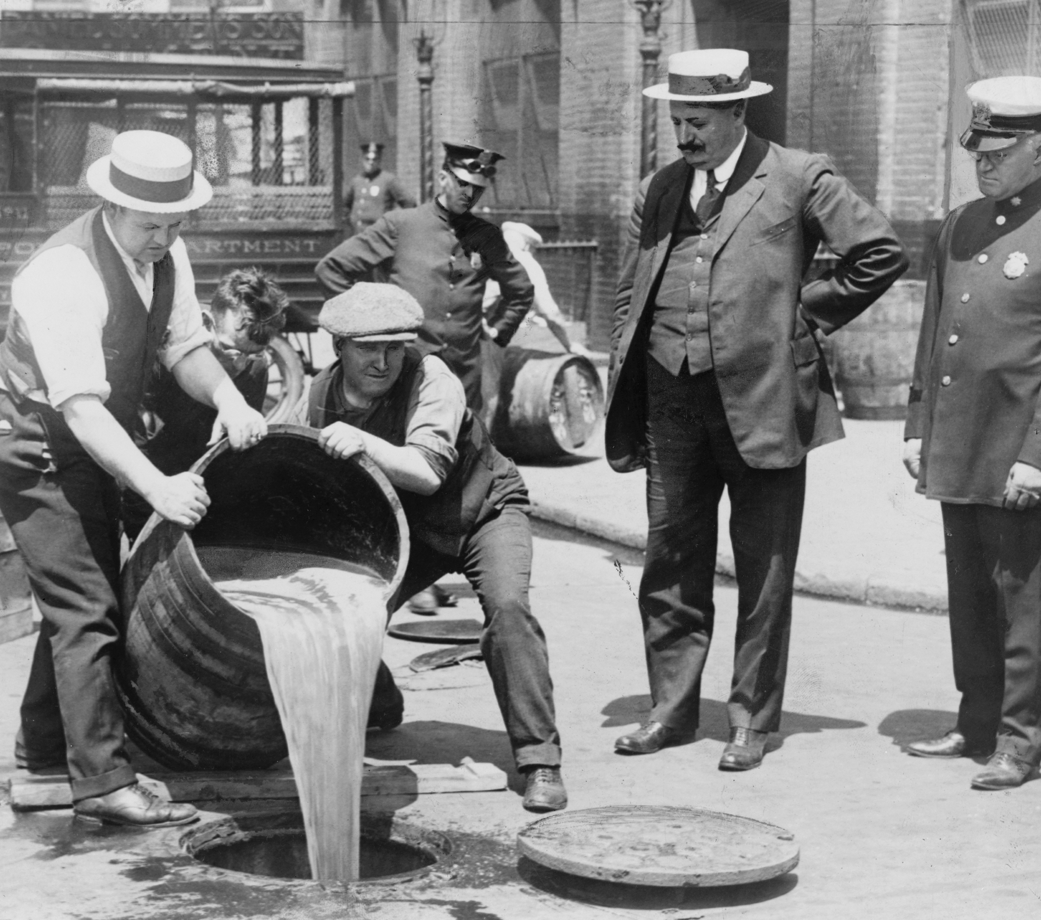
Weathering Storms 行业的暴风雪
Prohibition, Great Depression, World War
禁酒令，大萧条，世界大战
A series of unfortunate events plagues the Napa Valley wine industry
一系列的不幸折磨着纳帕谷的葡萄酒产业
1910
1920
1930
1940
1950
1960
1970
1980
Notes:
37
37
Then an even greater threat arrived in 1920 with the enactment of Prohibition, which lasted for 13 years.
The Great Depression didn’t help matters either.
By the time World War II came along, Napa’s grapevines and wineries were largely abandoned.
Many vineyards were planted over to plums and walnuts.
The Napa Valley wine industry was in shambles.

Slide 38
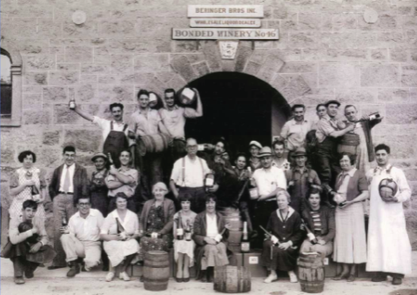
Recovery 恢复期
Prohibition ends 禁酒令废止
Prohibition repealed in 1933
1933年禁酒令被废止
1910
1920
1930
1940
1950
1960
1970
1980
Notes:
38
38
Despite the setbacks, a few vintners persevered.
With the repeal of Prohibition, Napa Valley began the road to recovery.

Slide 39
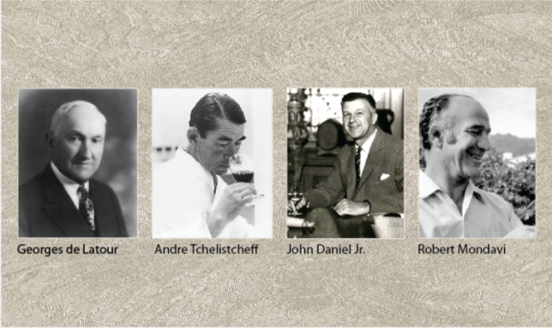
Rebirth 重生
Napa Valley’s Renaissance
纳帕谷的文艺复兴
John Daniel, Jr. inherits Inglenook in 1939
小约翰 丹尼尔在1939年继承了Inglenook
Robert Mondavi builds first new winery since Prohibition in 1966 罗伯特 蒙达维在1966年建立了自禁酒令后第一个新的酒庄
1910
1920
1930
1940
1950
1960
1970
1980
Notes:
39
39
But, many visionaries believed the Napa Valley could return to it’s pre-1900 glory.
Credit for the post-World War II rebirth of the Napa Valley wine industry goes to a handful of bold and visionary vintners, including Georges de Latour, of Beaulieu Vineyards, who in 1938 recruited Andre Tchelistcheff, research enologist from France's Pasteur Institute.
In 1939, John Daniel, Jr. inherited Inglenook, the Gustave Niebaum estate, and ran the winery for 25 years.
Of course, much of the “Napa Valley Renaissance” was led by Robert Mondavi, who championed the idea that fine wine was an integral part of the good life.

Slide 40
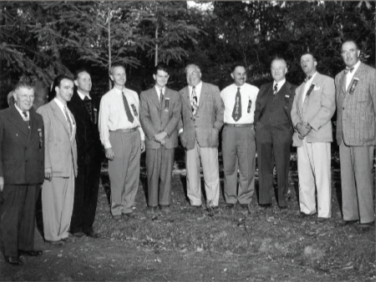
Banding Together 联合
Napa Valley Vintners 纳帕谷葡萄酒商协会
Agreement of association signed in 1944
在1944年签订了协会的协议
1910
1920
1930
1940
1950
1960
1970
1980
Notes:
40
40
Many of these vintner leaders, like Louis Martini, John Daniel, Jr., and Robert Mondavi knew there were challenges ahead for their fledgling wine industry, not the least the ongoing threat of natural disasters and growing regulation.
They formed the Napa Valley Vintners trade association in October 1944 with the idea that we are stronger together than individually.
Left to Right: Charles Forni (Napa Valley Cooperative Winery), Robert Mondavi (C. Mondavi & Sons), Brother Timothy (Mont La Salle), Al Huntsinger (Napa Valley Cooperative Winery), Mike Ahern (Freemark Abbey), Charles Beringer, Fred Abruzzini (Beringer Brothers), Louis M. Martini, John Daniel, Jr. (Ingelnook Vineyard Co.), and Martin Stelling, Jr. (Sunny St. Helena).

Slide 41
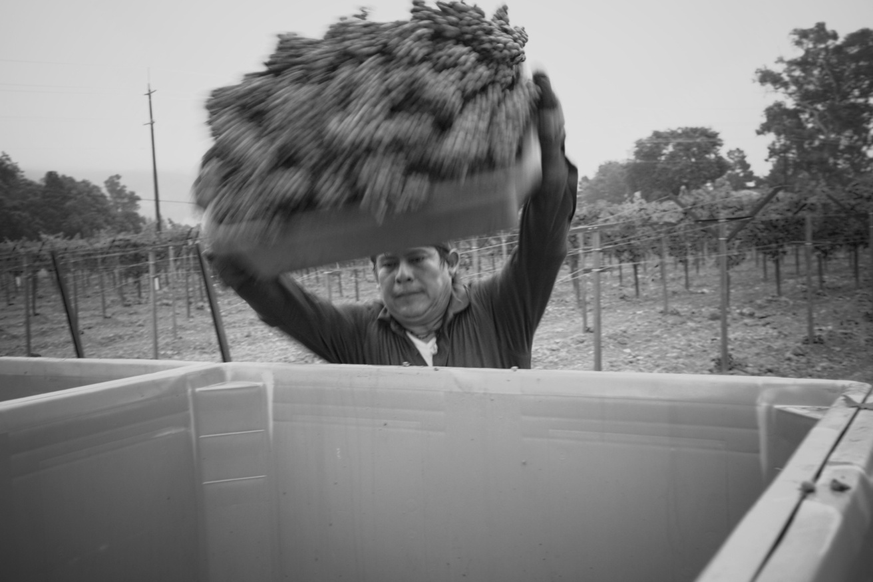
Hispanic Heritage 西班牙裔力量的注入
US and Mexico create “Bracero” program
美国和墨西哥共同开发了Bracero项目
1910
1920
1930
1940
1950
1960
1970
1980
Notes:
41
41
Another important part of Napa Valley’s history is its Hispanic heritage.
In 1942, facing a labor shortage brought on by World War II, the US and Mexico together created the “Bracero” program bringing guest laborers from south of the border to work in American agriculture.
Many of these laborers landed in the California and Napa Valley wine industries and, over time, become incredibly skilled in techniques related to premium grape growing.
Some went on to own their own vineyard management companies, while others have become Napa Valley vintners in their own right, moving from the vineyard to winemaking and winery ownership.

Slide 42

Judgment of Paris 巴黎品酒会
Napa Valley Chardonnay and Cabernet Sauvignon win blind tasting
纳帕谷霞多丽和赤霞珠在盲品比赛中胜出
1910
1920
1930
1940
1950
1960
1970
1980
Notes:
42
42
While these Napa Valley vintners believed in the quality of the appellation, and in the early 1970s Napa Valley’s reputation continued to grow, it was a pivotal endorsement from another part of the world that helped put Napa Valley on the winegrowing map.
The 1976 Judgment of Paris wine tasting, chronicled recently in the movie “Bottle Shock,” set the wine world on it’s ear: few could have imagined that California wines would win such a competition.
Yet California rated best in each category.
The hard work of Napa Valley’s vintners was starting to pay off.

Slide 43
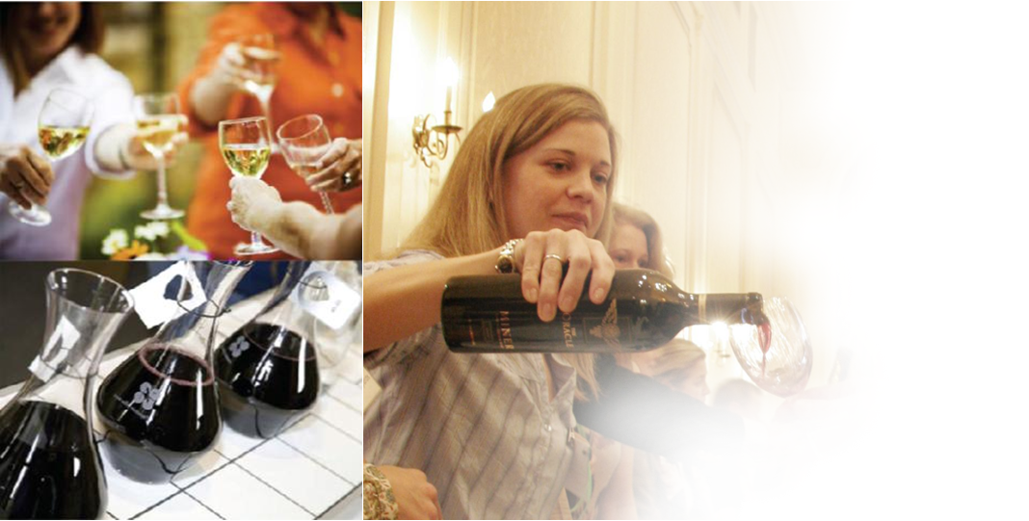
Napa Valley 纳帕谷
VINTNERS
酿酒商
Notes:
43
Nearly seven decades after being formed, and more than 450 wineries strong, the Napa Valley Vintners still work to promote and protect – as well as enhance – the Napa Valley AVA as the premier winegrowing region.

Slide 44
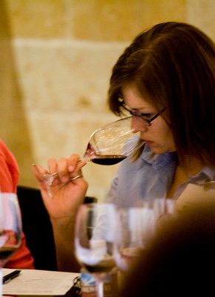
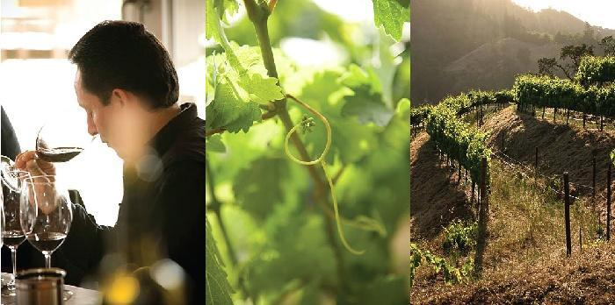
The Mission of the Napa Valley Vintners:
To promote, protect and enhance the Napa Valley appellation and its wines
纳帕谷酿酒商协会的使命：推广、保护、提升纳帕谷葡萄栽培区以及葡萄酒
Notes:
44
44
NVV members are deeply committed to conservation and sustainable farming, and to supporting the local community through charitable work.
The Napa Valley wine industry thrives on a strong culture of collaboration and pride in its agricultural heritage, community, and appellation.
As the appellation is defined by the soils, climate, geology, and topography, it has also been shaped by the contribution of its people.
Here are some highlights that demonstrate the leadership of Napa vintners…

Slide 45
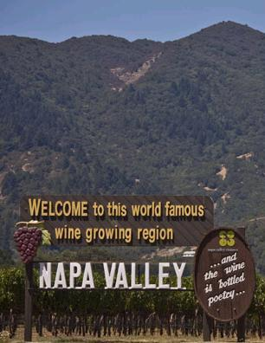
Promoting 推广纳帕谷
Napa Valley
Auction Napa Valley
纳帕谷拍卖
Premiere Napa Valley
纳帕谷首酒
Taste Napa Valley
品尝纳帕谷
Master Napa Valley
精通纳帕谷
Symposium for Professional Wine Writers
为专业葡萄酒作家举办座谈会
Wine Educators Academy
葡萄酒教育者学院
Notes:
45
45
Whether on the road or at home, the Napa Valley Vintners work together to promote the Napa Valley appellation through signature marketing programs, like Auction Napa Valley and Taste Napa Valley.
Our barrel tasting and auction, Premiere Napa Valley, encourages vintners to create some of the rarest wines made in Napa Valley.
Every year vintners bring groups of trade, educators, and writers to Napa Valley to learn more about the appellation and its wines.

Slide 46
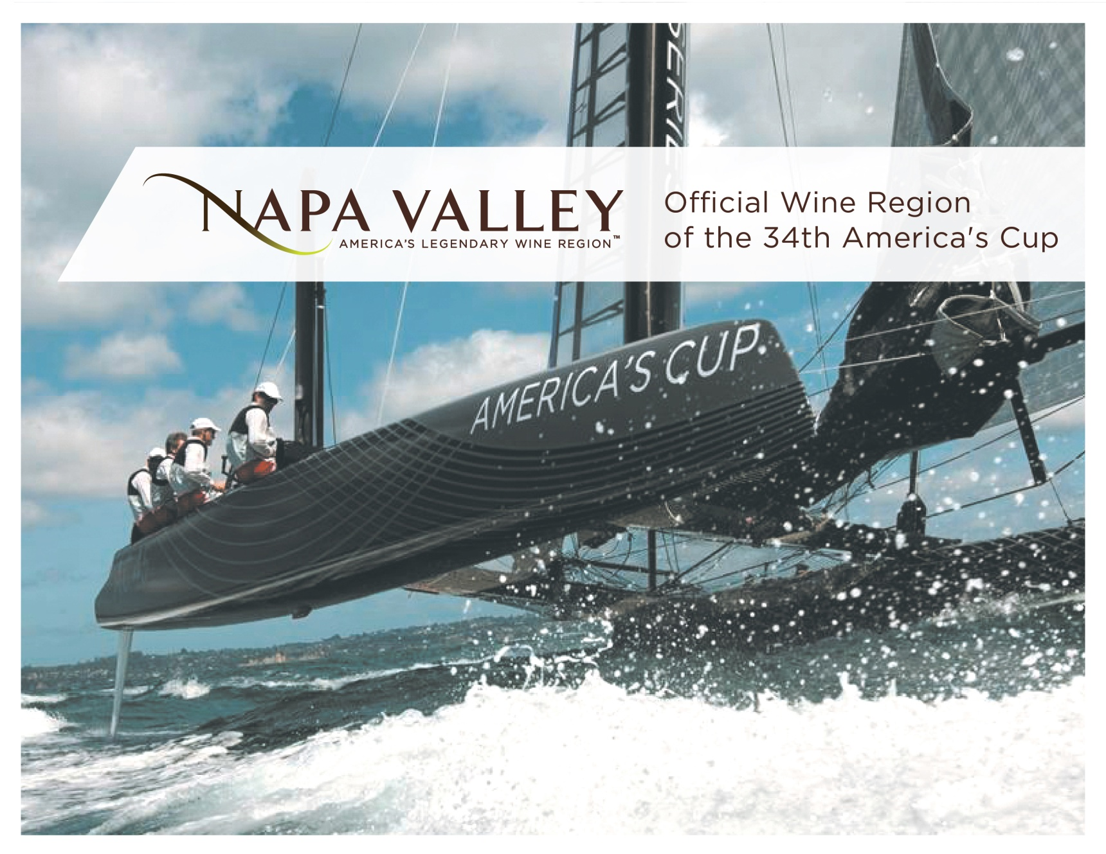
Global Partnerships 全球合作
Notes:
46
46
Another way the NVV is helping to promote the Napa Valley on a grand scale is our recent designation as the official wine region of the 34th America’s Cup, taking place in San Francisco in 2013.
This kind of marketing partnership illustrates the region’s desire to align our brand with other entities that believe in quality, innovation, and sustainability.

Slide 47




Protecting Napa Valley
保护纳帕谷
Conjunctive labeling
联结词标志规定
Napa Name Law 与纳帕命名相关的法律
First wine region to obtain Geographic Indication (GI) status in China 第一个在中国获得地理标识（GI）地位的产区
First non-European wine region to obtain GI Status in European Union 第一个获得欧盟GI地位的非欧盟葡萄酒产区
GI status obtained in Brazil, Canada, India, and Thailand 已在巴西、加拿大、印度和泰国获得GI地位
Ongoing trademark monitoring 从未间断的商标监控
Notes:
We were the first to enact Conjunctive Labeling laws for wine in California by ensuring that if a wine lists the name of a nested appellation on the label, like Oakville, it also includes the Napa Valley name on the same label
Napa Valley Vintners also believe that for a wine to have “Napa Valley” in the brand name, it should have Napa Valley wine in the bottle.
In other words, consumers should know where the wine they’re drinking really comes from.
The Napa Valley Vintners work to ensure that truth in wine labeling laws are adhered to around the globe – and have taken the fight all the way to the US Supreme Court, China, the European Union, and other major countries.
We also continuously monitor trademark applications around the globe to ensure these principles are followed.

Slide 48
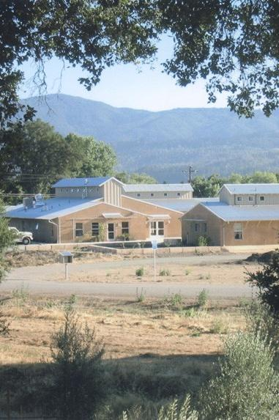
Protecting
Napa Valley 保护纳帕谷
Working Together
for the Industry 通力合作:
Monitoring ordinances that may affect the wine industry 关注可能影响葡萄酒行业的条例
Self taxation 自我征税
Pests and diseases 虫害、动物害和病害
Farmworker housing 农业工人住房问题
Notes:
48
48
Vintners also pay attention to what’s happening in the wine industry in general.
Much like the founding members of the NVV in the 1940’s, vintners today understand that they can do more together than on their own.
The NVV actively monitors winery and viticulture issues and takes action collectively when needed.
For example, the Napa Valley wine industry has twice over the past 10 years imposed ongoing taxes on itself – the first enhances local efforts to monitor and eradicate vineyard pests and diseases, and the other helps fund housing for the workers who tend to our vineyards.
This photo is of the River Ranch Farmworker Housing Center near St. Helena.

Slide 49
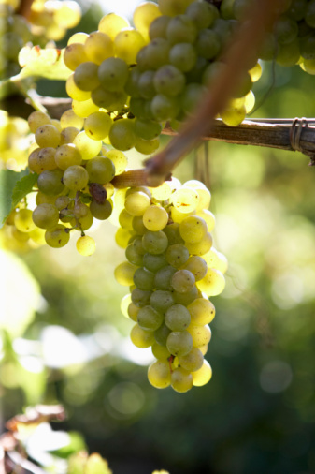
Environmental Leadership
倡导环境保护
1944
Napa Valley Vintners Forms
纳帕谷酿酒商协会成立
1968
Agricultural Preserve 农业保护区建立
1976
Conservation Easements 保护区地役权
1990
Growth Management System 种植管理体系
1990
Winery Definition Ordinance 定义酒庄法令
1991
Hillside Planting and Stream Setback
Ordinance and Zoning Agricultural Land
山坡种植及河溪缓冲带条例，农业土地分区
1998
Napa River Flood Control
纳帕河流洪水控制
2001
WICC Board and Viewshed Protection
纳帕流域信息与保护中心董事会及视域保护
2002
Farmworker Housing Assessment
农业工人住房评估
2003
Napa Green Certified Land
纳帕绿色授权土地
2008
Napa Green Certified Winery
纳帕绿色授权酒庄
Notes:
49
49
The other valuable asset that must be protected: the Napa Valley itself.
For more than 40 years, long before green and sustainable became buzzwords, vintners have supported the tradition of environmental leadership by focusing on environmentally sound practices.
Rather than waiting for government to enact rules and guidelines, Napa Valley Vintners often find themselves at the table helping to craft these policies.
Napa Valley’s vintners farm under the most stringent land use and environmental guidelines of any winegrowing region and have often created these strict rules themselves to protect what is important to them.

Slide 50
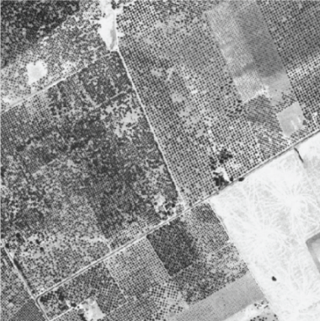
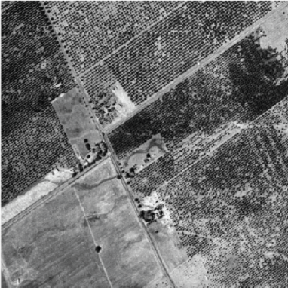
Napa Valley Agricultural Preserve
纳帕谷农业保护区
Highest and best use of the land 土地被最有效的利用
Napa Valley, 1940
1940年的纳帕谷
Santa Clara Valley, 1940
1940年的圣克拉拉谷
Napa Valley, 1940
1940年的纳帕谷
Santa Clara Valley, 1940
1940年的纳帕谷
Notes:
50
50
For example, the Napa Valley Ag Preserve, founded in 1968, was the first in the U.S. to set aside land specifically for agriculture.
Founded in 1968, it’s been going strong more than 40 years without compromise, and now protects 38,000 acres of valley floor farmland.
Another 20,000 acres of Napa Valley land has been placed into permanent conservation easements.
This slide and the next show the impact of the Ag Preserve on our county…and our way of life.
Here’s an aerial photo of Napa Valley and the Santa Clara Valley taken around 1940 – both of these communities are about an hour from San Francisco…

Slide 51
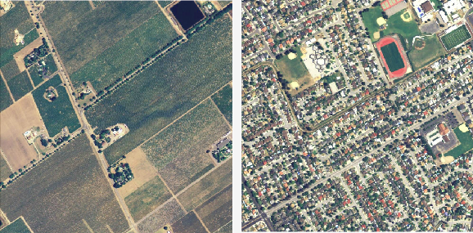
Napa Valley Agricultural Preserve
纳帕谷农业保护区
Protects roughly 38,000 acres of farmland
保护着大约38,000英亩的农田
Napa Valley, 2005
2005年的纳帕谷
Santa Clara Valley, 2005
2005年的圣克拉拉谷
Notes:
51
51
A photo was taken again of the same two places in 2005 – a couple of pictures here are worth more than 1,000 words!

Slide 52
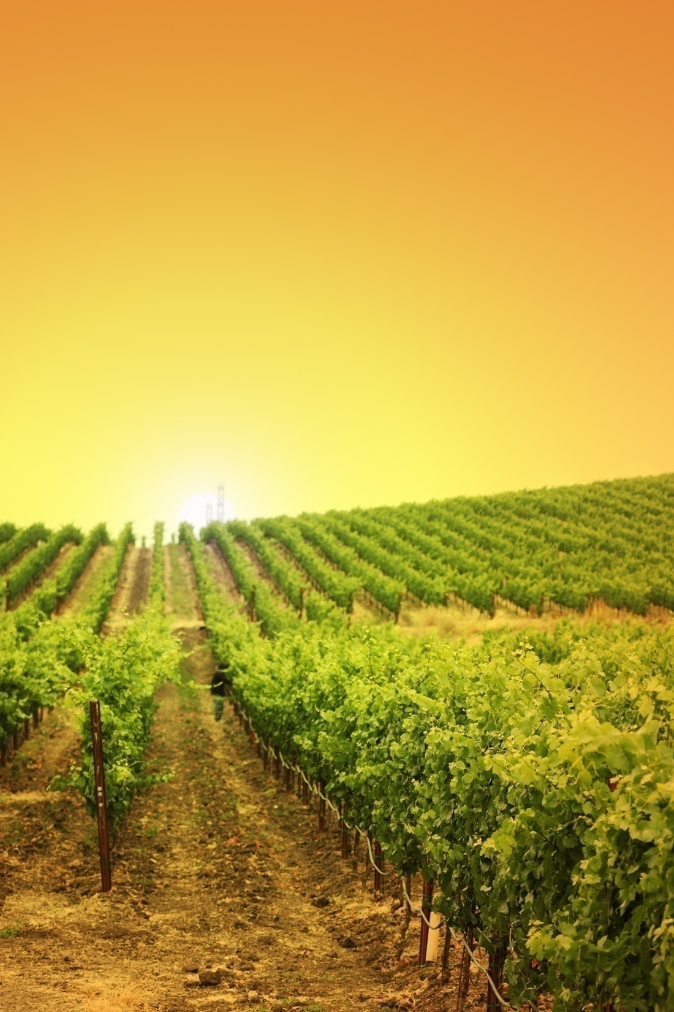

Enhancing the
Napa Valley 优化纳帕谷
Napa Green Land 纳帕绿色土地项目
Wine industry’s most rigorous land-use program 葡萄酒行业内最严厉的土地使用项目
Tailored to the Napa Valley watershed 根据纳帕谷流域进行调整
52,000 acres enrolled and 25,000 acres certified 包含对52,000英亩土地的评估，其中25,000英亩已被授权
Notes:
52
52
To further protect the environment, the Napa Valley Vintners, along with several other local, regional, and state agencies and organizations, developed the Napa Green Certified Land program in 2003.
The program uses sustainable agricultural practices while enhancing the watershed and restoring natural habitat, including soil and water conservation.
It’s the wine industry’s most rigorous land-use program, meeting and exceeding nearly 20 local, state, and federal “best practices.”
To date, 47,000 acres are enrolled in the Napa Green Land program and 26,000 acres have been certified.

Slide 53
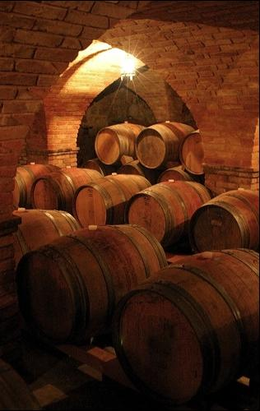

Enhancing the
Napa Valley 优化纳帕谷
Napa Green Winery 纳帕绿色酒庄项目
Reduces
greenhouse gasses 减少温室气体的排放
Independently certified by government regulators 由政府法规制定处独立授权
31 wineries certified and dozens more in process 目前有32家已通过授权，更多正在进行中
Notes:
53
53
Napa Green Certified Winery is a companion certification program launched in 2008 that implements best practices for wineries to reduce, reuse, and recycle energy, water, and waste to eliminate greenhouse gasses.
35 wineries are certified Napa Green with dozens more in progress.

Slide 54

Enhancing the
Napa Valley
提升纳帕谷
Caring for
the Community
关爱社区
Through Auction Napa Valley, the NVV has given
more than $128 million to the community since 1981
从1981年开始，纳帕谷葡萄酒商协会把近1亿美元通过纳帕谷竞拍筹集的资金用于社区建设
Notes:
54
54
And, through our annual community fundraiser, Auction Napa Valley, the NVV has given almost $130 million to date to dozens of local health, youth, and housing non-profits.
And vintner generosity extends well beyond the local community, as Napa Valley wines are the backbone of charity wine auctions across the US.

Slide 55




Napa Valley: Legendary American Wines
纳帕谷：美国的传奇葡萄酒
Learn more 了解更多: NapaVintners.com
Become a fan: Facebook.com/NapaVintners
Follow us on Twitter: @NapaVintners
Read our blog: NapaVintners.com/blog
Notes:
55
55
Millions of years of science…170 years of grape growing…80 years of cooperation and camaraderie.
Today, Napa Valley is the most recognized appellation in America, and its wines are considered some of the finest and most age-worthy in the world.
No other winegrowing region offers more diversity or a greater tradition of leadership.
Thank you for listening to our story.

