Slide 1
Notes:
Thank you for being here and welcome to “Napa Valley Rocks”
(INTRODUCE YOURSELF, INCLUDING YOUR TITLE AND YOUR WINERY NAME)
We’re proud members of the Napa Valley Vintners or N-V-V, the non-profit trade organization dedicated to the promotion, protection, and enhancement of the Napa Valley.
During this presentation, I’ll share with you scientific data, fun facts, history, and examples of specific attributes which make the Napa Valley unique in the world of wine.
We’ll also talk about the leadership of vintners past and present and how the combination of diverse geology, ideal climate, and dedicated people make the Napa Valley what it is today.

Slide 2
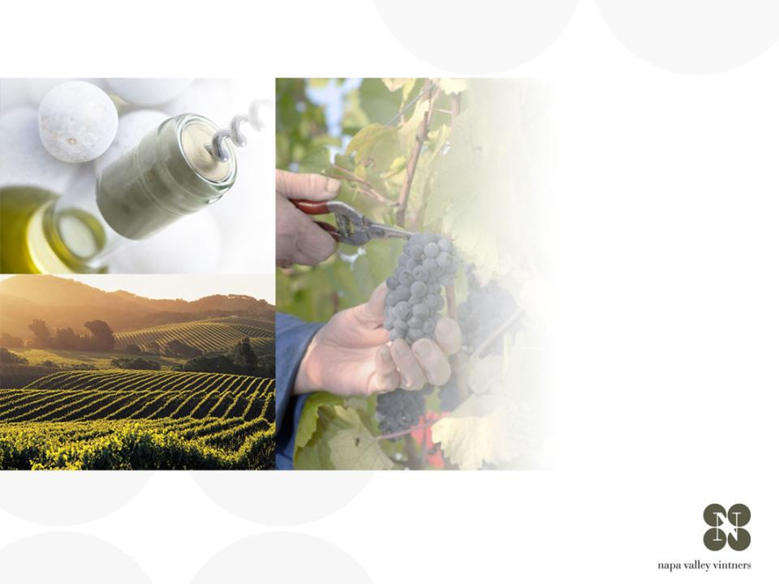
ナパ・ヴァレー
概観
Notes:
2
There are many great wine regions and Napa Valley is one of them.
Napa Valley is the home to America’s first Agricultural Preserve and is a region of incomparable natural beauty.
Though accounting for just 4% of California’s harvest, Napa Valley is the industry’s undisputed leader in land and community stewardship and is renowned the world over for its extraordinary wines.

Slide 3
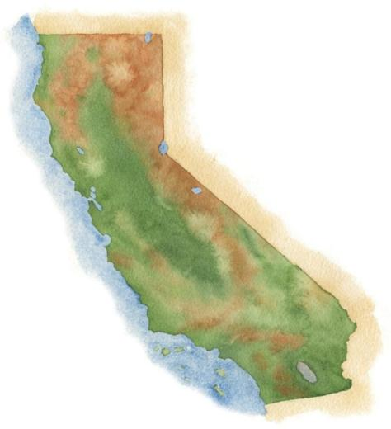
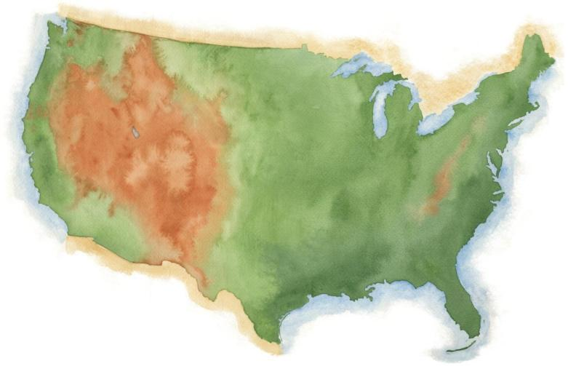
ナパ・ヴァレー
サン・フランシスコ
ロサンゼルス
Notes:
3
It’s a fairly young, “new world” wine region where wine has been made for only about 150 years.

Slide 4
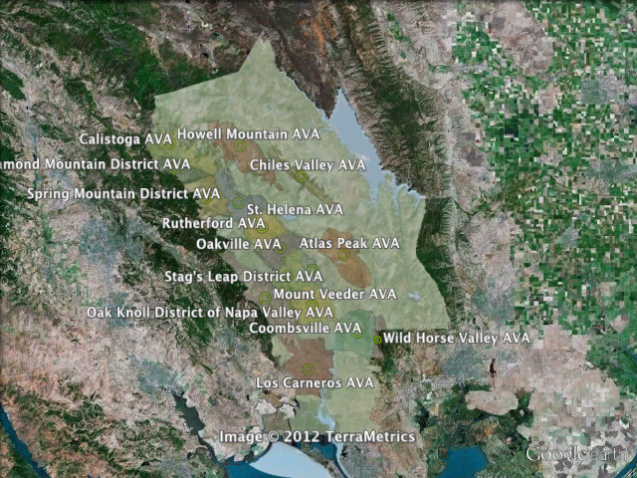
Notes:
An AVA is a geographic grape growing area that possesses distinguishable characteristics, including microclimate and terrain, and cultural and historic distinction.
Vintners and growers within these regions determine the boundaries of the growing area and give it a name that reflects the regional designation.
This data is then submitted to the U.S. government, which decides whether the proposed appellation designation will be granted.
Unlike Europe, these designations do not limit the type of grapes grown, the method of vinification, or the crop yield.
An AVA specifies only a geographical location from which at least 85% of the grapes used to make a wine must have been grown.
Napa Valley was the first AVA to be recognized in California in 1981.

Slide 5
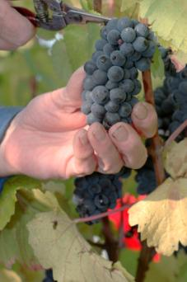
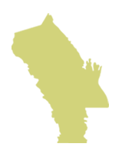
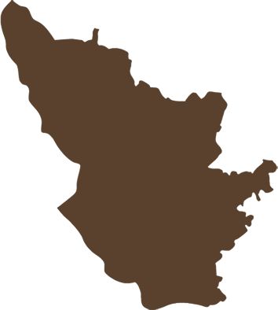
ナパ・ヴァレー AVA
ナパ・ヴァレー AVA
ぶどう栽培面積
45,000 acres (18, 250 ha)
ボルドー AC
ぶどう栽培面積
290,000 acres (117,500 ha)
ナパ・ヴァレーは
ボルドーの8分の１
ボルドー AC
Notes:
5
It is roughly the size of Burgundy’s Côte d’Or and about one-eighth the size of Bordeaux.
There are approximately 45,000 acres under vine, about 9% of all of Napa County.

Slide 6
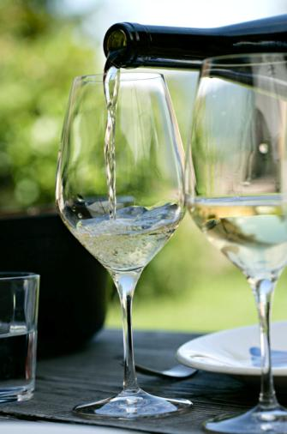

77%
小規模生産者
ＮＶＶメンバーの
77%は、 年間生産量
10,000c/s 以下
メンバー の 63%は、5,000ケース以下
Notes:
6
The majority of Napa Valley’s producers are also small:
Nearly 80% of the NVV’s 400 member wineries make less than 10,000 cases of a wine a year.
More than 60% produce fewer than 5,000 cases annually.

Slide 7
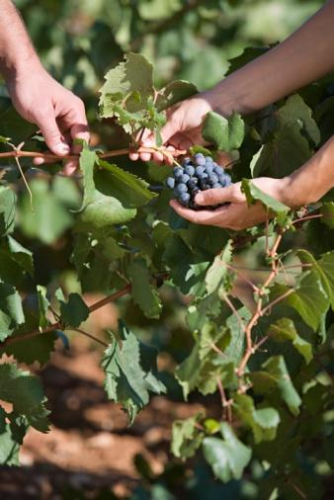
500億ドル
ナパ・カウンティ
以外へも大きな
経済効果
米国への経済効果は
年間500億ドル
カリフォルニアワイン産業全体のもたらす
経済効果の27％
Notes:
7
The Napa Valley wine industry has a $50 billion annual impact on the US economy
This accounts for 27% of the California wine industry’s total impact on the US

Slide 8
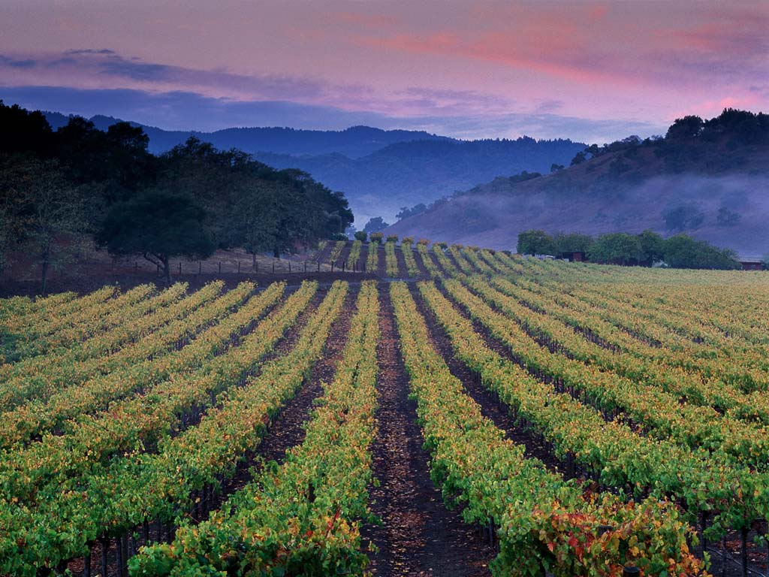
ナパ・ヴァレーは、
世界で最も多様性のある
ワイン生産地の一つ
Notes:
Although the place and the industry are relatively small, Napa Valley is one of the most diverse wine growing regions in the world.
Napa Valley has an amazing assortment of microclimates, soils, weather, and topography.
A wide array of grape varieties grow extraordinarily well here.

Slide 9
ワインにとって理想的な場所:
土壌
Notes:
We’ll start from the ground up - with soil.

Slide 10
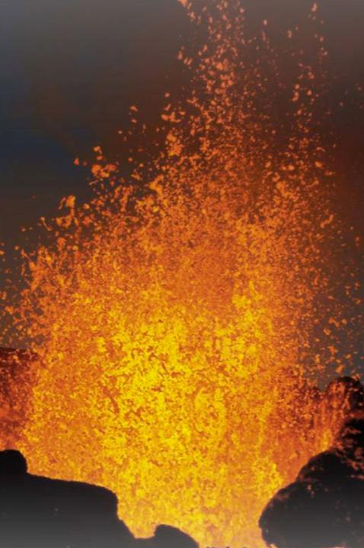
約１億５千万年前
様々なことが
ドミノのように
押し寄せました。
Notes:
10
About 150 million years ago, a series of geologic events caused the shifting, sliding, and lifting of land masses in the area that we know of today as California.
That plastered material onto the edge of North America and formed it into its present, yet ever-changing configuration.
This is the process that created the Napa Valley.

Slide 11

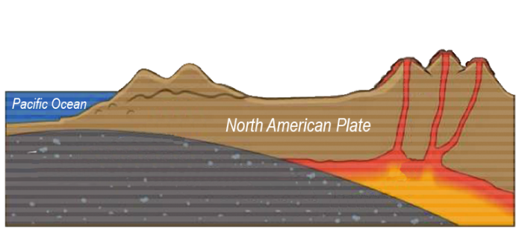
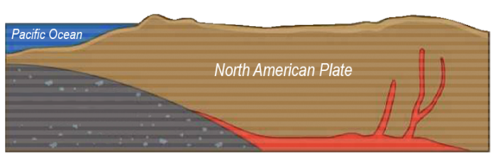
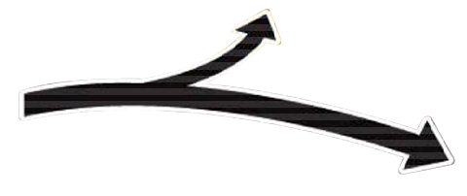


グレート・ヴァレー・シークエンスと
サンフランシスカン・フォーメーション
フランシスカン・フォーメーション
(海底でのプレートの沈み込み)
Pacific Plate Subduction
グレート・ヴァレー
シークエンス
マグマが上昇し、
山脈や火山
を形成
Notes:
11
Over time the mountains eroded and reformed, helping to create California.
Geologists call this the Great Valley Sequence, the remains of which are generally found on the east side of the Napa Valley.
As volcanoes were forming inland, the surface of the ocean floor was being sheered off as it met the coastline, literally plastering all sorts of marine sediment on top of the newly forming landmass, extending California westward.
Geologists call this the Franciscan Formation, the remains of which are generally found on the west side of present day Napa Valley.

Slide 12
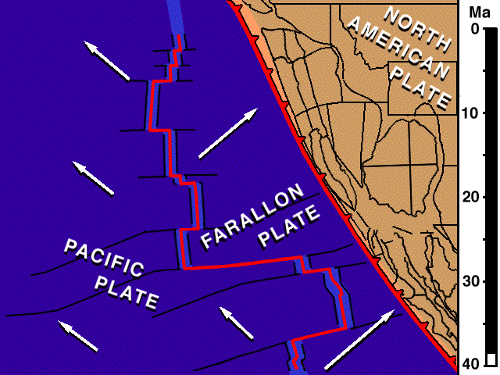
サン・アンドレアス断層
ファラロン・プレート、太平洋プレート、北アメリカ・プレートがぶつかる“トリプル・ジャンクション”で、プレート側面は北の方向にずれて、サン・アンドレアス断層を形成。
Notes:
12
About 24 million years ago the San Andreas Fault system took shape with the joining of three tectonic plates – the Farallon, the Pacific, and the North American.
These plates started to move laterally south to north, moving this volcanic and sedimentary bedrock in all directions.
As this “triple junction” slowly moved north, dragging the San Andreas fault along, tremendous compression forces pushed up wrinkles in the earth’s crust that eventually became the Coast Range and the Mayacamas Mountains.

Slide 13
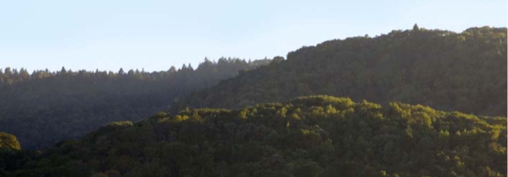
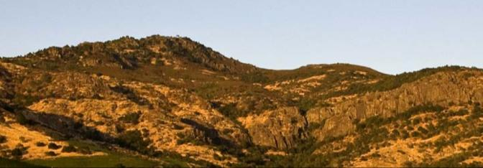
マヤカマス山脈
ヨーントヴィルの西側
ヴァカ山脈
スタッグス・リープ・ディストリクトの東側
Notes:
13
Around 3 million years ago plate motion shifted direction again, this time folding the land over on top of itself, creating the Mayacamas Mountains, the Vaca Range, and Napa Valley in-between.
The multiple bedrock sources that would make up Napa Valley’s distinct soils were now in place.

Slide 14
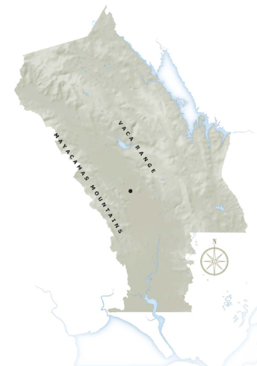
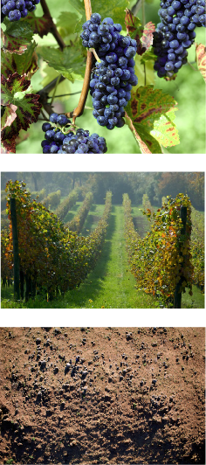
ナパ・ヴァレー
ヨーントヴィル
サン・パブロ湾
からの浸食
Notes:
14
14
Over many years rainfall helped break apart this bedrock sediment from the mountains and hillsides and settled it on the valley floor.
Vegetation grew and died, adding in organic material.
The Napa River spilled its banks with regularity.
San Pablo Bay – the northern arm of the San Francisco Bay – engulfed the lower valley as far inland as current day Yountville, only to retreat and then engulf the lower valley floor again.

Slide 15
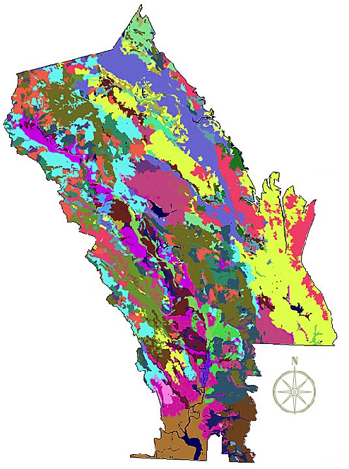
ナパ・ヴァレーＡＶＡ
の土壌体系
１００種類以上の
異なった土壌
３３の土壌体系
世界の全土壌の
半分が存在する
Notes:
15
Napa Valley contains more than 100 soil variations, 33 soil series, and half the soil orders found in the world.
This picture shows how, literally, you can have different kinds of soil in the same vineyard in Napa Valley.
This diversity allows vintners to grow and produce – and to produce well – a great number of different wine varieties in the Napa Valley.
One of the secrets of great winegrowing is in the soil and Napa Valley has some of the greatest soil diversity found in winegrowing regions around the world.
(Note difference between a soil order, series and variation: soil orders are based largely on soil forming processes. Soil series is of a similar evolution or formation, chemistry, and physical property. Soil variations take into account vegetative material, climate, and topography differences and/or make-up).

Slide 16
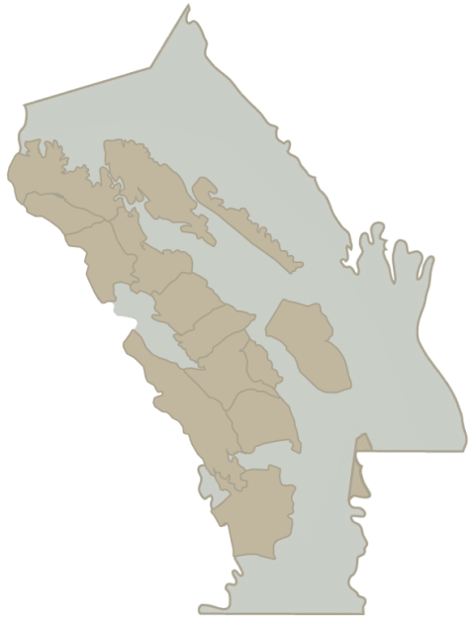
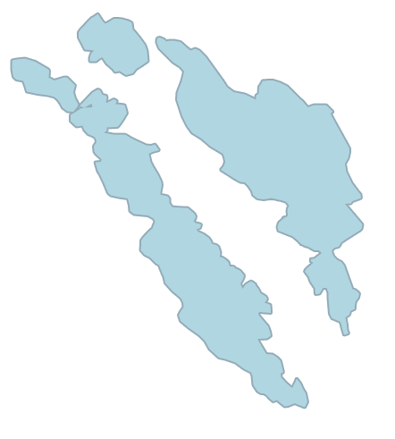
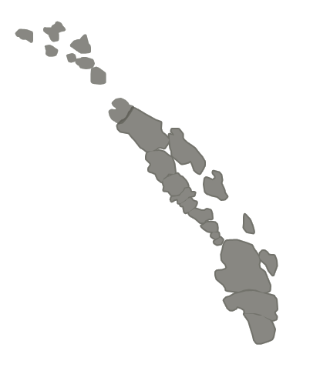
Howell
Mountain
Chiles
Valley
District
Calistoga
Spring
Mountain
District
堆積土壌について
St. Helena
Rutherford
Oakville
Atlas
Peak
Stags
Leap
District
Yountville
Mount
Veeder
Oak Knoll
District of
Napa Valley
Wild
Horse
Valley
Los
Carneros
分水嶺
堆積土壌
Notes:
16
Much of Napa Valley’s soils were formed by the marine sediment and volcanic material that make up the Mayacamas Mountains and Vaca Range.
Soils created by the runoff of a single creek from a hillside watershed are known as alluvial soils.
Along the valley floor exist these pockets of alluvial soils.
Alluvial and fluvial soils are generally deeper, more fertile, and hold more moisture than the thinner rocky soils covering hillsides and slopes.

Slide 17
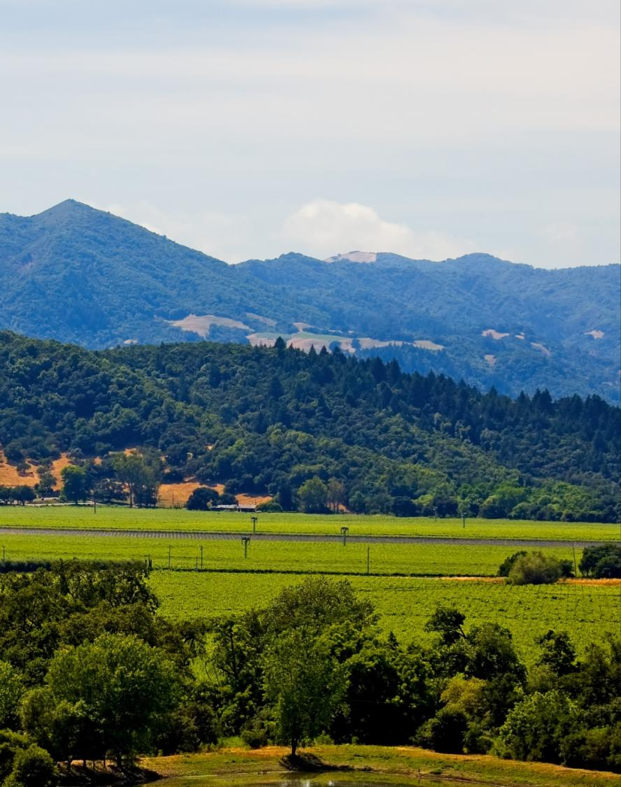
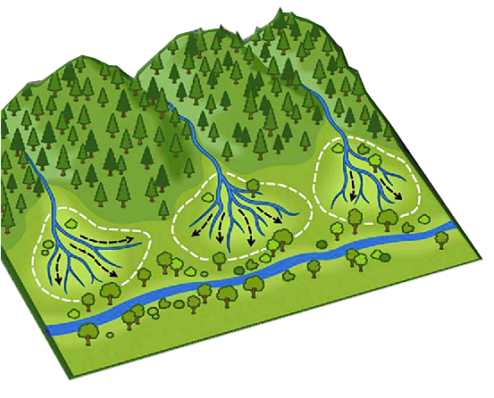
丘陵からの水流
堆積扇状地
川の近くは、川の流れによって
運ばれた堆積土壌。
Notes:
17
17
Alluvial soils spread out in a fan-like shape, when streams, running down from the mountains, become sediment-laden.
This creates an area of distinct soil called an alluvial fan.
Other soil can be made up of bedrock sediment from multiple watershed sources or from flooding - it is called fluvial soil.
Fluvial soils are generally found around the Napa River.
Soils can impart distinct character in wine grapes depending on their bedrock origin.
Soil depth and fertility will also affect the character of wine grapes and, ultimately, wine flavor.

Slide 18
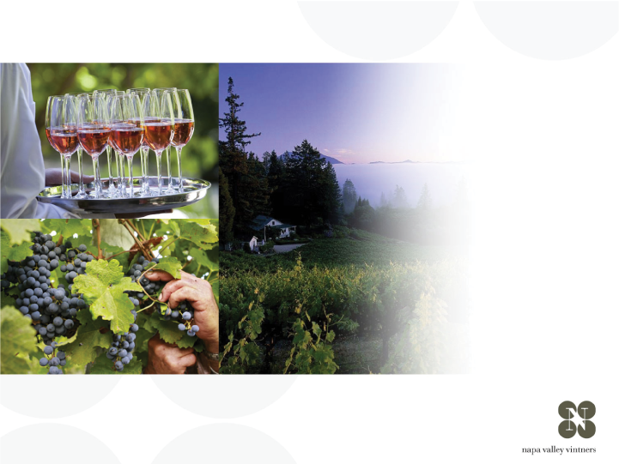
ワインにとって理想的な環境
気候
Notes:
18
Climate also has a significant impact on the flavor of the grapes.

Slide 19
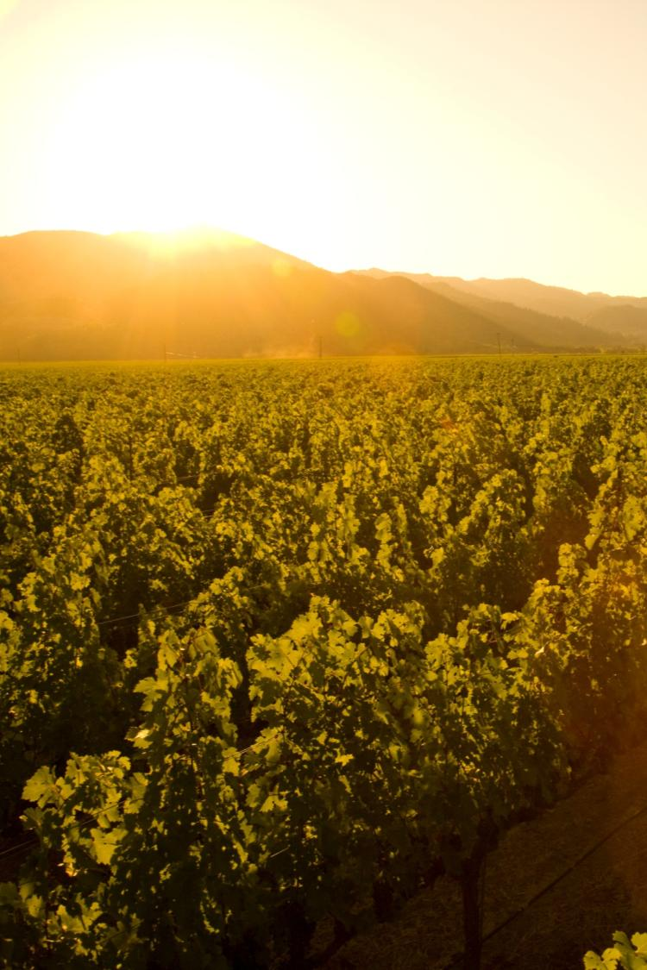
地中海性気候ゾーン
長いぶどう生育期
夏の間、雨が降らない
ヴィンテージ毎の差が小さく、安定した品質。
ぶどうの病害が少ない。
Notes:
19
19
Napa Valley is located within the rare Mediterranean climate zone, which encompasses just 2% of the earth’s surface.
The long growing season is marked by warm summer days and cool evenings – ideal for wine grapes to ripen slowly and evenly, with great balance between sugar and acid development.
Lack of summer rainfall helps to contribute to consistency of vintages and reduces the risk of vineyard diseases.
Most areas of the appellation can dry farm or tightly manage their irrigation practices.
Compared to most growing regions in the world, Napa Valley is unique in this regard.

Slide 20
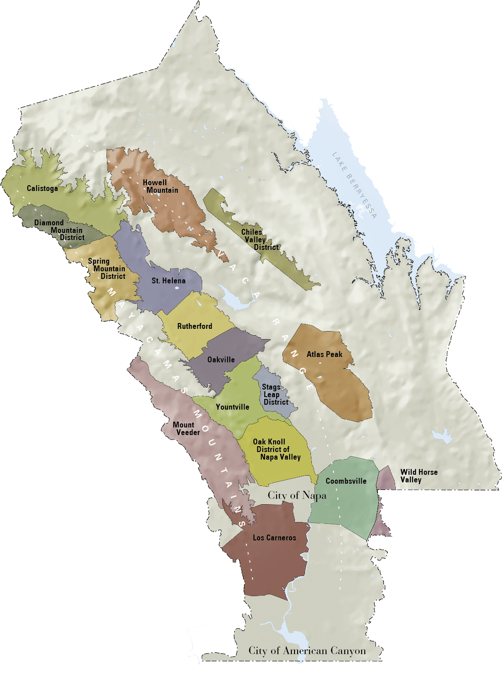
ナパ・ヴァレー AVA
平均降水量
40-55 in/102-140 cm
18-24 in/46-61 cm
Notes:
20
20
When it does rain in the winter, the southern reaches of Napa Valley AVA receive just 18 inches of rain each year.
The mountains at the northern end can record nearly 60 inches.

Slide 21


海からの霧が
毎日流入する
ための条件が
揃っている。
冷
暖
太平洋
Notes:
21
21
During the summer growing season, conditions exist for creating a recurring pattern of marine fog from the Pacific Ocean.
As hot air in California’s interior valley rises, it creates a vacuum effect which draws in moist, cool air from the Pacific Ocean, forming fog.
This pattern repeats most days during the warmer months of the year.

Slide 22

ナパ・ヴァレー AVA
北と南から霧が流れ込む
海からの冷たい霧
海からの冷たい霧
Notes:
22
22
Fog is more prevalent in the southern reaches of the Napa Valley where it comes up from the San Pablo Bay.
In the upper valley, fog enters through the Chalk Hill Gap in the Mayacamas Mountains.
Except on rare days, summer fog will burn-off by mid-morning in all areas of the valley.

Slide 23
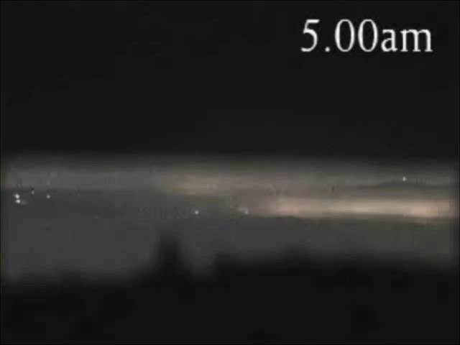
Notes:
This video shows how the fog advances and retreats in the Napa Valley from early until late morning.
Typically, the fog has a greater impact on the valley floor – often the hillsides, like the one where this video was filmed, are not reached by the fog.

Slide 24
ナパ・ヴァレー AVA
気温のバリエーション – 夏期
40-50ºf / 4.5-10ºc
85ºf / 29ºc
40-50ºf / 4.5-10ºc
95ºf / 35ºc
50ºf / 10ºc
77ºf / 25ºc
Notes:
24
24
Daytime temperatures can also vary dramatically throughout the AVA during the growing season.
The southern part of the valley, particularly Los Carneros AVA, is closer to San Pablo Bay and is cooled by marine breezes.
In summer, there can be as much as an 10-15°F difference between Carneros and St. Helena, to the north.
On many days, due to the cooling effect of the fog, there is a large diurnal (day to night) temperature swing throughout the valley.

Slide 25
セントヘレナ山
4000 ft / 1,219 m
ナパ・ヴァレー AVA
標高
スプリング・マウンテン
2200 ft / 671 m
アトラス・ピーク
2600 ft / 793 m
マウント・ヴィーダー
2100 ft / 650 m
ヴァレー・フロア
0– 750 ft / 0 – 214 m
Notes:
25
25
Adding to the diversity of Napa Valley is its topography.
It changes with its length, from the flat estuaries in the south near San Pablo Bay to the rolling hills just before 4,000-foot Mount St. Helena in the north.
And don’t forget the Mayacamas and Vacas to the west and east – each range reaches approximately 2,500 feet above the valley floor.
There is a strong correlation between topography and climate: slope, aspect, and elevation all influence the many mesoclimates found throughout the Napa Valley.

Slide 26
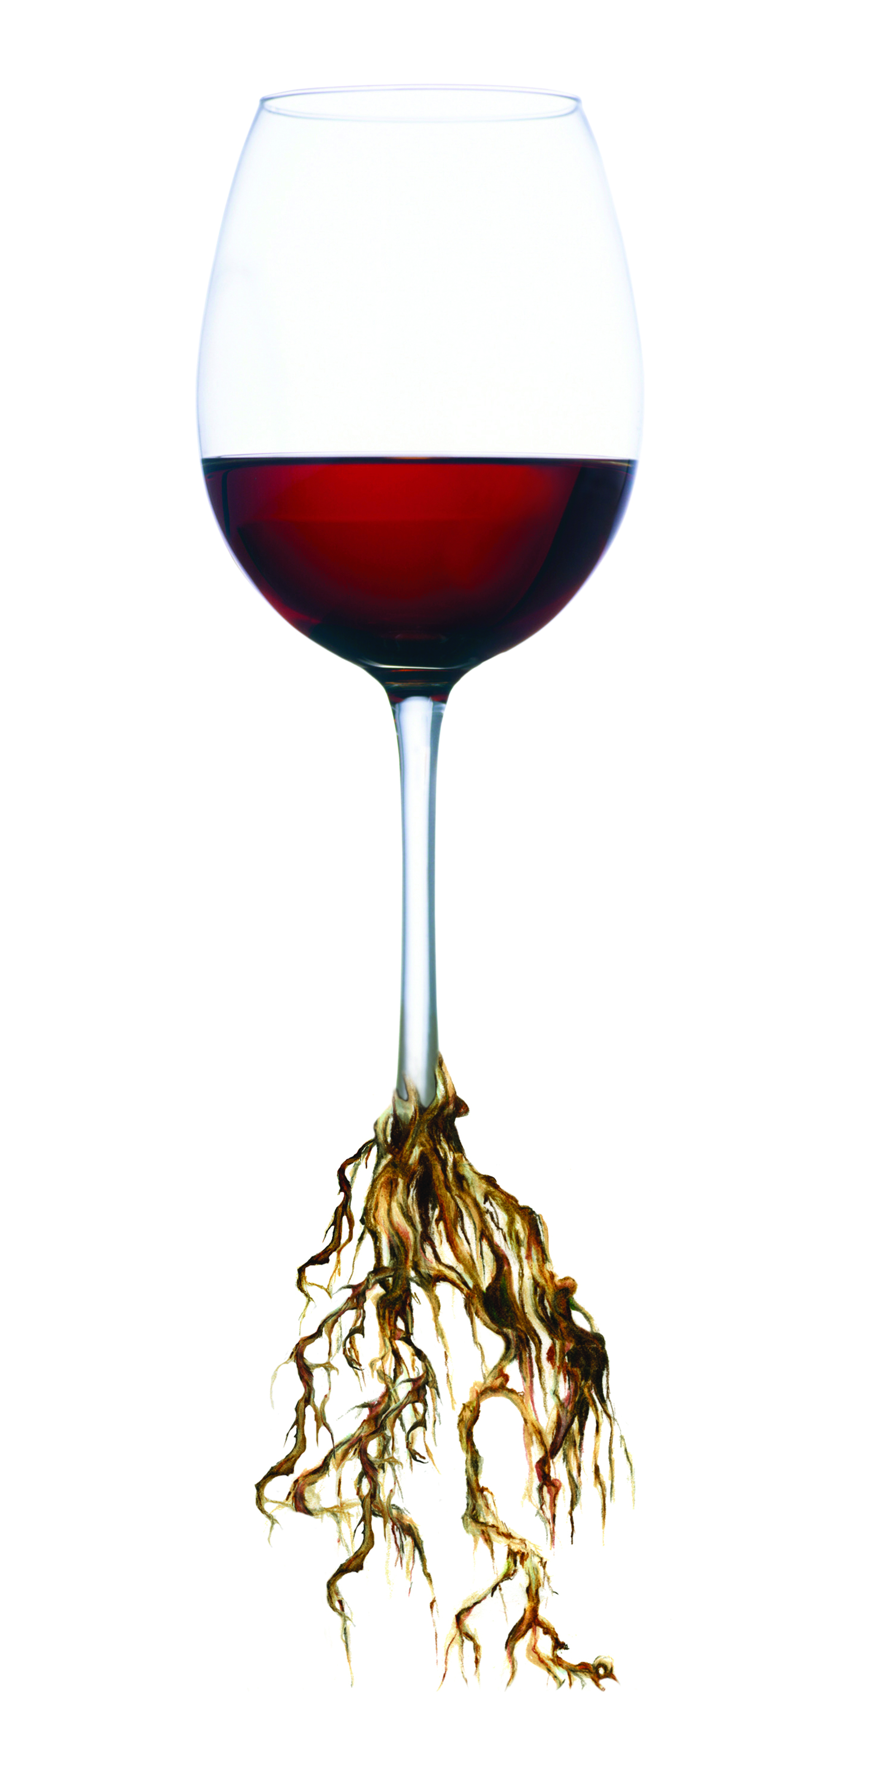
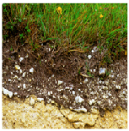
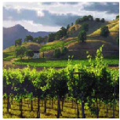
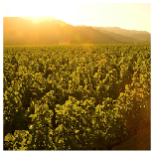
テロワール
全ての要素を総合
特徴的な土壌
特徴的な気候
特徴的な地勢
+
+
特徴的な
ぶどう栽培
エリア
Notes:
26
26
When you put it all together, these distinct soils, plus distinct climates, plus distinct topography it equals distinct growing conditions.
The sum of these factors is known by the French term, terroir.

Slide 27

ナパ・ヴァレー
ぶどう栽培
Notes:
27
Terroir also includes people – the people who make the decisions about how the grapes will be grown.

Slide 28
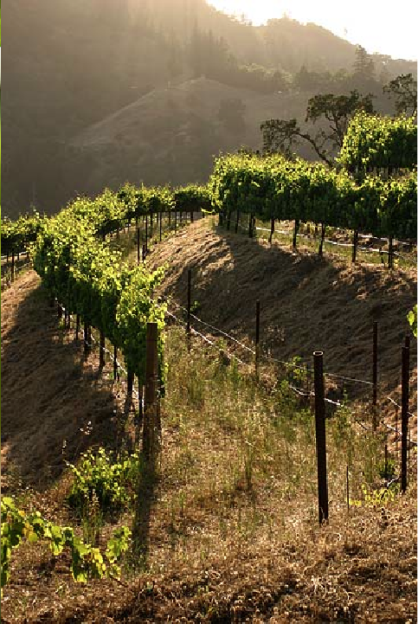
テロワールが
ぶどう栽培に
与える影響
畑の位置決定条件
地勢
土壌要素
水捌け
日照条件
気候・気温
ぶどう品種の選択条件
土壌要素
地勢
Notes:
28
28
When it comes to viticulture, there are many variables influenced by the people behind the wines.
These variables strongly influence grape growers in the Napa Valley and give them the opportunity to make myriad decisions and refinements to their grape growing practices.

Slide 29
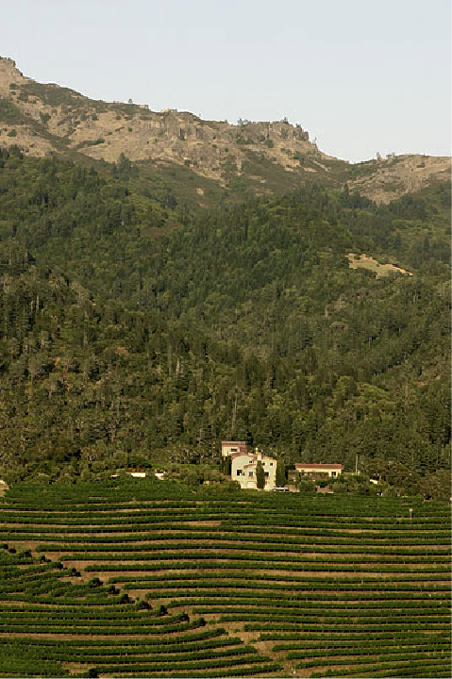
テロワールが
ぶどう栽培に
与える影響
ぶどう栽培の作業
キャノピー・マネージメント
土壌管理
灌漑
ぶどう樹の仕立て方
台木の選定
樹勢強 vs. 樹勢弱
Notes:
29
29
There are many factors to consider when determining the right grape variety and the best practices for the location being planted.

Slide 30

テロワールがワイン
醸造に与える影響
複数の畑の
ぶどう
=
より複雑性
が増す
単一畑の
ぶどう
=
より個性が
際立つ
Notes:
30
30
Take a wine grape – like, Cabernet Sauvignon – and grow it in different areas – and it will taste a little different depending on where it’s from.
For a winemaker, blending grapes from different vineyards means being able to make a wine of greater complexity.
Because of the diverse soils and climate that we’ve just learned about, you can see how the Napa Valley produces such a wide variety of winegrapes with different characteristics reflected depending on where the grapes were grown.
Another way to create a unique, distinctive wine is to focus on a single place or single vineyard.
Winemakers in Napa Valley have become famous for doing both – creating beautifully blended wines from many sources, and creating distinctive wines from a single grape source: think Martha’s Vineyard or To-Kalon.

Slide 31
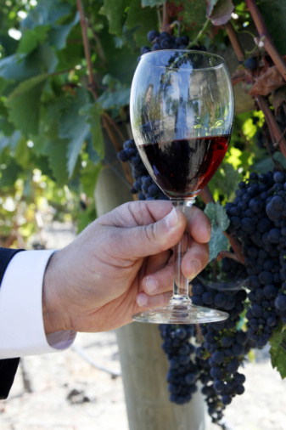
ナパ・ヴァレーの
代表的ぶどう品種：
（栽培面積の大きい順）
カベルネ・ソーヴィニヨン
シャルドネ
メルロー
ソーヴィニヨン・ブラン
ピノ・ノワール
ジンファンデル
シラー
（その他数種）
Notes:
31
31
Napa Valley has become synonymous with Cabernet Sauvignon.
The majority of Napa Valley winemakers produce it.
But, thanks to the many diverse growing conditions we’ve talked about, all kinds of varieties flourish.
Conditions are well-suited for growing both Burgundian (Chardonnay and Pinot Noir) and Bordeaux-style varieties (Cabernet, Merlot, Cabernet Franc, and Sauvignon Blanc).

Slide 32
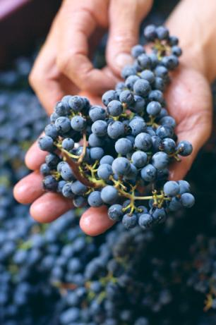
12%
カベルネ・ソーヴィニヨンは、カリフォルニアの全収穫量の１２％
を占める。
40%
カベルネ・ソーヴィニヨンは、
ナパ・ヴァレーの全収穫量の
４０％を占める。
55%
金額ベースでは、ナパ・ヴァレーの全収穫量の５５％を占める
Notes:
32
32
Cabernet Sauvignon accounts for 12% of California’s wine grape harvest.
It makes up approximately 40% of Napa Valley’s overall wine grape harvest, yet had a value of 55% of the harvest, according to the most recent crush report.
In 2010, the value of a ton of Napa Valley Cabernet Sauvignon grapes was four times the statewide average price for a ton of Cabernet Sauvignon grapes.
Napa’s quality is reflected in its grape prices.

Slide 33
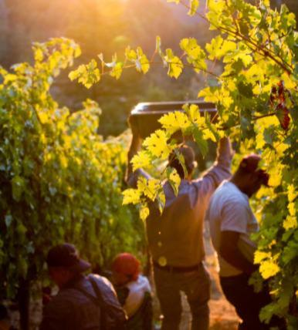
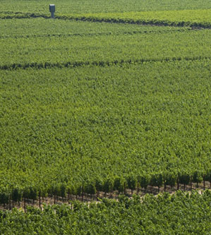
ナパ・ヴァレーのぶどう畑
意図的に収量を低くするぶどう栽培の方法
Notes:
33
33
Most winemakers will tell you that quality starts in the vineyard.
Napa Valley vineyards are intentionally farmed to produce low yields to allow only the healthiest of grape clusters to mature.
Throughout the growing season, the canopy is managed with leaf pruning, shoot pulling, and fruit thinning – all of which is done by hand – resulting in a perfect sunlight to shade ratio and optimal fruit development.
During the year, vineyard workers will tend to each individual vine at least 20 times.
This attention to detail in the vineyard is designed to produce wine grapes of the highest quality.

Slide 34
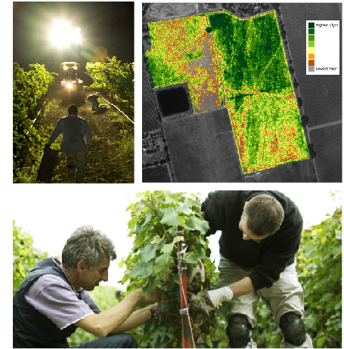
科学、共有された知見、ＮＡＳＡからＵＣデイヴィスに至る学術的情報ソース
ＮＡＳＡの衛星技術と
手作業による夜間の収穫
オークヴィルにある
ＵＳデイヴィスの研究所
ぶどう栽培と醸造の実地研究
• 台木とクローン・セレクション
• 水利用
• ぶどう品種の特徴
• ぶどう樹の効率性
• 発酵
Notes:
34
34
To continuously improve the quality of the grapes, vintners in Napa Valley have been at the forefront of using technology to improve viticultural practices from planting through harvest.
We were among the first to use NASA satellite technology during post-phylloxera replanting to map out best vineyard layouts.
Napa Valley vintners and growers also work in close partnership with the Viticulture and Enology Department at nearby UC Davis, one of the most respected wine schools in the world.
A 40-acre experimental vineyard and research facility in Napa Valley’s Oakville AVA allows students to conduct research.
Vintners from all over the world benefit from this research.

Slide 35
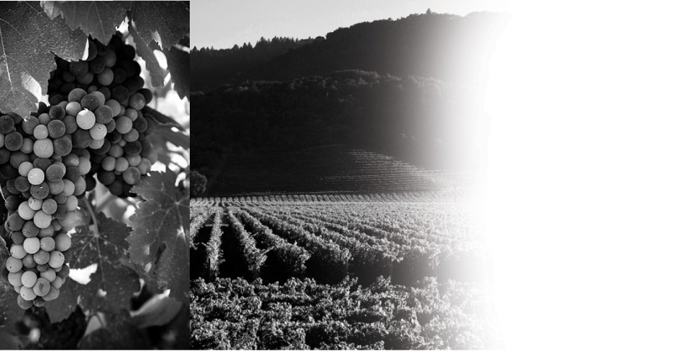
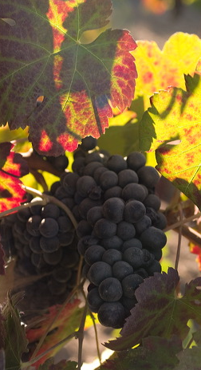
ナパ・ヴァレー
歴史
Notes:
35
It has taken more than 150 years and a long line of great leaders to make the Napa Valley what it is today.
Let’s take a look back at the history of this special place.

Slide 36
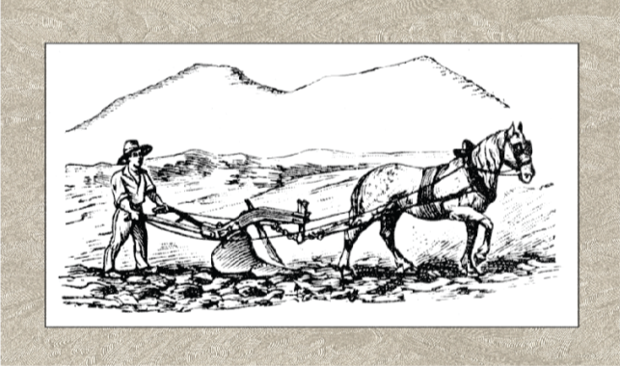
ナパ・ヴァレー
研究、改革、リーダー達
1838-39年にジョージ・ヨーントが最初のぶどう畑を拓く
1830
1840
1850
1860
1870
1880
1890
1900
Notes:
36
36
The Napa Valley of the Wappo Indians was home to spawning salmon, wildcats, elk, black bear, grizzlies… and wild grapes.
The name “Napa” is believed to mean “abundance” in the Wappo language.
Early settlers like George Calvert Yount were the first to recognize the valley's potential for cultivating wine grapes.
In 1838-1839, Yountville was established, and Yount was the first to plant vineyards in the valley.

Slide 37

1860年代
未開の西部がワインを見出す
ジェイコブ・シュラム、チャールズ・クリュッグ、
ジェイコブ・ベリンジャーがナパへ
1830
1840
1850
1860
1870
1880
1890
1900
Notes:
37
37
1849 started California’s Gold Rush.
In the 1860s and ‘70s, Europeans like Jacob Schram, Charles Krug, and Jacob Beringer arrived in Napa, eager to try their hand at making wine to rival the wines from their homeland.
Schram planted Napa County’s first hillside vineyard.
Most of the wine at that time was shipped in bulk to San Francisco for sales and distribution.

Slide 38

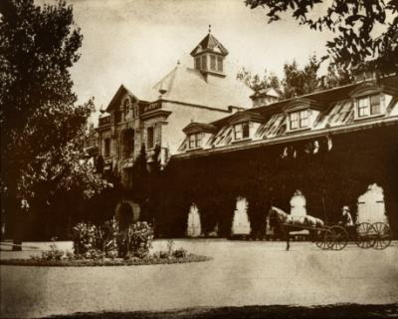
1861-1880
初期のワイナリー
チャールズ・クリュッグが初の商業ワイナリーを設立, 1861
イングルヌックが初のシャトー・スタイルのワイナリーを設立, 1879
1830
1840
1850
1860
1870
1880
1890
1900
Notes:
38
38
Charles Krug is credited with establishing Napa Valley's first commercial winery in 1861.
Gustave Niebaum, a Finnish fur trader, used his enormous wealth to import the best grapevines from Europe to Napa.
In 1879 he established Inglenook, the first chateau-style winery in the US and he was also the first to sell wine in bottles.

Slide 39
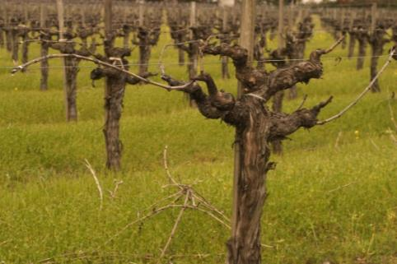
吹き荒れる嵐
フィロキセラ
ぶどう栽培面積は12年で15,807エーカーから 2,000エーカーに減少
1830
1840
1850
1860
1870
1880
1890
1900
Notes:
39
39
But, what’s a success story without a stunning setback or two?
In the late 1890s phylloxera, tiny sap-sucking insects which feed on the roots of grapevines and kill them, hit and nearly decimated Napa’s vineyards.
Acreage in Napa Valley declined from 15,807 in 1888 to just 2,000 acres by 1900.

Slide 40
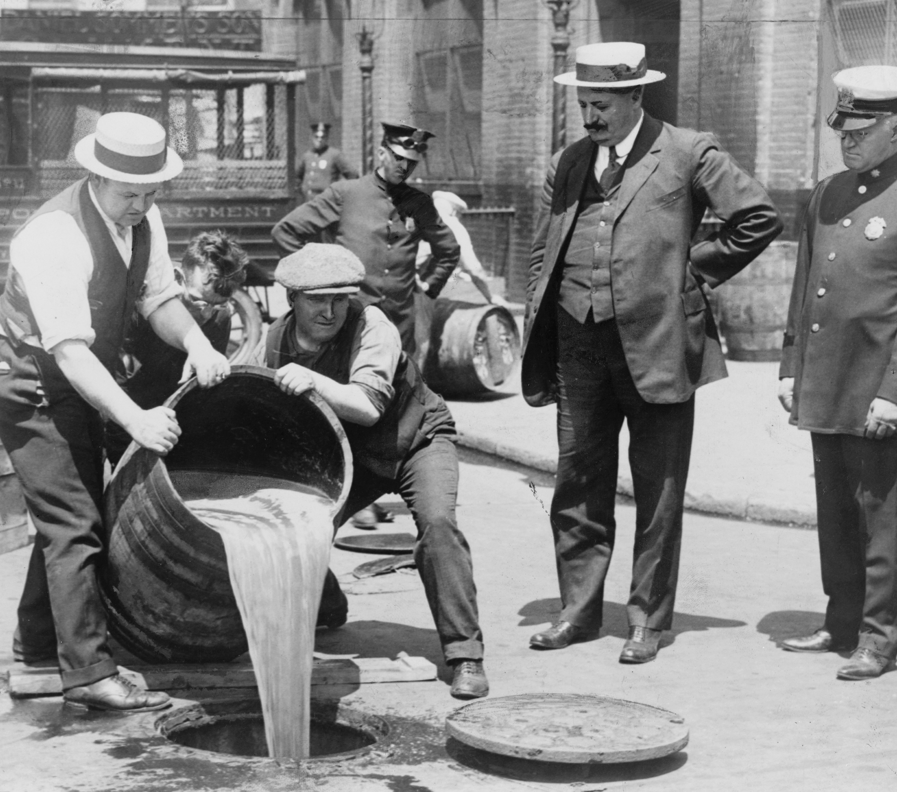
吹き荒れる嵐
禁酒法、世界恐慌、世界大戦
一連の不幸な出来事がナパ・ヴァレー
ワイン産業を襲う
1910
1920
1930
1940
1950
1960
1970
1980
Notes:
40
40
Then an even greater threat arrived in 1920 with the enactment of Prohibition, which lasted for 13 years.
The Great Depression didn’t help matters either.
By the time World War II came along, Napa’s grapevines and wineries were largely abandoned.
Many vineyards were planted over to plums and walnuts.
The Napa Valley wine industry was in shambles.

Slide 41
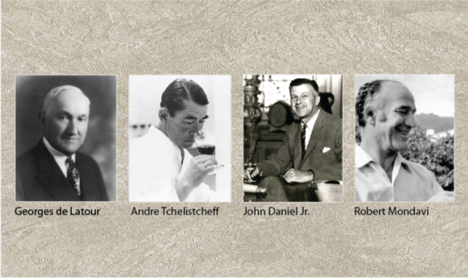
復活
ナパ・ヴァレーの再生
1939年ジョン・ダニエル・Jrがイングルヌックを継承。
1966年ロバート・モンダビが、禁酒法以初めての新しいワイナリーを建設。
1910
1920
1930
1940
1950
1960
1970
1980
Notes:
41
41
Credit for the post-World War II rebirth of the Napa Valley wine industry goes to a handful of bold and visionary vintners, including Georges de Latour, of Beaulieu Vineyards, who in 1938 recruited Andre Tchelistcheff, research enologist from France's Pasteur Institute.
In 1939, John Daniel, Jr. inherited Inglenook, the Gustave Niebaum estate, and ran the winery for 25 years.
Of course, much of the “Napa Valley Renaissance” was led by Robert Mondavi, who championed the idea that fine wine was an integral part of the good life.
In 1966 he founded the Robert Mondavi Winery with the goal of producing wines that would rival the finest wines of Europe.
His renowned marketing strategies brought worldwide recognition to Napa Valley and its wines.
He believed in wine hospitality and graciously welcomed visitors to the winery’s public tasting room.

Slide 42

パリ・テイスティング
ナパ・ヴァレーのシャルドネとカベルネ・ソーヴィニヨンがパリのブラインド・テイスティングで勝利。
1910
1920
1930
1940
1950
1960
1970
1980
Notes:
42
42
While these Napa Valley vintners believed in the quality of the appellation, and in the early 1970s Napa Valley’s reputation continued to grow, it was a pivotal endorsement from another part of the world that helped put Napa Valley on the winegrowing map.
The 1976 Judgment of Paris wine tasting, chronicled recently in the movie “Bottle Shock,” set the wine world on it’s ear: few could have imagined that California wines would win such a competition.
Yet California rated best in each category.
The hard work of Napa Valley’s vintners was starting to pay off.

Slide 43
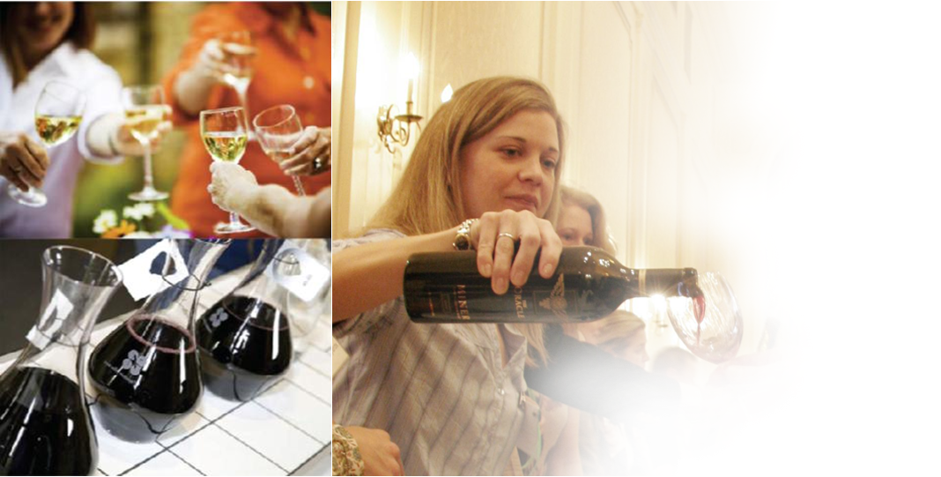
ナパ・ヴァレー
ヴィントナーズ
Notes:
43
Nearly seven decades after being formed, and now 400 wineries strong, the Napa Valley Vintners still work to promote and protect – as well as enhance – the Napa Valley AVA as the premier winegrowing region.

Slide 44
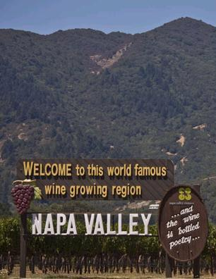
ナパ･ヴァレーの
名声を高める活動
オークション・ナパ･ヴァレー
プルミエ・ナパ・ヴァレー
テイスト・ナパ・ヴァレー
マスター・ナパ・ヴァレー
ワインライター・シンポジウム
ワイン・エデュケーターズ・
アカデミー
Notes:
44
44
Whether on the road or at home, the Napa Valley Vintners work together to promote the Napa Valley appellation through signature marketing programs, like Auction Napa Valley and Taste Napa Valley.
Our barrel tasting and auction, Premiere Napa Valley, encourages vintners to create some of the rarest wines made in Napa Valley.
Every year vintners bring groups of trade, educators, and writers to Napa Valley to learn more about the appellation and its wines.

Slide 45
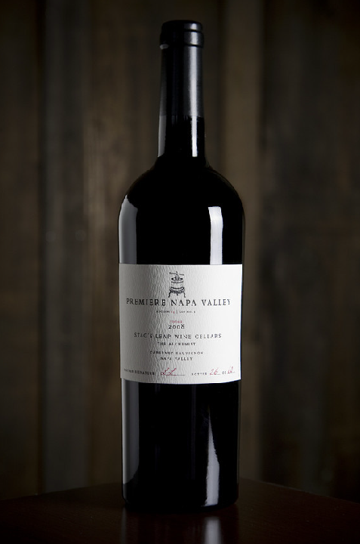
ナパ・ヴァレーのイベント
プルミエ・ナパ・ヴァレー
2月に行われるトレード対象の
バレル・オークション
1ロット60-240本の希少なワイン
だけが提供される。
詳細は： www.PremiereNapaWines.com
Notes:
Premiere Napa Valley wines are among the rarest in the world.
Crafted for the annual Premiere Napa Valley trade tasting and auction, these wines are created only once and sold to a single bidder in lots as small as 5 cases and not larger than 20 cases.
45

Slide 46

ナパ・ヴァレー
原産地呼称保護
接続的ラベル表記:
ナパ・ヴァレー・ヴィントナーズによって提案され、1986年に制定されたカリフォルニア州法により、ナパ・ヴァレーのサブ・アぺレーションを表示する場合は、ナパ・ヴァレーも同時に表記すること。
Notes:
Of course, we’d have nothing to promote if vintners did not protect one of their most important assets: the “brand” Napa Valley.
Remember, Napa Valley was the first AVA designated in California.
As other sub-appellations were approved within the Napa Valley, vintners realized they had to protect the overall brand.
As a result, Napa Valley became the first wine region to develop conjunctive labeling laws for its wholly contained sub-appellations, to further help consumers distinguish origin.
For example, if a bottle is labeled Rutherford, it must say “Rutherford Napa Valley.” This law helps position the Napa Valley as the over-arching brand.

Slide 47


ナパ・ヴァレー農業用地保護法
土地の最も有効な活用
ナパ・ヴァレー 1940
サンタ・クララ・ヴァレー 1940
Notes:
47
47
The Napa Valley Ag Preserve was the first in the U.S. to set aside land specifically for agriculture.
Founded in 1968, it’s been going strong more than 40 years without compromise, and now protects 38,000 acres of valley floor farmland.
Another 20,000 acres of Napa Valley land has been placed into permanent conservation easements.
This slide and the next show the impact of the Ag Preserve on our county…and our way of life.
Here’s an aerial photo of Napa Valley and the Santa Clara Valley taken around 1940 – both of these communities are about an hour from San Francisco…

Slide 48

ナパ・ヴァレー農業用地保護法
約38,000エーカーの農業用地を開発から守る
ナパ・ヴァレー 2005
サンタ・クララ・ヴァレー 2005
Notes:
48
48
A photo was taken again of the same two places in 2005 – a couple of pictures here are worth more than 1,000 words!

Slide 49


ナパ・ヴァレーの
環境保護
ナパ・グリーン・ランド
プログラム
ナパ・ヴァレーの水体系を
保護するためにデザインされた、世界でも類を見ない
環境保護プログラム
52,000 エーカーが加盟 25,000 エーカーが認証済
Notes:
49
49
To further protect the environment, the Napa Valley Vintners, along with several other local, regional, and state agencies and organizations, developed the Napa Green Certified Land program in 2003.
The program uses sustainable agricultural practices while enhancing the watershed and restoring natural habitat, including soil and water conservation.
It’s the wine industry’s most rigorous land-use program, meeting and exceeding nearly 20 local, state, and federal “best practices.”
To date, 52,000 acres are enrolled in the Napa Green Land program and 25,000 acres have been certified (more than 13,000 of this acreage is vineyard land).

Slide 50


ナパ・ヴァレーの
環境保護
ナパ・グリーン・ワイナリー
プログラム
ＣＯ２削減
独立した政府機関による
認証プログラム
31 ワイナリーが認証済み
数十が認証申請中
Notes:
50
50
Napa Green Certified Winery is a companion certification program launched in 2008 that implements best practices for wineries to reduce, reuse, and recycle energy, water, and waste to eliminate greenhouse gasses.
31 wineries are certified Napa Green with many more in progress.

Slide 51




ナパ・ヴァレー・ヴィントナーズ
ホームページ（日本語）： http://www.napawine.jp
Become a fan: Facebook.com/NapaVintners
Follow us on Twitter: @NapaVintners
Read our blog: NapaVintners.com/blog
Notes:
51
51
Millions of years of science…150 years of grape growing…70 years of cooperation and camaraderie.
Today, Napa Valley is the most recognized appellation in America, its wines are considered some of the finest and most age-worthy in the world.
No other winegrowing region offers more diversity or a greater tradition of leadership.
Thank you for listening to our story.

