Slide 1
Notes:
Thank you for being here and welcome to “Napa Valley Rocks”
(INTRODUCE YOURSELF, INCLUDING YOUR TITLE AND YOUR WINERY NAME)
We’re proud members of the Napa Valley Vintners or N-V-V, the non-profit trade organization dedicated to the promotion, protection, and enhancement of the Napa Valley.
During this presentation, I’ll share with you scientific data, fun facts, history, and examples of specific attributes which make the Napa Valley unique in the world of wine.
We’ll also talk about the leadership of vintners past and present and how the combination of diverse geology, ideal climate, and dedicated people make the Napa Valley what it is today.

Slide 2
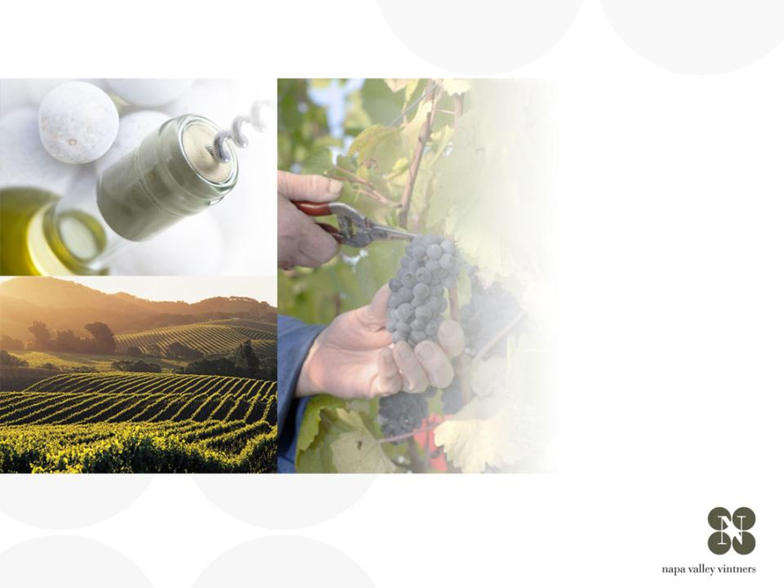
overview of
NAPA VALLEY
Notes:
There are many great wine regions and Napa Valley is one of them.
Napa Valley is the home to America’s first Agricultural Preserve and is a region of incomparable natural beauty.
Though accounting for just 4% of California’s harvest, Napa Valley is the industry’s undisputed leader in land and community stewardship and is renowned the world over for its extraordinary wines.

Slide 3
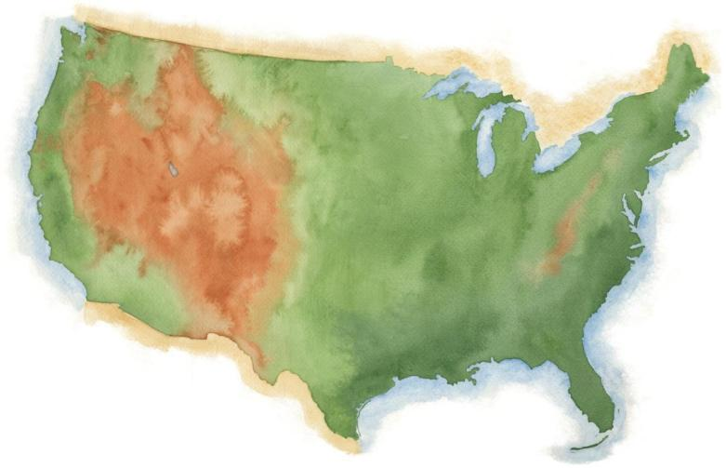
NAPA VALLEY
Notes:
Napa Valley is located in Northern California, very close to San Francisco and the Pacific Ocean, and several hundred miles from Los Angeles.

Slide 4
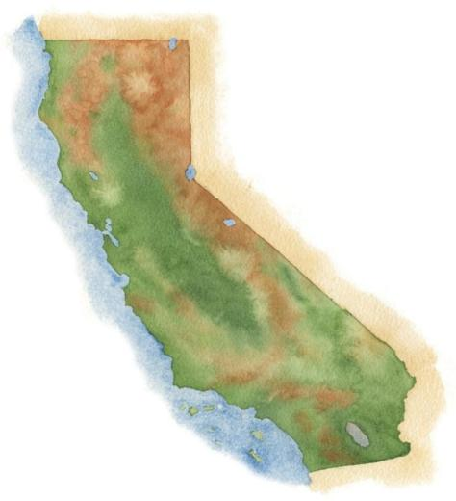
NAPA VALLEY
San Francisco
Los Angeles
Notes:
4
It’s a fairly young, “new world” wine region where wine has been made for only about 150 years.

Slide 5
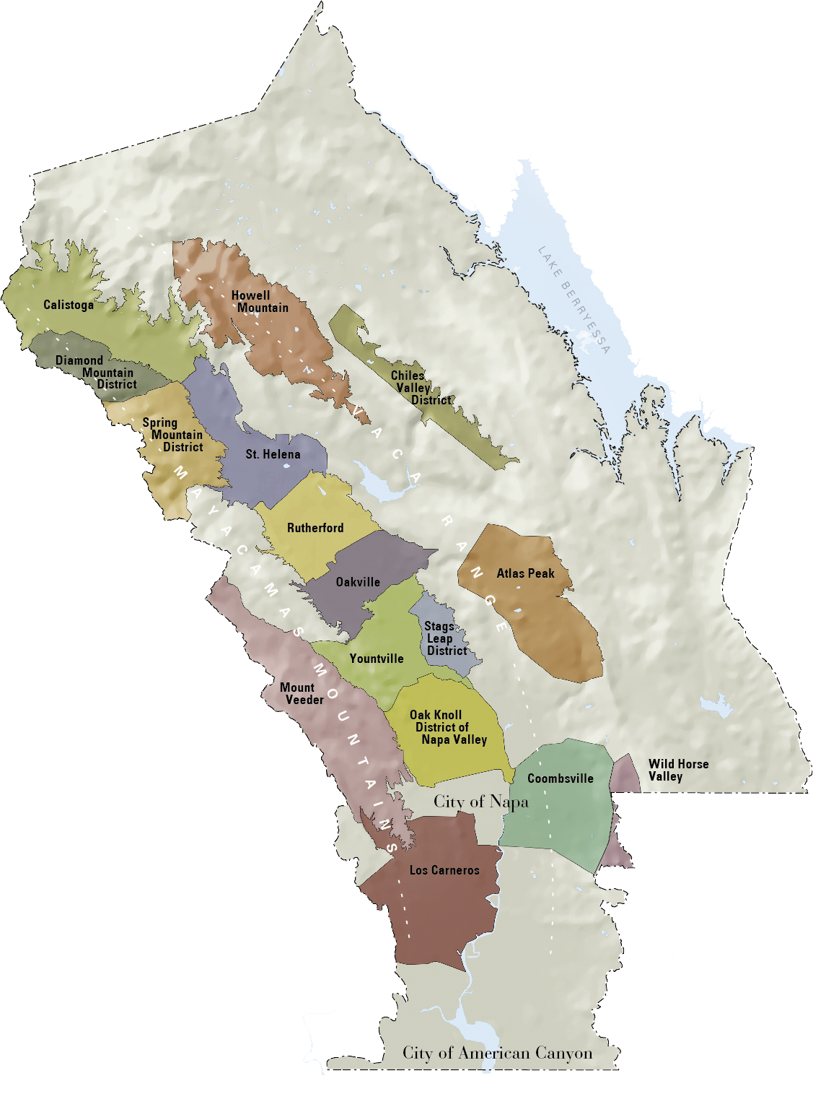

NAPA VALLEY
Distance to Pacific Ocean
36mi / 58km
Distance to San Francisco
48mi / 77km
Distance to Los Angeles
360mi / 579km
Notes:
5
Napa Valley is small: the valley floor, located between the Mayacamas Mountains and Vaca Range, is just about 5 miles across at its widest point and 30 miles at its longest.
There are even smaller places within it: the Napa Valley itself is an AVA or American Viticultural Area and within the Napa Valley AVA there are currently 16 recognized sub- or “nested” AVAs

Slide 6
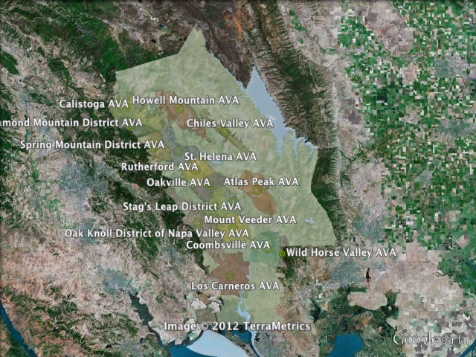
Notes:
An AVA is a geographic grape growing area that possesses distinguishable characteristics, including microclimate and terrain, and cultural and historic distinction.
Vintners and growers within these regions determine the boundaries of the growing area and give it a name that reflects the regional designation.
This data is then submitted to the U.S. government, which decides whether the proposed appellation designation will be granted.
Unlike Europe, these designations do not limit the type of grapes grown, the method of vinification, or the crop yield.
An AVA specifies only a geographical location from which at least 85% of the grapes used to make a wine must have been grown.
Napa Valley was the first AVA to be recognized in California in 1981.

Slide 7
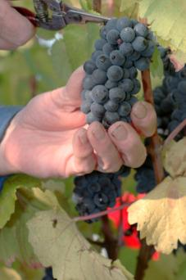
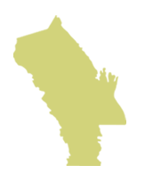

Napa Valley AVA
NAPA VALLEY
Small in size.
Big in quality and diversity
4% of California wine
4/10ths of 1% of the
world’s wine
Notes:
7
If there’s one message we could leave you with today, it’s that the Napa Valley may be one of the most renowned wine growing regions in the world, but it is also one of the smallest.
Napa Valley produces just 4% of California’s wine and a mere four-tenths of one percent of the world’s wine.

Slide 8
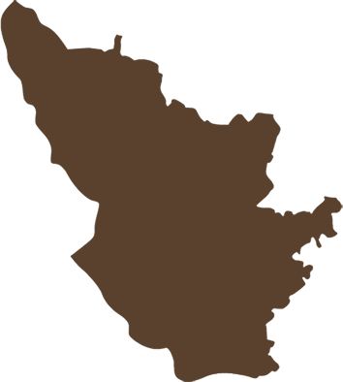
Napa Valley AVA
NAPA VALLEY AVA
45,000 acres
(18, 250 ha) under vine
Bordeaux AC
290,000 acres
(117,500 ha) under vine.
NAPA VALLEY is 1/8
the size of Bordeaux
Bordeaux AC
Notes:
8
It is roughly the size of Burgundy’s Côte d’Or and about one-eighth the size of Bordeaux – about the same size as the Medoc.
There are approximately 45,000 acres under vine, about 9% of all of Napa County.

Slide 9
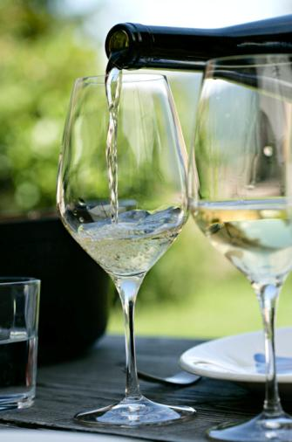

77%
Small producers
77% of NVV members make less than 10,000 cases of a wine a year
63% produce less than 5,000 cases
Notes:
9
The majority of Napa Valley’s producers are also small:
Nearly 80% of the NVV’s 450 member wineries make less than 10,000 cases of a wine a year.
More than 60% produce fewer than 5,000 cases annually.

Slide 10
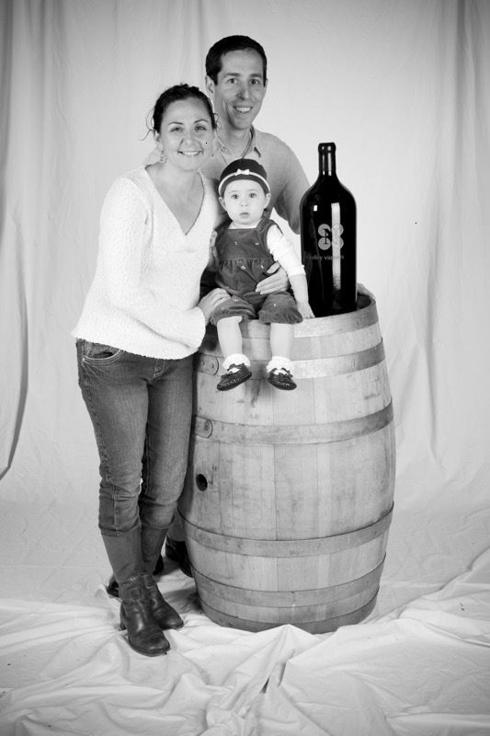

95%
Small producers
95% of Napa Valley wineries are family owned or operated
Notes:
10
10
95% of Napa Valley wineries are family owned or operated.

Slide 11
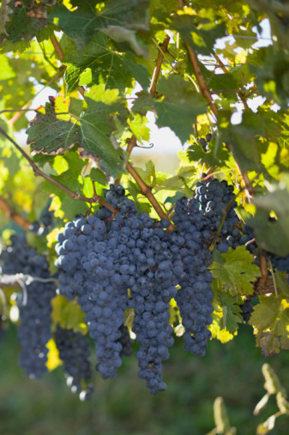
$13B
Big impact in Napa County
46,000 jobs
$13 billion annual economic impact
Notes:
11
In spite of its small size, the Napa Valley wine industry has a big impact.
It results in 46,000 jobs in Napa County and an annual local economic impact of more than $13 billion.

Slide 12
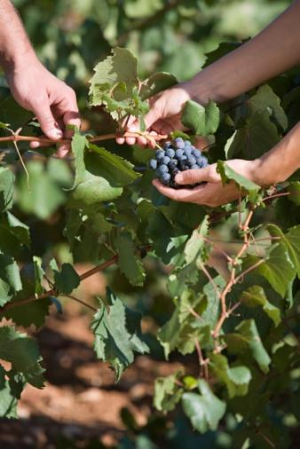
$50B
Big impact beyond Napa County
$50 billion annual impact on the US economy
27% of the CA wine industry’s total economic impact
Notes:
12
The Napa Valley wine industry has a $50 billion annual impact on the US economy
It accounts for 27% of the California wine industry’s total economic impact in the US – compared to just 4% of California’s production

Slide 13
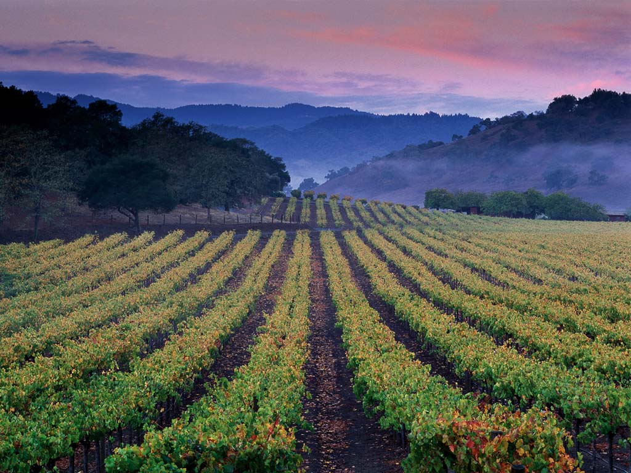
Napa Valley is one of the most diverse
wine growing regions in the world
Notes:
Although the place and the industry are relatively small, Napa Valley is one of the most diverse wine growing regions in the world.
Napa Valley has an amazing assortment of microclimates, soils, weather, and topography.
A wide array of grape varieties grow extraordinarily well here.

Slide 14
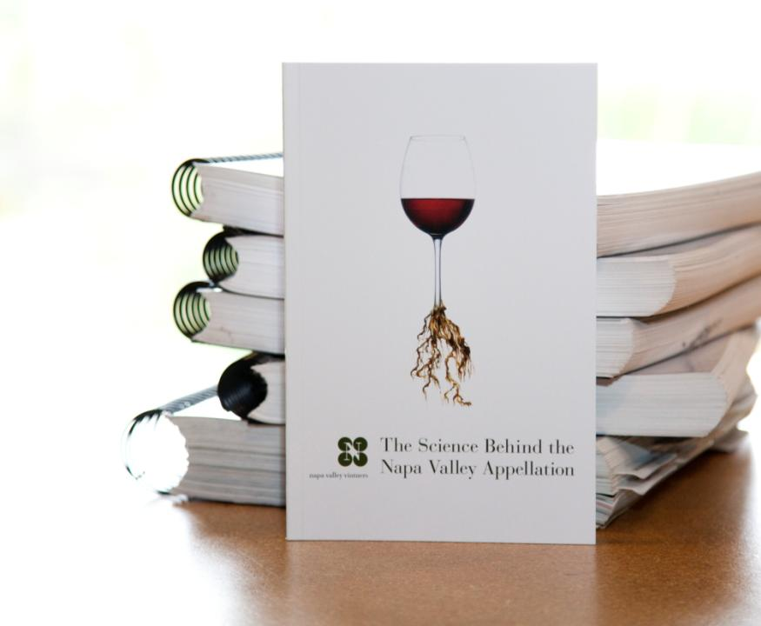
We have
the research
behind it
Notes:
14
14
It’s one thing to say a place is special, but it’s another to prove it.
Between 2001 and 2003, the Napa Valley Vintners trade organization commissioned three major studies to verify that the Napa Valley’s AVAs unique geology, soils, climate, weather, and topography all work together to nurture the winegrapes.
The next part of this presentation will show you how a wonderful series of scientific coincidences make the Napa Valley a great place for wine.
(The scientists who conducted the studies were Jonathan Swinchatt of EarthVision, David Howell of the US Geologic Survey, and Paul W. Skinner, PhD. Of Terra Spase.)

Slide 15
a great place for wine:
SOIL
Notes:
We’ll start from the ground up - with soil.

Slide 16
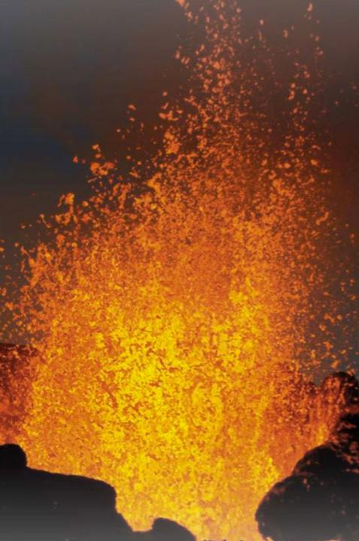
About 150 million years ago a domino-like chain
of events began.
Notes:
16
About 150 million years ago, a series of geologic events caused the shifting, sliding, and lifting of land masses in the area that we know of today as California.
That plastered material onto the edge of North America and formed it into its present, yet ever-changing configuration.
This is the process that created the Napa Valley.

Slide 17

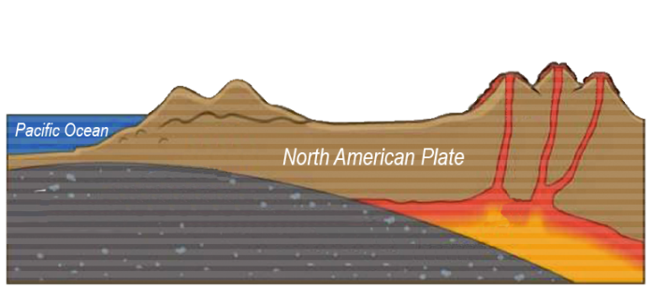
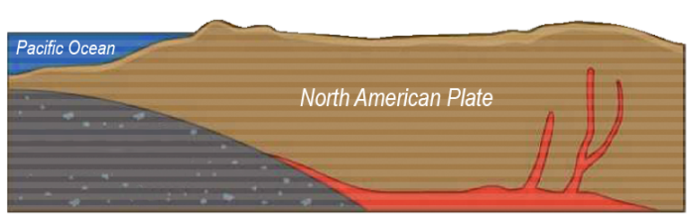



The Great Valley Sequence and The Franciscan Formation
Franciscan Formation (ocean floor)
Pacific Plate Subduction
Great valley
sequence
Magma rises to
form volcanoes
and mountains
Notes:
17
Over time the mountains eroded and reformed, helping to create California.
Geologists call this the Great Valley Sequence, the remains of which are generally found on the east side of the Napa Valley.
As volcanoes were forming inland, the surface of the ocean floor was being sheered off as it met the coastline, literally plastering all sorts of marine sediment on top of the newly forming landmass, extending California westward.
Geologists call this the Franciscan Formation, the remains of which are generally found on the west side of present day Napa Valley.

Slide 18
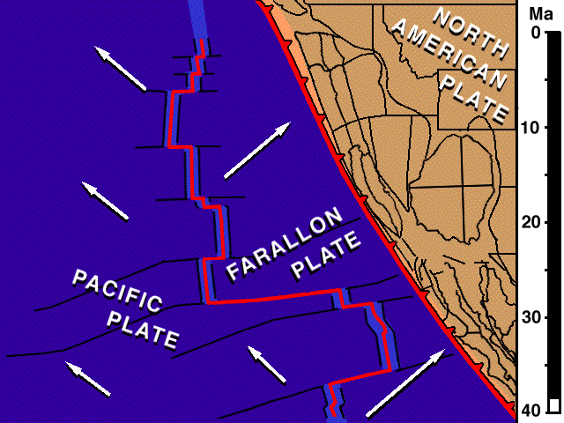
The San Andreas Fault System
Farallon Plate, Pacific Plate, North American Plate meet at a “Triple Junction.”
Plates change to lateral northern direction creating San Andreas Fault
Notes:
18
About 24 million years ago the San Andreas Fault system took shape with the joining of three tectonic plates – the Farallon, the Pacific, and the North American.
These plates started to move laterally south to north, moving this volcanic and sedimentary bedrock in all directions.
As this “triple junction” slowly moved north, dragging the San Andreas fault along, tremendous compression forces pushed up wrinkles in the earth’s crust that eventually became the Coast Range and the Mayacamas Mountains.

Slide 19
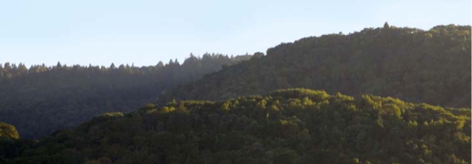
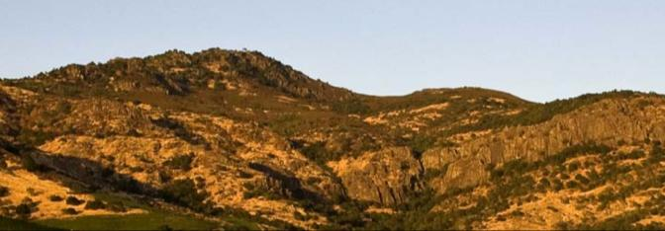
Mayacamas Mountains
Looking west, Yountville
Vaca Range
Looking east, Stags Leap District
Notes:
19
Around 3 million years ago plate motion shifted direction again, this time folding the land over on top of itself, creating the Mayacamas Mountains, the Vaca Range, and Napa Valley in-between.
The multiple bedrock sources that would make up Napa Valley’s distinct soils were now in place.

Slide 20
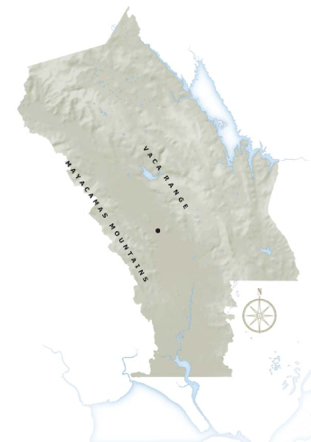
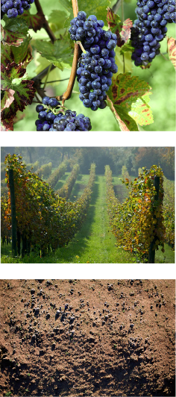
NAPA VALLEY
Yountville
San Pablo
Bay Encroachment
Notes:
20
20
Over many years rainfall helped break apart this bedrock sediment from the mountains and hillsides and settled it on the valley floor.
Vegetation grew and died, adding in organic material.
The Napa River spilled its banks with regularity.
San Pablo Bay – the northern arm of the San Francisco Bay – engulfed the lower valley as far inland as current day Yountville, only to retreat and then engulf the lower valley floor again.

Slide 21
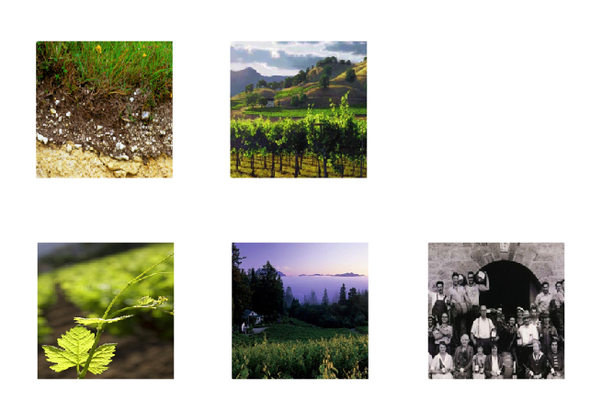
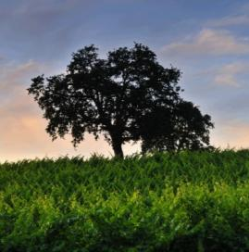
Topography
Parent Material
NAPA
VALLEY
Plant/Animal Life
Climate
Time
Notes:
21
The unique combination of five soil forming factors are responsible for the diverse soil conditions which allow each Napa Valley AVA to produce a wide range of quality winegrapes.
Soils act as building blocks in determining the quality of premium winegrapes.

Slide 22
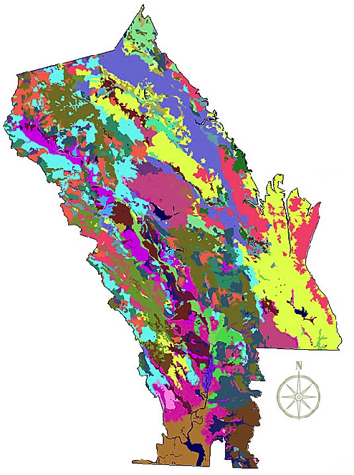
Napa Valley
AVA Soil Series
Over 100 Soil variations
33 soil series
Half the world’s
soil orders
Copyright Terra Spase, Inc. 2003
Notes:
22
Napa Valley contains more than 100 soil variations, 33 soil series, and half the soil orders found in the world.
This picture shows how, literally, you can have different kinds of soil in the same vineyard in Napa Valley.
This diversity allows vintners to grow and produce – and to produce well – a great number of different wine varieties in the Napa Valley.
One of the secrets of great winegrowing is in the soil and Napa Valley has some of the greatest soil diversity found in any winegrowing region around the world.
(Note difference between a soil order, series and variation: soil orders are based largely on soil forming processes. Soil series is of a similar evolution or formation, chemistry, and physical property. Soil variations take into account vegetative material, climate, and topography differences and/or make-up).

Slide 23
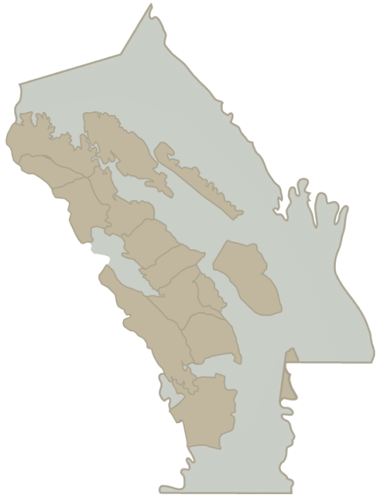
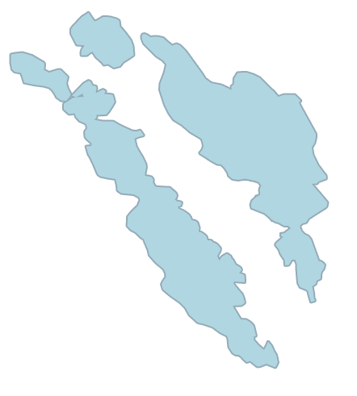
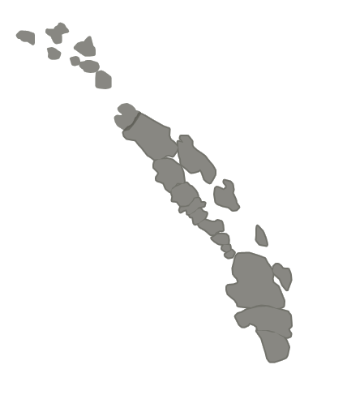
Howell
Mountain
Chiles
Valley
District
Calistoga
Spring
Mountain
District
A word on
alluvial soils
St. Helena
Rutherford
Oakville
Atlas
Peak
Stags
Leap
District
Yountville
Mount
Veeder
Oak Knoll
District of
Napa Valley
Wild
Horse
Valley
Coombsville
Los
Carneros
Watersheds
Alluvial Soils
Notes:
23
Much of Napa Valley’s soils were formed by the marine sediment and volcanic material that make up the Mayacamas Mountains and Vaca Range.
Soils created by the runoff of a single creek from a hillside watershed are known as alluvial soils.
Along the valley floor exist these pockets of alluvial soils,
Alluvial and fluvial soils are generally deeper, more fertile, and hold more moisture than the thinner rocky soils covering hillsides and slopes.

Slide 24
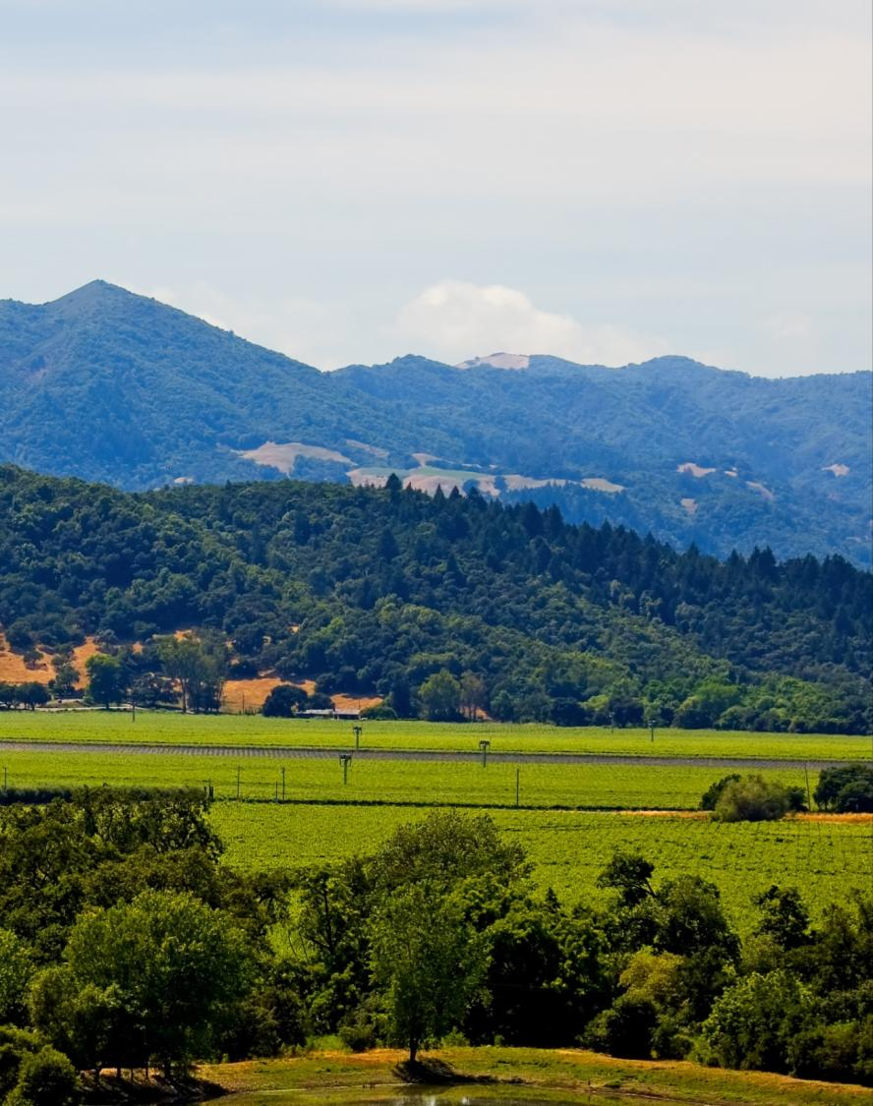
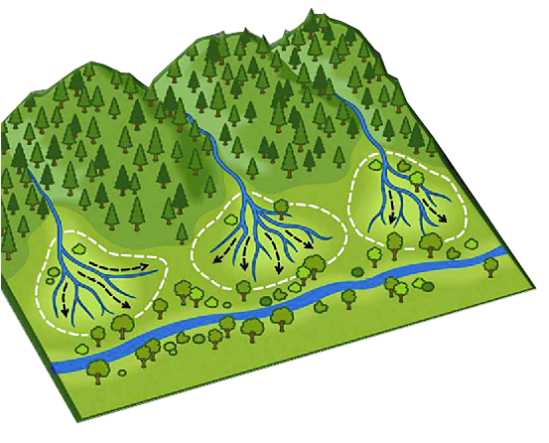
Hillside Stream
Alluvial Fan
Fluvial soils are
found near the river
Notes:
24
24
Alluvial soils spread out in a fan-like shape, when streams, running down from the mountains, become sediment-laden.
This creates an area of distinct soil called an alluvial fan – examples of these formations include the Rutherford Bench and the Oakville Bench.
Other soil can be made up of bedrock sediment from multiple watershed sources or from flooding - it is called fluvial soil.
Fluvial soils are generally found around the Napa River.
Soils can impart distinct character in wine grapes depending on their bedrock origin.
Soil depth and fertility will also affect the character of wine grapes and, ultimately, wine flavor.

Slide 25
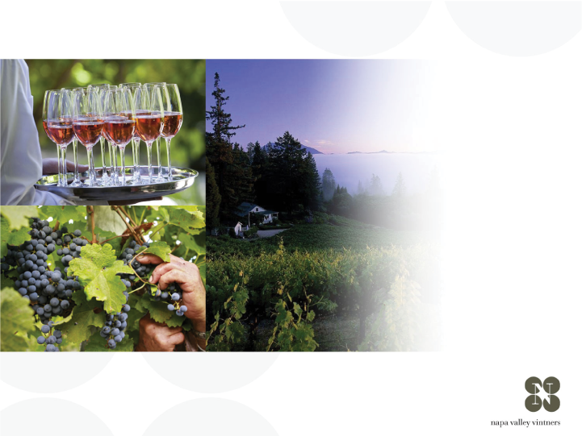
a great place for wine:
CLIMATE
Notes:
25
Climate also has a significant impact on the flavor of the grapes.

Slide 26
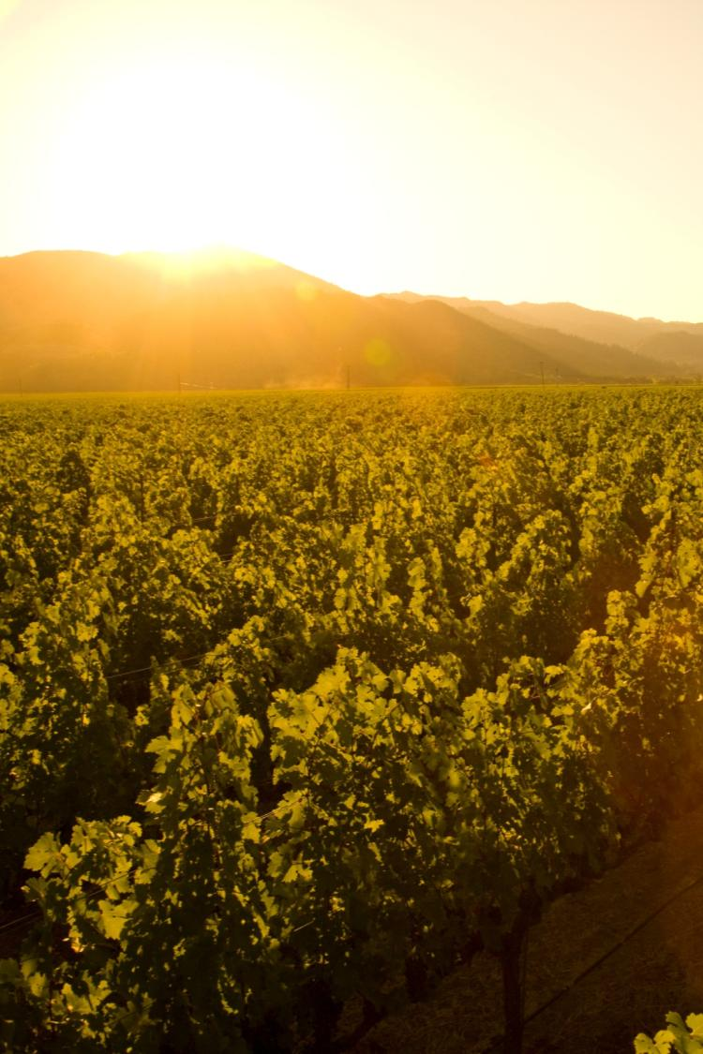
Mediterranean climate zone
Long growing season
Lack of summer rainfall
Vintage to vintage consistency and reduced risk for vineyard disease
Notes:
26
26
Napa Valley is located within the rare Mediterranean climate zone, which encompasses just 2% of the earth’s surface.
The long growing season is marked by warm summer days and cool evenings – ideal for wine grapes to ripen slowly and evenly, with great balance between sugar and acid development.
Lack of summer rainfall helps to contribute to consistency of vintages and reduces the risk of vineyard diseases.
Most areas of the appellation can dry farm or tightly manage their irrigation practices.
Compared to most growing regions in the world, Napa Valley is unique in this regard.

Slide 27
NAPA VALLEY AVA
Average rainfall
40-55 in/102-140 cm
18-24 in/46-61 cm
Notes:
27
27
When it does rain in the winter, the southern reaches of Napa Valley AVA receive just 18 inches of rain each year.
The mountains at the northern end can record nearly 60 inches.

Slide 28


Conditions exist for creating a recurring pattern of marine fog
C
H
Pacific Ocean
Notes:
28
28
During the summer growing season, conditions exist for creating a recurring pattern of marine fog from the Pacific Ocean.
As hot air in California’s interior valley rises, it creates a vacuum effect which draws in moist, cool air from the Pacific Ocean, forming fog.
This pattern repeats most days during the warmer months of the year.

Slide 29

NAPA VALLEY AVA
Fog enters from the north and the south
Marine fog
Marine fog
Notes:
29
29
Fog is more prevalent in the southern reaches of the Napa Valley where it comes up from the San Pablo Bay.
In the upper valley, fog enters through the Chalk Hill Gap in the Mayacamas Mountains.
Except on rare days, summer fog will burn-off by mid-morning in all areas of the valley.

Slide 30

Notes:
This video shows how the fog advances and retreats in the Napa Valley from early until late morning.
Typically, the fog has a greater impact on the valley floor – often the hillsides, like the one where this video was filmed, are not reached by the fog.

Slide 31
NAPA VALLEY AVA
Temperature variation - summer
40-50ºf / 4.5-10ºc
85ºf / 29ºc
40-50ºf / 4.5-10ºc
95ºf / 35ºc
50ºf / 10ºc
77ºf / 25ºc
Notes:
31
31
Daytime temperatures can also vary dramatically throughout the AVA during the growing season.
The southern part of the valley, particularly Los Carneros AVA, is closer to San Pablo Bay and is cooled by marine breezes.
In summer, there can be as much as an 10-15°F difference between Carneros and St. Helena, to the north.
On many days, due to the cooling effect of the fog, there is a large diurnal (day to night) temperature swing throughout the valley.

Slide 32
Mount St. Helena
4000 ft / 1,219 m
NAPA VALLEY AVA
Elevation
Spring Mountain
2200 ft / 671 m
Atlas Peak
2600 ft / 793 m
Mount Veeder
2100 ft / 650 m
Valley Floor
0– 750 ft / 0 – 214 m
Notes:
32
32
Adding to the diversity of Napa Valley is its topography.
It changes with its length, from the flat estuaries in the south near San Pablo Bay to the rolling hills just before 4,000-foot Mount St. Helena in the north.
And don’t forget the Mayacamas and Vacas to the west and east – each range reaches approximately 2,500 feet above the valley floor.
There is a strong correlation between topography and climate: slope, aspect, and elevation all influence the many mesoclimates found throughout the Napa Valley.

Slide 33
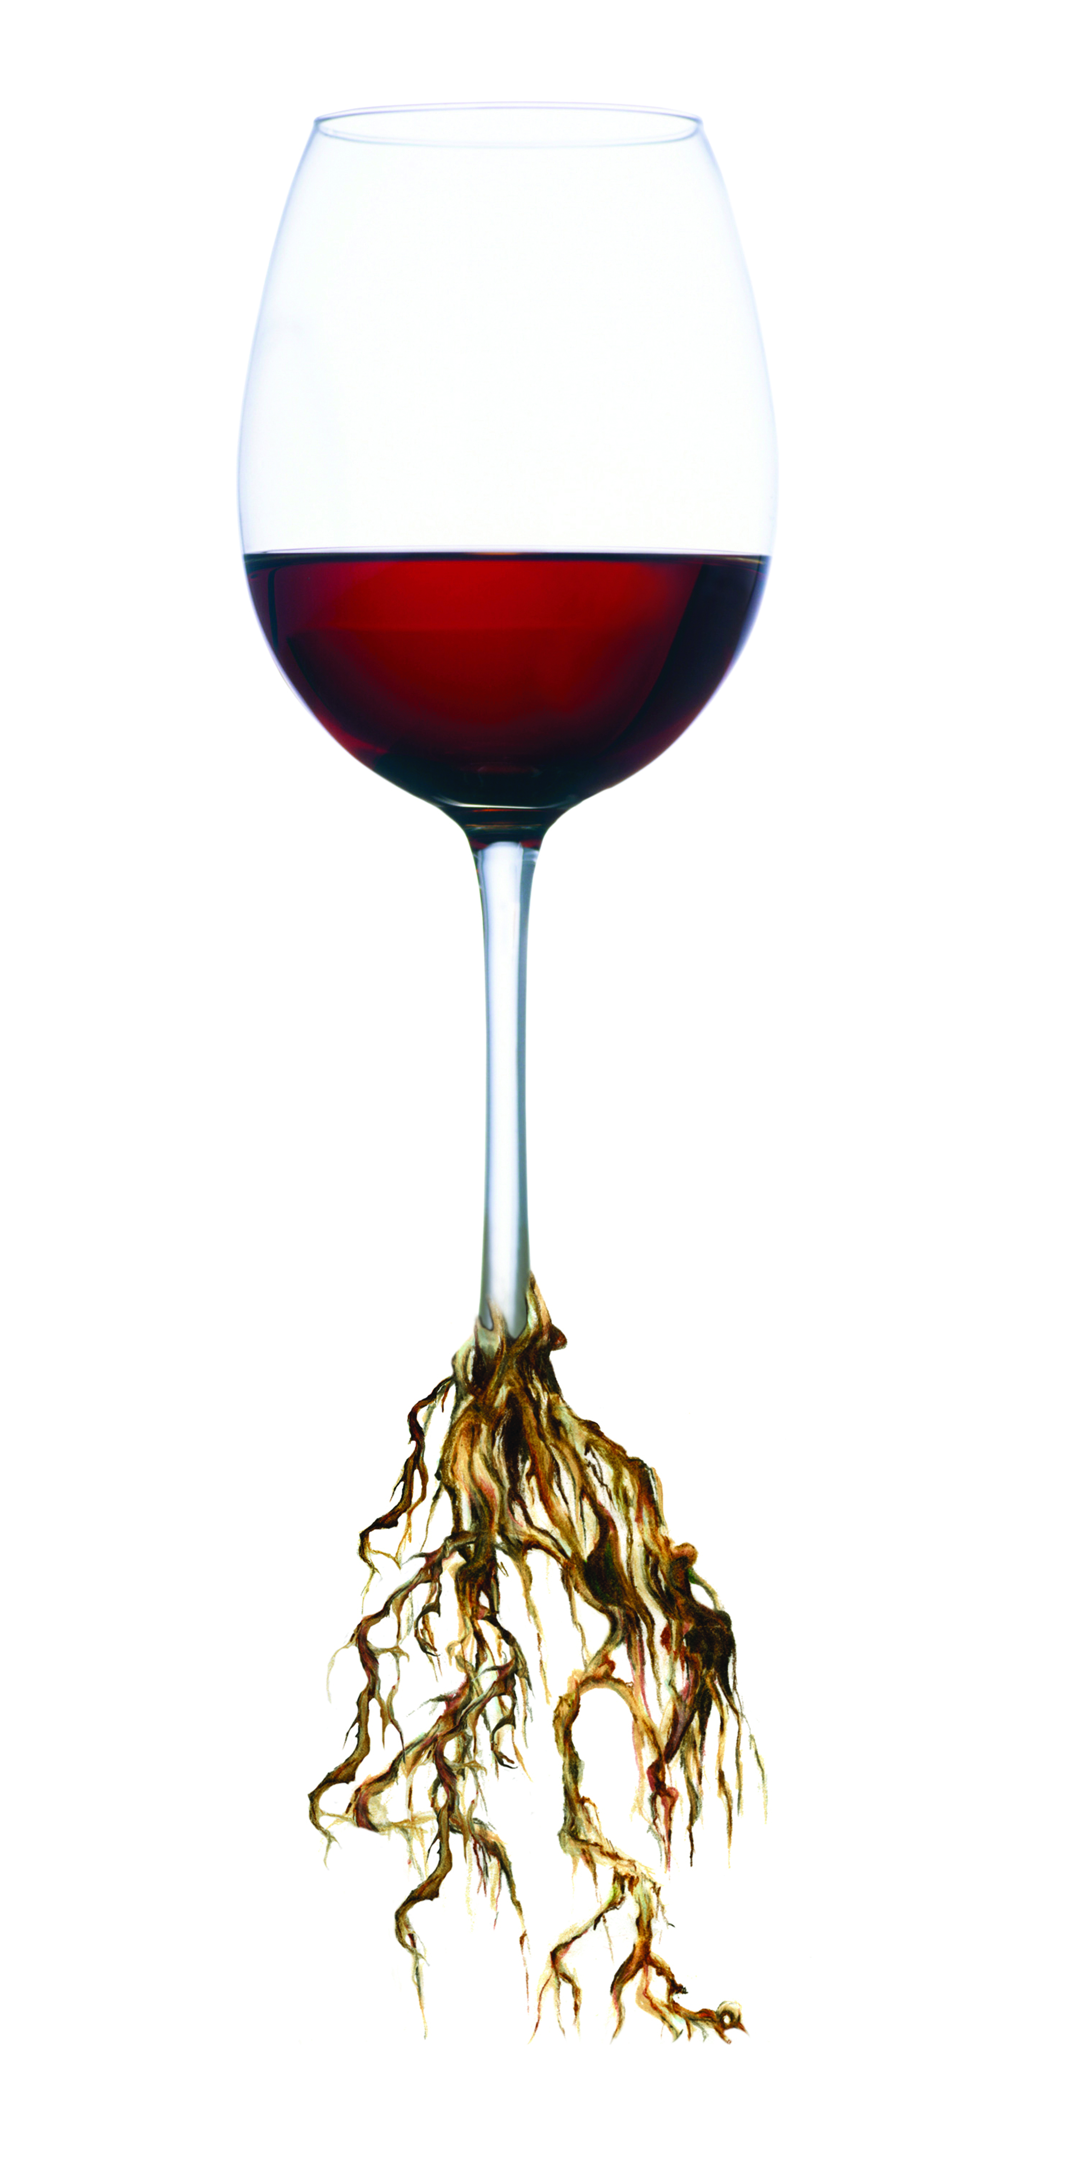
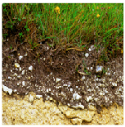
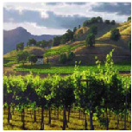
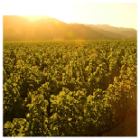
TERROIR
Putting it all together
Distinct Soils
Distinct Climates
Distinct Topography
+
+
Distinct
Growing
Regions
Notes:
33
33
When you put it all together, these distinct soils, plus distinct climates, plus distinct topography it equals distinct growing conditions.
The sum of these factors is known by the French term, terroir.

Slide 34

Napa Valley
VITICULTURE
Notes:
34
Terroir also includes people – the people who make the decisions about how the grapes will be grown.

Slide 35
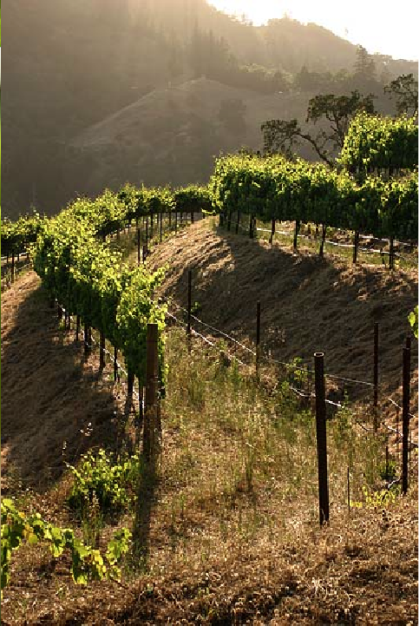
How does terroir affect viticulture?
Site selection
Topography
Soil Composition
Drainage
Sun exposure
Climate/temperature
Grape variety selection
Soil composition
Topography
Notes:
35
35
When it comes to viticulture, there are many variables influenced by the people behind the wines.
These variables strongly influence grape growers in the Napa Valley and give them the opportunity to make myriad decisions and refinements to their grape growing practices.

Slide 36
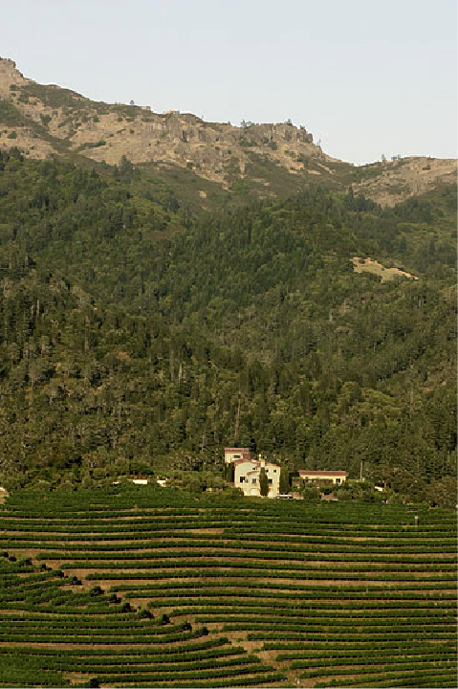
How does terroir affect viticulture?
Viticulture practices
Canopy management
Soil management
Irrigation management
Trellising
Rootstock selection
Vigorous vs. non-vigorous
Notes:
36
36
There are many factors to consider when determining the right grape variety and the best practices for the location being planted.

Slide 37

How is terroir relevant
to winemaking?
Multiple
vineyards
=
Greater
complexity
Single
vineyard
=
Greater
distinction
Notes:
37
37
Take a wine grape – like, Cabernet Sauvignon – and grow it in different areas – and it will taste a little different depending on where it’s from.
For a winemaker, blending grapes from different vineyards means being able to make a wine of greater complexity.
Because of the diverse soils and climate that we’ve just learned about, you can see how the Napa Valley produces such a wide variety of winegrapes with different characteristics reflected depending on where the grapes were grown.
Another way to create a unique, distinctive wine is to focus on a single place or single vineyard.
Winemakers in Napa Valley have become famous for doing both – creating beautifully blended wines from many sources, and creating distinctive wines from a single grape source: think Martha’s Vineyard or To-Kalon.

Slide 38
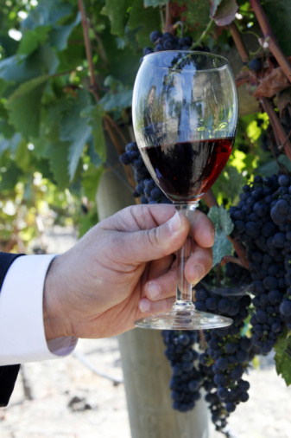
Napa Valley’s top varieties in descending order:
Cabernet Sauvignon
Chardonnay
Merlot
Sauvignon Blanc
Pinot Noir
Zinfandel
Syrah
(& several others)
Notes:
38
38
Napa Valley has become synonymous with Cabernet Sauvignon.
The majority of Napa Valley winemakers produce it.
But, thanks to the many diverse growing conditions we’ve talked about, all kinds of varieties flourish.
Conditions are well-suited for growing both Burgundian (Chardonnay and Pinot Noir) and Bordeaux-style varieties (Cabernet, Merlot, Cabernet Franc, and Sauvignon Blanc).

Slide 39
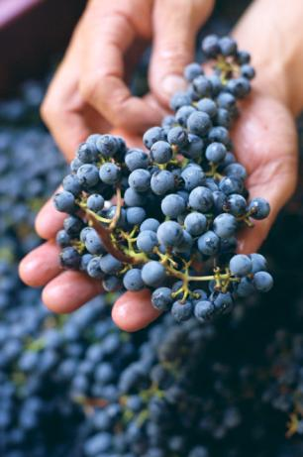
12%
Cabernet Sauvignon makes up 12% of the total California wine grape harvest
40%
Cabernet Sauvignon makes up 40% of the total Napa Valley wine grape harvest
55%
but has a value of 55% of the Napa Valley wine grape harvest
Notes:
39
39
Cabernet Sauvignon accounts for 12% of California’s wine grape harvest.
It makes up approximately 40% of Napa Valley’s overall wine grape harvest, yet had a value of 55% of the harvest, according to the most recent crush report.
In 2011, the value of a ton of Napa Valley Cabernet Sauvignon grapes was four times the statewide average price for a ton of Cabernet Sauvignon grapes.
Napa’s quality is reflected in its grape prices.

Slide 40
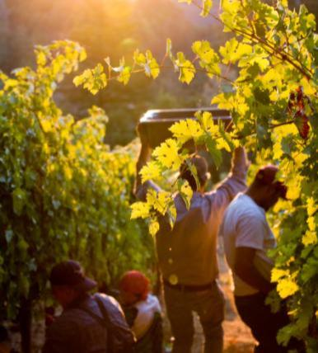
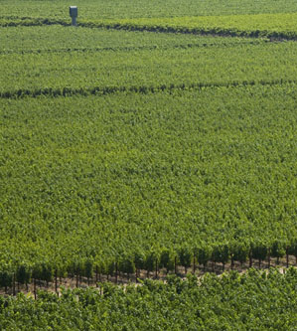
Napa Vineyards
Intentionally farmed to produce low yields
Notes:
40
40
Most winemakers will tell you that quality starts in the vineyard.
Napa Valley vineyards are intentionally farmed to produce low yields to allow only the healthiest of grape clusters to mature.
Throughout the growing season, the canopy is carefully managed, usually by hand, to ensure optimal sunlight to shade ratio and fruit development.
This attention to detail in the vineyard is designed to produce wine grapes of the highest quality.

Slide 41
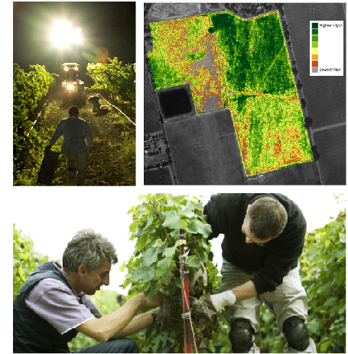
Science, Street Smarts and Academia
From NASA to UC Davis
NASA satellite technology and night harvesting
by hand
Home of UC Davis Experimental Station
in Oakville
ongoing research in viticulture and enology
• Rootstock and clones
• Water use
• Varietal characteristics
• Vine performance
• Fermentation
Notes:
41
41
To continuously improve the quality of the grapes, vintners in Napa Valley have been at the forefront of using technology to improve viticultural practices from planting through harvest.
We were among the first to use NASA satellite technology during post-phylloxera replanting to map out best vineyard layouts.
Napa Valley vintners and growers also work in close partnership with the Viticulture and Enology Department at nearby UC Davis, one of the most respected wine schools in the world.
A 40-acre experimental vineyard and research facility in Napa Valley’s Oakville AVA allows students to conduct research.
Vintners from all over the world benefit from this research.

Slide 42
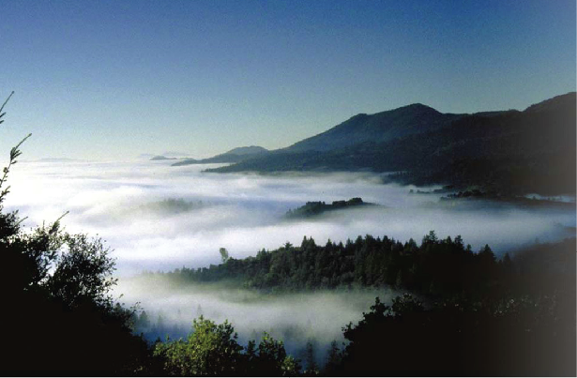
Climate Study
You’re not tasting climate change in the glass
Scientists from Stanford University and Scripps Institution at UC San Diego
Four year project
12,000 data collection points
Notes:
42
42
Speaking of research, in 2006, when Napa Valley became the poster child for the potential agricultural impacts of climate change, the NVV commissioned renowned climate scientists from Stanford University and Scripps Institution at UC San Diego to help us research and better understand this topic.
For four years, the scientists captured and studied data from 12,000 collection points throughout the Napa Valley.
What did they find? You are NOT tasting climate change in a glass of Napa Valley wine!
While there has been a slight warming of overnight temperatures between the months of January and August, stylistic preferences of winemakers have evolved over the past 20 years and remain unique to each wine and winery – that is what you taste in each glass.

Slide 43
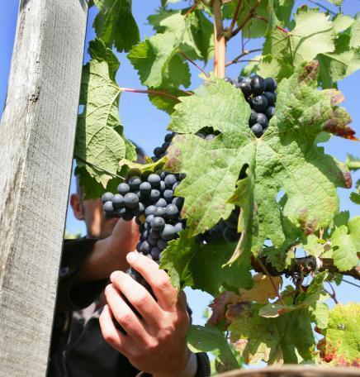
Winemaking Practices
Gentle handling is the norm
Focus on innovation
and quality
Collaboration is common
Continuing education for
ongoing improvement
Notes:
43
43
Inside the winery, most Napa Valley winemakers agree that “less is more” and their best approach is gentle and “hands off” allowing the grapes to express themselves.
Napa Valley vintners are always trying to improve quality - there is a culture of “we can do better.”
Innovative viticulture practices sometimes give a nod to the past, like use of concrete fermenters, gravity flow facilities, or wild yeasts, and also have a vision for the future, like new technology, which can provide an automated godsend to small producers with limited manpower.
Napa vintners regularly collaborate and participate in local wine technical group meetings and discussions, including the NVV’s winemaker discussion group.
They also regularly attend knowledge-building programs at local education institutions, like UC Davis, Sonoma State University, or even the local community college, which has an extensive enology program.

Slide 44

Napa is the epicenter of California wine, all California wines. With all due respect to Sonoma and the Central Coast—all great wines flow from Napa Valley.
Robert Parker, Jr.
Quoted from address to NVV
members
Notes:
44
44
So, how is this emphasis on quality and innovation reflected in the words of renowned wine experts?
Here is what a few have to say:
At a presentation to Napa Valley Vintners in the fall of 2010, wine critic Robert Parker, Jr. credited Napa Valley as being the epicenter of California wines.

Slide 45

While the Napa Valley is not the only California region to make great wine, it consistently makes the most polished, classy, and complex wines in the state.
Karen MacNeil
The Wine Bible
Notes:
45
45
In her book The Wine Bible, author and educator Karen MacNeil acknowledges the consistency of Napa Valley wines.

Slide 46

Napa’s magic is derived in no small part from a magnificent diversity of exposure, climate, and soil…
Jancis Robinson
The Oxford Companion to Wine
Notes:
46
46
And, wine authority and Master of Wine Jancis Robinson acknowledges in the Oxford Companion to Wine the magical coming together of Napa Valley’s unique characteristics.

Slide 47
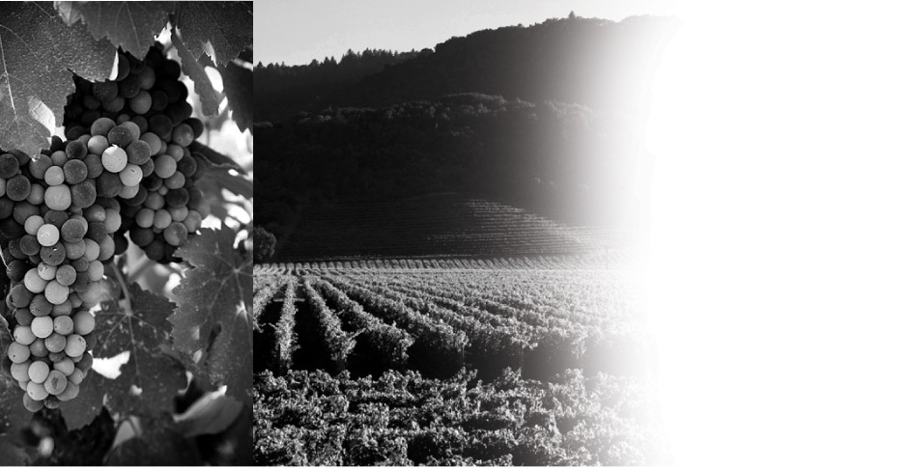
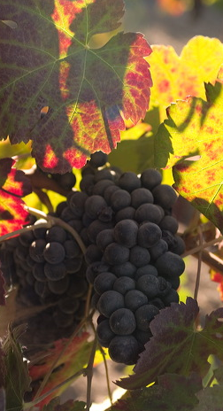
Napa Valley
HISTORY
Notes:
47
It has taken more than 150 years and a long line of great leaders to make the Napa Valley what it is today.
Let’s take a look back at the history of this special place.

Slide 48
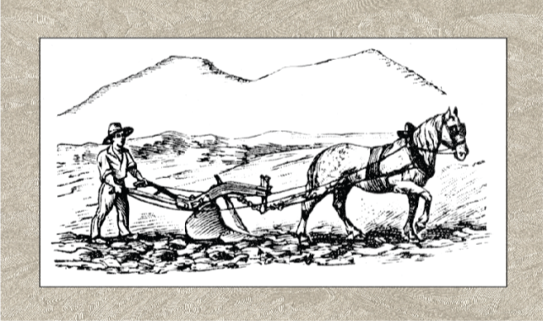
NAPA VALLEY
Experimenters, innovators, leaders
George Yount plants first vineyards in 1838-39
1830
1840
1850
1860
1870
1880
1890
1900
Notes:
48
48
Winemaking history in the Napa Valley begins in 1838-39, when George Calvert Yount, founder of the town of Yountville, plants the first commercial vineyards in the valley.

Slide 49

The 1860s
The wild, wild west finds wine
Jacob Schram, Charles Krug and
Jacob Beringer arrive in Napa Valley
1830
1840
1850
1860
1870
1880
1890
1900
Notes:
49
49
1849 started California’s Gold Rush.
In the 1860s and ‘70s, Europeans like Jacob Schram, Charles Krug, and Jacob Beringer arrived in Napa, eager to try their hand at making wine to rival the wines from their homeland.
Schram planted Napa County’s first hillside vineyard.
Most of the wine at that time was shipped in bulk to San Francisco for sales and distribution.

Slide 50

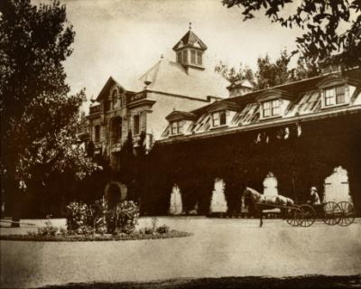
1861-1880
First wineries established
Charles Krug, first commercial winery, 1861
Inglenook, first chateau-style winery, 1879
1830
1840
1850
1860
1870
1880
1890
1900
Notes:
50
50
Charles Krug is credited with establishing Napa Valley's first commercial winery in 1861.
Gustave Niebaum, a Finnish fur trader, used his enormous wealth to import the best grapevines from Europe to Napa.
In 1879 he established Inglenook, the first chateau-style winery in the US and he was also the first to sell wine in bottles.

Slide 51
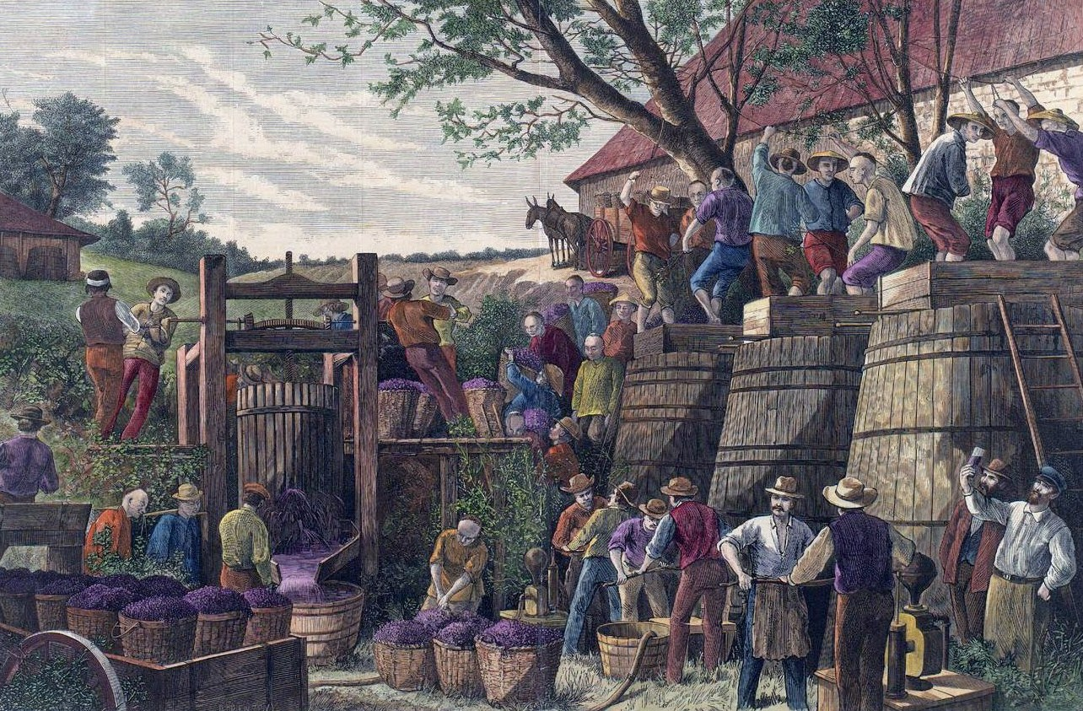
Late 1800’s
Chinese contract labor
First immigrant labor force for grape harvest, 1870’s
Experience in building railroad translates to underground wine cave construction
1830
1840
1850
1860
1870
1880
1890
1900
Notes:
51
51
Another significant group of immigrants to make their way to Napa Valley were Chinese laborers
By some accounts, field laborers of the 1870’s and 1880’s were primarily Chinese making up as much as 70-80% of the workforce at that time
Following the completion of the transcontinental railroad, many Chinese made their way to the Bay Area and continued their hard labor on projects like building underground wine caves in the Napa Valley

Slide 52

Late 1800’s
Napa Valley’s first boom
By 1889, Napa had more than 140 wineries
1830
1840
1850
1860
1870
1880
1890
1900
Notes:
52
52
By 1889, Napa had more than 140 wineries, including Schramsberg, Beringer, and Inglenook.
Though never a large producer – that description was more apt for other agricultural areas of California, like Los Angeles, Sonoma, and Livermore – Napa was booming.
PHOTO: Avenue of Elms, St. Helena, about c. 1900. Frederick Beringer (sitting on his barrel), next to his daughter

Slide 53

Weathering Storms
Phylloxera
Grapevine acreage decreases from 15,807 to 2,000 in just 12 years
1830
1840
1850
1860
1870
1880
1890
1900
Notes:
53
53
But, what’s a success story without a stunning setback or two?
In the late 1890s phylloxera, tiny sap-sucking insects which feed on the roots of grapevines and kill them, hit and nearly decimated Napa’s vineyards.
Acreage in Napa Valley declined from 15,807 in 1888 to just 2,000 acres by 1900.

Slide 54

Weathering Storms
Prohibition, Great Depression, World War
A series of unfortunate events plagues the Napa Valley wine industry
1910
1920
1930
1940
1950
1960
1970
1980
Notes:
54
54
Then an even greater threat arrived in 1920 with the enactment of Prohibition, which lasted for 13 years.
The Great Depression didn’t help matters either.
By the time World War II came along, Napa’s grapevines and wineries were largely abandoned.
Many vineyards were planted over to plums and walnuts.
The Napa Valley wine industry was in shambles.

Slide 55

Recovery
Prohibition ends
Prohibition repealed in 1933
1910
1920
1930
1940
1950
1960
1970
1980
Notes:
55
55
Despite the setbacks, a few vintners persevered.
With the repeal of Prohibition, Napa Valley began the road to recovery.

Slide 56

Rebirth
Napa Valley’s Renaissance
John Daniel, Jr. inherits Inglenook in 1939
Robert Mondavi builds his winery in 1966
1910
1920
1930
1940
1950
1960
1970
1980
Notes:
56
56
Credit for the post-World War II rebirth of the Napa Valley wine industry goes to a handful of bold and visionary vintners, including Georges de Latour, of Beaulieu Vineyards, who in 1938 recruited Andre Tchelistcheff, research enologist from France's Pasteur Institute.
In 1939, John Daniel, Jr. inherited Inglenook, the Gustave Niebaum estate, and ran the winery for 25 years.
Like Beaulieu and Inglenook, a number of pre-Prohibition wineries came back to life between the late 1930’s and the mid 1960’s, but new winery growth was limited to just a handful, like the establishment of Stony Hill Vineyard and Heitz Wine Cellars.
In 1966 Robert Mondavi founded his iconic winery on Highway 29 with the goal of producing wines that would rival the finest wines of Europe.
Mr. Mondavi’s renowned marketing strategies brought worldwide recognition to Napa Valley and its wines.
He believed in wine hospitality and graciously welcomed visitors to the winery’s public tasting room.
His vision helped propel Napa Valley’s position in the world of wine and was a major factor in Napa Valley’s 20th century Renaissance.

Slide 57

Banding Together
Napa Valley Vintners
Agreement of association signed in 1944
1910
1920
1930
1940
1950
1960
1970
1980
Notes:
57
57
Many of these vintner leaders, like Louis Martini, John Daniel, Jr., and Robert Mondavi knew there were challenges ahead for their fledgling wine industry, not the least the ongoing threat of natural disasters and growing regulation.
They formed the Napa Valley Vintners trade association in October 1944 with the idea that we are stronger together than individually.
Left to Right: Charles Forni (Napa Valley Cooperative Winery), Robert Mondavi (C. Mondavi & Sons), Brother Timothy (Mont La Salle), Al Huntsinger (Napa Valley Cooperative Winery), Mike Ahern (Freemark Abbey), Charles Beringer, Fred Abruzzini (Beringer Brothers), Louis M. Martini, John Daniel, Jr. (Ingelnook Vineyard Co.), and Martin Stelling, Jr. (Sunny St. Helena).

Slide 58

Hispanic Heritage
US and Mexico create “Bracero” program
1910
1920
1930
1940
1950
1960
1970
1980
Notes:
58
58
Another important part of Napa Valley’s history is its Hispanic heritage.
In 1942, facing a labor shortage brought on by World War II, the US and Mexico together created the “Bracero” program bringing guest laborers from south of the border to work in American agriculture.
Many of these laborers landed in the California and Napa Valley wine industries and, over time, become incredibly skilled in techniques related to premium grape growing.
Some went on to own their own vineyard management companies, while others have become Napa Valley vintners in their own right, moving from the vineyard to winemaking and winery ownership.

Slide 59

Judgment of Paris
Napa Valley Chardonnay and Cabernet Sauvignon win blind tasting
1910
1920
1930
1940
1950
1960
1970
1980
Notes:
59
59
While the vintners of Napa Valley believed themselves in the quality of the appellation, and in the early 1970s Napa Valley’s reputation continued to grow, it was a pivotal endorsement from another part of the world that helped put Napa Valley on the map.
The 1976 Judgment of Paris wine tasting, chronicled recently in the movie “Bottle Shock,” set the wine world on it’s ear: few could have imagined that California wines would win such a competition.
Yet California rated best in each category.
The hard work of Napa Valley’s vintners was starting to pay off.

Slide 60

Napa Valley
VINTNERS
Notes:
60
Nearly seven decades after being formed, and now more than 450 wineries strong, the Napa Valley Vintners still work to promote and protect – as well as enhance – the Napa Valley AVA as the premier winegrowing region.

Slide 61


The Mission of the Napa Valley Vintners:
To promote, protect and enhance the Napa Valley appellation, our wines, vintners and community
Notes:
61
61
NVV members are deeply committed to conservation and sustainable farming, and to supporting the local community through charitable work.
The Napa Valley wine industry thrives on a strong culture of collaboration and pride in its agricultural heritage, community, and appellation.
As the appellation is defined by the soils, climate, geology, and topography, it has also been shaped by the contribution of its people.
Here are some highlights that demonstrate the leadership of Napa vintners…

Slide 62

Promoting
Napa Valley
Auction Napa Valley
Premiere Napa Valley
Taste Napa Valley
Master Napa Valley
Symposium for Professional Wine Writers
Wine Educators Academy
Experience Napa Valley
Notes:
62
62
Whether on the road or at home, the Napa Valley Vintners work together to promote the Napa Valley appellation through signature marketing programs, like Auction Napa Valley and Taste Napa Valley.
Our barrel tasting and auction, Premiere Napa Valley, encourages vintners to create some of the rarest wines made in Napa Valley.
Every year vintners bring groups of trade, educators, and writers to Napa Valley to learn more about the appellation and its wines.

Slide 63

Promoting
Napa Valley
Auction
Napa Valley:
The world’s most successful charity
wine event
The best of Napa Valley
First weekend in June
Notes:
The first weekend every June, vintners present the best of the Napa Valley at Auction Napa Valley.
It includes four days of incredible wine and food, vintner hospitality, and more than 250 auction lots.
All proceeds benefit the local community.

Slide 64

Promoting
Napa Valley
Premiere
Napa Valley:
Mid-winter barrel auction for the trade
60-240 bottles per lot – some of the rarest wines in the world
Visit www.PremiereNapaWines.com for more info
Notes:
Premiere Napa Valley wines are among the rarest in the world.
Crafted for the annual Premiere Napa Valley trade tasting and auction, these wines are created only once and sold to a single bidder in lots as small as 5 cases and not larger than 20 cases.

Slide 65

Promoting
Napa Valley
Education and immersion programs in Napa Valley:
Wine Educators Academy
Master Napa Valley
Wine Writers Symposium
Trade Boot Camps
Experience Napa Valley
Notes:
Throughout the year, Napa Valley Vintners bring groups of trade and educators from around the world to our scenic valley for immersion programs, like the Napa Valley Wine Educators Academy, Master Napa Valley, Trade Boot Camps, and Experience Napa Valley.
Each February, wine writers from around the world hone their craft at the Wine Writers Symposium, hosted by the NVV, Meadowood Napa Valley, and The Culinary Institute of America, Greystone.

Slide 66

Global Partnerships
Notes:
66
66
Another way the NVV is helping to promote the Napa Valley on a grand scale is our recent designation as the official wine region of the 34th America’s Cup, taking place in San Francisco in 2013.
This kind of marketing partnership illustrates the region’s desire to align our brand with other entities that believe in quality, innovation, and sustainability.

Slide 67


Global Partnerships
San Francisco/
Napa Valley:
North America’s Great Wine Capital
Notes:
67
67
We participate in the Great Wine Capitals network of nine major global cities which share a key economic and cultural asset: their internationally renowned wine regions.
As only one capital is permitted per country, it stands to reason Napa Valley has that title for North America.
(The other Great Wine Capitals are: Bilbao/Rioja, Bordeaux, Cape Town, Christchurch/South Island, Florence, Mainz/Rheinhessen, Mendoza, and Porto)

Slide 68


Global Partnerships
Place is important
to wine
Notes:
68
68
More and more, people are realizing how important place of origin is when it comes to wine.
That’s why the Napa Valley Vintners have joined forces with wine regions around the world to create a global initiative to protect the names of wine’s place of origin.
This coalition seeks to educate consumers and influence policy and opinion makers on the importance of wine region integrity.
Members of the coalition include: Champagne, Napa Valley, Oregon, Washington State, Jerez, Porto, Walla Walla, Chianti Classico, Sonoma County, Victoria, Paso Robles, Tokaj, Western Australia, Long Island, and Rioja

Slide 69

Protecting
Napa Valley
Conjunctive Labeling:
If the nested AVA is
listed, Napa Valley must
also be listed
1989 CA state law
sponsored by Napa Valley
Vintners
Notes:
Of course, we’d have nothing to promote if vintners did not protect one of their most important assets: the “brand” Napa Valley.
Remember, Napa Valley was the first AVA designated in California.
As other sub-appellations were approved within the Napa Valley, vintners realized they had to protect the overall brand.
As a result, Napa Valley became the first wine region to develop conjunctive labeling laws for its wholly contained sub-appellations, to further help consumers distinguish origin.
For example, if a bottle is labeled Rutherford, it must say “Rutherford Napa Valley.” This law helps position the Napa Valley as the over-arching brand.

Slide 70




Protecting
Napa Valley
Napa Name Law
First wine region to obtain Geographic Indication (GI) status in China
First non-European wine region to obtain GI Status in European Union
GI status obtained in Brazil, Canada, India and Thailand
Ongoing trademark
monitoring
Notes:
Napa Valley Vintners also believe that for a wine to have “Napa Valley” on the label, including in the brand name, it should have Napa Valley wine in the bottle.
In other words, consumers should know where the wine they’re drinking really comes from.
The Napa Valley Vintners work to ensure that truth in wine labeling laws are adhered to around the globe – and have taken the fight all the way to the US Supreme Court, China, the European Union, and other major countries.
We also continuously monitor trademark applications around the globe to ensure these principles are adhered to.

Slide 71

Protecting
Napa Valley
Working Together
for the Industry:
Monitoring ordinances that may affect the wine industry
Self taxation
Pests and diseases
Farmworker housing
Notes:
71
71
Vintners also pay attention to what’s happening in the wine industry in general.
Much like the founding members of the NVV in the 1940’s, vintners today understand that they can do more together than on their own.
The NVV actively monitors winery and viticulture issues and takes action collectively when needed.
For example, the Napa Valley wine industry has twice imposed ongoing taxes on itself – the first enhances local efforts to monitor and eradicate vineyard pests and diseases, and the other helps fund housing for the workers who tend to our vineyards.
This photo is of the River Ranch Farmworker Housing Center near St. Helena.

Slide 72

Environmental Leadership
1944
Napa Valley Vintners Forms
1968
Agricultural Preserve
1976
Conservation Easements
1990
Growth Management System
1990
Winery Definition Ordinance
1991
Hillside Planting and Stream Setback
Ordinance and Zoning Agricultural Land
1998
Napa River Flood Control
2001
WICC Board and Viewshed Protection
2002
Farmworker Housing Assessment
2003
Napa Green Certified Land
2008
Napa Green Certified Winery
Notes:
72
72
The other valuable asset that must be protected: the Napa Valley itself.
For more than 40 years, long before green and sustainable became buzzwords, vintners have supported the tradition of environmental leadership by focusing on environmentally sound practices.
Rather than waiting for government to enact rules and guidelines, Napa Valley Vintners often find themselves at the table helping to craft these policies.
Napa Valley’s vintners farm under the most stringent land use and environmental guidelines of any winegrowing region and have often created these strict rules themselves to protect what is important to them.

Slide 73

Napa Valley Agricultural Preserve
First in the U.S. – founded in 1968
Notes:
73
73
For example, much of the San Francisco Bay Area has gone the way of tract housing, business parks, and shopping malls.
But, Napa Valley, less than 50 miles or about an hour’s drive from San Francisco, has held its ground.
Acres of grapevines surrounded by rural beauty and charm, today’s Napa is the result of The Napa Valley Agricultural Preserve: a commitment to agriculture as the highest and best use of the land in Napa County.
Growers, community members, and Napa Valley vintners, like Jack Davies of Schramsberg Vineyards, were instrumental in establishing the Napa Valley Ag Preserve.
Though controversial at the time, today it is held up as one of the County’s most visionary acts and is at the heart of the community’s core values.

Slide 74


Napa Valley Agricultural Preserve
Highest and best use of the land
Napa Valley, 1940
Santa Clara Valley, 1940
Napa Valley, 1940
Santa Clara Valley, 1940
Notes:
74
74
The Napa Valley Ag Preserve was the first in the U.S. to set aside land specifically for agriculture.
Founded in 1968, it’s been going strong more than 40 years without compromise, and now protects 38,000 acres of valley floor farmland.
Another 53,000 acres of Napa Valley land have been placed into permanent conservation easements by the local Land Trust.
This slide and the next show the impact of the Ag Preserve on our county…and our way of life.
Here’s an aerial photo of Napa Valley and the Santa Clara Valley taken around 1940 – both of these communities are about an hour from San Francisco…

Slide 75

Napa Valley Agricultural Preserve
Protects roughly 38,000 acres of farmland
Napa Valley, 2005
Santa Clara Valley, 2005
Notes:
75
75
A photo was taken again of the same two places in 2005 – a couple of pictures here are worth more than 1,000 words!

Slide 76


Enhancing the
Napa Valley
Napa Green Land
Wine industry’s most rigorous land-use program
Tailored to the Napa Valley watershed
55,000 acres enrolled and 32,000 acres certified
Notes:
76
76
To further protect the environment, the Napa Valley Vintners, along with several other local, regional, and state agencies and organizations, developed the Napa Green Certified Land program in 2003.
The program uses sustainable agricultural practices while enhancing the watershed and restoring natural habitat, including soil and water conservation.
It’s the wine industry’s most rigorous land-use program, meeting and exceeding nearly 20 local, state, and federal “best practices.”
To date, 55,000 acres are enrolled in the Napa Green Land program and 32,000 acres have been certified – more acreage than is planted to grapes in Napa County.
Approximately 1/3 of all Napa Valley’s vineyard land is now certified Napa Green.

Slide 77


Enhancing the
Napa Valley
Napa Green Winery
Reduces
greenhouse gasses
Independently certified by government regulators
35 wineries certified and many more in process
Notes:
77
77
Napa Green Certified Winery is a companion certification program launched in 2008 that implements best practices for wineries to reduce, reuse, and recycle energy, water, and waste to eliminate greenhouse gasses.
35 wineries are certified Napa Green with many more in progress.

Slide 78

Enhancing the
Napa Valley
Napa Green Program
Yvon Chouinard, Patagonia ® founder and noted environmentalist
on Napa Green:
I’ve been at this for 30 years and this is the best, most well thought out program I’ve ever seen.
As quoted in Wine Spectator
Notes:
78
78
In an interview with Wine Spectator Magazine, mountaineer, noted environmentalist, and Patagonia brand founder Yvon Chouinard said of Napa Green: “The Napa Valley Vintners have realized that local governments and grassroot movements and businesses are where changes are going to come from. I’ve been at this for 30 years and this is the best, most well-thought-out program I’ve ever seen.”

Slide 79

Enhancing the
Napa Valley
Caring for
the Community
Community outreach programs like
Adopt-a-School and Afternoon in the Vineyards help vintners support and stay connected to their community
Partnering with others to build Vine Trail
Notes:
79
79
For the greater Napa County community, our Adopt-a-School program aims to connect all public schools in Napa County with a winery sponsor.
Every year we invite our neighbors to come out for a visit through the Afternoon in the Vineyards program.
Vintners are working with other interested parties to help build a walking/biking path that will run the length of the valley, from Napa to Calistoga.

Slide 80

Enhancing the
Napa Valley
Caring for
the Community
Through Auction Napa Valley, the NVV has given
more than $110 million to the community since 1981
Notes:
80
80
And, through our annual community fundraiser, Auction Napa Valley, the NVV has given more than $110 million to date to dozens of local health, youth, and housing non-profits.
And vintner generosity extends well beyond the local community as Napa Valley wines are the backbone of charity wine auctions across the US.

Slide 81




Napa Valley: Legendary American Wines
Learn more: NapaVintners.com
Become a fan: Facebook.com/NapaVintners
Follow us on Twitter: @NapaVintners
Read our blog: NapaVintners.com/blog
Notes:
81
81
Millions of years of science…150 years of grape growing…70 years of cooperation and camaraderie.
Today, Napa Valley is the most recognized appellation in America, its wines are considered some of the finest and most age-worthy in the world.
No other winegrowing region offers more diversity or a greater tradition of leadership.
Thank you for listening to our story.

