Slide 1
Notes:
Thank you for being here and welcome to “Napa Valley Rocks”
(INTRODUCE YOURSELF, INCLUDING YOUR TITLE AND YOUR WINERY NAME)
We’re proud members of the Napa Valley Vintners or N-V-V, the non-profit trade organization dedicated to the promotion, protection, and enhancement of the Napa Valley.
During this presentation, I’ll share with you scientific data, fun facts, history, and examples of specific attributes which make the Napa Valley unique in the world of wine.
We’ll also talk about the leadership of vintners past and present and how the combination of diverse geology, ideal climate, and dedicated people make the Napa Valley what it is today.

Slide 2
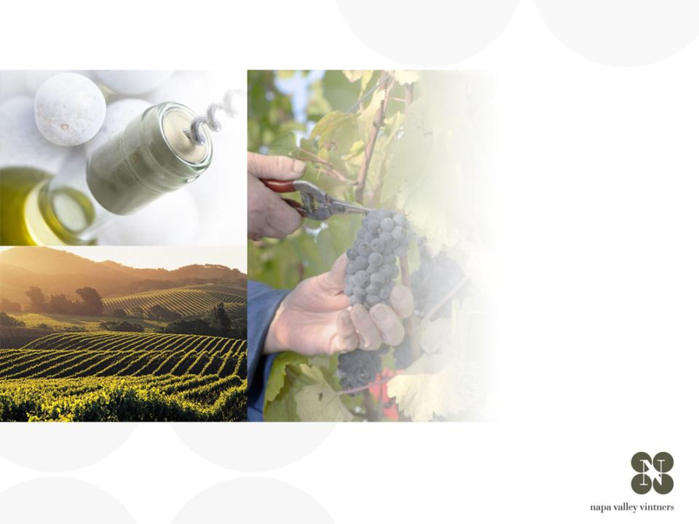
coup d’oeil sur
NAPA VALLEY
Notes:
There are many great wine regions and Napa Valley is one of them.
Napa Valley is the home to America’s first Agricultural Preserve and is a region of incomparable natural beauty.
Though accounting for just 4% of California’s harvest, Napa Valley is the industry’s undisputed leader in land and community stewardship and is renowned the world over for its extraordinary wines.

Slide 3
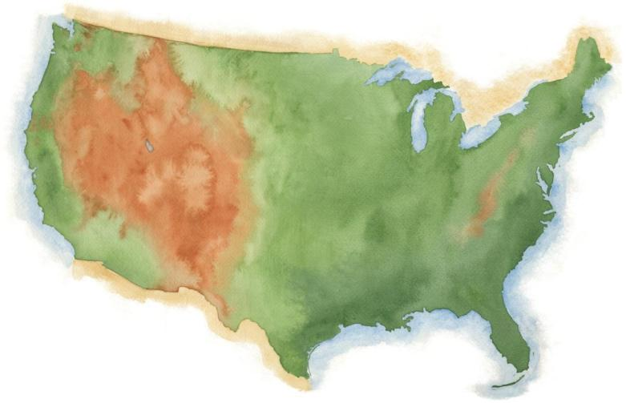
NAPA VALLEY
Notes:
Napa Valley is located in Northern California, very close to San Francisco and the Pacific Ocean, and several hundred miles from Los Angeles.

Slide 4
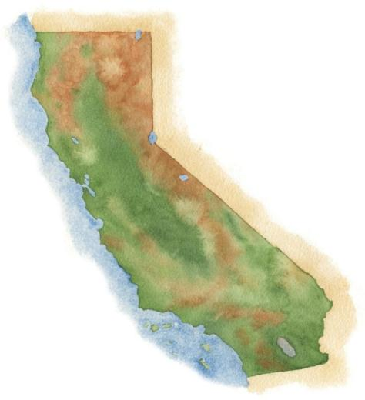
NAPA VALLEY
San Francisco
Los Angeles
Notes:
4
It’s a fairly young, “new world” wine region where wine has been made for only about 150 years.

Slide 5
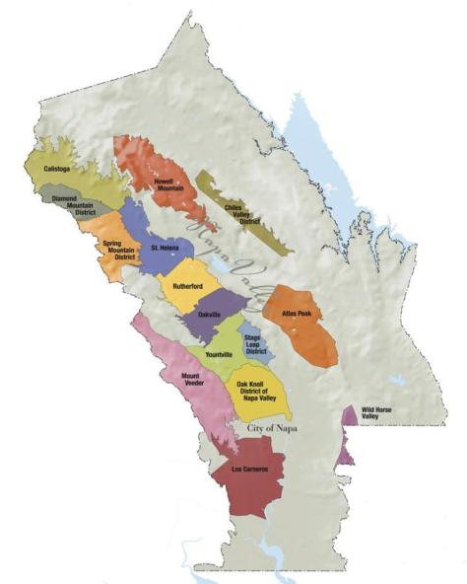

NAPA VALLEY
Distance à l’océan Pacific
36mi / 58km
Distance à San Francisco
48mi / 77km
Distance à Los Angeles
360mi / 579km
Notes:
5
Napa Valley is small: the valley floor, located between the Mayacamas Mountains and Vaca Range, is just about 5 miles across at its widest point and 30 miles at its longest.
The Napa Valley became California’s first recognized AVA or American Viticultural Area in 1981.
Within the Napa Valley AVA there are currently 15 recognized sub- or “nested” AVAs.

Slide 6
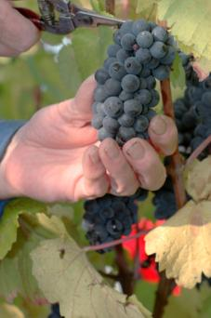
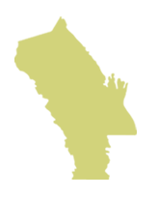
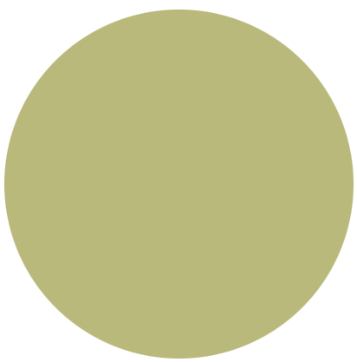
Napa Valley AVA
NAPA VALLEY
Petite vallée -
mais grande qualité et diversité
4% du vin Californien
4/10èmes d’ 1% du vin
mondial
Notes:
6
If there’s one message we could leave you with today, it’s that the Napa Valley may be one of the most renowned wine growing regions in the world, but it is also one of the smallest.
Napa Valley produces just 4% of California’s wine and a mere four-tenths of one percent of the world’s wine.

Slide 7
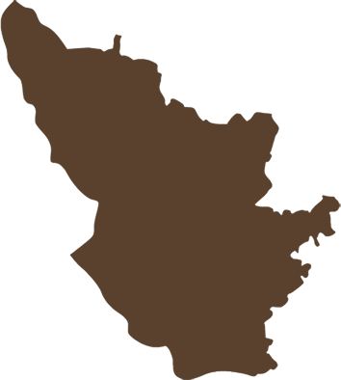
Napa Valley AVA
NAPA VALLEY AVA
45,000 acres
(18, 250 ha) de vignes
Bordeaux AC
290,000 acres
(117,500 ha) de vignes
L’AVA NAPA VALLEY est
huit fois plus petite que
l’AOC Bordeaux
Bordeaux AC
Notes:
7
It is roughly the size of Burgundy’s Côte d’Or and about one-eighth the size of Bordeaux.
There are approximately 45,000 acres under vine, about 9% of all of Napa County.

Slide 8
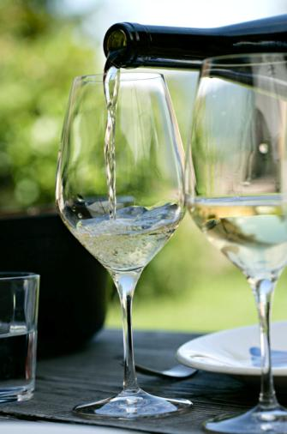
Vignerons artisanales
77% des 435 wineries membres des NVV produisent moins de 10 000 caisses par an.
63% produisent moins de 5 000 caisses par an.
95% des wineries de la vallée de Napa sont des exploitations familiales.
Notes:
8
The majority of Napa Valley’s producers are also small:
Nearly 80% of the NVV’s 400 member wineries make less than 10,000 cases of a wine a year.
More than 60% produce fewer than 5,000 cases annually.
95% of Napa Valley wineries are family owned or operated.

Slide 9
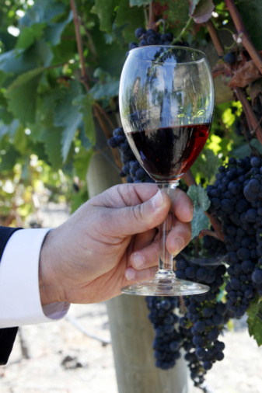
Les cépages clés de Napa Valley en ordre d’importance décroissant:
Cabernet Sauvignon
Chardonnay
Merlot
Sauvignon Blanc
Pinot Noir
Zinfandel
Syrah
(& bien d’autres encore…)
Notes:
9
9
Napa Valley has become synonymous with Cabernet Sauvignon.
The majority of Napa Valley winemakers produce it.
But, thanks to the many diverse growing conditions we’re about to review, all kinds of varieties flourish.
Conditions are well-suited for growing both Burgundian (Chardonnay and Pinot Noir) and Bordeaux-style varieties (Cabernet, Merlot, Cabernet Franc, and Sauvignon Blanc).

Slide 10
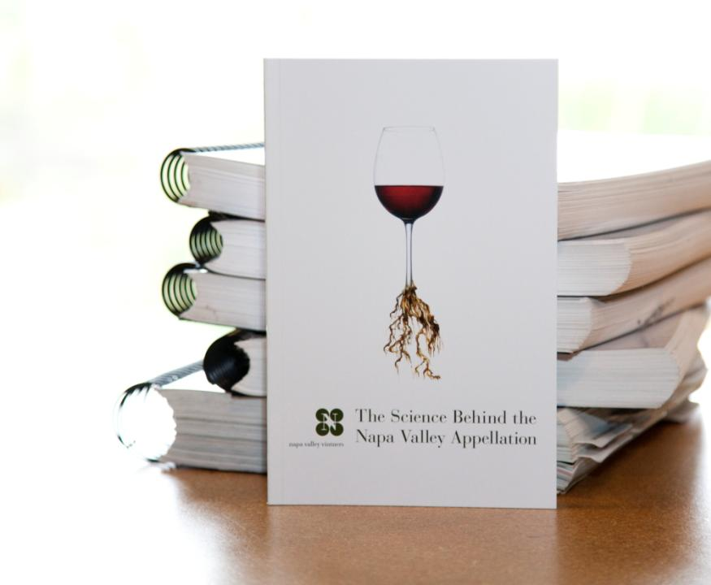
Nous avons
fait des
recherches…
Notes:
10
10
Although the place and the industry are relatively small, Napa Valley is one of the most diverse wine growing regions in the world.
It’s one thing to say a place is special, but it’s another to prove it.
Between 2001 and 2003, the Napa Valley Vintners trade organization commissioned three major studies to verify that the Napa Valley’s AVAs unique geology, soils, climate, weather, and topography all work together to nurture the winegrapes.
The next part of this presentation will explain more.
(The scientists who conducted the studies were Jonathan Swinchatt of EarthVision and Paul W. Skinner, PhD. Of Terra Spase.)

Slide 11
un lieu extraordinaire pour le vin:
SOLS
Notes:
We’ll start from the ground up - with soil.

Slide 12
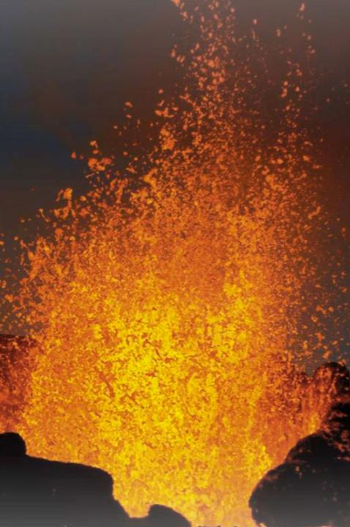
Il y a environ 150 millions d’années est survenu le premier d’une série d’événements liés…
Notes:
12
About 150 million years ago, a series of geologic events caused the shifting, sliding, and lifting of land masses in the area that we know of today as California.
That plastered material onto the edge of North America and formed it into its present, yet ever-changing configuration.
This is the process that created the Napa Valley.

Slide 13

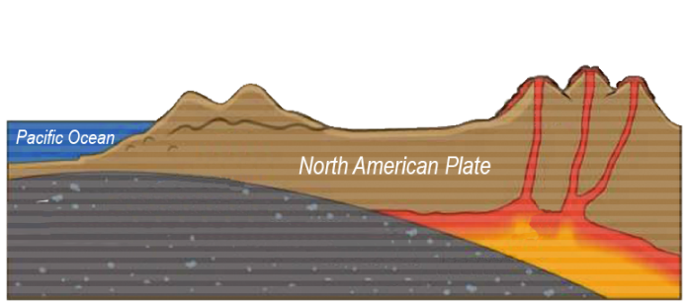
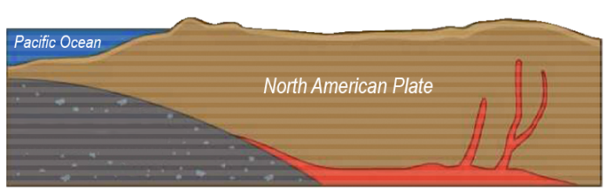

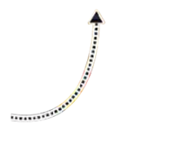

La séquence de Great Valley et le gradient franciscain
Gradient franciscain (plancher océanique)
Pacific Plate Subduction
Séquence de
Great valley
En montant à la surface, le magma forme des volcans et des montagnes
Notes:
13
Over time the mountains eroded and reformed, helping to create California.
Geologists call this the Great Valley Sequence, the remains of which are generally found on the east side of the Napa Valley.
As volcanoes were forming inland, the surface of the ocean floor was being sheered off as it met the coastline, literally plastering all sorts of marine sediment on top of the newly forming landmass, extending California westward.
Geologists call this the Franciscan Formation, the remains of which are generally found on the west side of present day Napa Valley.

Slide 14
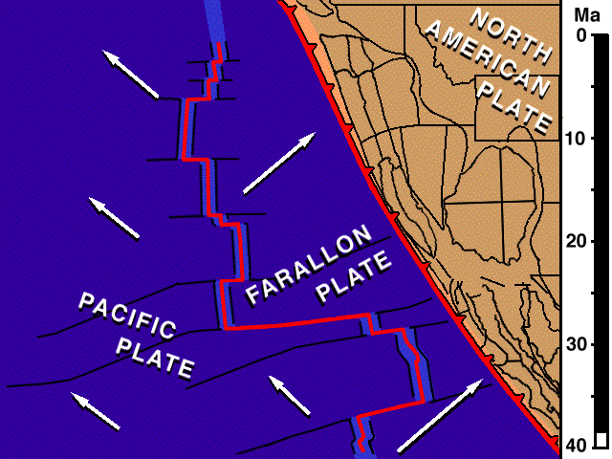
Le système de failles de San Andreas
La plaque de Farallon, la plaque du Pacifique et la plaque nord-américaine se touchent à une « triple jonction » .
Les plaques s’éloignent l’une de l’autre en se déplaçant vers le nord, et ce mouvement est à l’origine de la faille de San Andreas.
NORTH AMERICAN PLATE = PLAQUE NORD-AMÉRICAINE
FARALLON PLATE = PLAQUE DE FARALLON
PACIFIC PLATE = PLAQUE DU PACIFIQUE
Notes:
14
About 24 million years ago the San Andreas Fault system took shape with the joining of three tectonic plates – the Farallon, the Pacific, and the North American.
These plates started to move laterally south to north, moving this volcanic and sedimentary bedrock in all directions.
As this “triple junction” slowly moved north, dragging the San Andreas fault along, tremendous compression forces pushed up wrinkles in the earth’s crust that eventually became the Coast Range and the Mayacamas Mountains.

Slide 15
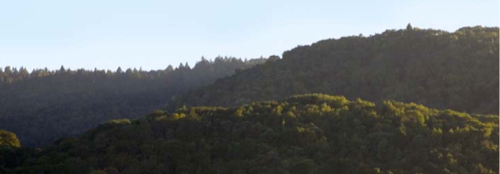
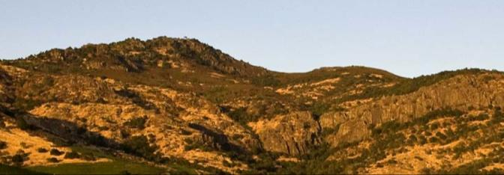
Monts Mayacamas
Vers l’ouest, Yountville
Montagnes Vaca
Vers l’est, district de Stags Leap
Notes:
15
Around 3 million years ago plate motion shifted direction again, this time folding the land over on top of itself, creating the Mayacamas Mountains, the Vaca Range, and Napa Valley in-between.
The multiple bedrock sources that would make up Napa Valley’s distinct soils were now in place.

Slide 16
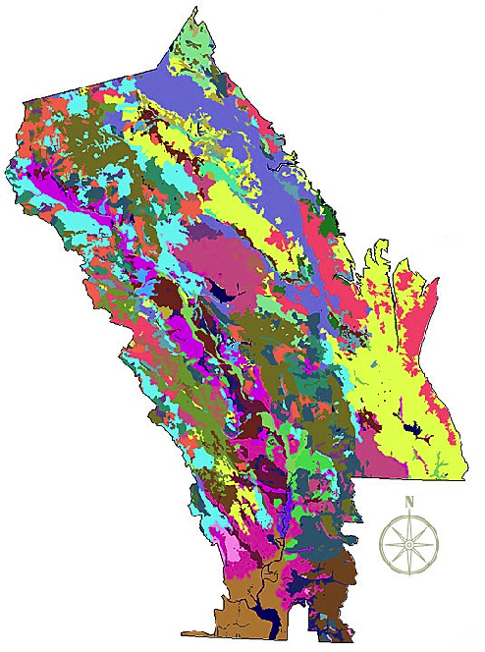
Série de sols de l’AVA Napa Valley
Plus de 100 sols différents
33 séries de sols
La moitié des ordres de sols du monde
Notes:
16
Napa Valley contains more than 100 soil variations, 33 soil series, and half the soil orders found in the world.
This picture shows how, literally, you can have different kinds of soil in the same vineyard in Napa Valley.
This diversity allows vintners to grow and produce – and to produce well – a great number of different wine varieties in the Napa Valley.
One of the secrets of great winegrowing is in the soil and Napa Valley has some of the greatest soil diversity found in winegrowing regions around the world.
(Note difference between a soil order, series and variation: soil orders are based largely on soil forming processes. Soil series is of a similar evolution or formation, chemistry, and physical property. Soil variations take into account vegetative material, climate, and topography differences and/or make-up).

Slide 17
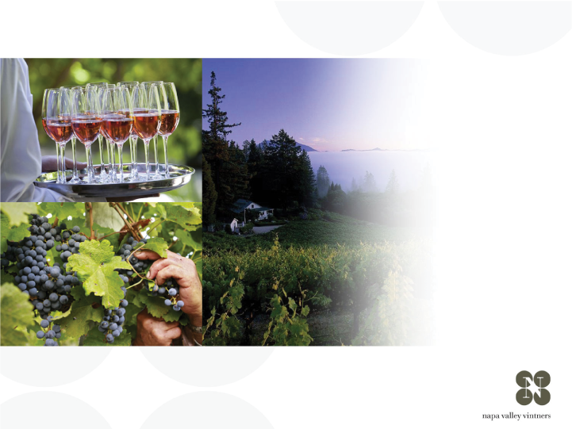
un lieu extraordinaire pour le vin:
CLIMAT
Notes:
17
Climate also has a significant impact on the flavor of the grapes.

Slide 18
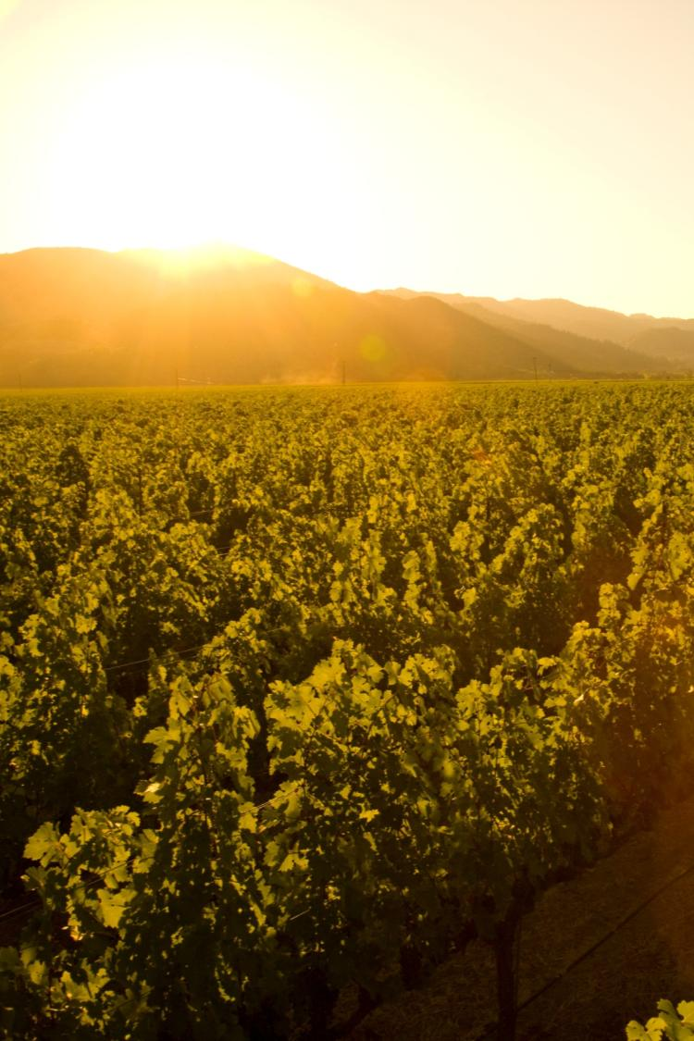
Zone de climat méditerranéen (qui ne compte que 2% des terres émergées de la planète)
Longue saison végétative
Mûrissement parfait des raisins
Consistance d’un millésime à l’autre
Notes:
18
18
Napa Valley is located within the rare Mediterranean climate zone, which encompasses just 2% of the earth’s surface.
The long growing season is marked by warm summer days and cool evenings – ideal for wine grapes to ripen slowly and evenly, with great balance between sugar and acid development.
Lack of summer rainfall helps to contribute to consistency of vintages and reduces the risk of vineyard diseases.
Most areas of the appellation can dry farm or tightly manage their irrigation practices.
Compared to most growing regions in the world, Napa Valley is unique in this regard.

Slide 19


Les conditions climatiques favorisent la formation régulière d’un brouillard marin
C
H
Pacific Ocean
Notes:
19
19
During the summer growing season, conditions exist for creating a recurring pattern of marine fog from the Pacific Ocean.
As hot air in California’s interior valley rises, it creates a vacuum effect which draws in moist, cool air from the Pacific Ocean, forming fog.
This pattern repeats most days during the warmer months of the year.

Slide 20

Notes:
This video shows how the fog advances and retreats in the Napa Valley from early until late morning.
Typically, the fog has a greater impact on the valley floor – often the hillsides, like the one where this video was filmed, are not reached by the fog.

Slide 21
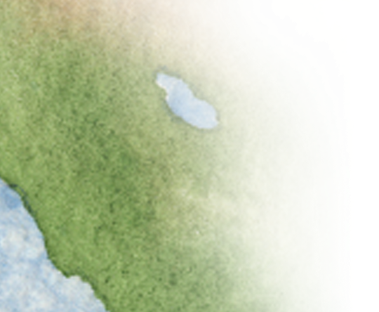
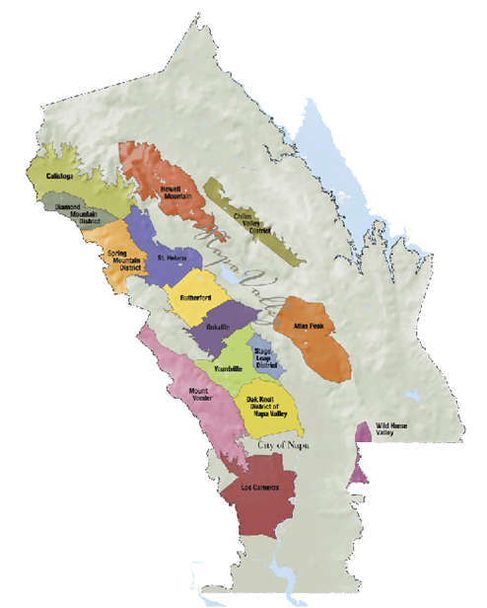
NAPA VALLEY AVA
Variation de temperatures - été
40-50ºf / 4.5-10ºc
85ºf / 29ºc
40-50ºf / 4.5-10ºc
95ºf / 35ºc
50ºf / 10ºc
77ºf / 25ºc
Notes:
21
21
Daytime temperatures can also vary dramatically throughout the AVA during the growing season.
The southern part of the valley, particularly Los Carneros AVA, is closer to San Pablo Bay and is cooled by marine breezes.
In summer, there can be as much as an 10-15°F difference between Carneros and St. Helena, to the north.
On many days, due to the cooling effect of the fog, there is a large diurnal (day to night) temperature swing throughout the valley.

Slide 22
Mount St. Helena
4000 ft / 1,219 m
NAPA VALLEY AVA
Elévation
Spring Mountain
2200 ft / 671 m
Atlas Peak
2600 ft / 793 m
Mount Veeder
2100 ft / 650 m
Valley Floor
0– 750 ft / 0 – 214 m
Notes:
22
22
Adding to the diversity of Napa Valley is its topography.
It changes with its length, from the flat estuaries in the south near San Pablo Bay to the rolling hills just before 4,000-foot Mount St. Helena in the north.
And don’t forget the Mayacamas and Vacas to the west and east – each range reaches approximately 2,500 feet above the valley floor.
There is a strong correlation between topography and climate: slope, aspect, and elevation all influence the many mesoclimates found throughout the Napa Valley.

Slide 23
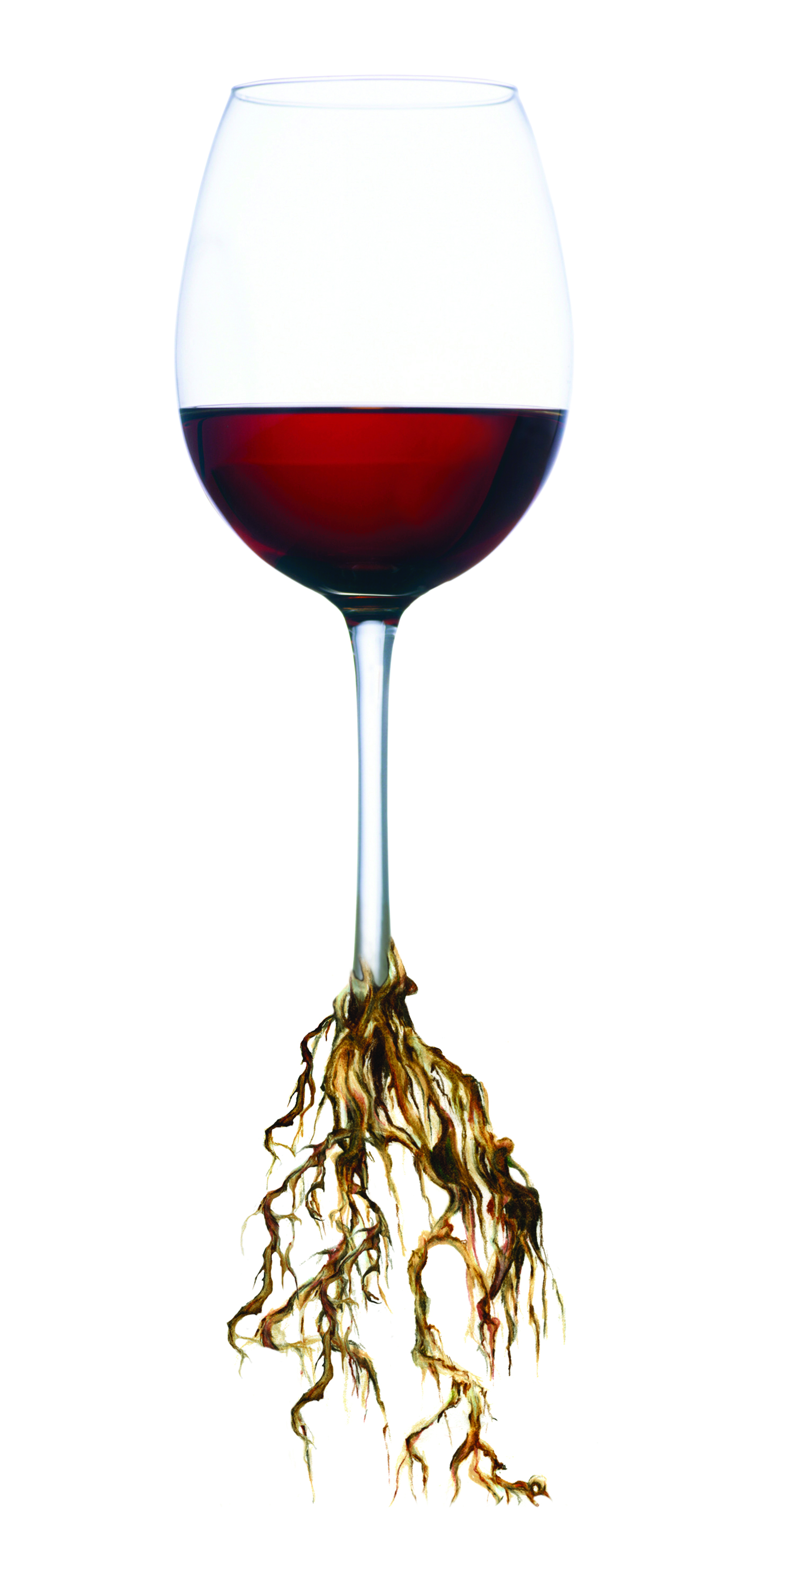
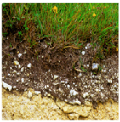
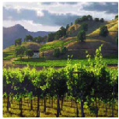
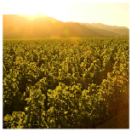
TERROIR
Quand tout se rassemble…
Sols Distincts
Climats Distincts
Topographie Distincte
+
+
Régions
viticoles
distinctes
Notes:
23
23
When you put it all together, these distinct soils, plus distinct climates, plus distinct topography it equals distinct growing conditions.
The sum of these factors is known by the French term, terroir.

Slide 24

Napa Valley
VITICULTURE
Notes:
24
Terroir also includes people – the people who make the decisions about how the grapes will be grown.

Slide 25
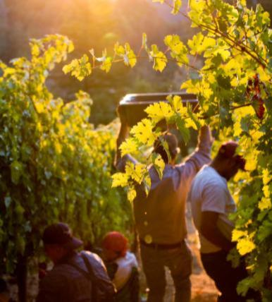
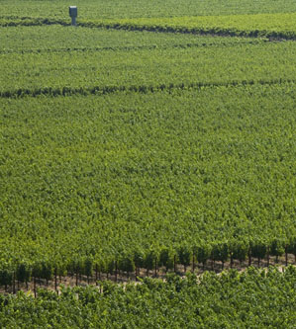
Vignobles de Napa
Les rendements sont maintenus à un bas niveau dans la vallée de Napa
Notes:
25
25
Most winemakers will tell you that quality starts in the vineyard.
Napa Valley vineyards are intentionally farmed to produce low yields to allow only the healthiest of grape clusters to mature.
Throughout the growing season, the canopy is managed with leaf pruning, shoot pulling, and fruit thinning – all of which is done by hand – resulting in a perfect sunlight to shade ratio and optimal fruit development.
During the year, vineyard workers will tend to each individual vine at least 20 times.
This attention to detail in the vineyard is designed to produce wine grapes of the highest quality.

Slide 26
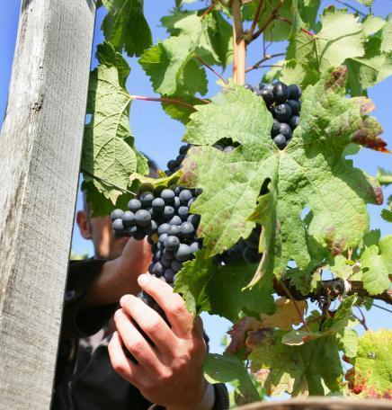
Pratiques d’élaboration
Une manutention délicate est la norme
L’accent est mis sur l’innovation et la qualité
La collaboration est courante entre les vignerons de la vallée de Napa
Apprentissage constant pour une amélioration constante de la qualité
Notes:
26
26
Inside the winery, most Napa Valley winemakers agree that “less is more” and their best approach is gentle and “hands off” allowing the grapes to express themselves.
Napa Valley vintners are always trying to improve quality - there is a culture of “we can do better.”
Innovative viticulture practices sometimes give a nod to the past, like use of concrete fermenters, gravity flow facilities, or wild yeasts, and also have a vision for the future, like new technology, which can provide an automated godsend to small producers with limited manpower.
Napa vintners regularly collaborate and participate in local wine technical group meetings and discussions, including the NVV’s winemaker discussion group.
They also regularly attend knowledge-building programs at local education institutions, like UC Davis, Sonoma State University, or even the local community college, which has an extensive enology program.

Slide 27
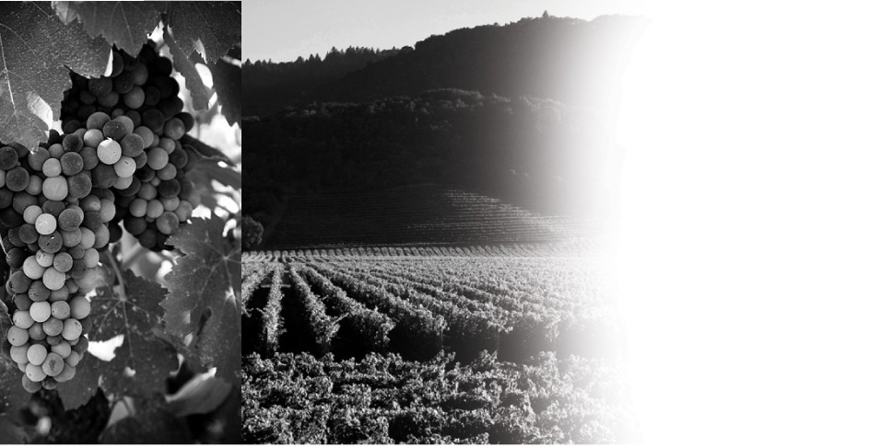
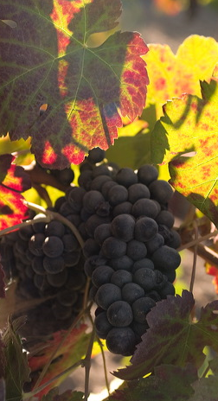
Napa Valley
HISTOIRE
Notes:
27
It has taken more than 150 years and a long line of great leaders to make the Napa Valley what it is today.
Let’s take a look back at the history of this special place.

Slide 28
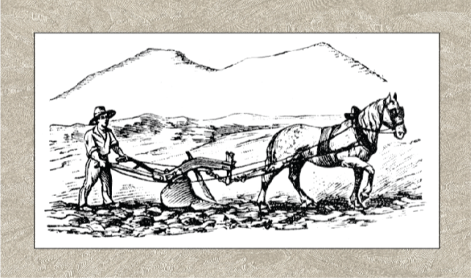
NAPA VALLEY
Expérimentateurs, innovateurs, chefs de file
George Yount plante les premiers vignobles en 1838-1839
1830
1840
1850
1860
1870
1880
1890
1900
Notes:
28
28
The Napa Valley of the Wappo Indians was home to spawning salmon, wildcats, elk, black bear, grizzlies… and wild grapes.
The name “Napa” is believed to mean “abundance” in the Wappo language.
Early settlers like George Calvert Yount were the first to recognize the valley's potential for cultivating wine grapes.
In 1838-1839, Yountville was established, and Yount was the first to plant vineyards in the valley.

Slide 29

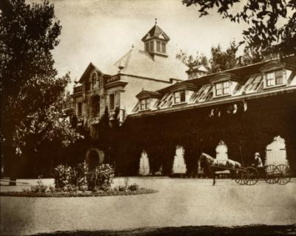
1861-1880
Les premiers wineries sont établis
Charles Krug, premier winery commerical, 1861
Inglenook, premier “château” au Napa Valley, 1879
1830
1840
1850
1860
1870
1880
1890
1900
Notes:
29
29
Following California’s Gold Rush, in the 1860s and ‘70s, Europeans arrived in Napa, eager to try their hand at making wine to rival the wines from their homeland.
Most of the wine at that time was shipped in bulk to San Francisco for sales and distribution.
Charles Krug is credited with establishing Napa Valley's first commercial winery in 1861.
In 1879, Gustav Niebaum established Inglenook, the first chateau-style winery in the US and he was also the first to sell wine in bottles.
By 1889, Napa Valley had 140 wineries.

Slide 30
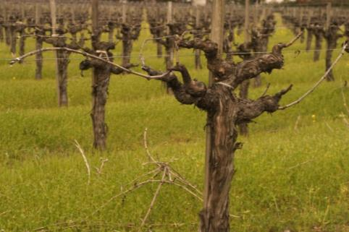
Les bouleversements
Phylloxera
Les acres de vignes diminuent de 15,807 à 2,000 en seulement 12 ans
1830
1840
1850
1860
1870
1880
1890
1900
Notes:
30
30
But, what’s a success story without a stunning setback or two?
In the late 1890s phylloxera, tiny sap-sucking insects which feed on the roots of grapevines and kill them, hit and nearly decimated Napa’s vineyards.
Acreage in Napa Valley declined from 15,807 in 1888 to just 2,000 acres by 1900.

Slide 31
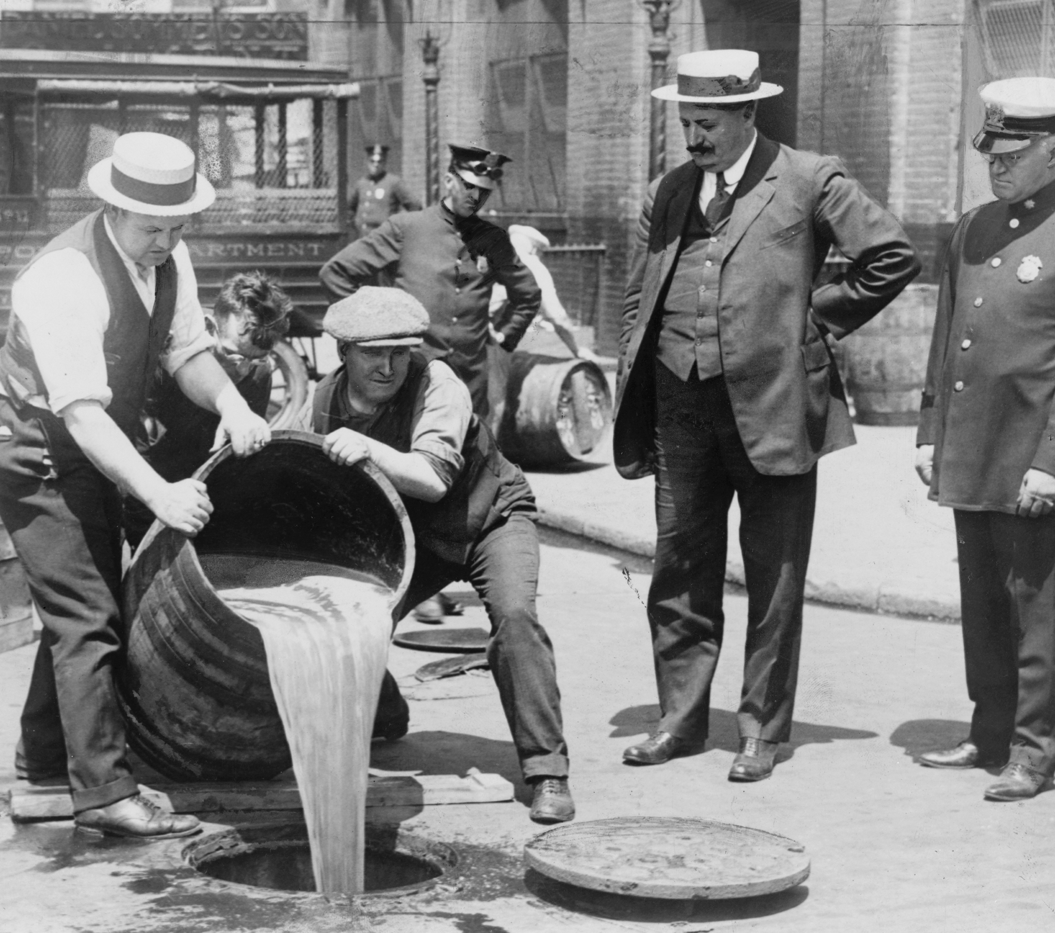
Les bouleversements
La Prohibition, La Crise de 1929, La Guerre Mondiale
Une série d’événements dévastateurs pour l’industrie du vin à Napa Valley
1910
1920
1930
1940
1950
1960
1970
1980
Notes:
31
31
Then an even greater threat arrived in 1920 with the enactment of Prohibition, which lasted for 13 years.
The Great Depression didn’t help matters either.
By the time World War II came along, Napa’s grapevines and wineries were largely abandoned.
Many vineyards were planted over to plums and walnuts.
The Napa Valley wine industry was in shambles.

Slide 32
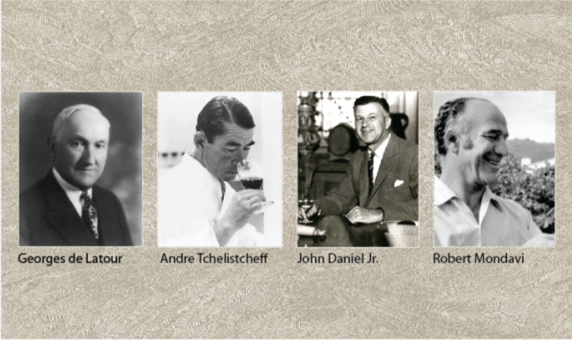
Renaissance
Le renouvellement du secteur vinicole dans la vallée de Napa
John Daniel, Jr. hérite d’Inglenook en 1939
Robert Mondavi construit le premier nouveau winery depuis la Prohibition in 1966
1910
1920
1930
1940
1950
1960
1970
1980
Notes:
32
32
But, many visionaries believed the Napa Valley could return to it’s pre-1900 glory.
Credit for the post-World War II rebirth of the Napa Valley wine industry goes to a handful of bold and visionary vintners, including Georges de Latour, of Beaulieu Vineyards, who in 1938 recruited Andre Tchelistcheff, research enologist from France's Pasteur Institute.
In 1939, John Daniel, Jr. inherited Inglenook, the Gustave Niebaum estate, and ran the winery for 25 years.
Of course, much of the “Napa Valley Renaissance” was led by Robert Mondavi, who championed the idea that fine wine was an integral part of the good life.

Slide 33
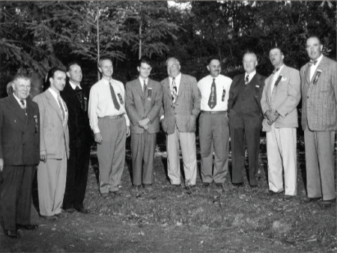
L’Union fait la force:
Les Napa Valley Vintners
L’association fut crée en 1944
1910
1920
1930
1940
1950
1960
1970
1980
Notes:
33
33
Many of these vintner leaders, like Louis Martini, John Daniel, Jr., and Robert Mondavi knew there were challenges ahead for their fledgling wine industry, not the least the ongoing threat of natural disasters and growing regulation.
They formed the Napa Valley Vintners trade association in October 1944 with the idea that we are stronger together than individually.
Left to Right: Charles Forni (Napa Valley Cooperative Winery), Robert Mondavi (C. Mondavi & Sons), Brother Timothy (Mont La Salle), Al Huntsinger (Napa Valley Cooperative Winery), Mike Ahern (Freemark Abbey), Charles Beringer, Fred Abruzzini (Beringer Brothers), Louis M. Martini, John Daniel, Jr. (Ingelnook Vineyard Co.), and Martin Stelling, Jr. (Sunny St. Helena).

Slide 34

Le Jugement de Paris, 1976
Chardonnay et Cabernet Sauvignon de Napa Valley gagnent en dégustation à l’aveugle contre les vins français
1910
1920
1930
1940
1950
1960
1970
1980
Notes:
34
34
While these Napa Valley vintners believed in the quality of the appellation, and in the early 1970s Napa Valley’s reputation continued to grow, it was a pivotal endorsement from another part of the world that helped put Napa Valley on the winegrowing map.
The 1976 Judgment of Paris wine tasting, chronicled recently in the movie “Bottle Shock,” set the wine world on it’s ear: few could have imagined that California wines would win such a competition.
Yet California rated best in each category.
The hard work of Napa Valley’s vintners was starting to pay off.

Slide 35
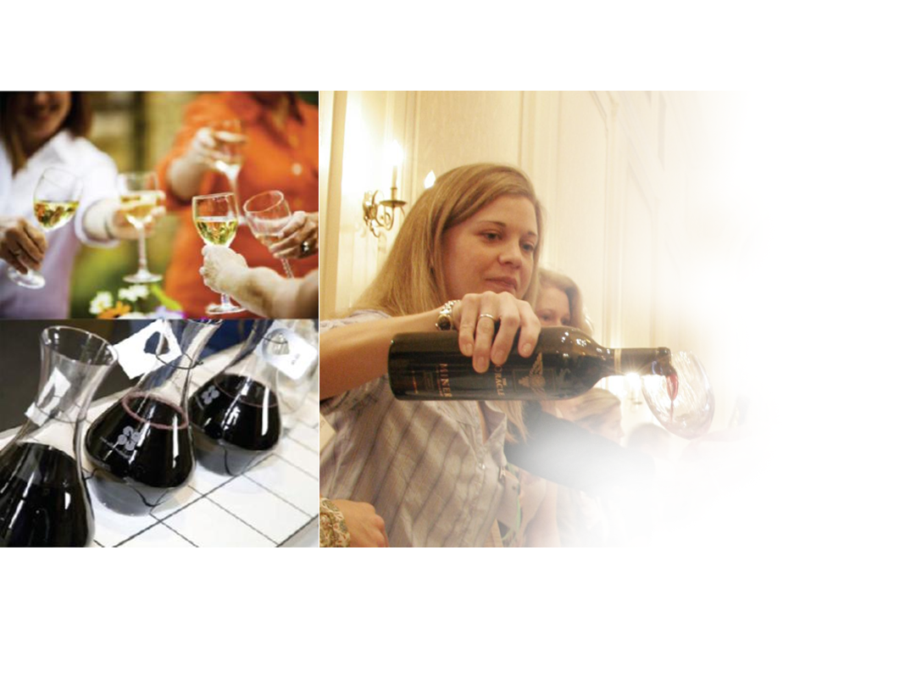
Napa Valley
VIGNERONS
Notes:
35
Nearly seven decades after being formed, and now more than 435 wineries strong, the Napa Valley Vintners still work to promote and protect – as well as enhance – the Napa Valley AVA as the premier winegrowing region.

Slide 36
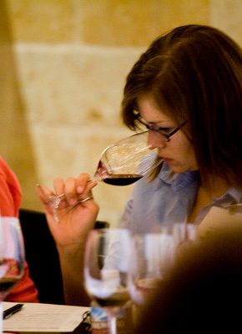
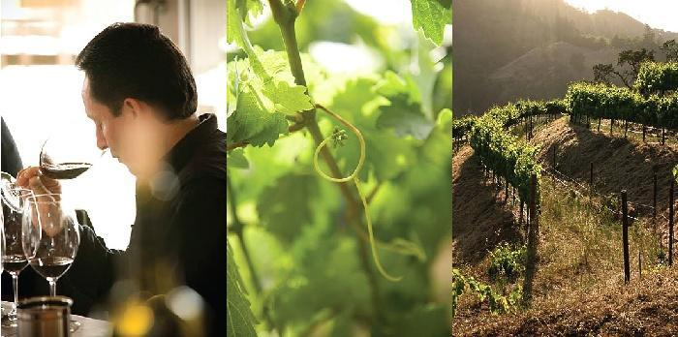
La Mission des Napa Valley Vintners:
Promouvoir, protéger et améliorer l’appelation de Napa Valley et ses vins.
Notes:
36
36
NVV members are deeply committed to conservation and sustainable farming, and to supporting the local community through charitable work.
The Napa Valley wine industry thrives on a strong culture of collaboration and pride in its agricultural heritage, community, and appellation.
As the appellation is defined by the soils, climate, geology, and topography, it has also been shaped by the contribution of its people.
Here are some highlights that demonstrate the leadership of Napa vintners…

Slide 37
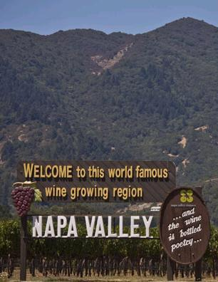
Promouvoir
Napa Valley
Auction Napa Valley
Premiere Napa Valley
Taste Napa Valley
Master Napa Valley
Symposium for Professional Wine Writers
Wine Educators Academy
Notes:
37
37
Whether on the road or at home, the Napa Valley Vintners work together to promote the Napa Valley appellation through signature marketing programs, like Auction Napa Valley and Taste Napa Valley.
Our barrel tasting and auction, Premiere Napa Valley, encourages vintners to create some of the rarest wines made in Napa Valley.
Every year vintners bring groups of trade, educators, and writers to Napa Valley to learn more about the appellation and its wines.

Slide 38
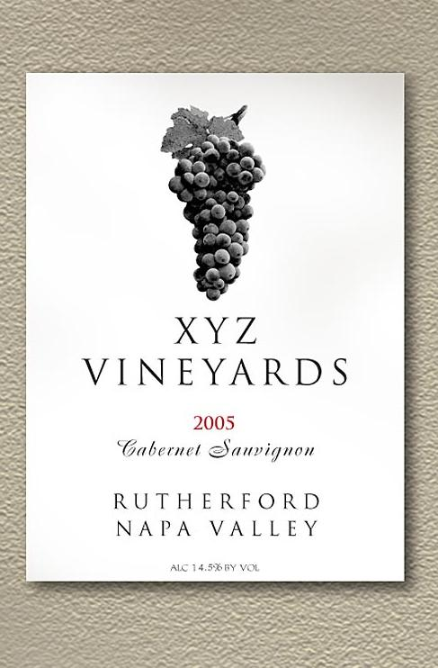
Protéger
Napa Valley
Etiquettes et
propriété intellectuelle
Etiquetage conjonctif
Napa Name law
Appellation contrôlée
Veille des marques
Calistoga AVA
Notes:
Of course, we’d have nothing to promote if vintners did not protect one of their most important assets: the “brand” Napa Valley.
Napa Valley became the first wine region to develop conjunctive labeling laws - if a bottle is labeled Rutherford, it must say “Rutherford Napa Valley.”
The Napa Valley Vintners also work to ensure that truth in wine labeling laws are adhered to around the globe – and have taken the fight all the way to the US Supreme Court and the European Union.
We believe that if it says “Napa” or “Napa Valley” in the brand name, it should be Napa wine in the bottle.
Napa Vintners also worked for more than six years in support of the approval of the Calistoga appellation – another victory for truth in labeling and consumer rights.

Slide 39
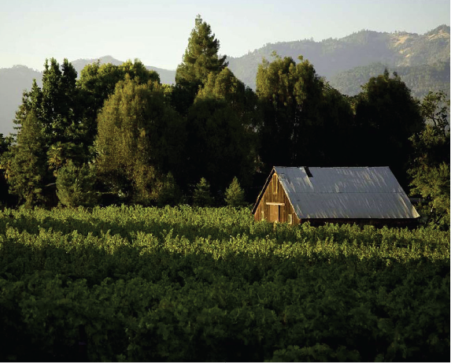
La réserve agricole de Napa Valley
Première réserve du genre aux États-Unis, créée en 1968.
Notes:
39
39
The other valuable asset that must be protected: the Napa Valley itself.
For more than 40 years, long before green and sustainable became buzzwords, vintners have supported the tradition of environmental leadership by focusing on environmentally sound practices.
Rather than waiting for government to enact rules and guidelines, Napa Valley Vintners often find themselves at the table helping to craft these policies.
Napa Valley’s vintners farm under the most stringent land use and environmental guidelines of any winegrowing region and have often created these strict rules themselves to protect what is important to them.

Slide 40
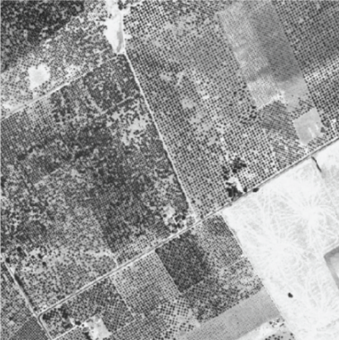
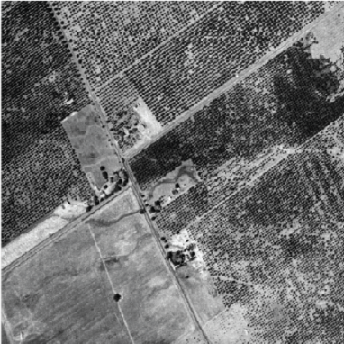
La réserve agricole de Napa Valley
Assurer le meilleur usage des terres
Napa Valley, 1940
Santa Clara Valley, 1940
Napa Valley, 1940
Santa Clara Valley, 1940
Notes:
40
40
For example, the Napa Valley Ag Preserve, founded in 1968, was the first in the U.S. to set aside land specifically for agriculture.
Founded in 1968, it’s been going strong more than 40 years without compromise, and now protects 38,000 acres of valley floor farmland.
Another 20,000 acres of Napa Valley land has been placed into permanent conservation easements.
This slide and the next show the impact of the Ag Preserve on our county…and our way of life.
Here’s an aerial photo of Napa Valley and the Santa Clara Valley taken around 1940 – both of these communities are about an hour from San Francisco…

Slide 41
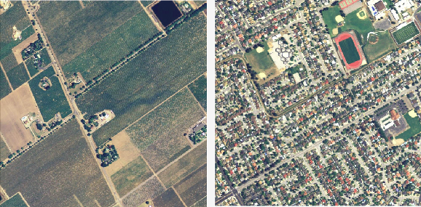
La réserve agricole de Napa Valley
Aujourd’hui, environ 38 000 acres de terres agricoles sont protégées
Napa Valley, 2005
Santa Clara Valley, 2005
Notes:
41
41
A photo was taken again of the same two places in 2005 – a couple of pictures here are worth more than 1,000 words!

Slide 42

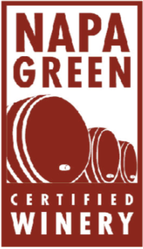
Napa Green Land & Winery
Améliorer les réserves en eau et restorer les habitats
Programmes à participation volontaire
Les normes les plus strictes dans le secteur
Certification indépendante par des organismes de réglementation du gouvernement
Napa Green Land :
Améliorer le bassin hydrologique et restaurer l’habitat grâce à des pratiques écologiques
Napa Green Winery :
Réduire, réutiliser et recycler pour éliminer les gaz à effet de serre
Notes:
42
42
To further protect the environment, the Napa Valley Vintners, along with several other local, regional, and state agencies and organizations, developed the Napa Green Certified Land program in 2003.
The program uses sustainable agricultural practices while enhancing the watershed and restoring natural habitat, including soil and water conservation.
It’s the wine industry’s most rigorous land-use program, meeting and exceeding nearly 20 local, state, and federal “best practices.”
To date, 52,000 acres are enrolled in the Napa Green Land program and 25,000 acres have been certified (more than 13,000 of this acreage is vineyard land).
Napa Green Certified Winery is a companion certification program launched in 2008 that implements best practices for wineries to reduce, reuse, and recycle energy, water, and waste to eliminate greenhouse gasses.
26 wineries are certified Napa Green with dozens more in progress.

Slide 43
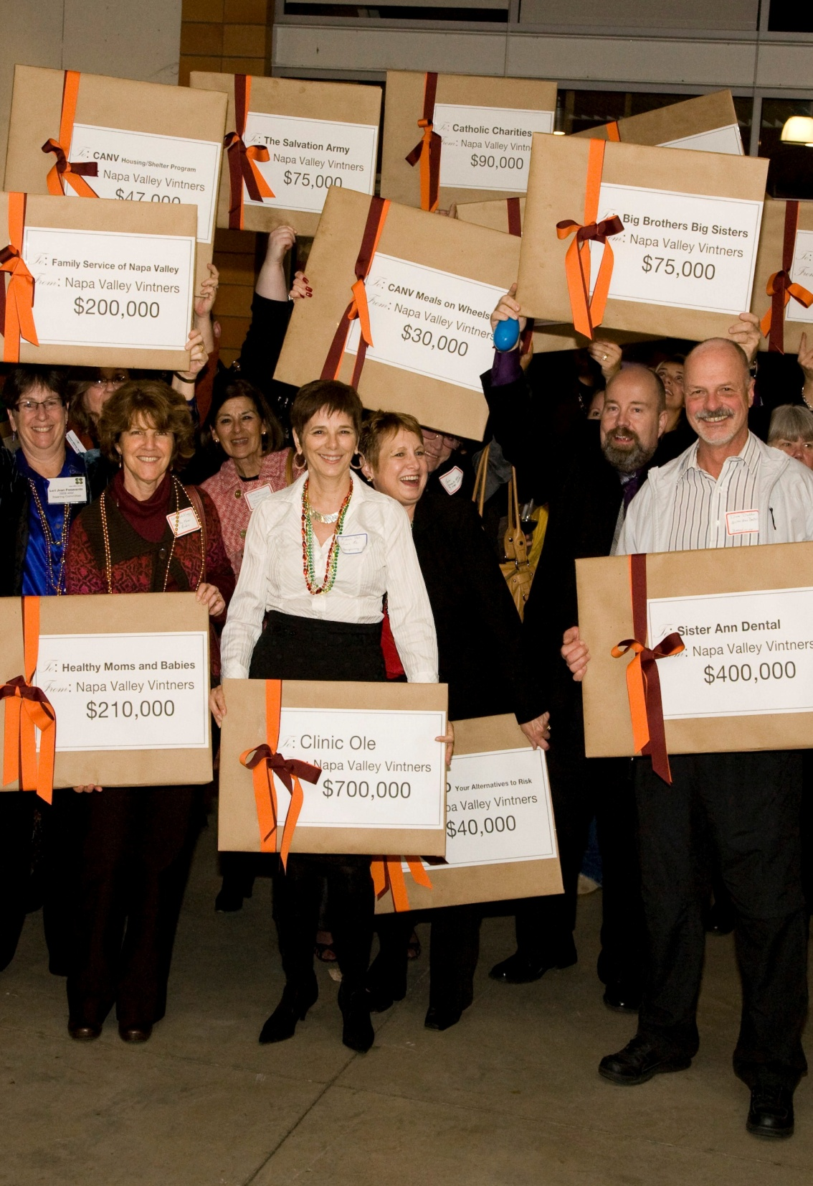
Ameliorer le
Napa Valley
Redonner à sa communauté
Vente aux enchères dans la vallée de Napa - Auction Napa Valley - a permis de donner 100 millions de dollars à la collectivité depuis 1981
Notes:
43
43
And, through our annual community fundraiser, Auction Napa Valley, the NVV has given more than $100 million to date to dozens of local health, youth, and housing non-profits.
And vintner generosity extends well beyond the local community as Napa Valley wines are the backbone of charity wine auctions across the US.

Slide 44
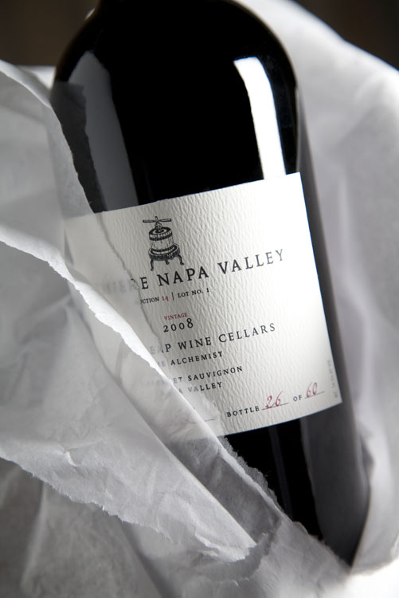
Premiere Napa Valley
Dégustation du vin en barrique et enchères réservée aux professionnels du vin
Les vins les plus rares de la vallée de Napa
Le 26 février 2011
Notes:
For 14 years, Napa Valley’s top winemakers have offered ultra-boutique wines to the trade, crafted in as few as five cases and never more than 20 cases, as individual bottlings for the brand known as Premiere Napa Valley. These wines, created each only once, by 200 different wineries each year are offered as futures at auction only to the wine trade so they have the most unique, and some of the very best wines made from America’s leading appellation. Essentially think of Premiere Napa Valley as a brand consisting of 200 “single vineyard,” small case production offerings. Each wine from each producer is one-of-a-kind, and will not be found in the market except by the wine seller who secures the unique wine via an annual trade auction held each winter. Though reminiscent of how Hospice de Beaune wines are produced, the process is uniquely American. The winemakers take a gloves-off approach, often using varieties they may not bottle as a stand-alone, or perhaps a noted white-wine-only house producing a red wine. These wines are innovative and showcase the region’s sense of explorations in fine winemaking. If you are interested in joining us next year at Premiere Napa Valley, please request an invitation today.

Slide 45




Napa Valley: Les Vins Légendaires d’Amérique
Learn more: NapaVintners.com
Become a fan: Facebook.com/NapaVintners
Follow us on Twitter: @NapaVintners
Read our blog: NapaVintners.com/blog
Notes:
45
45
Millions of years of science…150 years of grape growing…70 years of cooperation and camaraderie.
Today, Napa Valley is the most recognized appellation in America, its wines are considered some of the finest and most age-worthy in the world.
No other winegrowing region offers more diversity or a greater tradition of leadership.
Thank you for listening to our story.

