Slide 1
Notes:
Thank you for being here and welcome to “Napa Valley Rocks”
(INTRODUCE YOURSELF, INCLUDING YOUR TITLE AND YOUR WINERY NAME)
This educational presentation was created by the Napa Valley Vintners or N-V-V, a voluntary, non-profit trade organization.
During this presentation, I’ll share with you scientific data and examples of specific attributes which make the Napa Valley unique in the world of wine.

Slide 2

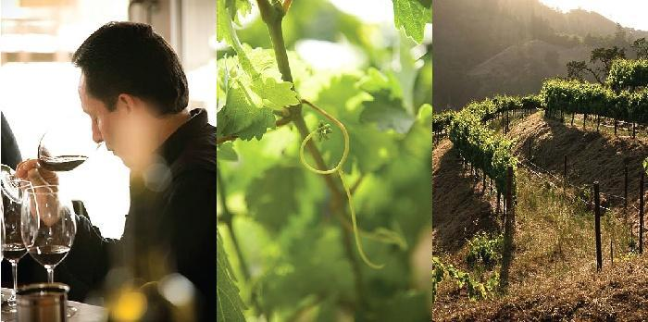
納帕谷酒商協會(NVV)的使命：為推廣，保護及提昇納帕谷產區的酒，酒商和社群
Notes:
2
2
Formed in 1944, the Napa Valley Vintners today has more than 425 member wineries who work to promote, protect and enhance the Napa Valley appellation, our wines, vintners and community.
Our winery is a member of the NVV.

Slide 3
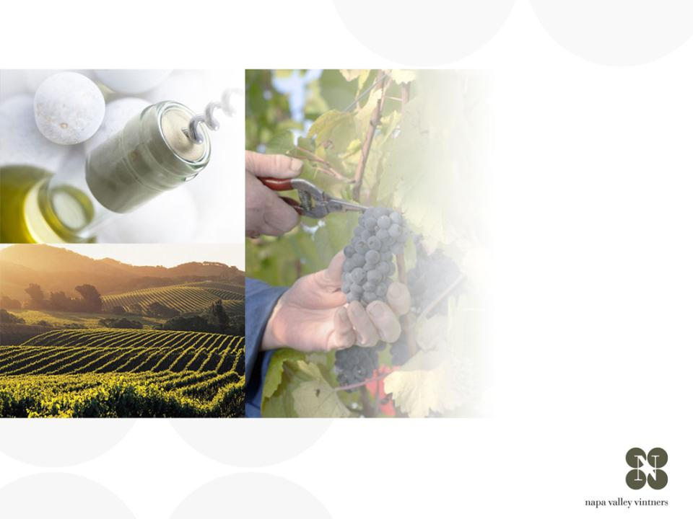
纳帕谷的概述
NAPA VALLEY
Notes:
There are many great wine regions and Napa Valley is one of them.
Napa Valley is the home to America’s first Agricultural Preserve and is a region of incomparable natural beauty.
Though accounting for a fraction of California’s harvest, Napa Valley is the industry’s undisputed leader in land and community stewardship and is renowned the world over for its extraordinary wines.

Slide 4
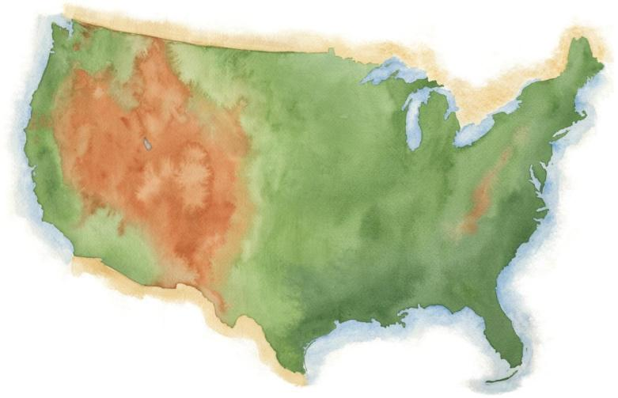
納帕谷
Notes:
Napa Valley is located in Northern California, very close to San Francisco and the Pacific Ocean, and several hundred miles from Los Angeles.

Slide 5
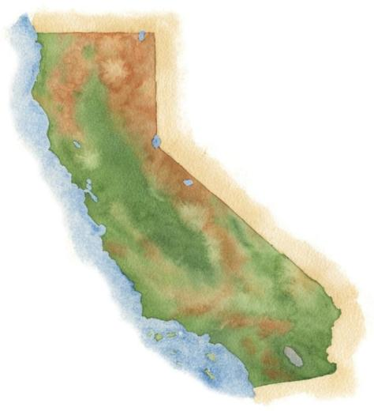
納帕谷
舊金山
洛杉磯
Notes:
5
It’s a fairly young, “new world” wine region where wine has been made for only about 150 years.

Slide 6
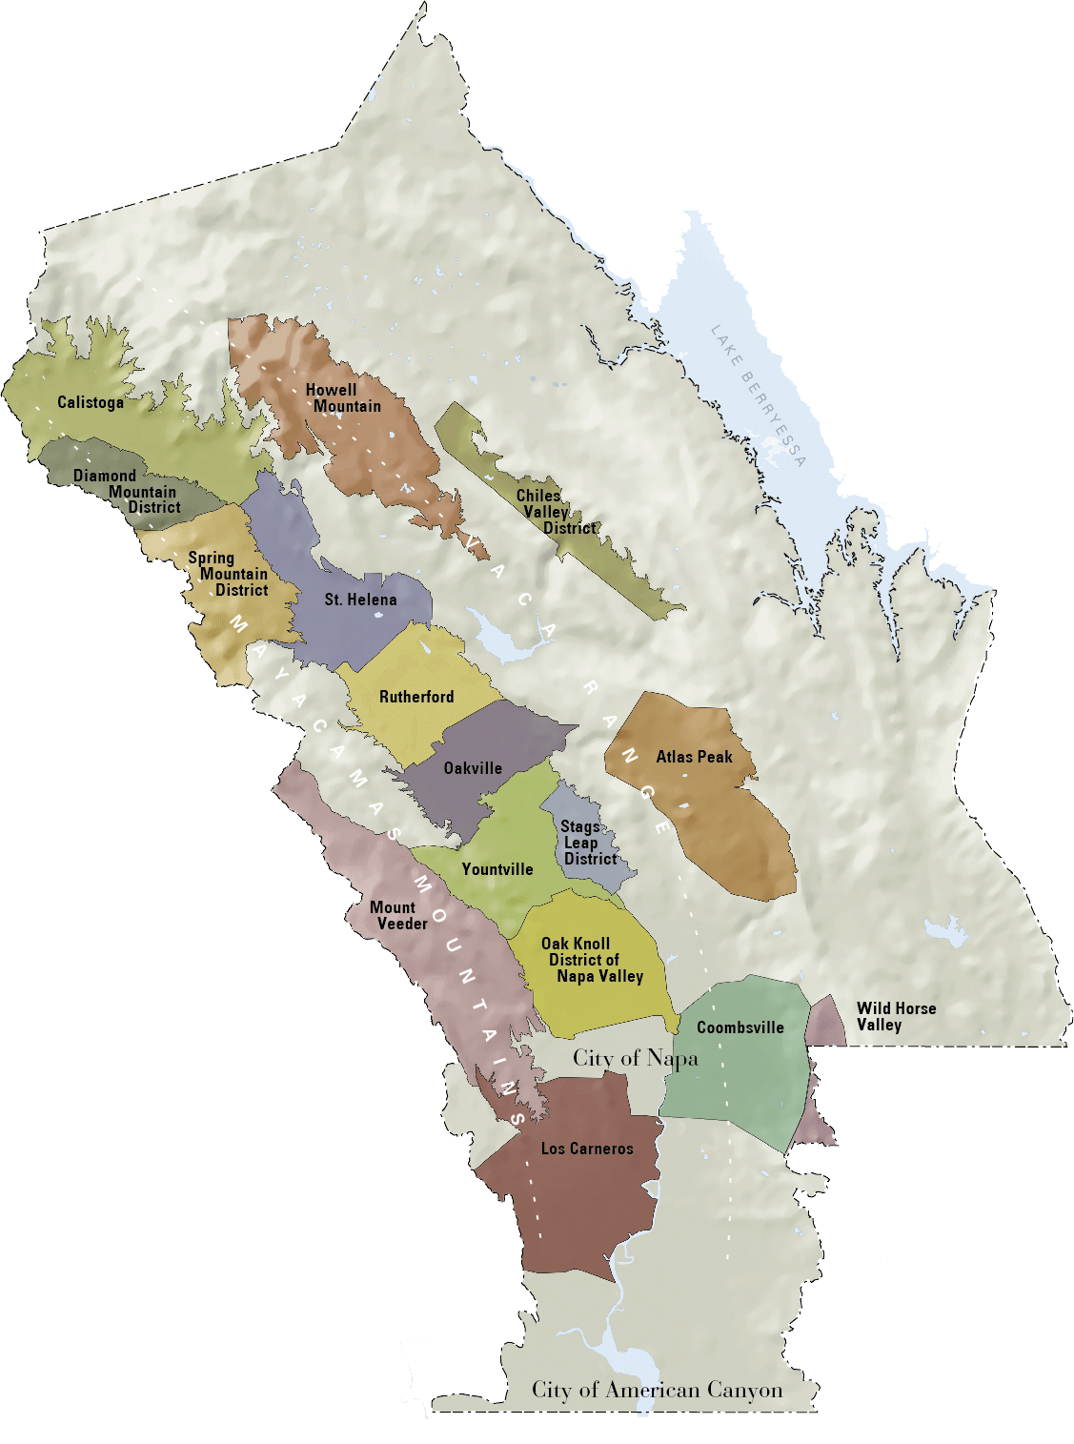

納帕谷
與太平洋的距離
36mi / 58km
與舊金山的距離
48mi / 77km
與洛杉磯的距離
360mi / 579km
Notes:
6
Napa Valley is small: the valley floor, located between the Mayacamas Mountains and Vaca Range, is just about 5 miles across at its widest point and 30 miles at its longest.
There are even smaller places within it: the Napa Valley itself is an AVA or American Viticultural Area, the first to be recognized in California in 1981
Within the Napa Valley AVA there are 16 recognized sub- or “nested” AVAs

Slide 7
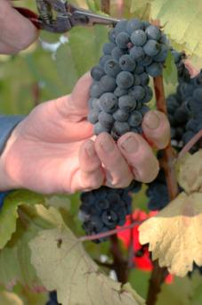


納帕谷產區
納帕谷
小面積
.
強於質量和多樣性
佔加州葡萄酒的4％
世界葡萄酒1％中的4/10
Notes:
7
If there’s one message we could leave you with today, it’s that the Napa Valley may be one of the most renowned wine growing regions in the world, but it is also one of the smallest.
Napa Valley produces just 4% of California’s wine and a mere four-tenths of one percent of the world’s wine.

Slide 8
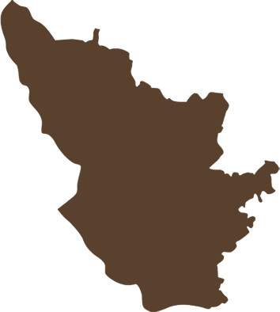
納帕谷產區
納帕谷產區
種植面積 45,000英畝
（約18,250公頃）
波爾多產區
種植面積290,000英畝
（約117,500公頃）
納帕谷是波爾多的1/8大小
波爾多產區
Notes:
8
It is roughly the size of Burgundy’s Côte d’Or and about one-eighth the size of Bordeaux.
There are approximately 45,000 acres under vine, about 9% of all of Napa County.

Slide 9
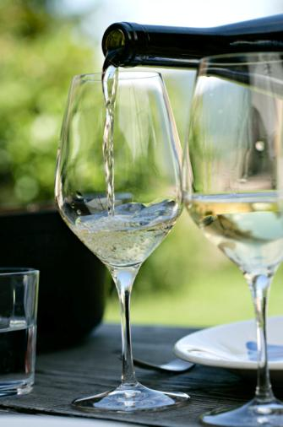

77%
小型生產者
NVV的會員
77％年產量小於10000箱
63％的產量不到5000箱95% 是家族事業
Notes:
9
The majority of Napa Valley’s producers are also small:
Nearly 80% of the NVV’s 425 member wineries make less than 10,000 cases of a wine a year.
More than 60% produce fewer than 5,000 cases annually.
95% of all Napa Valley wineries are family owned.

Slide 10
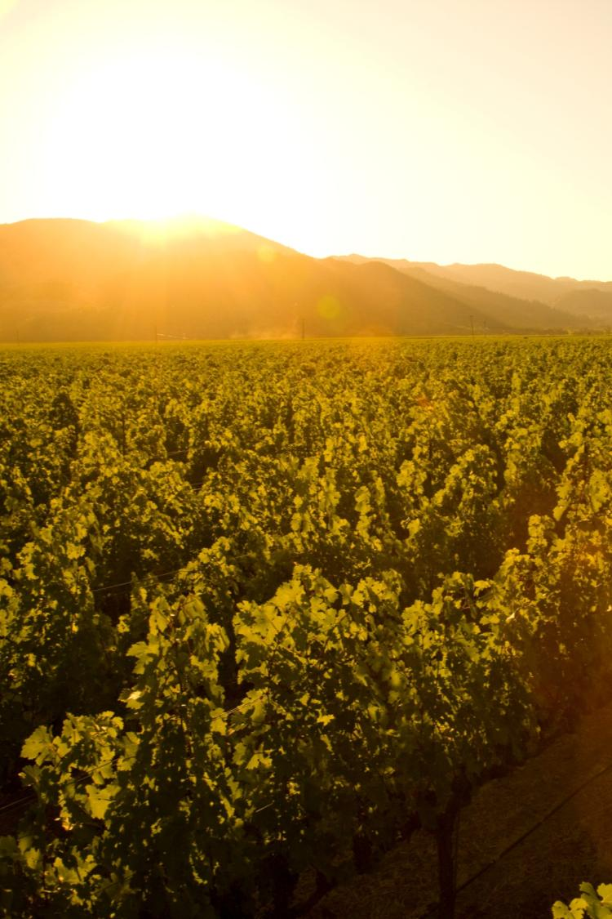
地中海氣候區
生長季節長
夏季降雨缺乏
年復年保持一致性和降低風險的管理讓葡萄園免除病害
Notes:
10
10
Napa Valley is located within the rare Mediterranean climate zone, which encompasses just 2% of the earth’s surface.
The long growing season is marked by warm summer days and cool evenings – ideal for wine grapes to ripen slowly and evenly, with great balance between sugar and acid development.
Lack of summer rainfall helps to contribute to consistency of vintages and reduces the risk of vineyard diseases.
Most areas of the appellation can dry farm or tightly manage their irrigation practices.
Compared to most growing regions in the world, Napa Valley is unique in this regard.

Slide 11


海洋霧氣造成一個的循環模式的成立
C
H
大平洋
Notes:
11
11
During the summer growing season, conditions exist for creating a recurring pattern of marine fog from the Pacific Ocean.
As hot air in California’s interior valley rises, it creates a vacuum effect which draws in moist, cool air from the Pacific Ocean, forming fog.
This pattern repeats most days during the warmer months of the year.

Slide 12


納帕谷產區
溫度的變化 -
夏季
40-50ºf / 4.5-10ºc
85ºf / 29ºc
40-50ºf / 4.5-10ºc
95ºf / 35ºc
50ºf / 10ºc
77ºf / 25ºc
Notes:
12
12
Daytime temperatures can also vary dramatically throughout the AVA during the growing season.
The southern part of the valley, particularly Los Carneros AVA, is closer to San Pablo Bay and is cooled by marine breezes.
In summer, there can be as much as an 10-15°F difference between Carneros and St. Helena, to the north.
On many days, due to the cooling effect of the fog, there is a large diurnal (day to night) temperature swing throughout the valley.

Slide 13
Mount St. Helena
4000 ft / 1,219 m
納帕谷產區
海拔
Spring Mountain
2200 ft / 671 m
Atlas Peak
2600 ft / 793 m
Mount Veeder
2100 ft / 650 m
Valley Floor
0– 750 ft / 0 – 214 m
Notes:
13
13
Adding to the diversity of Napa Valley is its topography.
It changes with its length, from the flat estuaries in the south near San Pablo Bay to the rolling hills just before 4,000-foot Mount St. Helena in the north.
And don’t forget the Mayacamas and Vacas to the west and east – each range reaches approximately 2,500 feet above the valley floor.
There is a strong correlation between topography and climate: slope, aspect, and elevation all influence the many mesoclimates found throughout the Napa Valley.

Slide 14
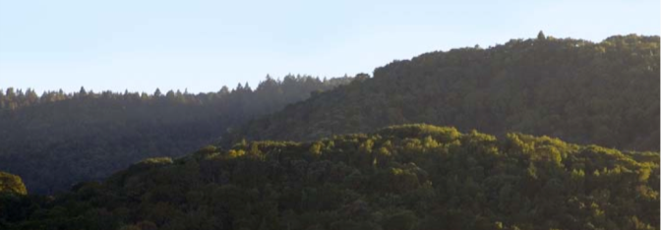
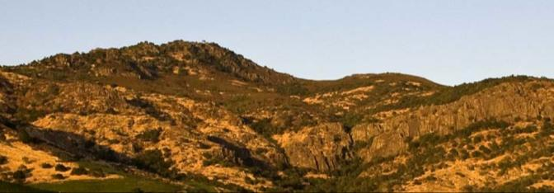
從Mayacamas 山脈朝西看Yountville區域
從Vaca Range朝東看Stags Leap 區域
Notes:
14
Millions of years of geology have also influenced the Napa Valley, creating an incredible diversity of soil.
As you can see in this photo, the two sides of the Napa Valley, less than 5 miles apart, look completely different due to the variation in geology and climate.

Slide 15
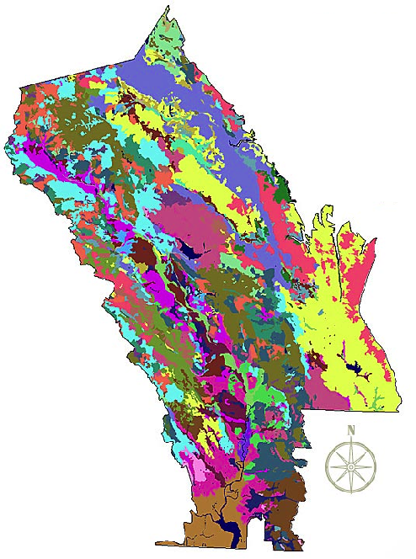
納帕谷產區
土壤結構
超過100個不同的土質
33土系
世界上一半的土壤結構
Copyright Terra Spase, Inc. 2003
Notes:
15
Napa Valley contains more than 100 soil variations, 33 soil series, and half the soil orders found in the world.
This picture shows how, literally, you can have different kinds of soil in the same vineyard in Napa Valley.
This diversity allows vintners to grow and produce – and to produce well – a great number of different wine varieties in the Napa Valley.
One of the secrets of great winegrowing is in the soil and Napa Valley has some of the greatest soil diversity found in winegrowing regions around the world.
(Note difference between a soil order, series and variation: soil orders are based largely on soil forming processes. Soil series is of a similar evolution or formation, chemistry, and physical property. Soil variations take into account vegetative material, climate, and topography differences and/or make-up).

Slide 16
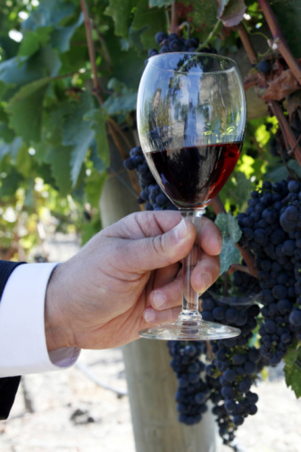
納帕谷最大的品種：
(依產量排序, 大到小)
Cabernet Sauvignon
Chardonnay
Merlot
Sauvignon Blanc
Pinot Noir
Zinfandel
Syrah
(及 其他)
Notes:
16
16
Napa Valley has become synonymous with Cabernet Sauvignon.
The majority of Napa Valley winemakers produce it.
But, thanks to the many diverse growing conditions we’ve talked about, all kinds of varieties flourish.
Conditions are well-suited for growing both Burgundian (Chardonnay and Pinot Noir) and Bordeaux-style varieties (Cabernet, Merlot, Cabernet Franc, and Sauvignon Blanc).

Slide 17
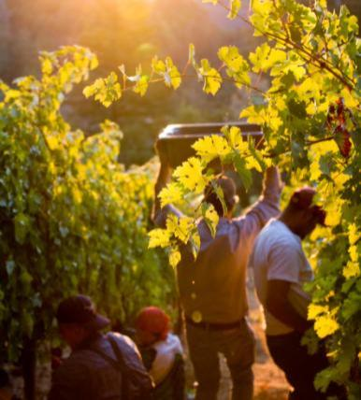
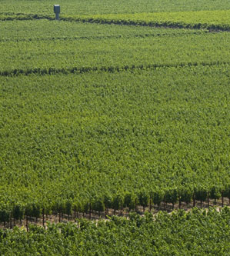
納帕葡萄園
刻意控制低產量
Notes:
17
17
Most winemakers will tell you that quality starts in the vineyard.
Napa Valley vineyards are intentionally farmed to produce low yields to allow only the healthiest of grape clusters to mature.
Throughout the growing season, the canopy is managed with leaf pruning, shoot pulling, and fruit thinning – all of which is done by hand – resulting in a perfect sunlight to shade ratio and optimal fruit development.
During the year, vineyard workers will tend to each individual vine at least 20 times.
This attention to detail in the vineyard is designed to produce wine grapes of the highest quality.

Slide 18
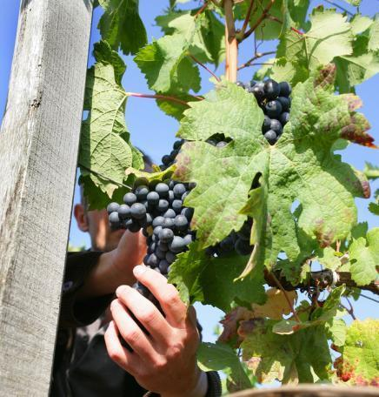
釀酒模式
處理規範著重溫和
重點在創新及品質
酒商間經常性的相互合作
持續的教育促使長久進步
Notes:
18
18
Inside the winery, most Napa Valley winemakers agree that “less is more” and their best approach is gentle and “hands off” allowing the grapes to express themselves.
Napa Valley vintners are always trying to improve quality - there is a culture of “we can do better.”
Innovative viticulture practices sometimes give a nod to the past, like use of concrete fermenters, gravity flow facilities, or wild yeasts, and also have a vision for the future, like new technology, which can provide an automated godsend to small producers with limited manpower.
Napa vintners regularly collaborate and participate in local wine technical group meetings and discussions, including the NVV’s winemaker discussion group.
They also regularly attend knowledge-building programs at local education institutions, like UC Davis, Sonoma State University, or even the local community college, which has an extensive enology program.

Slide 19
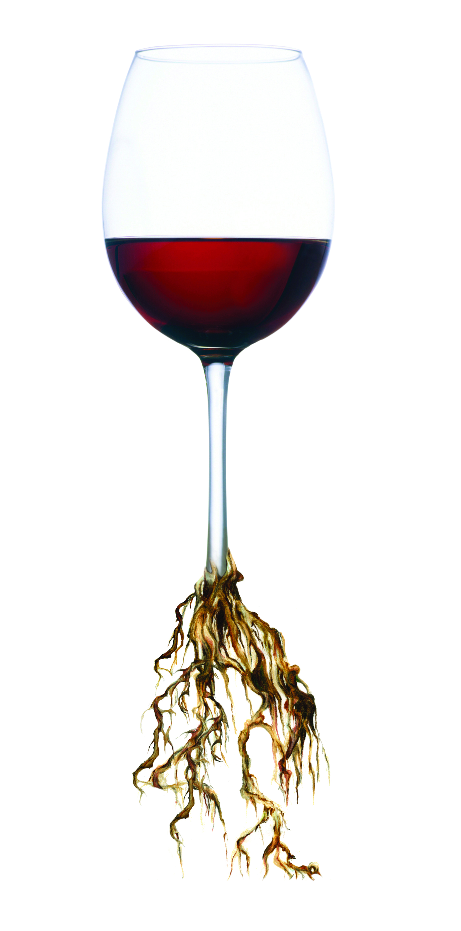
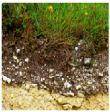
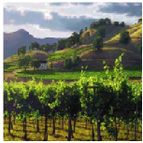
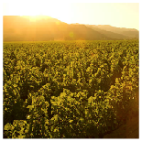
風土條件
集所有優勢於一身
獨特的土壤
獨特的氣候
人文
+
+
獨特的產區
Notes:
19
19
When you put it all together, these distinct soils, distinct climates, distinct topography, and the influence of grape growers and winemakers, it yields distinctive winemaking.
The sum of these factors is known by the French term, terroir.

Slide 20
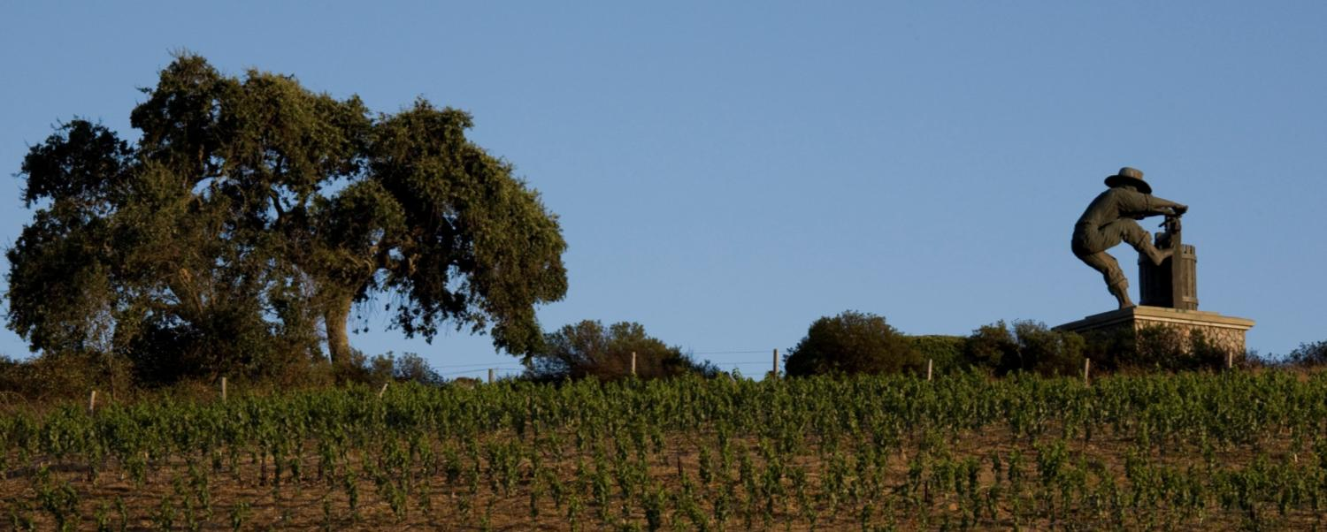



納帕谷：傳奇的美國葡萄酒
了解更多: NapaVintners.com
加入粉絲團: Facebook.com/NapaVintners
Twitter 追蹤最新資訊 : @NapaVintners
閱讀我們的部落格: NapaVintners.com/blog
Notes:
20
20
Millions of years of science…150 years of grape growing…70 years of cooperation and camaraderie.
Today, Napa Valley is the most recognized appellation in America, its wines are considered some of the finest and most age-worthy in the world.
No other winegrowing region offers more diversity or a greater tradition of leadership.
Thank you for listening to our story.

