Slide 1
Notes:
Thank you for being here and welcome to “Napa Valley Rocks”
(INTRODUCE YOURSELF, INCLUDING YOUR TITLE AND YOUR WINERY NAME)
This educational presentation was created by the Napa Valley Vintners or N-V-V, a voluntary, non-profit trade organization.
During this presentation, I’ll share with you scientific data and examples of specific attributes which make the Napa Valley unique in the world of wine.

Slide 2
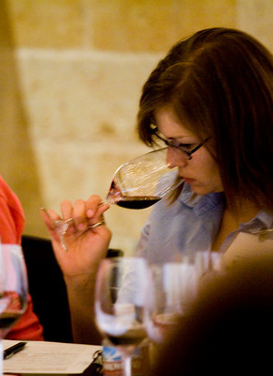
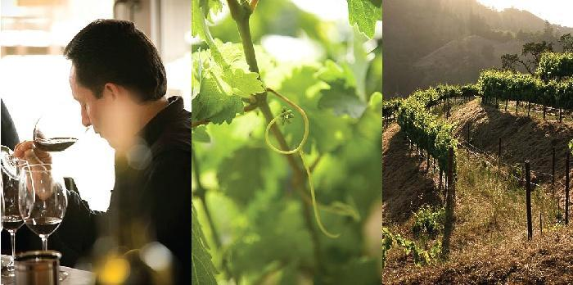
The Mission of the Napa Valley Vintners:
To promote, protect and enhance the Napa Valley appellation, our wines, vintners and community
Notes:
2
2
Formed in 1944, the Napa Valley Vintners today has more than 425 member wineries who work to promote, protect and enhance the Napa Valley appellation, our wines, vintners and community.
Our winery is a member of the NVV.

Slide 3
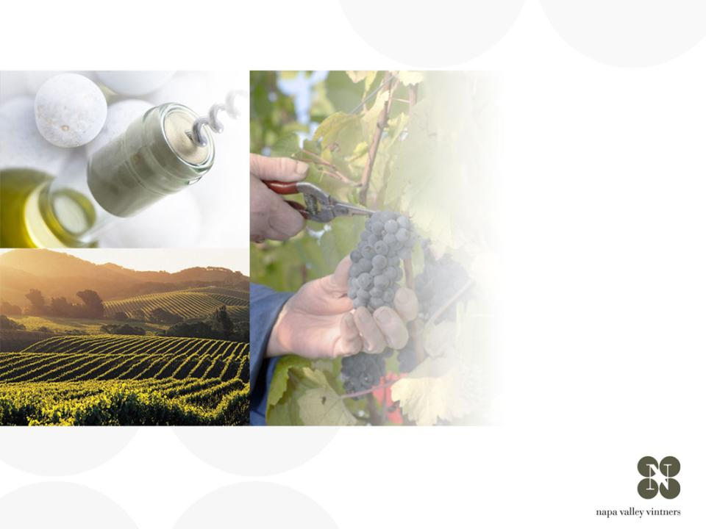
overview of
NAPA VALLEY
Notes:
There are many great wine regions and Napa Valley is one of them.
Napa Valley is the home to America’s first Agricultural Preserve and is a region of incomparable natural beauty.
Though accounting for a fraction of California’s harvest, Napa Valley is the industry’s undisputed leader in land and community stewardship and is renowned the world over for its extraordinary wines.

Slide 4
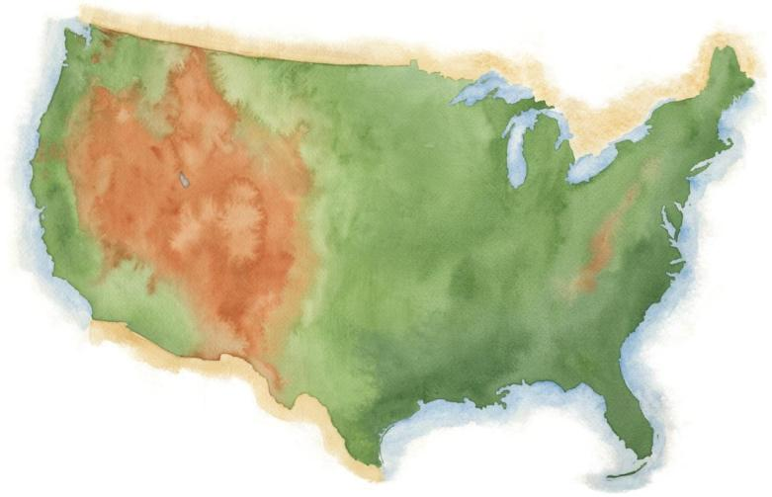
NAPA VALLEY
Notes:
Napa Valley is located in Northern California, very close to San Francisco and the Pacific Ocean, and several hundred miles from Los Angeles.

Slide 5
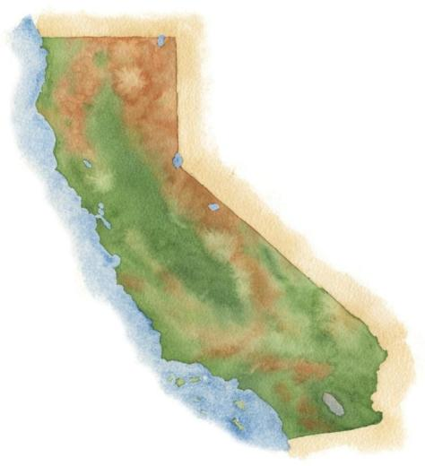
NAPA VALLEY
San Francisco
Los Angeles
Notes:
5
It’s a fairly young, “new world” wine region where wine has been made for only about 150 years.

Slide 6
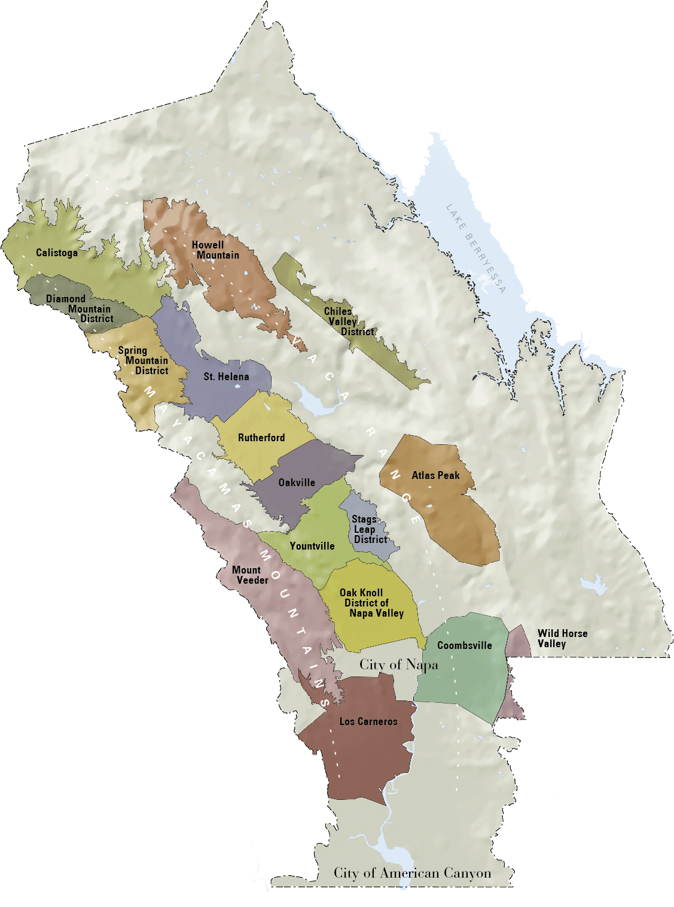

NAPA VALLEY
Distance to Pacific Ocean
36mi / 58km
Distance to San Francisco
48mi / 77km
Distance to Los Angeles
360mi / 579km
Notes:
6
Napa Valley is small: the valley floor, located between the Mayacamas Mountains and Vaca Range, is just about 5 miles across at its widest point and 30 miles at its longest.
There are even smaller places within it: the Napa Valley itself is an AVA or American Viticultural Area, the first to be recognized in California in 1981
Within the Napa Valley AVA there are 16 recognized sub- or “nested” AVAs

Slide 7
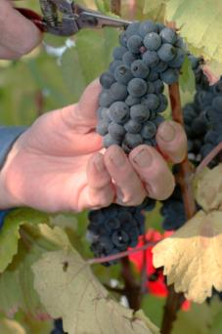
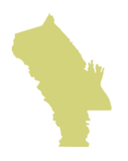
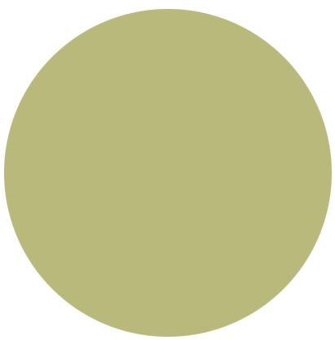
Napa Valley AVA
NAPA VALLEY
Small in size.
Big in quality and diversity
4% of California wine
4/10ths of 1% of the
world’s wine
Notes:
7
If there’s one message we could leave you with today, it’s that the Napa Valley may be one of the most renowned wine growing regions in the world, but it is also one of the smallest.
Napa Valley produces just 4% of California’s wine and a mere four-tenths of one percent of the world’s wine.

Slide 8
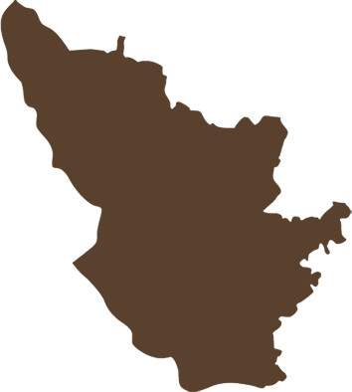
Napa Valley AVA
NAPA VALLEY AVA
45,000 acres
(18, 250 ha) under vine
Bordeaux AC
290,000 acres
(117,500 ha) under vine.
NAPA VALLEY is 1/8
the size of Bordeaux
Bordeaux AC
Notes:
8
It is roughly the size of Burgundy’s Côte d’Or and about one-eighth the size of Bordeaux.
There are approximately 45,000 acres under vine, about 9% of all of Napa County.

Slide 9
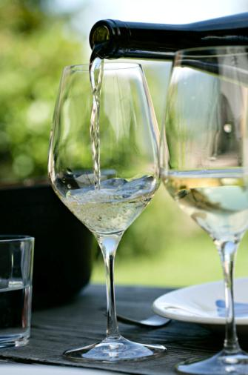

77%
Small producers
77% of NVV members make less than 10,000 cases of a wine a year
63% produce less than 5,000 cases
95% family owned
Notes:
9
The majority of Napa Valley’s producers are also small:
Nearly 80% of the NVV’s 425 member wineries make less than 10,000 cases of a wine a year.
More than 60% produce fewer than 5,000 cases annually.
95% of all Napa Valley wineries are family owned.

Slide 10
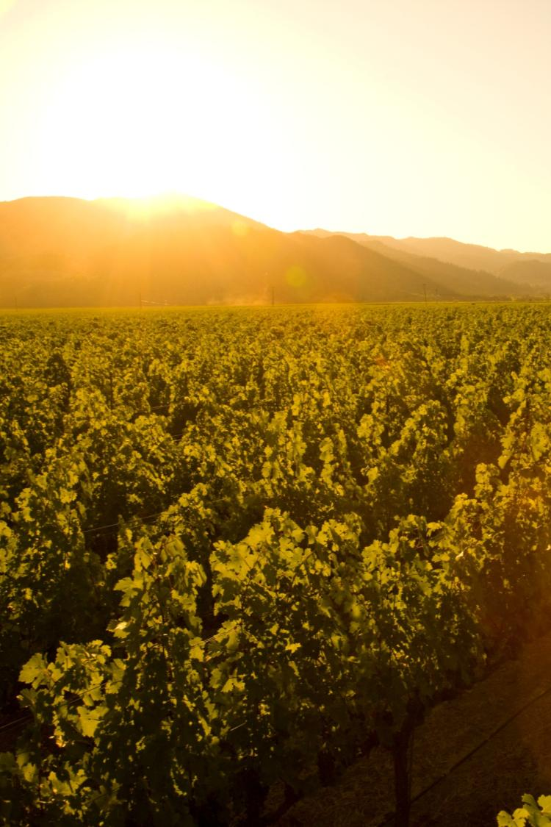
Mediterranean climate zone
Long growing season
Lack of summer rainfall
Vintage to vintage consistency and reduced risk for vineyard disease
Notes:
10
10
Napa Valley is located within the rare Mediterranean climate zone, which encompasses just 2% of the earth’s surface.
The long growing season is marked by warm summer days and cool evenings – ideal for wine grapes to ripen slowly and evenly, with great balance between sugar and acid development.
Lack of summer rainfall helps to contribute to consistency of vintages and reduces the risk of vineyard diseases.
Most areas of the appellation can dry farm or tightly manage their irrigation practices.
Compared to most growing regions in the world, Napa Valley is unique in this regard.

Slide 11


Conditions exist for creating a recurring pattern of marine fog
C
H
Pacific Ocean
Notes:
11
11
During the summer growing season, conditions exist for creating a recurring pattern of marine fog from the Pacific Ocean.
As hot air in California’s interior valley rises, it creates a vacuum effect which draws in moist, cool air from the Pacific Ocean, forming fog.
This pattern repeats most days during the warmer months of the year.

Slide 12


NAPA VALLEY AVA
Temperature variation - summer
40-50ºf / 4.5-10ºc
85ºf / 29ºc
40-50ºf / 4.5-10ºc
95ºf / 35ºc
50ºf / 10ºc
77ºf / 25ºc
Notes:
12
12
Daytime temperatures can also vary dramatically throughout the AVA during the growing season.
The southern part of the valley, particularly Los Carneros AVA, is closer to San Pablo Bay and is cooled by marine breezes.
In summer, there can be as much as an 10-15°F difference between Carneros and St. Helena, to the north.
On many days, due to the cooling effect of the fog, there is a large diurnal (day to night) temperature swing throughout the valley.

Slide 13
Mount St. Helena
4000 ft / 1,219 m
NAPA VALLEY AVA
Elevation
Spring Mountain
2200 ft / 671 m
Atlas Peak
2600 ft / 793 m
Mount Veeder
2100 ft / 650 m
Valley Floor
0– 750 ft / 0 – 214 m
Notes:
13
13
Adding to the diversity of Napa Valley is its topography.
It changes with its length, from the flat estuaries in the south near San Pablo Bay to the rolling hills just before 4,000-foot Mount St. Helena in the north.
And don’t forget the Mayacamas and Vacas to the west and east – each range reaches approximately 2,500 feet above the valley floor.
There is a strong correlation between topography and climate: slope, aspect, and elevation all influence the many mesoclimates found throughout the Napa Valley.

Slide 14
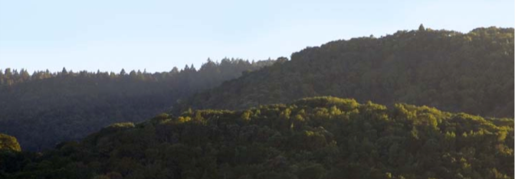
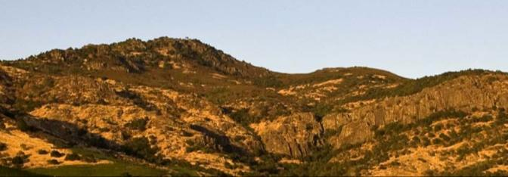
Mayacamas Mountains
Looking west, Yountville
Vaca Range
Looking east, Stags Leap District
Notes:
14
Millions of years of geology have also influenced the Napa Valley, creating an incredible diversity of soil.
As you can see in this photo, the two sides of the Napa Valley, less than 5 miles apart, look completely different due to the variation in geology and climate.

Slide 15
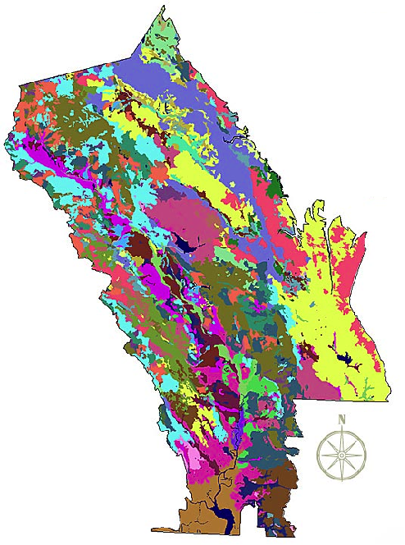
Napa Valley
AVA Soil Series
Over 100 Soil variations
33 soil series
Half the world’s
soil orders
Copyright Terra Spase, Inc. 2003
Notes:
15
Napa Valley contains more than 100 soil variations, 33 soil series, and half the soil orders found in the world.
This picture shows how, literally, you can have different kinds of soil in the same vineyard in Napa Valley.
This diversity allows vintners to grow and produce – and to produce well – a great number of different wine varieties in the Napa Valley.
One of the secrets of great winegrowing is in the soil and Napa Valley has some of the greatest soil diversity found in winegrowing regions around the world.
(Note difference between a soil order, series and variation: soil orders are based largely on soil forming processes. Soil series is of a similar evolution or formation, chemistry, and physical property. Soil variations take into account vegetative material, climate, and topography differences and/or make-up).

Slide 16
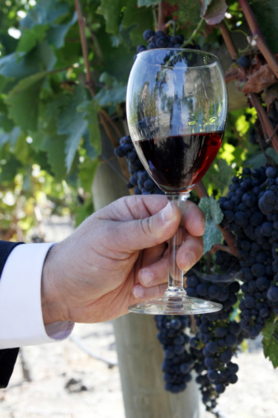
Napa Valley’s top varieties in descending order:
Cabernet Sauvignon
Chardonnay
Merlot
Sauvignon Blanc
Pinot Noir
Zinfandel
Syrah
(& several others)
Notes:
16
16
Napa Valley has become synonymous with Cabernet Sauvignon.
The majority of Napa Valley winemakers produce it.
But, thanks to the many diverse growing conditions we’ve talked about, all kinds of varieties flourish.
Conditions are well-suited for growing both Burgundian (Chardonnay and Pinot Noir) and Bordeaux-style varieties (Cabernet, Merlot, Cabernet Franc, and Sauvignon Blanc).

Slide 17
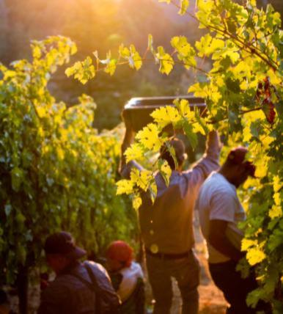
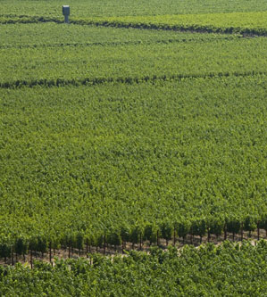
Napa Vineyards
Intentionally farmed to produce low yields
Notes:
17
17
Most winemakers will tell you that quality starts in the vineyard.
Napa Valley vineyards are intentionally farmed to produce low yields to allow only the healthiest of grape clusters to mature.
Throughout the growing season, the canopy is managed with leaf pruning, shoot pulling, and fruit thinning – all of which is done by hand – resulting in a perfect sunlight to shade ratio and optimal fruit development.
During the year, vineyard workers will tend to each individual vine at least 20 times.
This attention to detail in the vineyard is designed to produce wine grapes of the highest quality.

Slide 18
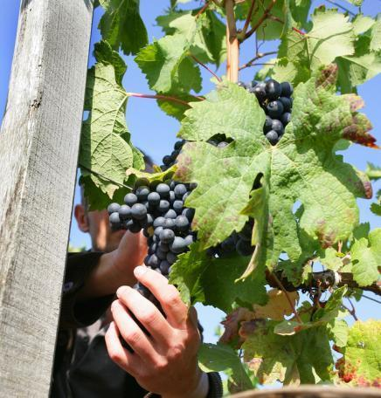
Winemaking Practices
Gentle handling is the norm
Focus on innovation
and quality
Collaboration is common
Continuing education for
ongoing improvement
Notes:
18
18
Inside the winery, most Napa Valley winemakers agree that “less is more” and their best approach is gentle and “hands off” allowing the grapes to express themselves.
Napa Valley vintners are always trying to improve quality - there is a culture of “we can do better.”
Innovative viticulture practices sometimes give a nod to the past, like use of concrete fermenters, gravity flow facilities, or wild yeasts, and also have a vision for the future, like new technology, which can provide an automated godsend to small producers with limited manpower.
Napa vintners regularly collaborate and participate in local wine technical group meetings and discussions, including the NVV’s winemaker discussion group.
They also regularly attend knowledge-building programs at local education institutions, like UC Davis, Sonoma State University, or even the local community college, which has an extensive enology program.

Slide 19
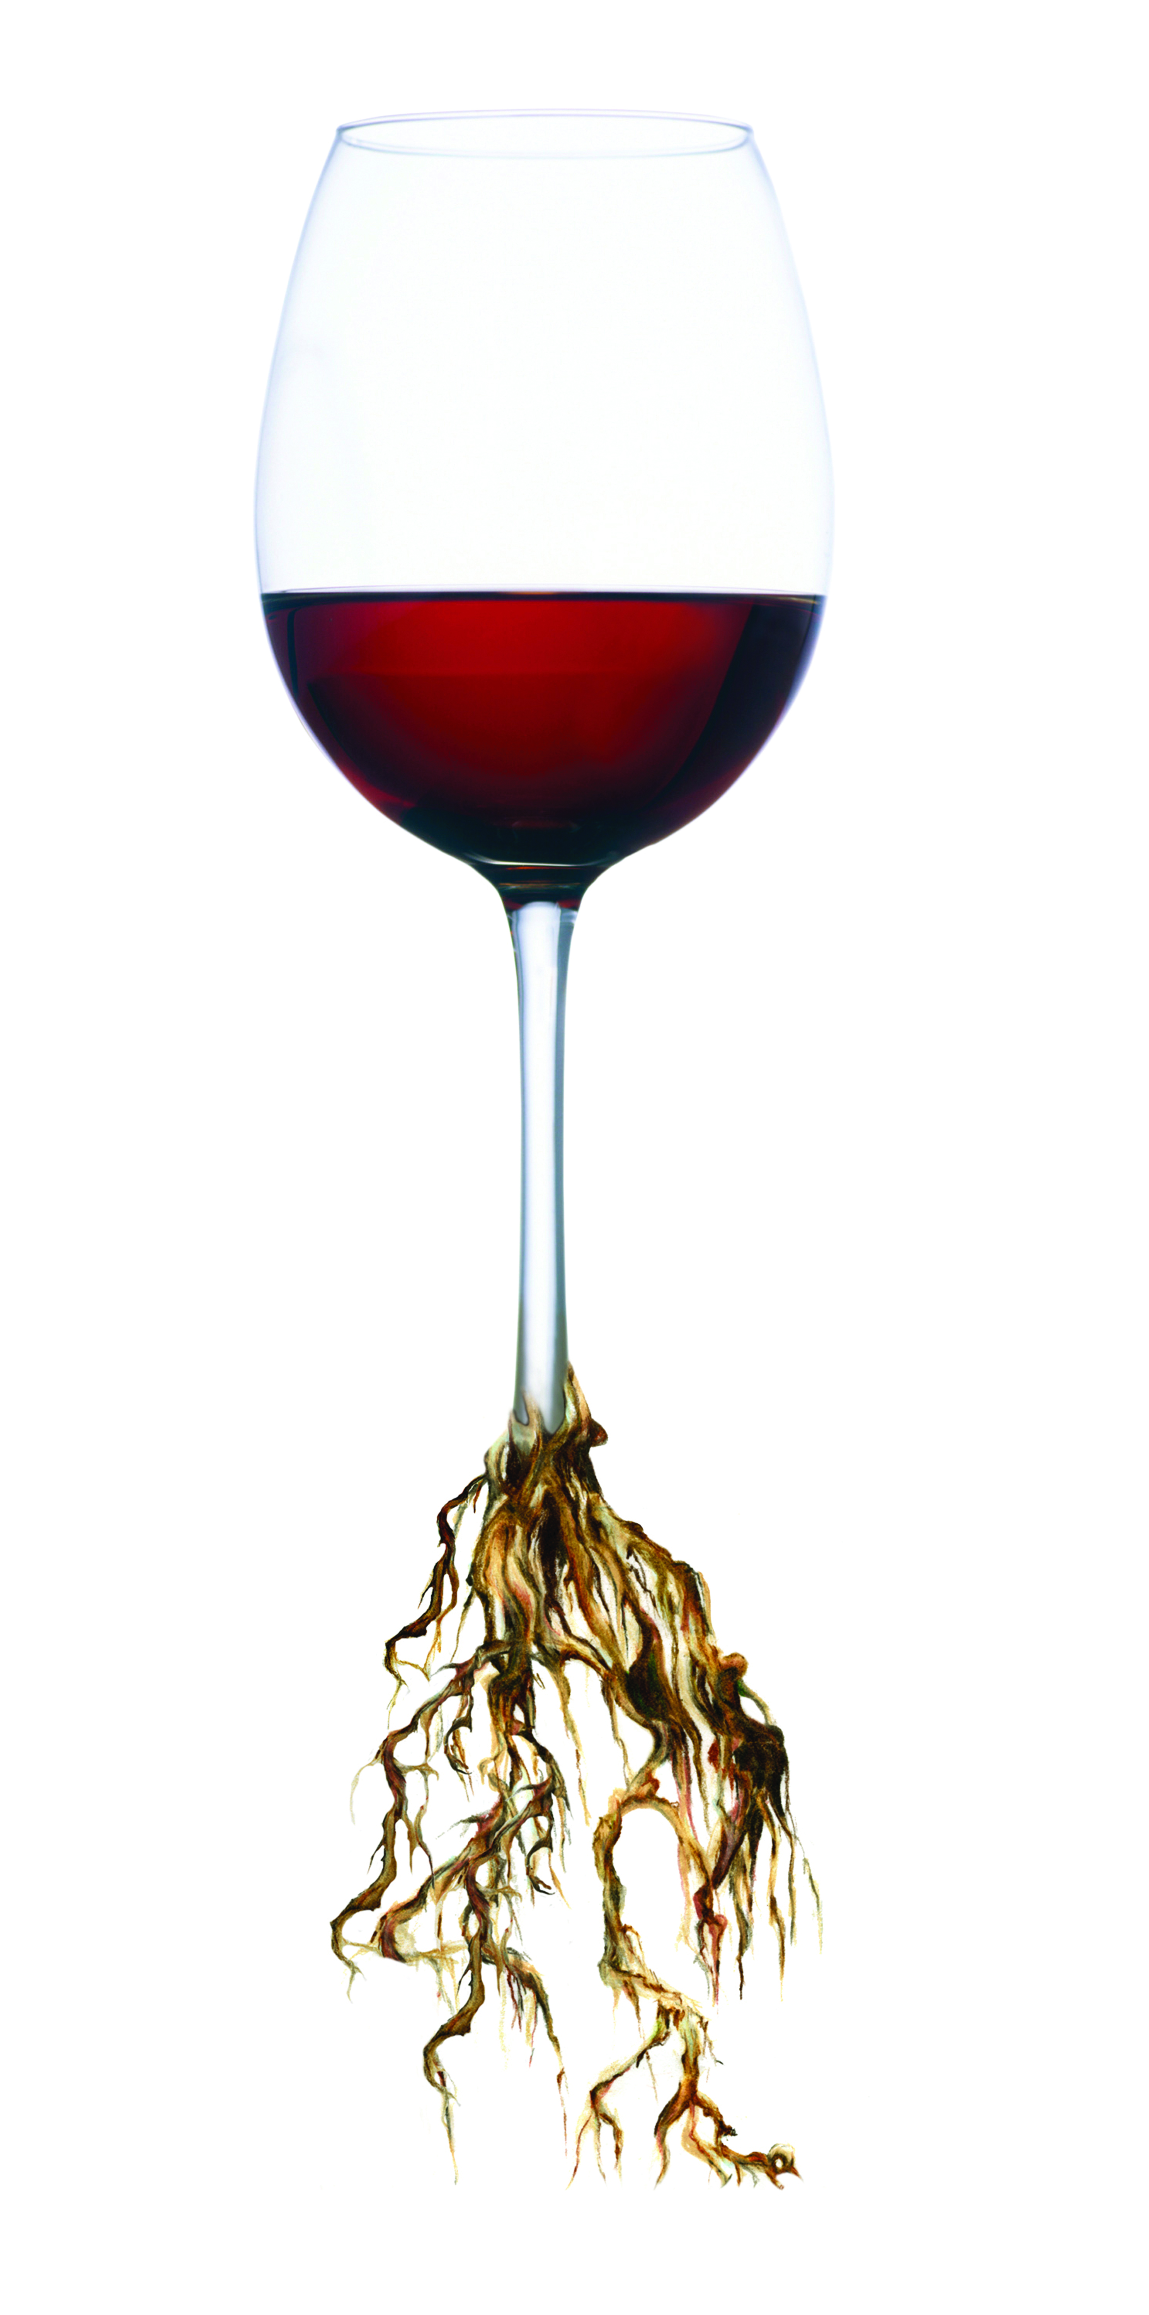
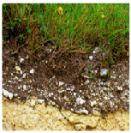
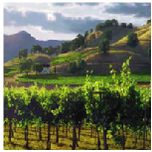
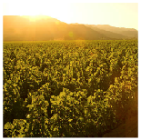
TERROIR
Putting it all together
Distinct Soils
Distinct Climates
People
+
+
Distinct
Growing
Regions
Notes:
19
19
When you put it all together, these distinct soils, distinct climates, distinct topography, and the influence of grapegrowers and winemakers, it yields distinctive winemaking.
The sum of these factors is known by the French term, terroir.

Slide 20
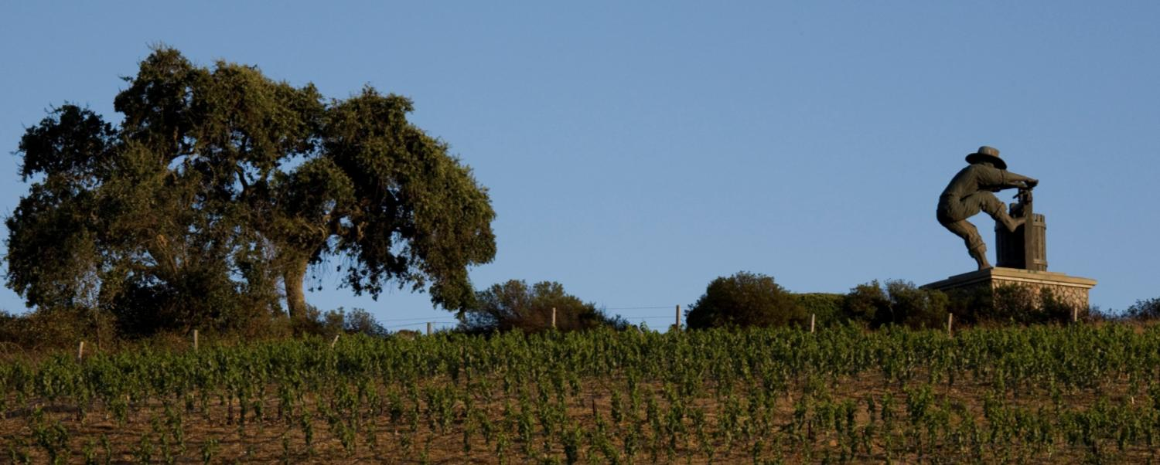



Napa Valley: Legendary American Wines
Learn more: NapaVintners.com
Become a fan: Facebook.com/NapaVintners
Follow us on Twitter: @NapaVintners
Read our blog: NapaVintners.com/blog
Notes:
20
20
Millions of years of science…150 years of grape growing…70 years of cooperation and camaraderie.
Today, Napa Valley is the most recognized appellation in America, its wines are considered some of the finest and most age-worthy in the world.
No other winegrowing region offers more diversity or a greater tradition of leadership.
Thank you for listening to our story.

